Slide 1
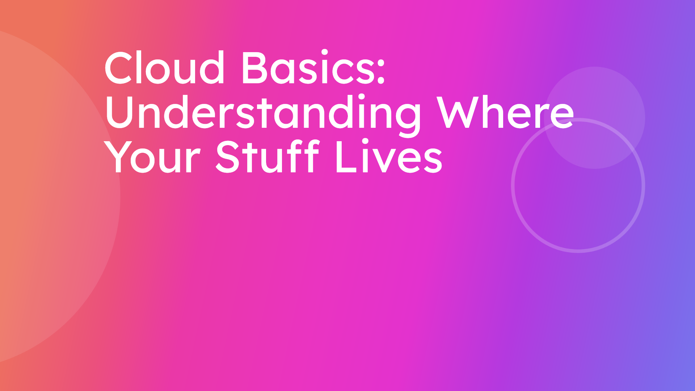
Notes:
In today's digital world, understanding cloud technology is more important than ever for managing your digital life with confidence. This comprehensive session will simplify the concept of the cloud, covering everything from accessing and managing storage to essential safety tips and real-life examples, empowering you to use technology with peace of mind.

Slide 2
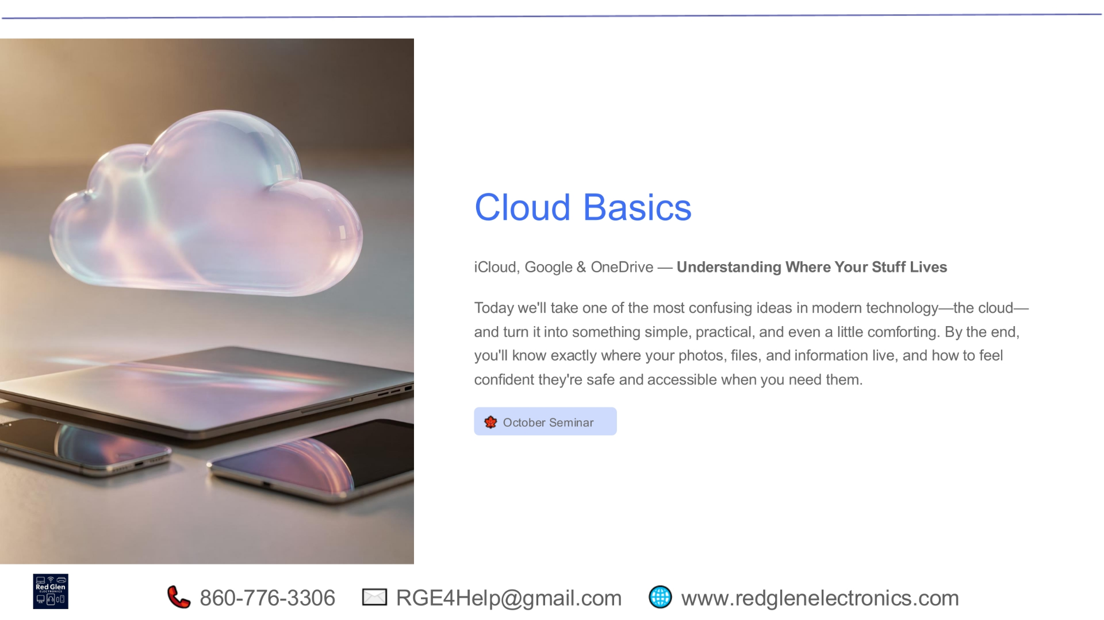
Notes:
Welcome to our October seminar on Cloud Basics. Today, we'll clarify one of the most confusing parts of modern technology: the cloud. Our aim is to make it straightforward, practical, and even reassuring, so you'll understand exactly where your digital information resides and how to keep it secure.

Slide 3
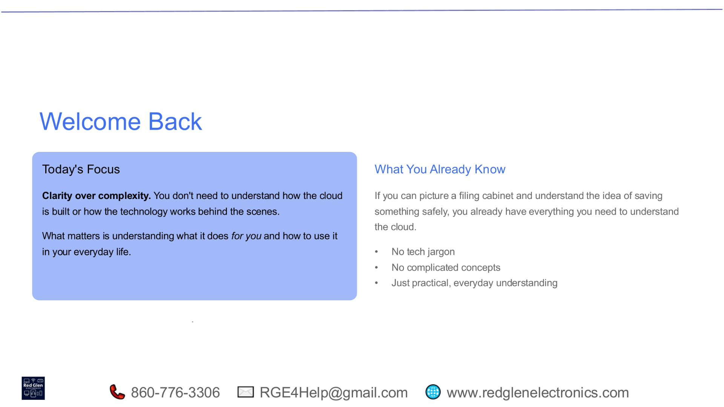
Notes:
Our focus today is clarity over complexity. You don't need to understand the intricate technical details of how the cloud is built. What truly matters is grasping what it does for you and how to integrate it into your daily life. Think of it like a filing cabinet: if you understand how to save things safely in a physical cabinet, you already have the foundational knowledge to understand the cloud. We'll avoid tech jargon and complicated concepts, focusing instead on practical, everyday understanding.

Slide 4
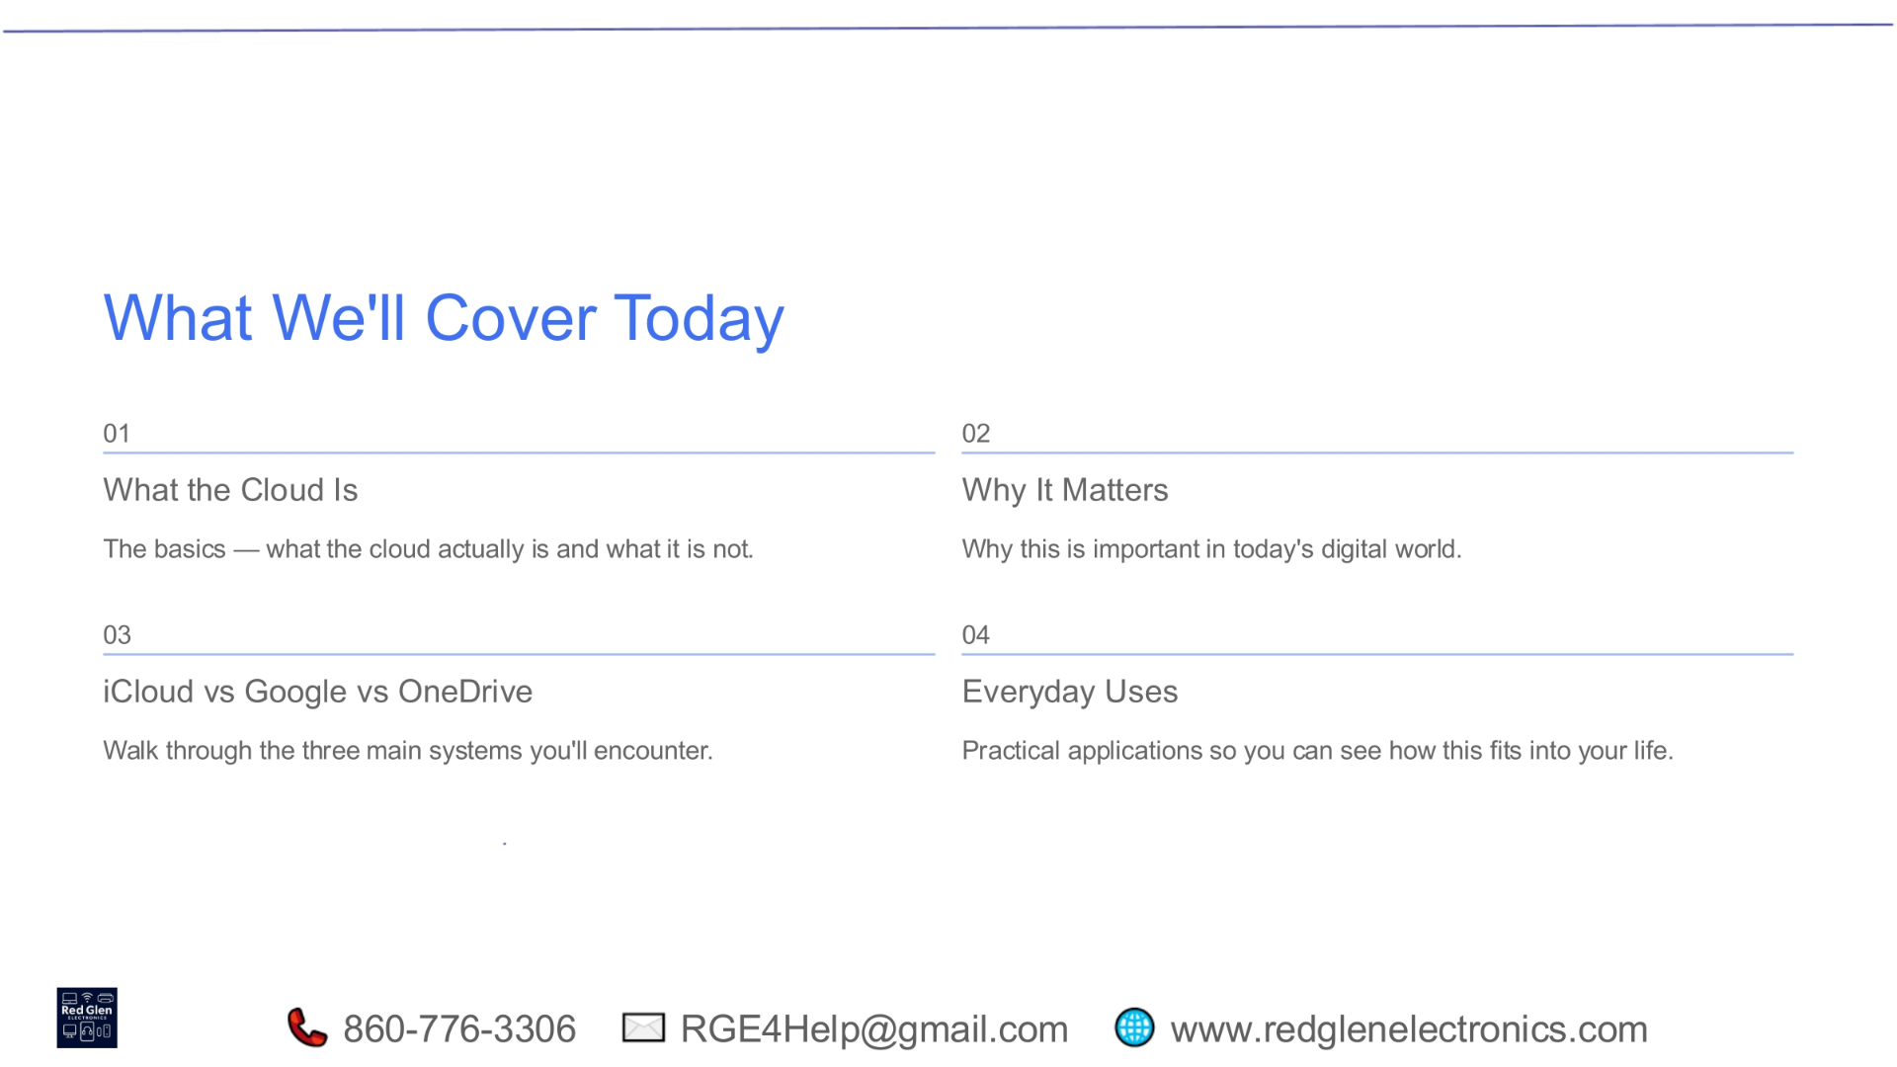
Notes:
Today's session is structured into four key areas. First, we'll define what the cloud is and what it is not, covering the essential basics. Next, we'll explore why the cloud matters in our increasingly digital world. Then, we'll compare the three main systems you're likely to encounter: iCloud, Google Drive, and OneDrive. Finally, we'll look at practical everyday uses, helping you see how the cloud fits seamlessly into your life.

Slide 5
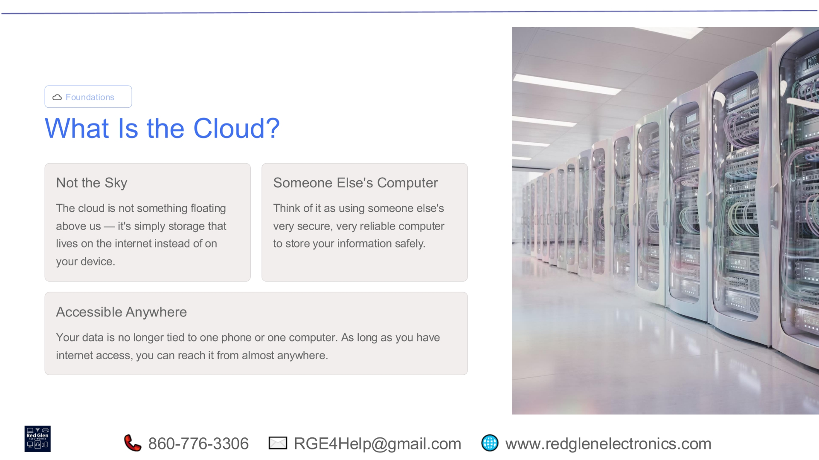
Notes:
The cloud isn't some mysterious entity floating in the sky. It's simply storage that resides on the internet, rather than exclusively on your physical device. You can think of it as using someone else's highly secure and reliable computer to store your information safely. This means your data is no longer tied to a single phone or computer; as long as you have internet access, you can reach your files from almost anywhere, offering unparalleled accessibility.

Slide 6
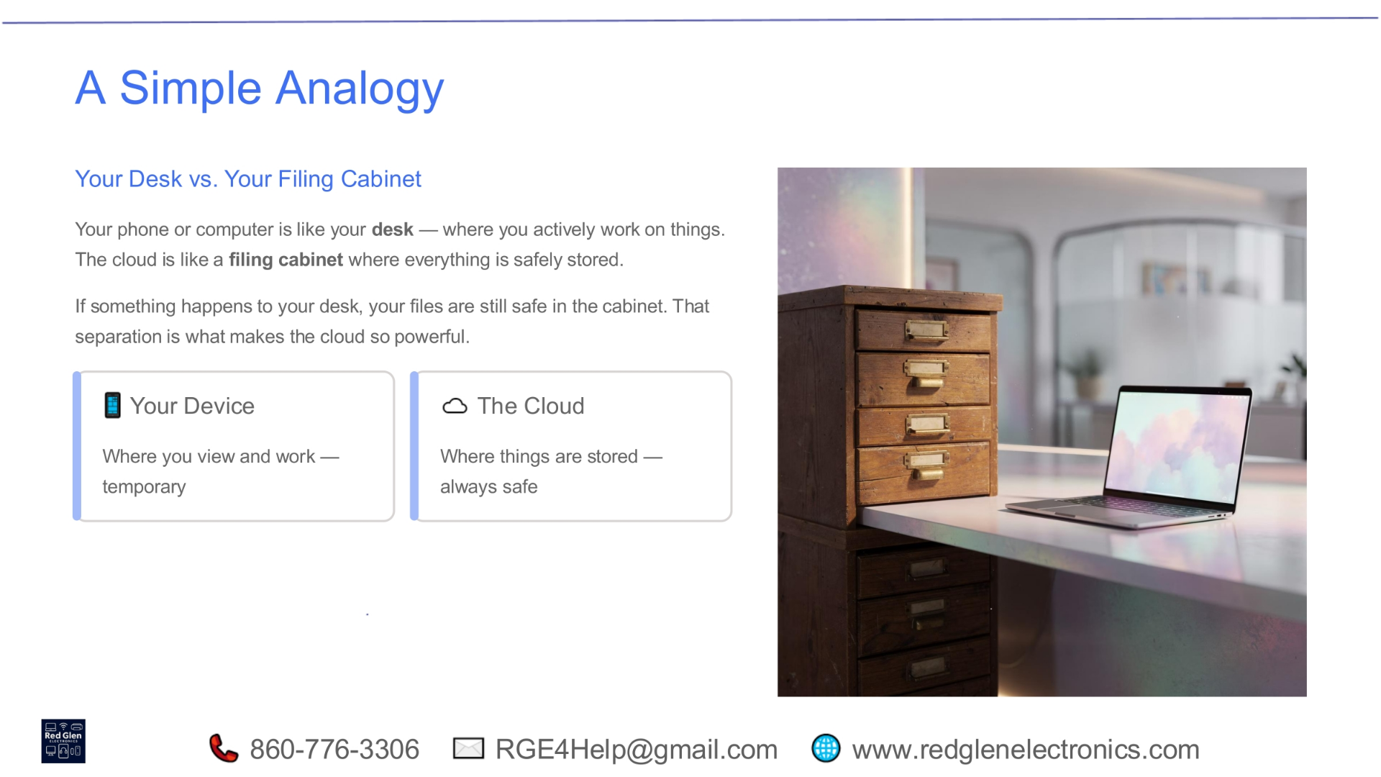
Notes:
To simplify the concept, let's use a simple analogy: your desk versus your filing cabinet. Your phone or computer is like your desk, where you actively work on things temporarily. The cloud, on the other hand, is like a secure filing cabinet where everything is safely stored long-term. This separation is what makes the cloud so powerful. If something happens to your desk, your files remain safe in the cabinet, ensuring your important information is protected.

Slide 7
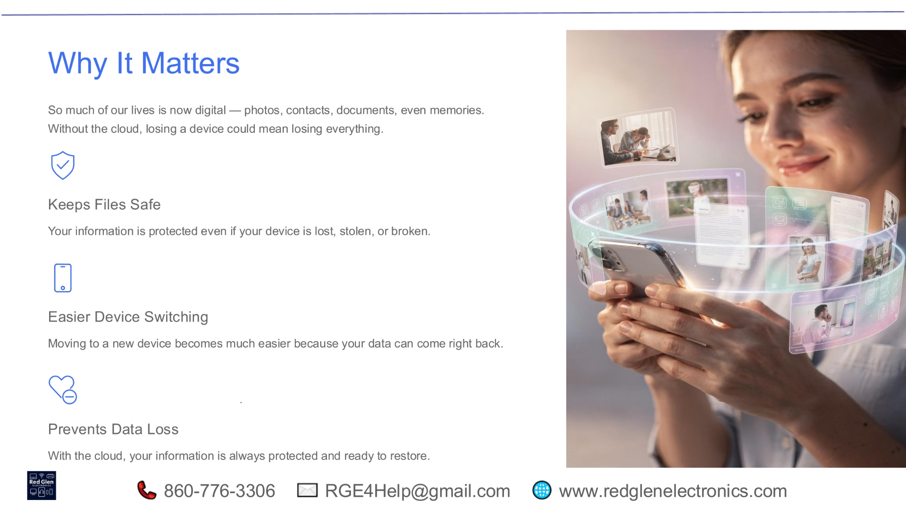
Notes:
The cloud matters because so much of our lives is now digital, encompassing photos, contacts, documents, and cherished memories. Without the cloud, losing a device could mean losing everything. It keeps your files safe, protecting your information even if your device is lost, stolen, or broken. It also makes device switching much easier, as your data can be quickly restored to a new device. Ultimately, the cloud prevents data loss, ensuring your information is always protected and ready to restore.

Slide 8
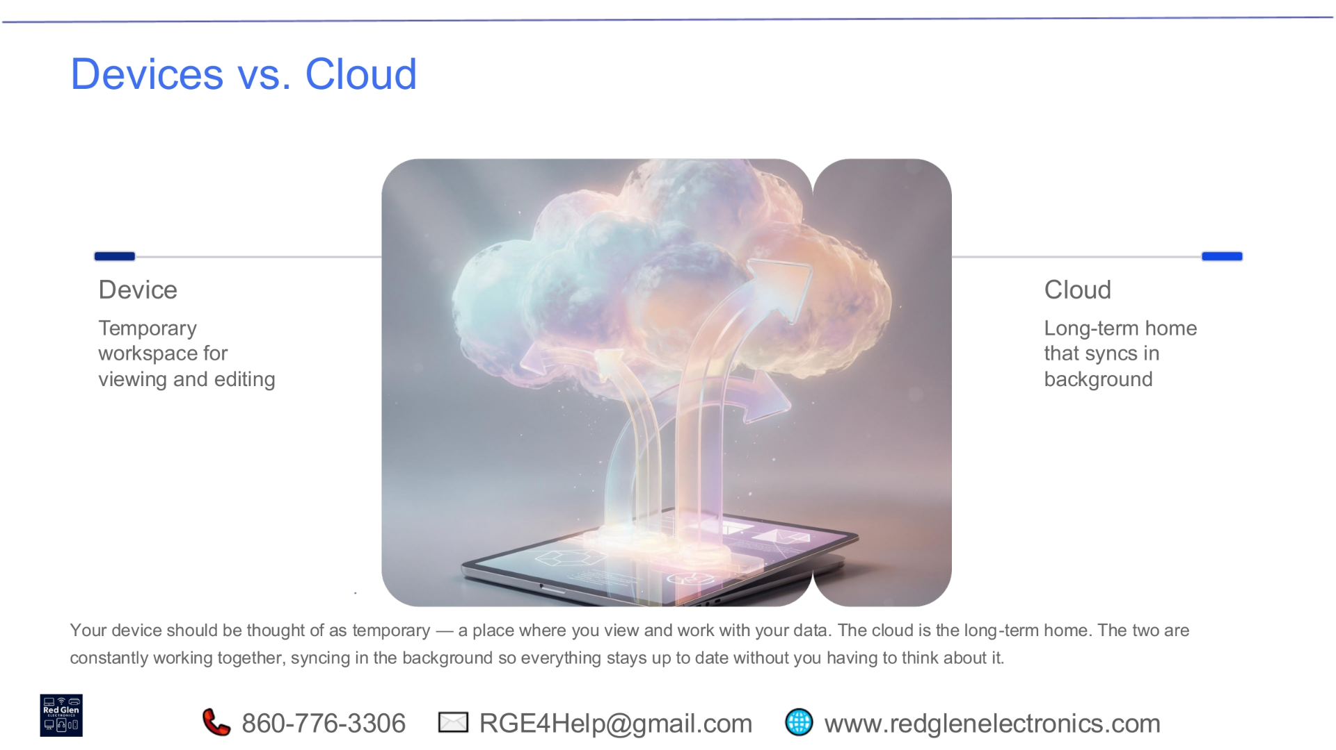
Notes:
Your device serves as a temporary workspace for viewing and editing your data. The cloud, however, is the long-term home for your information, constantly syncing in the background. These two elements work together seamlessly, ensuring everything stays up to date without you needing to actively manage it. This continuous synchronization provides peace of mind, knowing your data is always current and accessible across all your platforms.

Slide 9
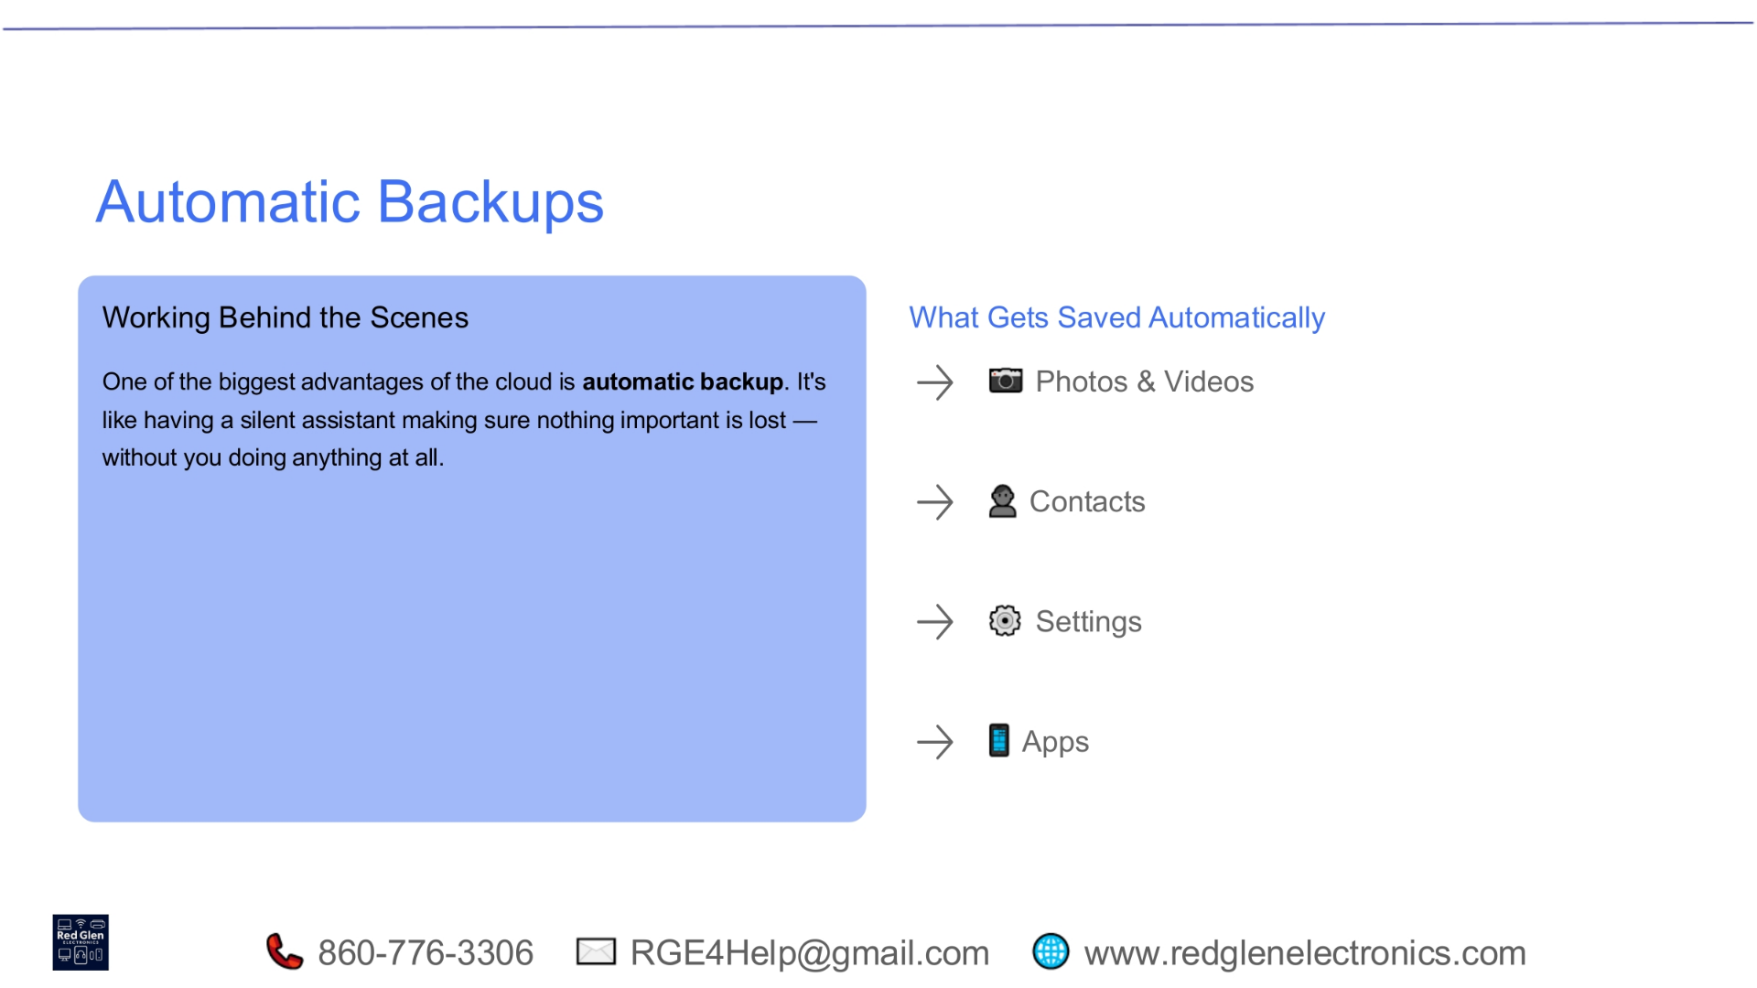
Notes:
One of the cloud's biggest advantages is its automatic backup capability. It functions like a silent assistant, diligently working behind the scenes to ensure nothing important is lost, all without requiring any action from you. This automatic process typically saves your photos and videos, contacts, device settings, and even data from many of your apps, providing a comprehensive safety net for your digital life.

Slide 10
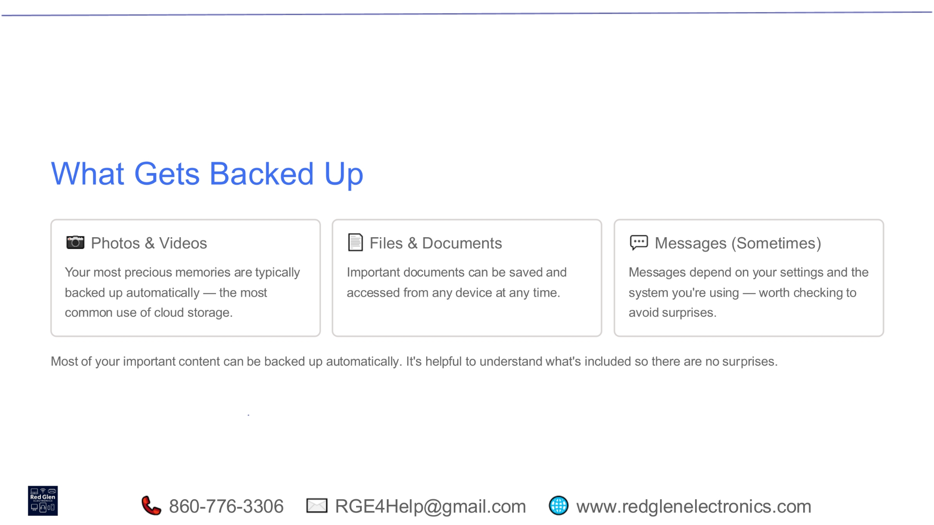
Notes:
Most of your important content can be backed up automatically. Your photos and videos, often your most precious memories, are typically saved without effort, making this the most common use of cloud storage. Important files and documents can also be saved and accessed from any device at any time. Messages, however, can be a bit more nuanced; their backup depends on your specific settings and the system you're using, so it's always worth checking to avoid surprises.

Slide 11
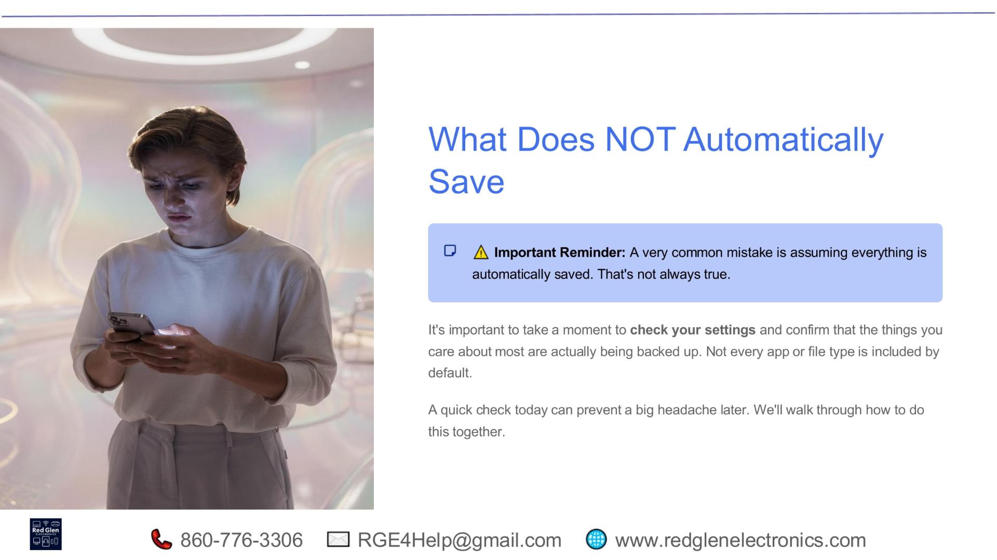
Notes:
It's crucial to remember that not everything is automatically saved to the cloud by default. A common mistake is assuming comprehensive backup, but this isn't always true. It's important to take a moment to check your settings and confirm that the specific items you care about most are indeed being backed up. Not every app or file type is included automatically, so a quick check today can prevent significant headaches later. We'll guide you through this process together.

Slide 12
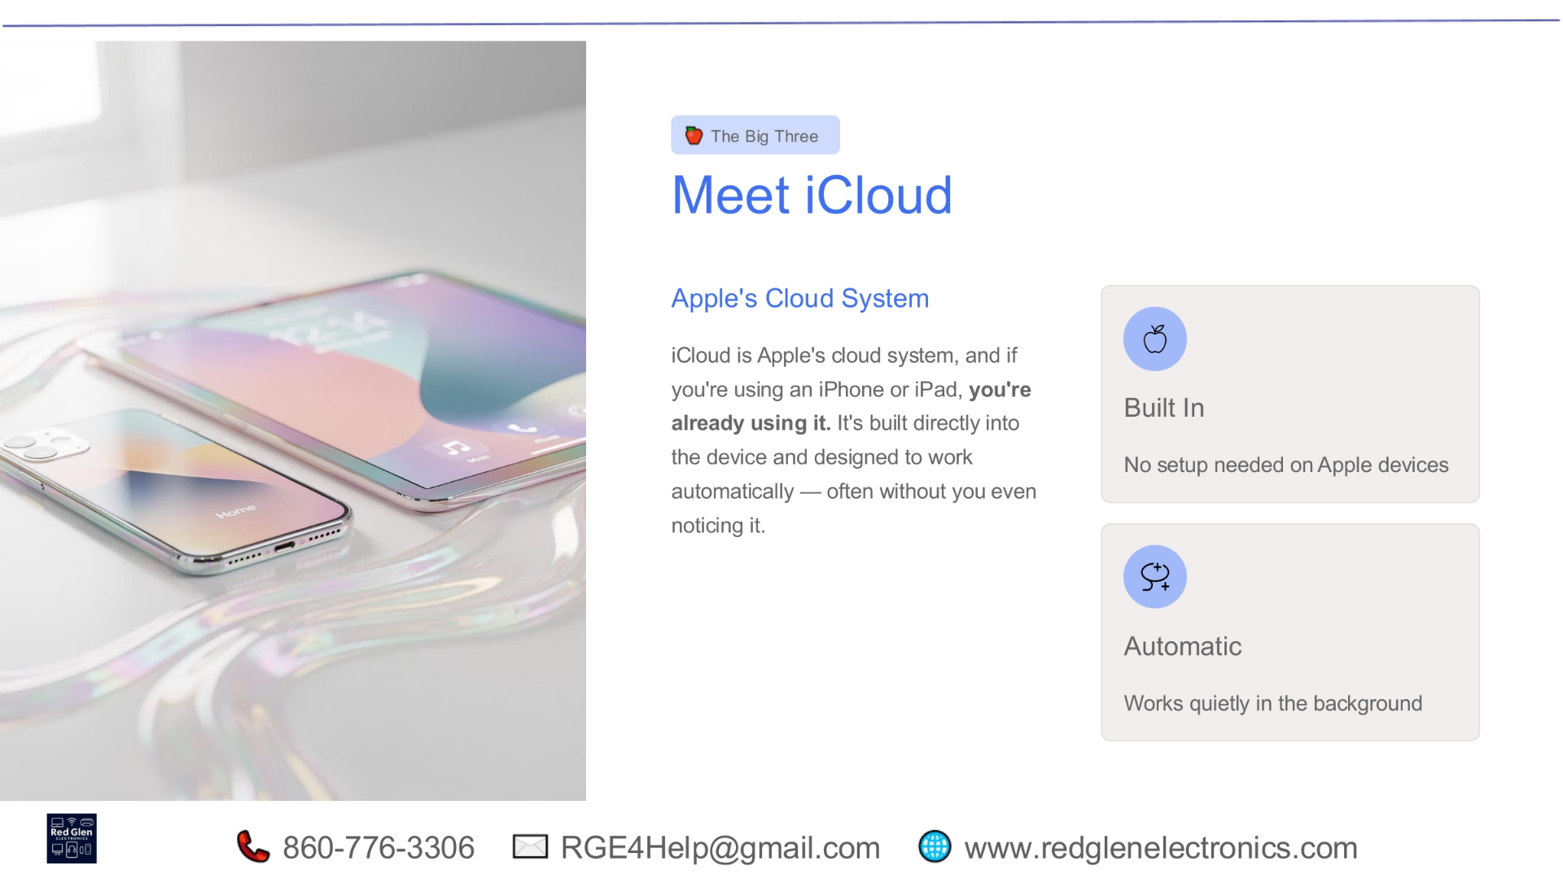
Notes:
Let's meet iCloud, Apple's cloud system. If you're an iPhone or iPad user, you're likely already using it, perhaps without even realizing. iCloud is built directly into Apple devices and is designed to work automatically, often quietly in the background. This means there's no complex setup needed on Apple devices, making it incredibly user-friendly and integrated into the Apple ecosystem.

Slide 13
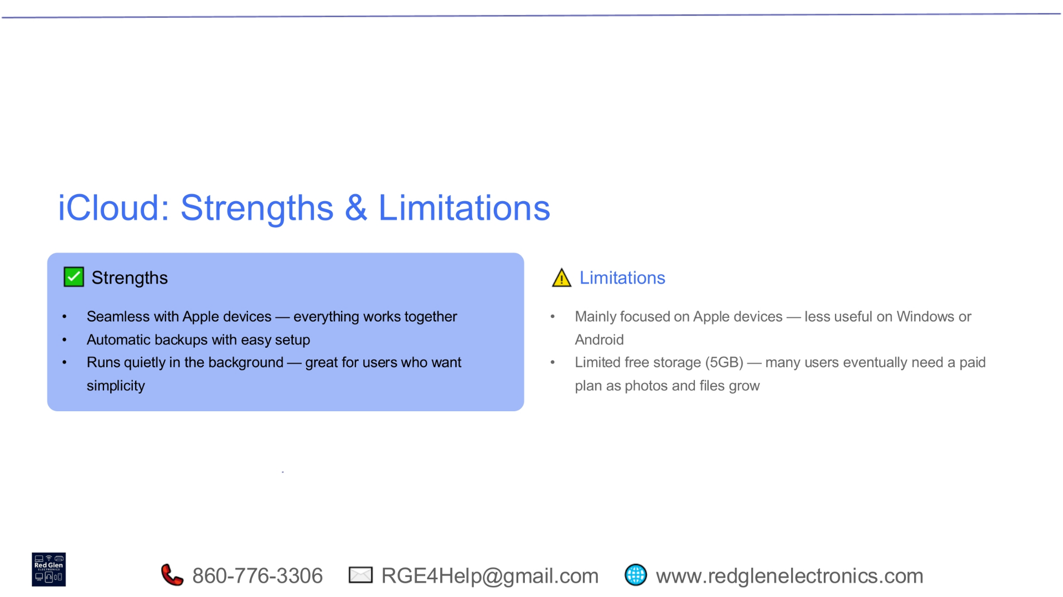
Notes:
iCloud offers several strengths, including seamless integration with Apple devices, ensuring everything works together effortlessly. It provides automatic backups with easy setup and runs quietly in the background, which is ideal for users who prioritize simplicity. However, it does have limitations. iCloud is mainly focused on Apple devices, making it less useful for Windows or Android users. Additionally, it offers limited free storage, typically 5GB, meaning many users eventually need a paid plan as their photos and files grow.

Slide 14
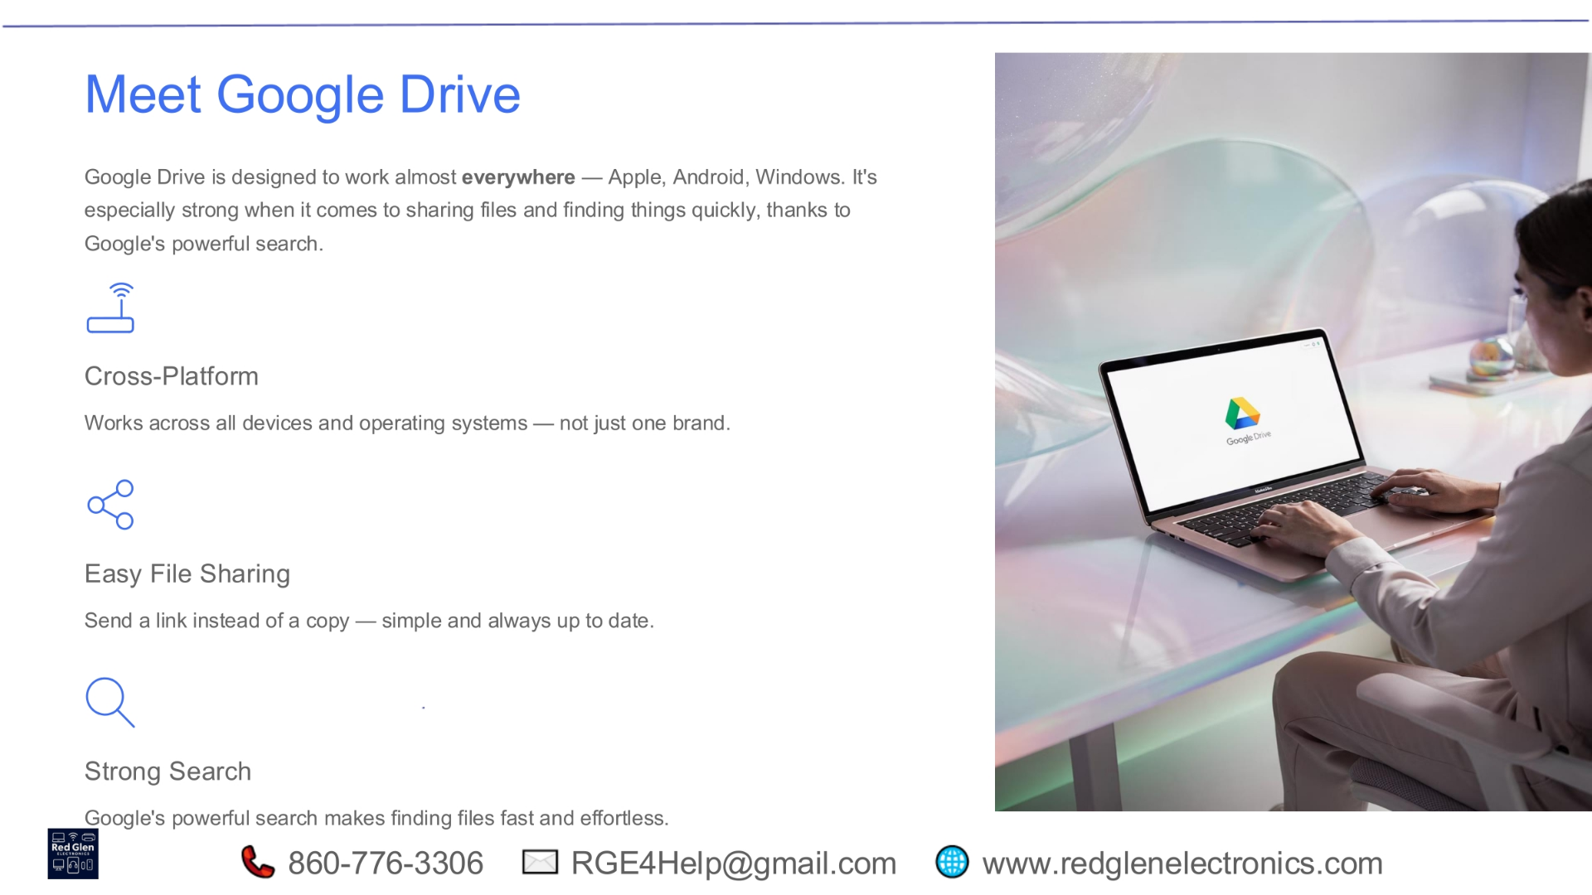
Notes:
Next, we have Google Drive, designed to work almost everywhere across Apple, Android, and Windows platforms. It excels in file sharing and quick searching, thanks to Google's powerful search capabilities. Google Drive is cross-platform, working across various devices and operating systems, not just one brand. It also facilitates easy file sharing, allowing you to send a link to a live file instead of multiple copies, ensuring everyone always has the most up-to-date version.

Slide 15
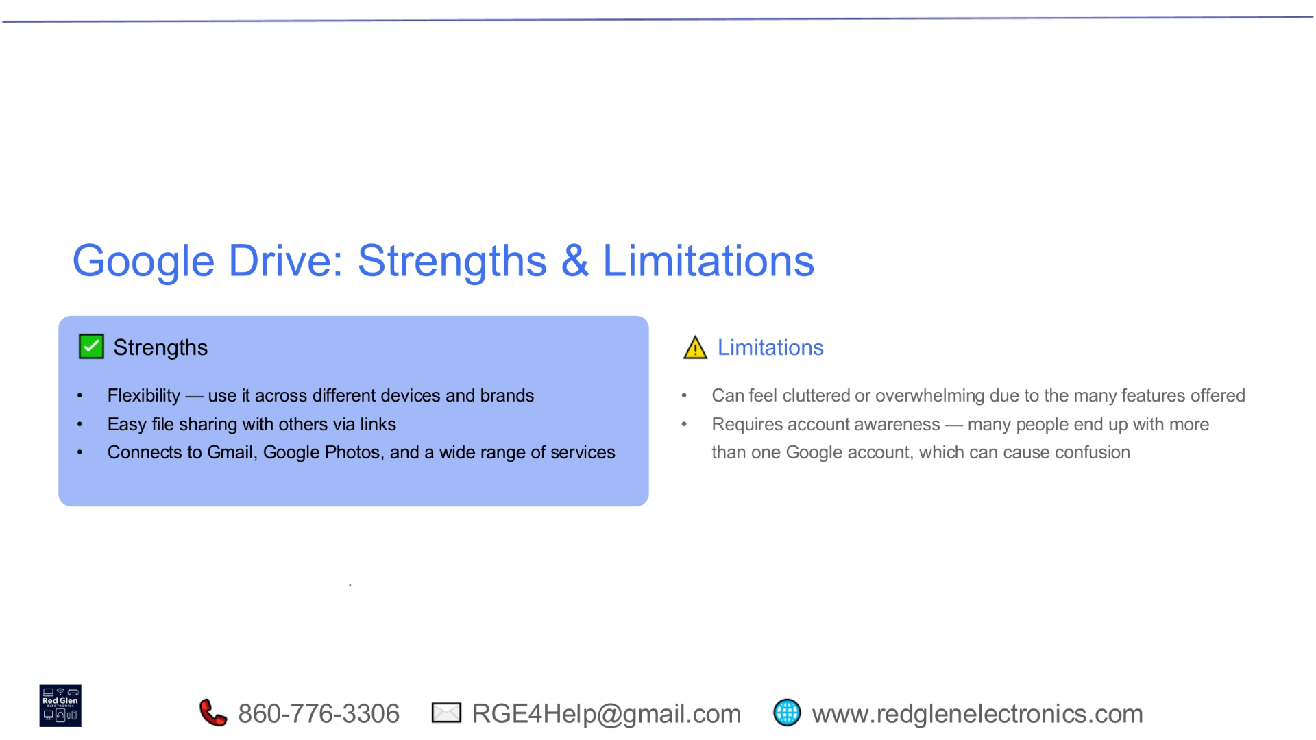
Notes:
Google Drive's strengths include its impressive flexibility, allowing you to use it across different devices and brands. It offers easy file sharing through links and connects seamlessly to other Google services like Gmail and Google Photos. However, it can sometimes feel cluttered or overwhelming due to the sheer number of features available. Another limitation is the need for account awareness, as many users end up with more than one Google account, which can lead to confusion when managing files.

Slide 16
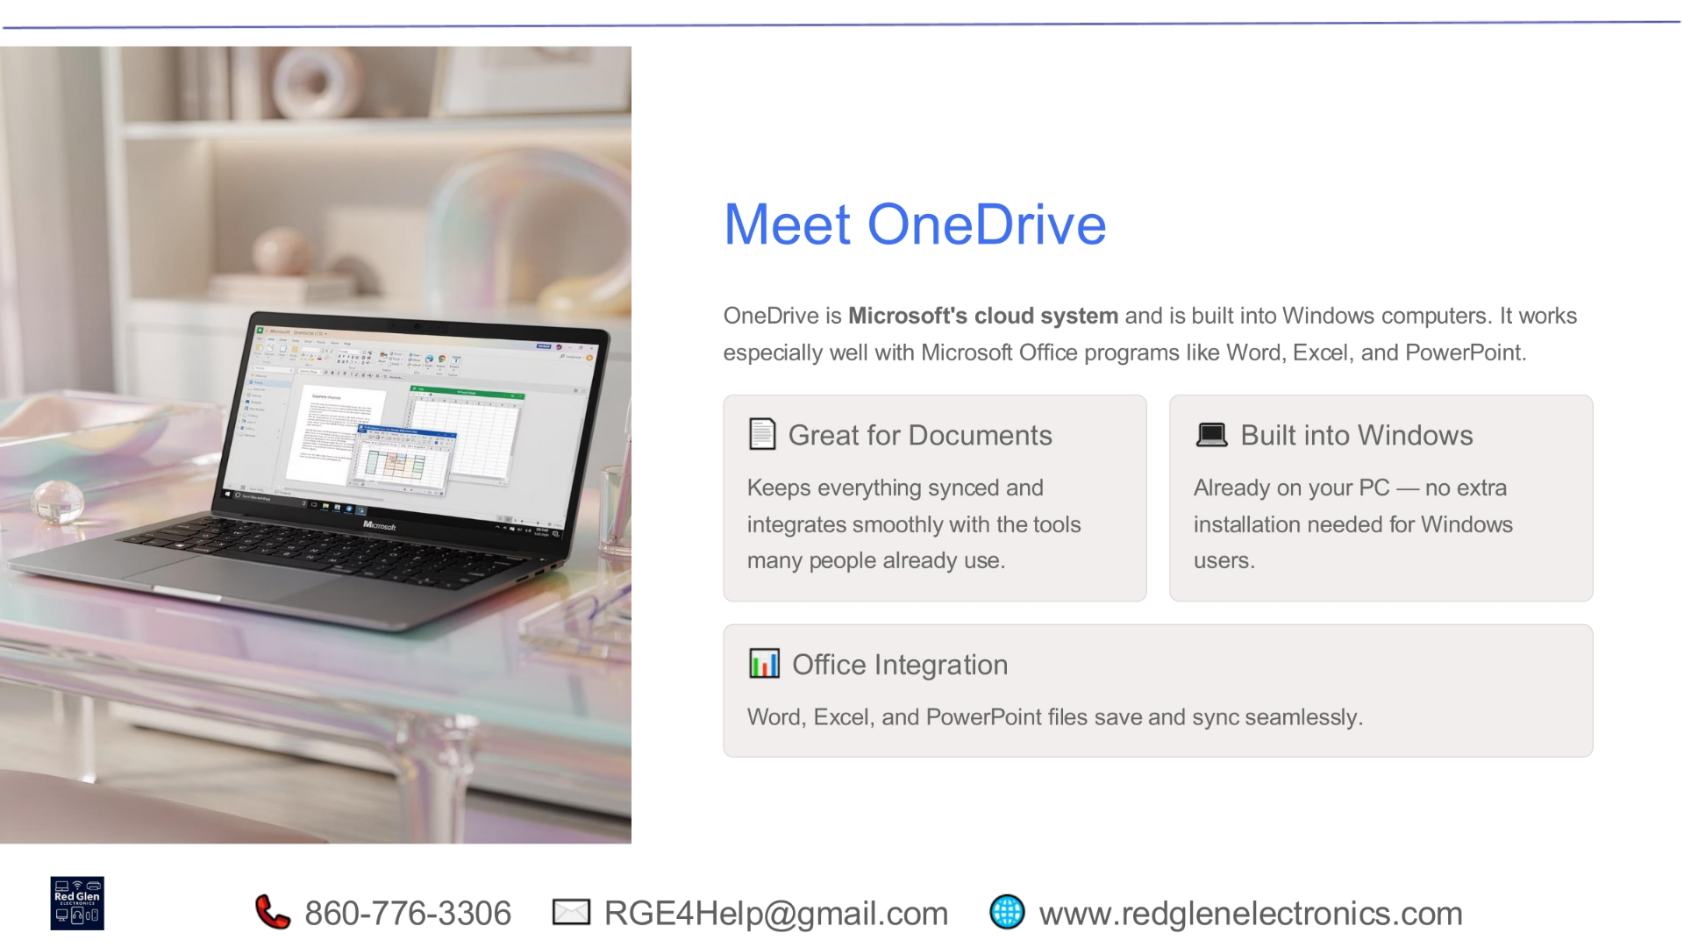
Notes:
Now, let's explore OneDrive, Microsoft's cloud system. It's built directly into Windows computers and integrates exceptionally well with Microsoft Office programs such as Word, Excel, and PowerPoint. OneDrive is great for documents, keeping everything synced and integrating smoothly with the tools many people already use. Since it's built into Windows, no extra installation is needed for Windows users, and Office files save and sync seamlessly, enhancing productivity.

Slide 17
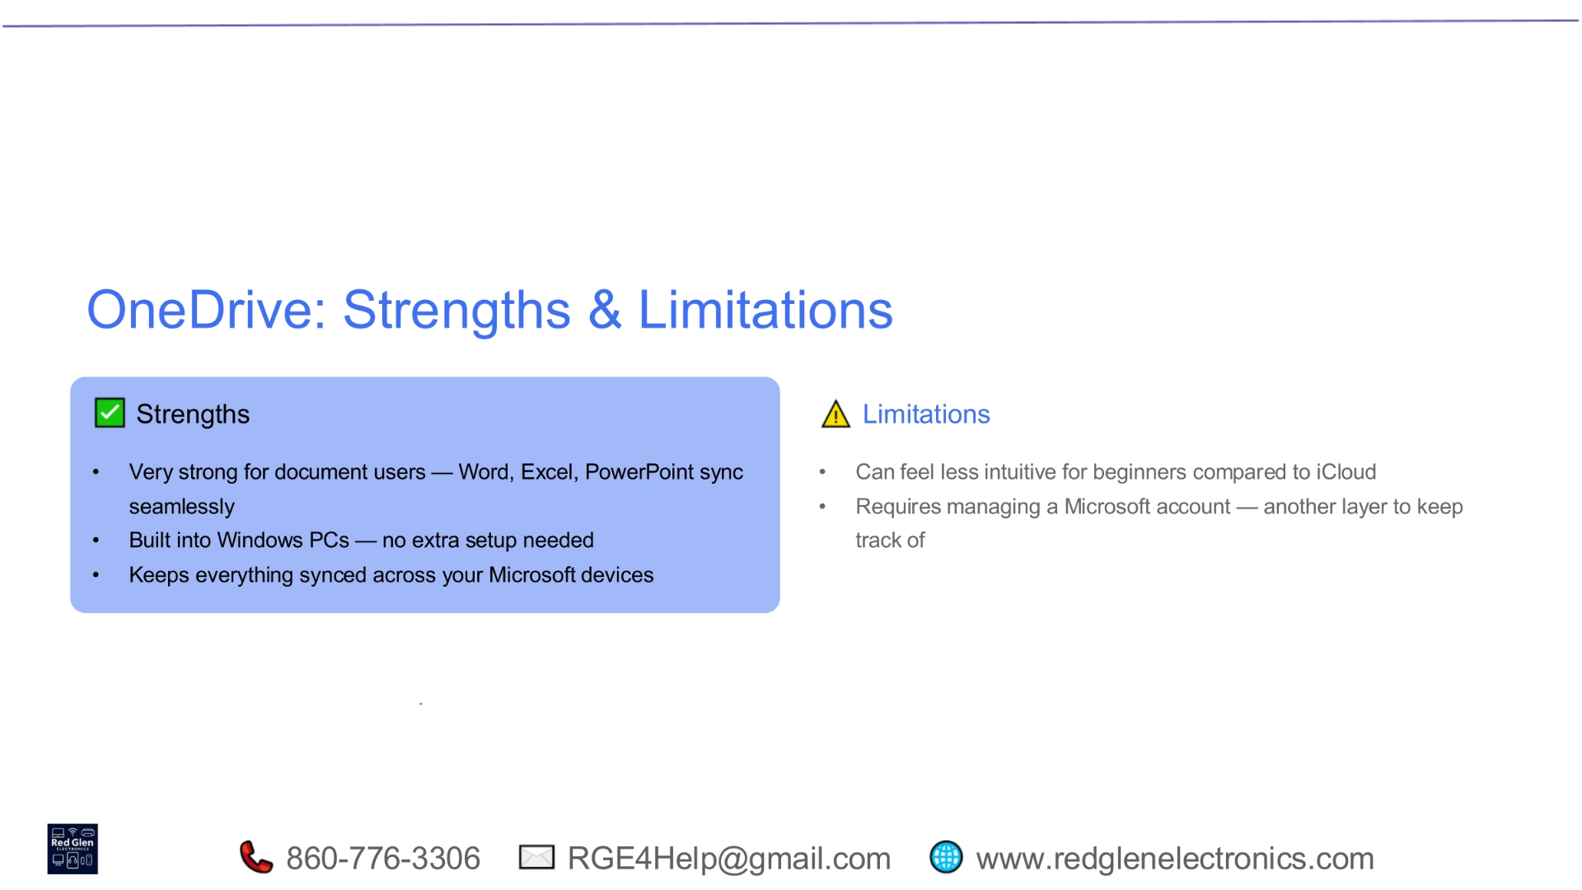
Notes:
OneDrive's strengths are particularly evident for document users, with seamless syncing for Word, Excel, and PowerPoint files. It's built into Windows PCs, requiring no extra setup, and keeps everything synced across your Microsoft devices. On the limitation side, OneDrive can feel less intuitive for beginners compared to iCloud. It also requires managing a Microsoft account, which adds another layer to keep track of, potentially causing minor complexities for some users.

Slide 18
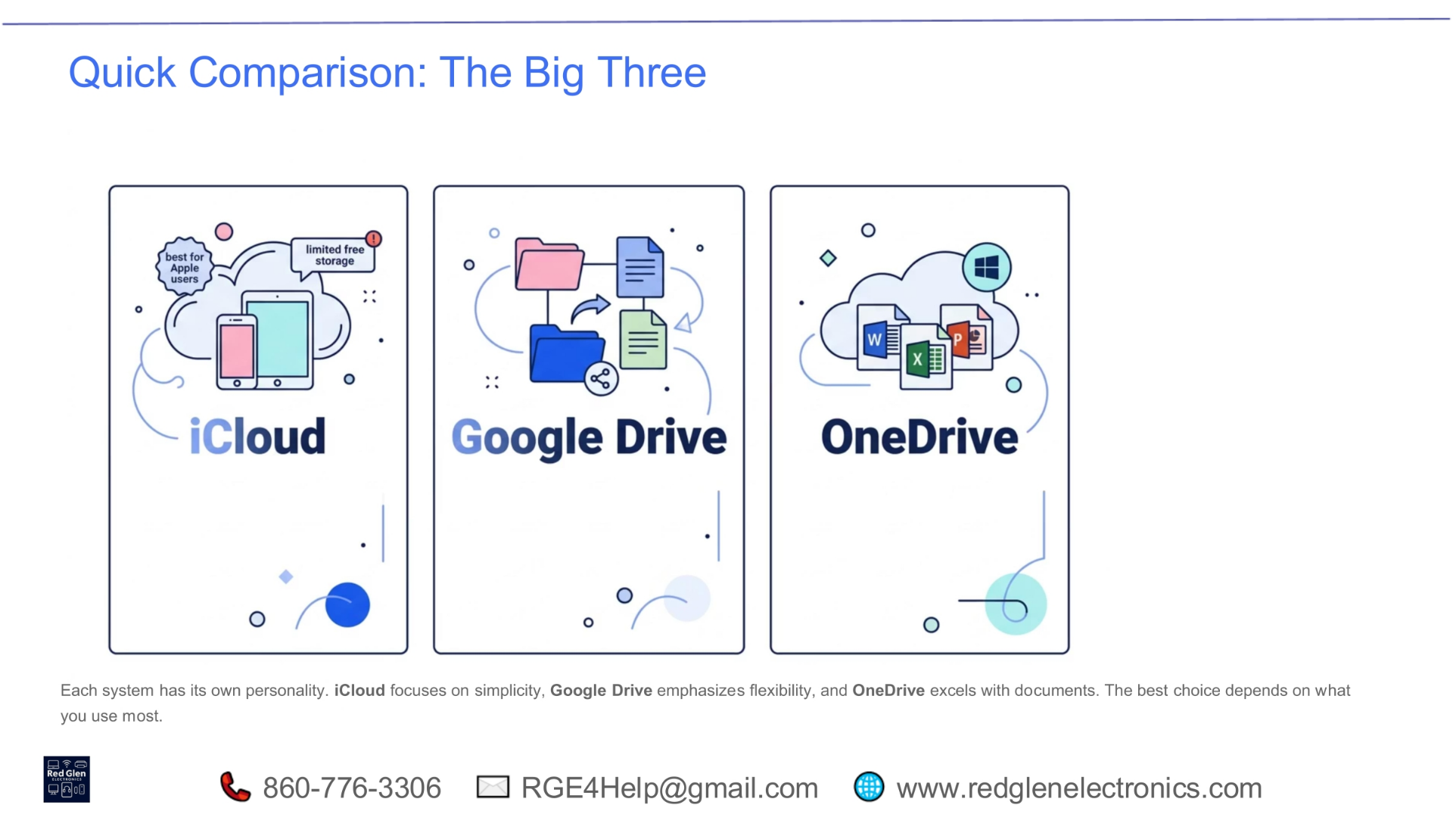
Notes:
Each of these cloud systems has its own distinct personality. iCloud focuses on simplicity and is best for Apple users, though it has limited free storage. Google Drive emphasizes flexibility and cross-platform compatibility, making it versatile for various devices. OneDrive excels with documents and integrates perfectly within the Microsoft ecosystem. The best choice ultimately depends on what devices and software you use most frequently, aligning with your personal or professional workflow.

Slide 19
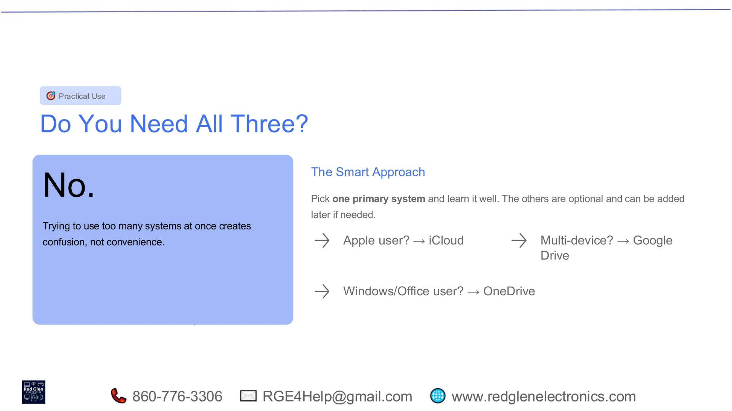
Notes:
The simple answer is no, you don't need all three cloud systems. Trying to manage too many at once often leads to confusion rather than convenience. The smart approach is to pick one primary system and learn it thoroughly. The others are optional and can be added later if needed. If you're an Apple user, iCloud is a natural fit. For multi-device users, Google Drive offers excellent flexibility. And if you primarily use Windows and Office applications, OneDrive is likely your best choice.

Slide 20
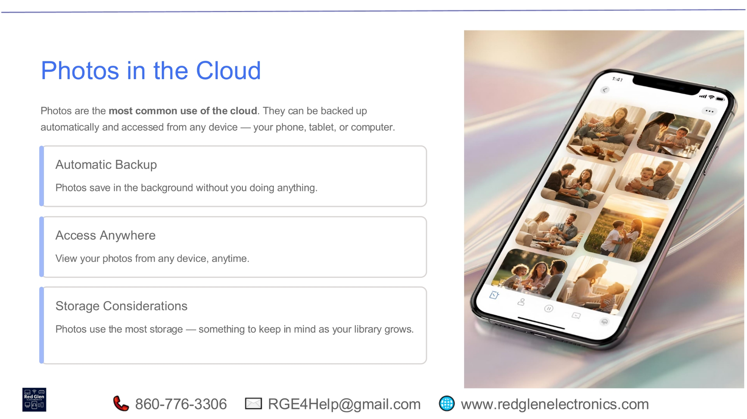
Notes:
Photos are arguably the most common use of the cloud. They can be automatically backed up and accessed from any device, whether it's your phone, tablet, or computer. This automatic backup means your photos save in the background without you needing to do anything. With cloud storage, you gain access anywhere, allowing you to view your photos from any device, anytime. However, photos do use the most storage, which is an important consideration as your digital library grows.

Slide 21
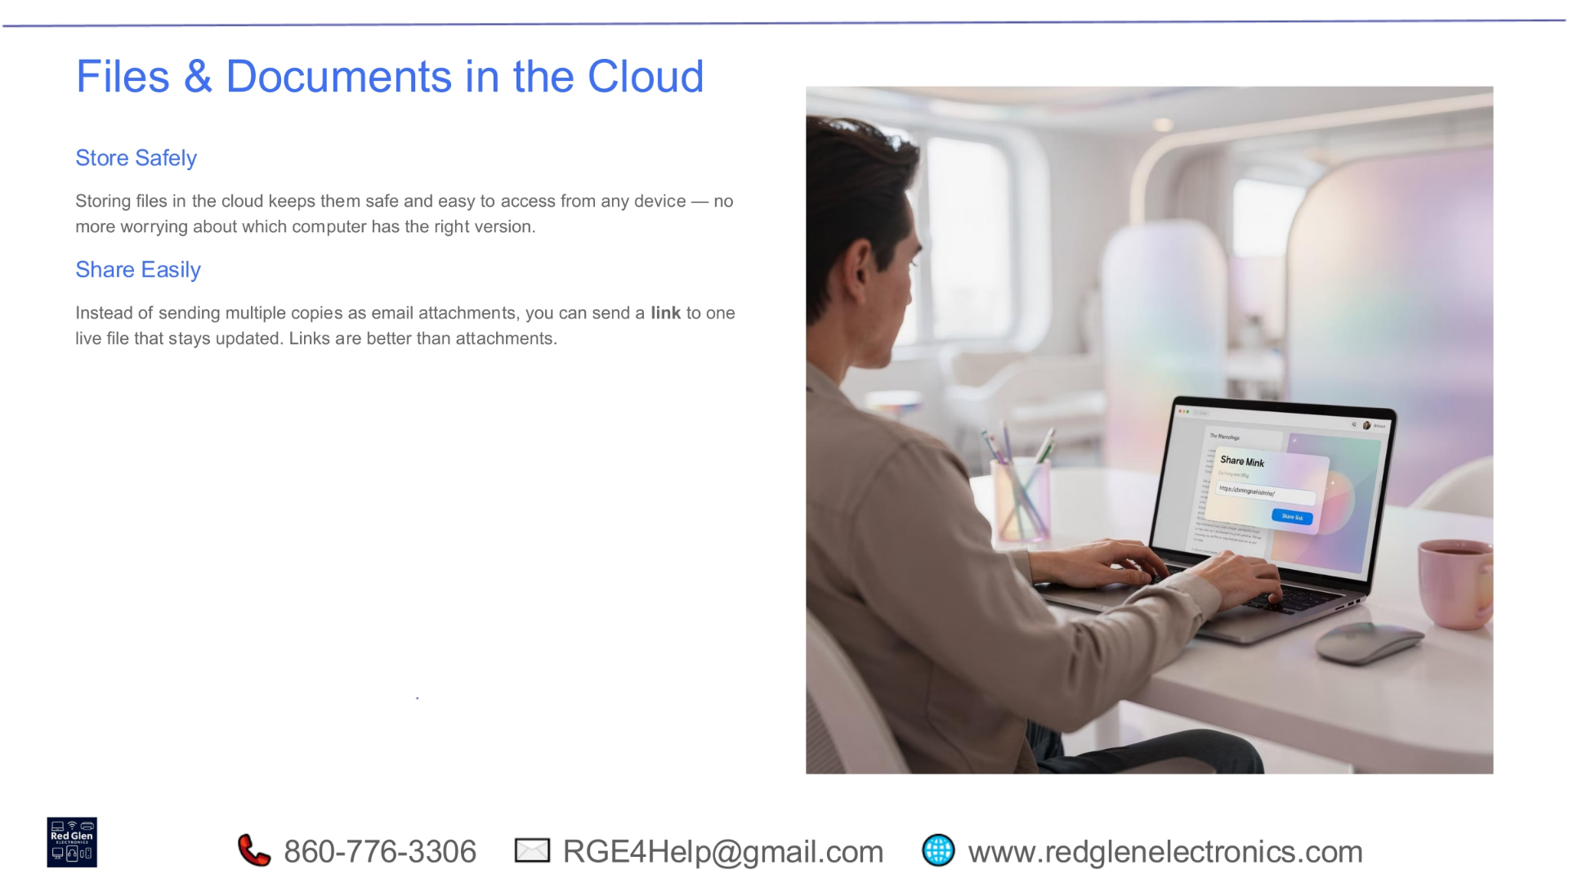
Notes:
Storing files and documents in the cloud offers significant advantages. It keeps them safe and easily accessible from any device, eliminating worries about which computer holds the correct version. Furthermore, the cloud makes sharing incredibly easy. Instead of sending multiple copies as email attachments, you can simply send a link to one live file that stays updated. This ensures everyone always has access to the most current version, making links a far more efficient solution than traditional attachments.

Slide 22
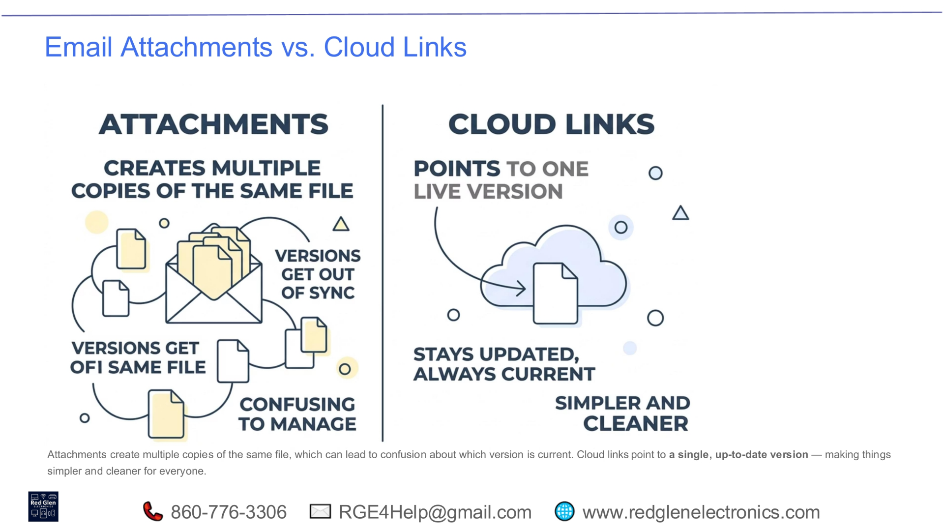
Notes:
When sharing files, we often face a choice between email attachments and cloud links. Attachments create multiple copies of the same file, which can quickly lead to confusion about which version is the most current. This often results in versions getting out of sync and becoming difficult to manage. In contrast, cloud links point to one live version of your file. This means your document stays updated and always current, making the entire process much simpler and cleaner for everyone involved.

Slide 23
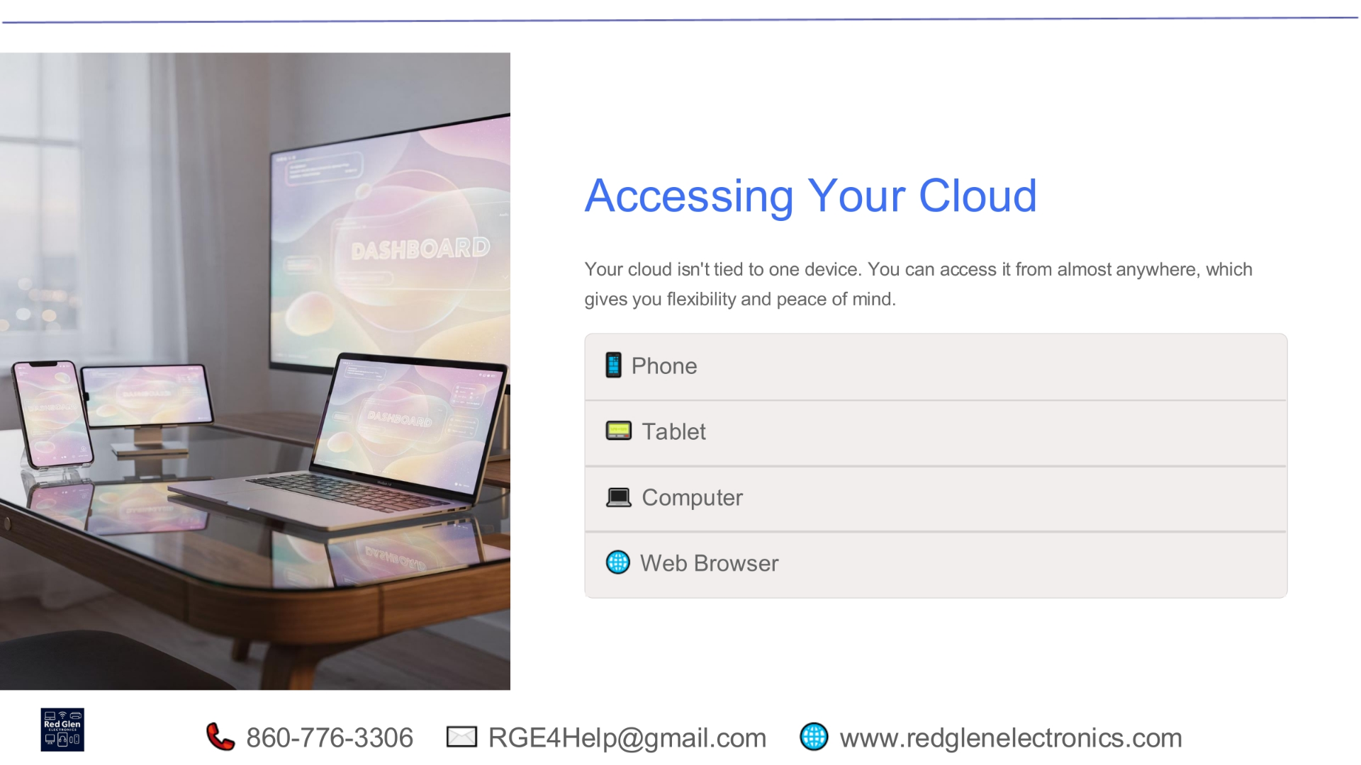
Notes:
One of the greatest advantages of cloud technology is its accessibility. Your cloud isn't tied to a single device, offering you incredible flexibility and peace of mind. You can access your stored data from almost anywhere, whether you're using your phone, tablet, computer, or simply a web browser. This seamless access ensures your important files and memories are always within reach, no matter where you are or what device you're using.

Slide 24
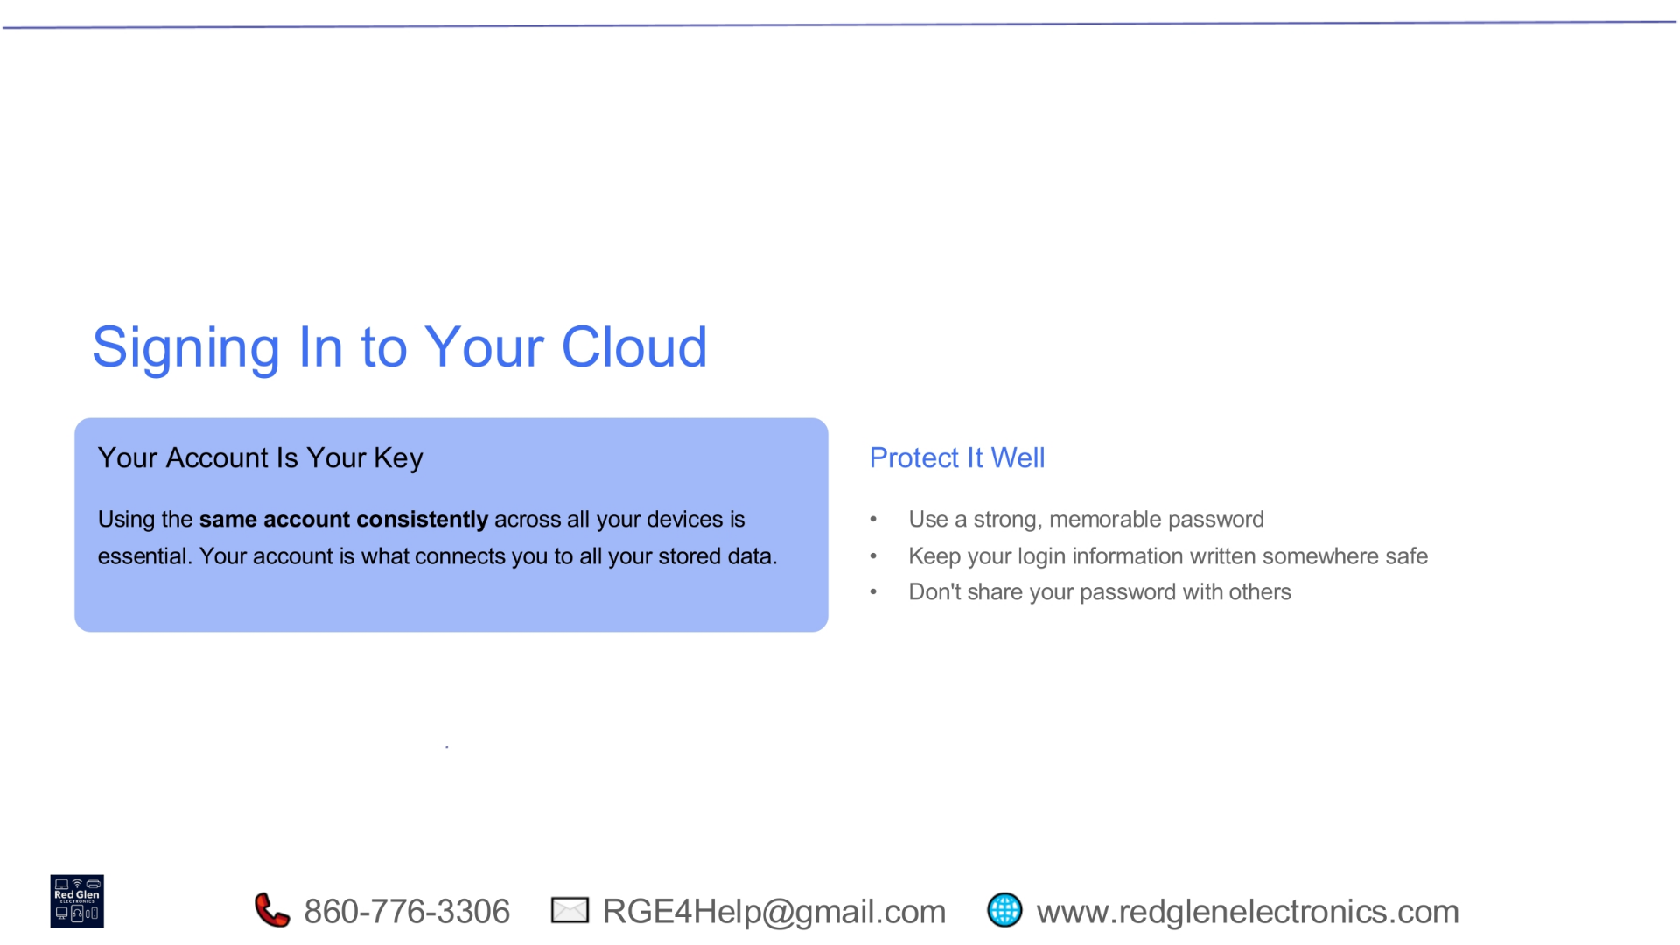
Notes:
Your account is truly your key to unlocking all the benefits of cloud storage. Using the same account consistently across all your devices is essential, as it's what connects you to all your stored data. To protect this valuable access, it's crucial to use a strong, memorable password. We also recommend keeping your login information written down somewhere safe and, most importantly, never sharing your password with others. These simple steps are vital for safeguarding your digital life.

Slide 25
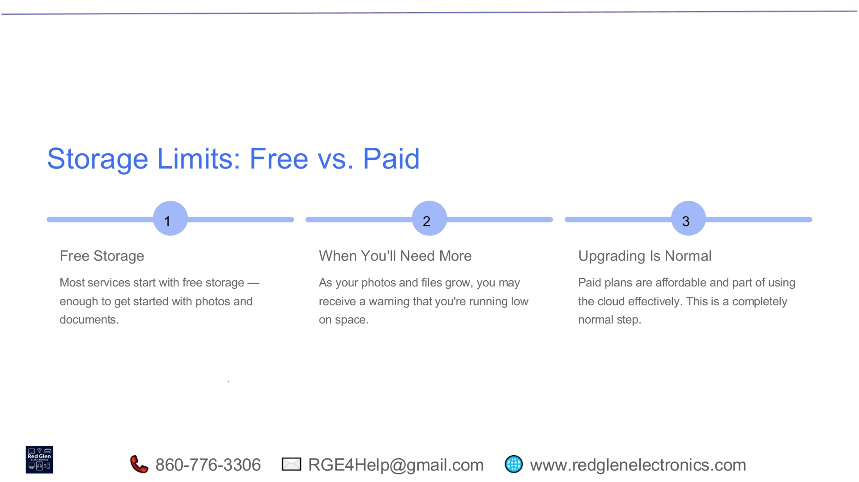
Notes:
Many cloud services offer a tiered approach to storage, starting with free options. Most services provide enough free storage to get you started with your photos and documents. However, as your digital life expands and your collection of photos and files grows, you may receive warnings that you're running low on space. Upgrading to a paid plan is a completely normal and often necessary step to continue using the cloud effectively, as these plans are designed to be affordable and scalable for your needs.

Slide 26
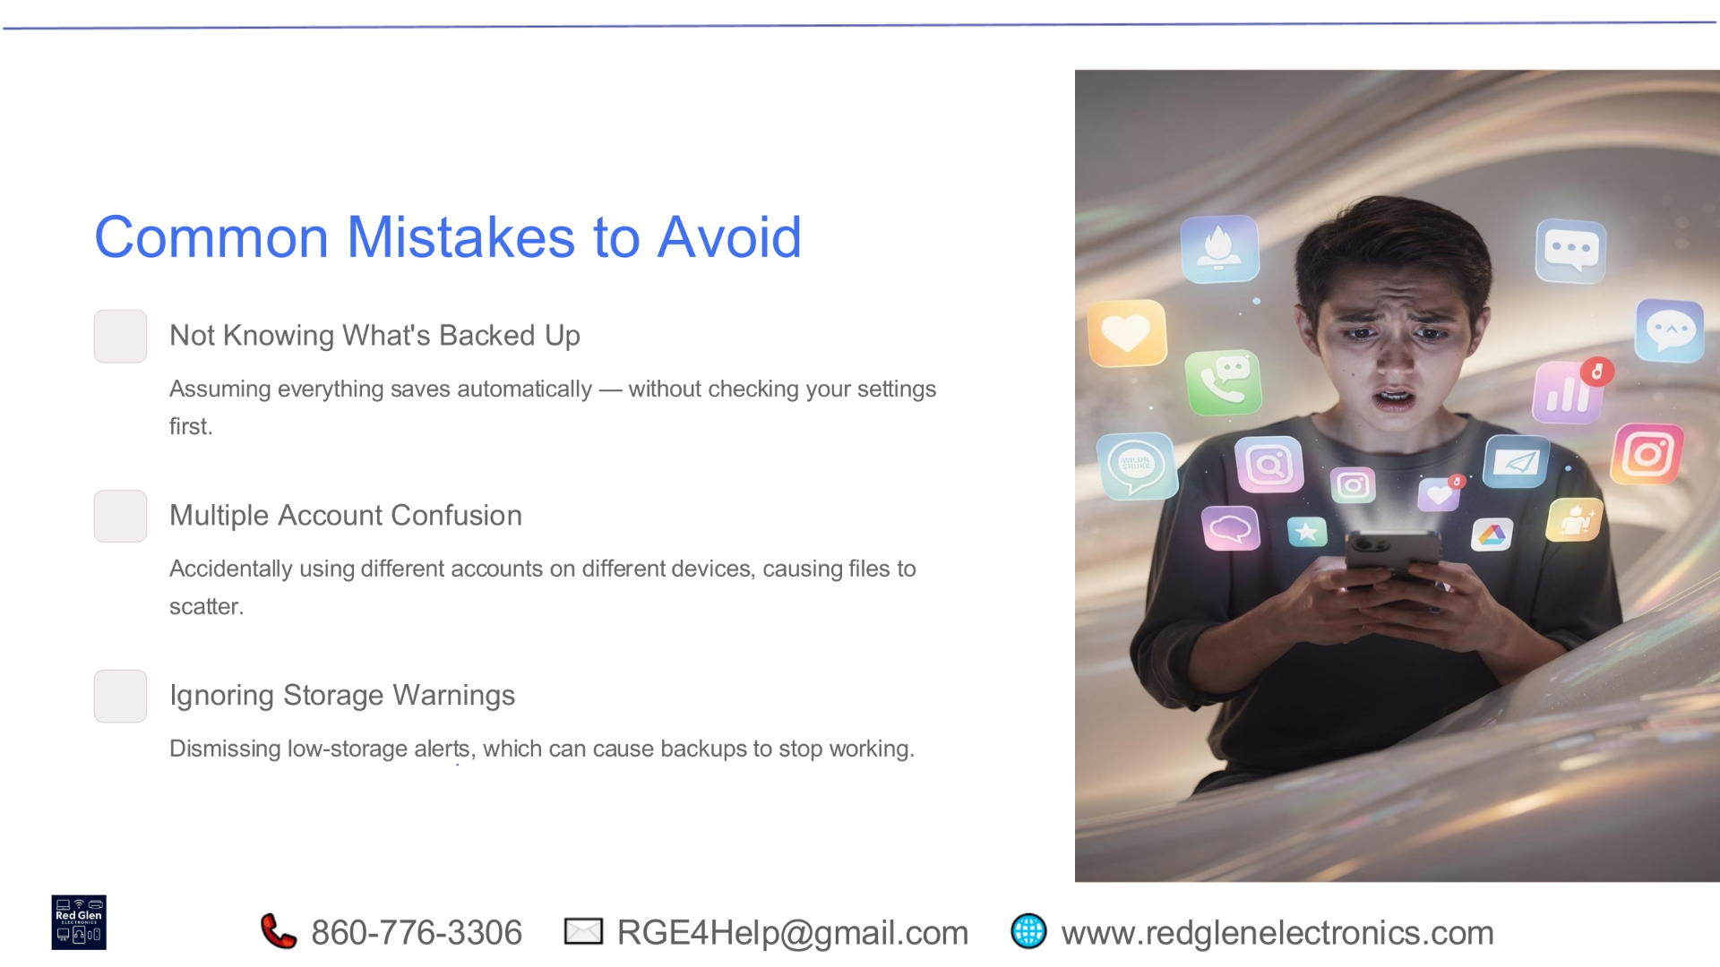
Notes:
To ensure a smooth cloud experience, it's helpful to be aware of common pitfalls. One mistake is assuming everything saves automatically without first checking your settings. Another common issue is multiple account confusion, where accidentally using different accounts on different devices can cause your files to scatter across various locations. Finally, ignoring storage warnings can be problematic, as dismissing low-storage alerts can lead to your backups stopping altogether, putting your valuable data at risk.

Slide 27
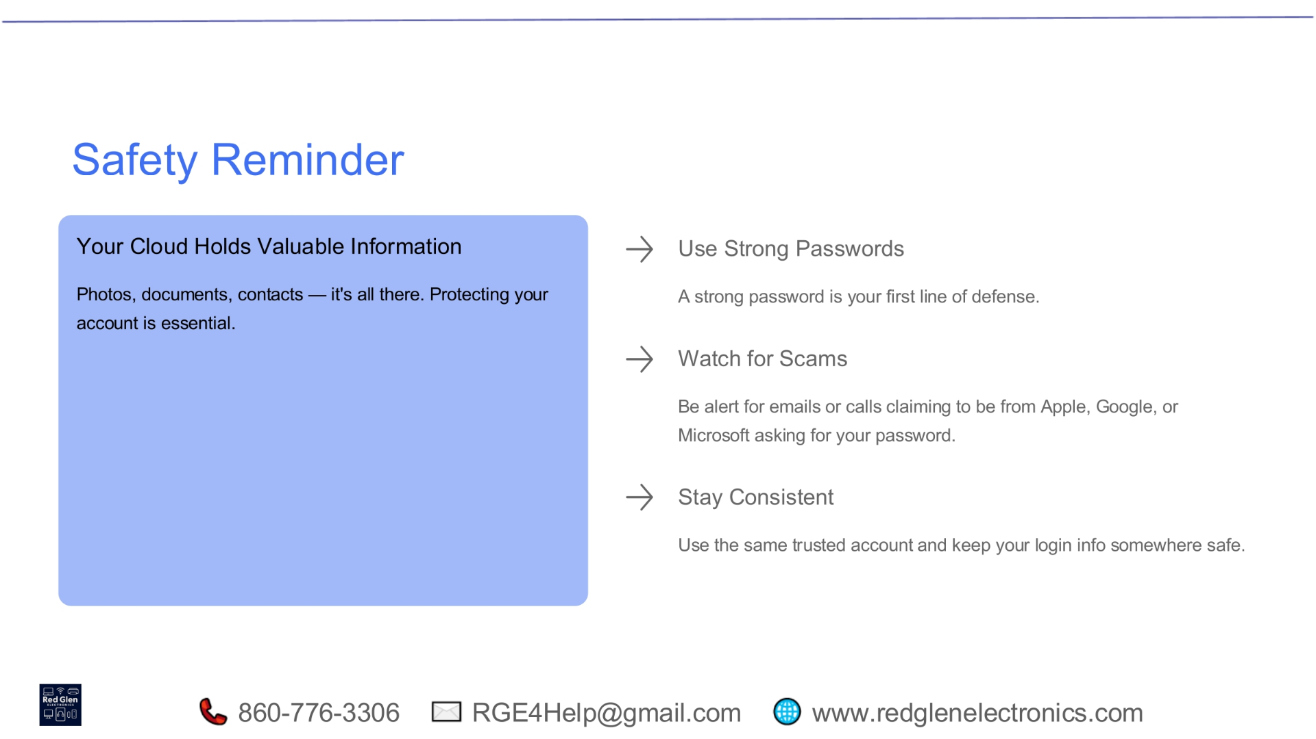
Notes:
Your cloud holds a wealth of valuable information, including your photos, documents, and contacts, making its protection absolutely essential. To keep your data safe, always use strong passwords; they are your first line of defense against unauthorized access. Be vigilant for scams, staying alert for emails or calls that claim to be from reputable companies like Apple, Google, or Microsoft, but are actually asking for your password. Lastly, stay consistent by using the same trusted account and keeping your login information secure.

Slide 28
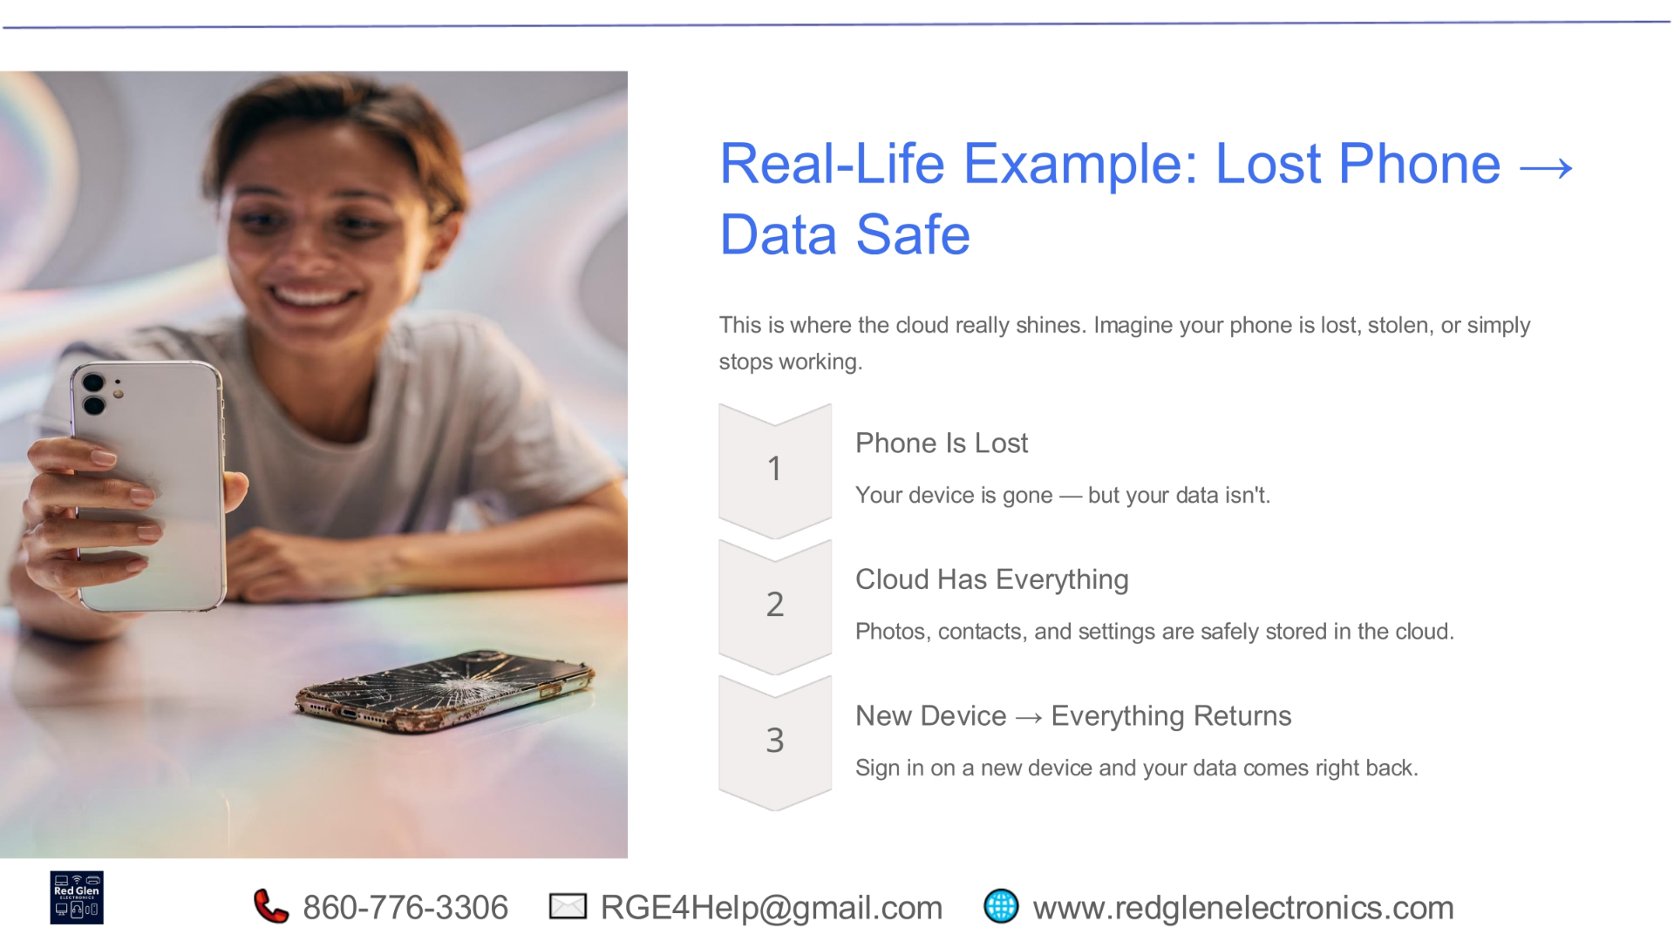
Notes:
This scenario truly highlights the power of cloud storage. Imagine your phone is lost, stolen, or simply stops working. While your device may be gone, your data isn't. With cloud backup, all your photos, contacts, and settings are safely stored. When you get a new device, you simply sign in with your cloud account, and all your data comes right back, seamlessly restoring your digital life. This provides immense peace of mind, knowing your memories and important information are always protected.

Slide 29
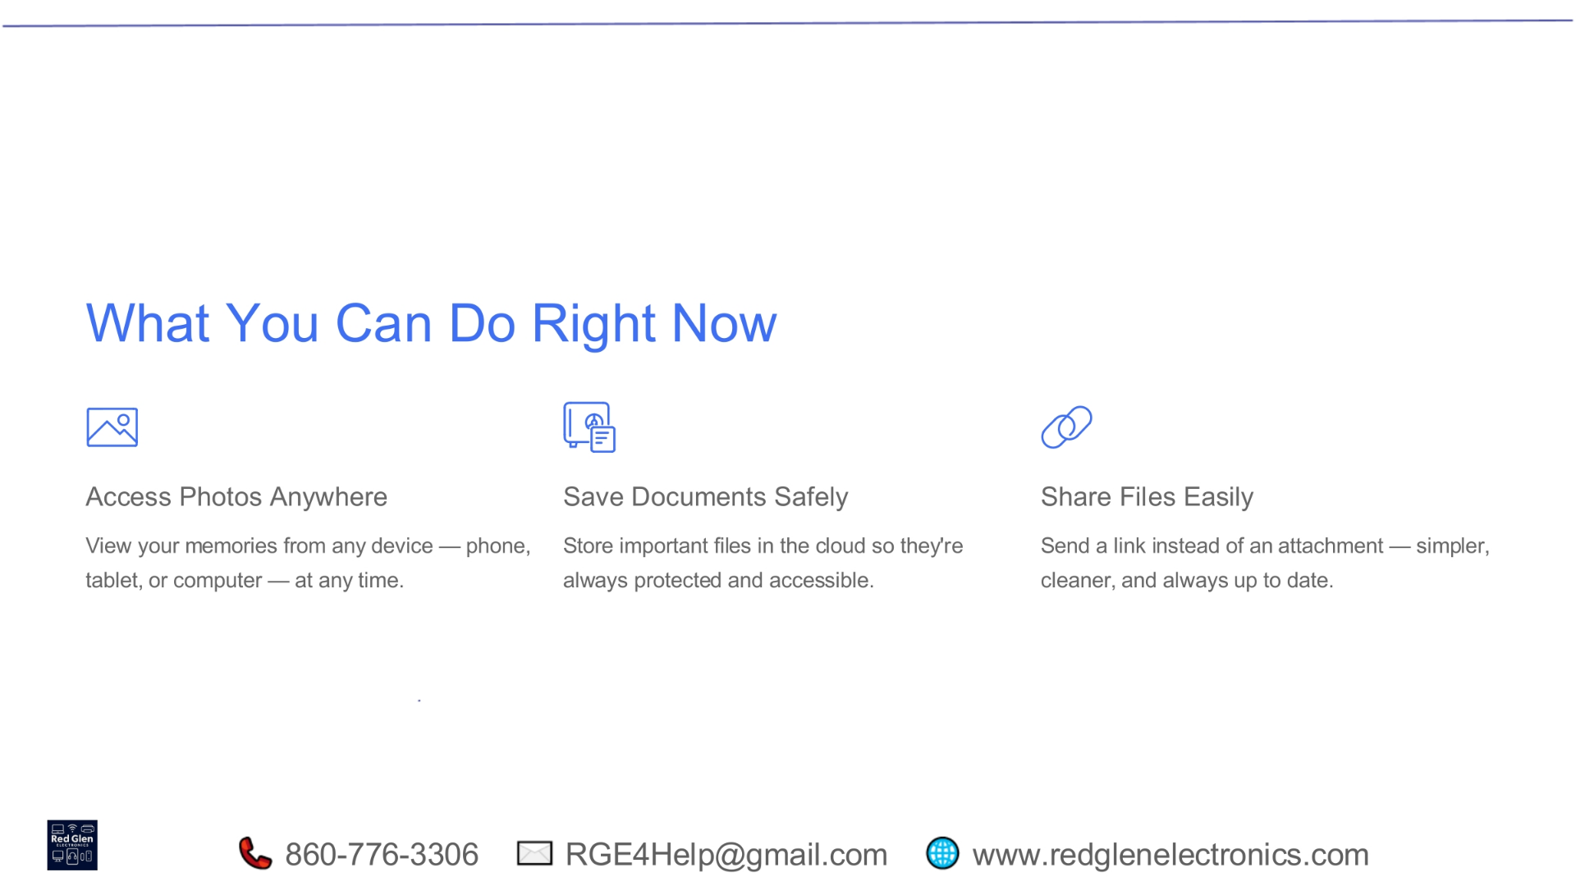
Notes:
There are immediate steps you can take to leverage the benefits of cloud technology. First, you can access your photos anywhere, viewing your cherished memories from any device—whether it's your phone, tablet, or computer—at any time. Second, save your documents safely by storing important files in the cloud, ensuring they are always protected and accessible. Finally, share files easily by sending a link instead of an attachment, which is simpler, cleaner, and always ensures recipients have the most up-to-date version.

Slide 30
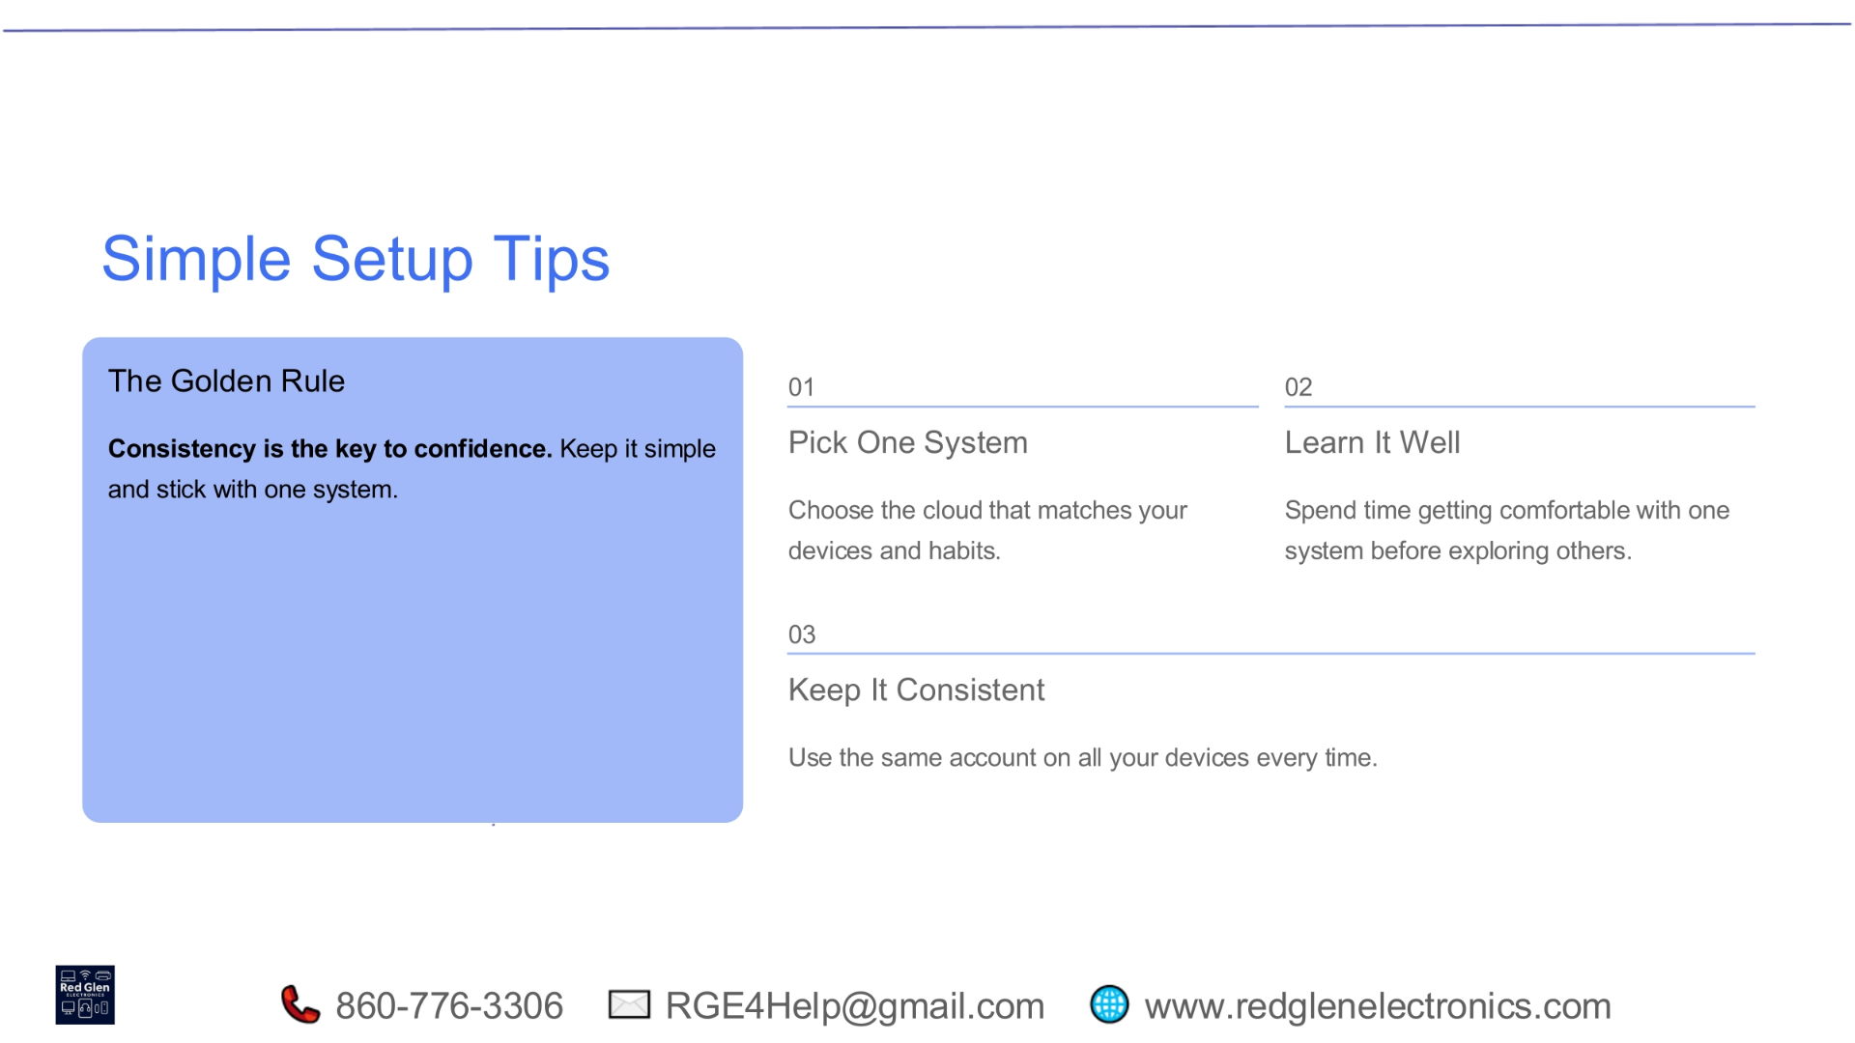
Notes:
When setting up your cloud, remember the golden rule: consistency is the key to confidence. Keep it simple and stick with one system. Start by picking one cloud system that best matches your devices and habits. Then, take the time to learn it well, getting comfortable with that single system before exploring others. Most importantly, keep it consistent by using the same account on all your devices every time. This approach minimizes confusion and maximizes your cloud's effectiveness.

Slide 31
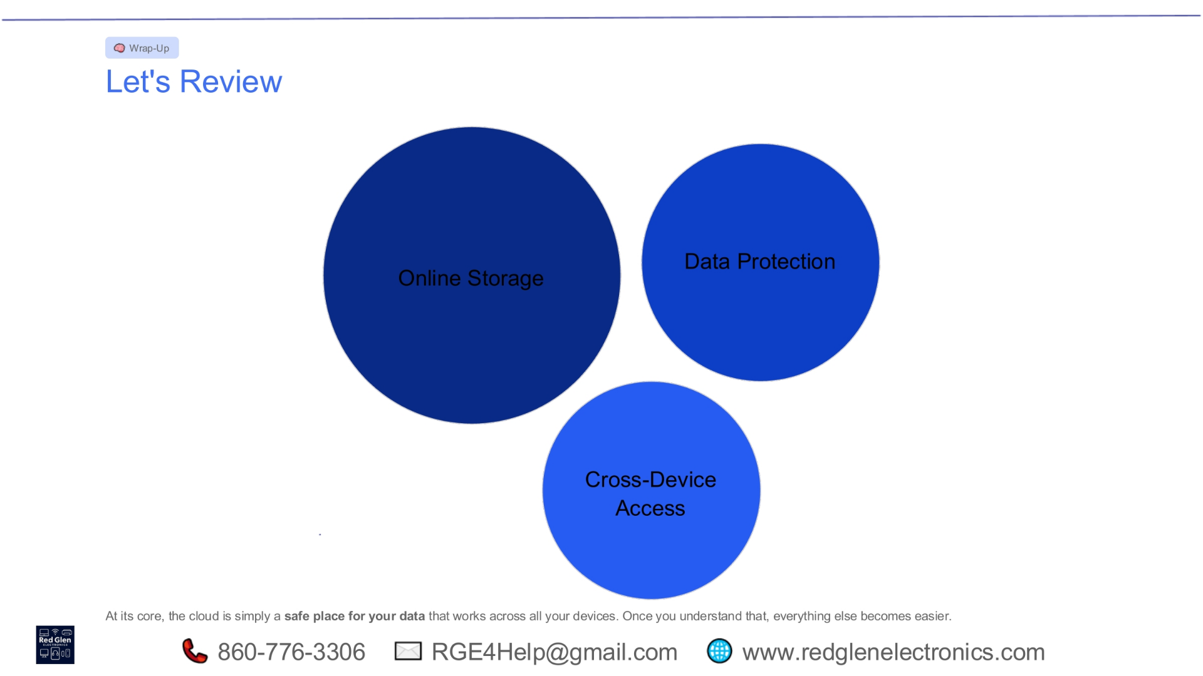
Notes:
As we wrap up, let's review the core benefits of cloud technology. It provides robust online storage for all your files, ensuring data protection against loss or damage. Furthermore, it offers seamless cross-device access, allowing you to reach your information from anywhere. At its core, the cloud is simply a safe place for your data that works across all your devices. Once you understand these fundamental aspects, managing your digital life becomes significantly easier.

Slide 32
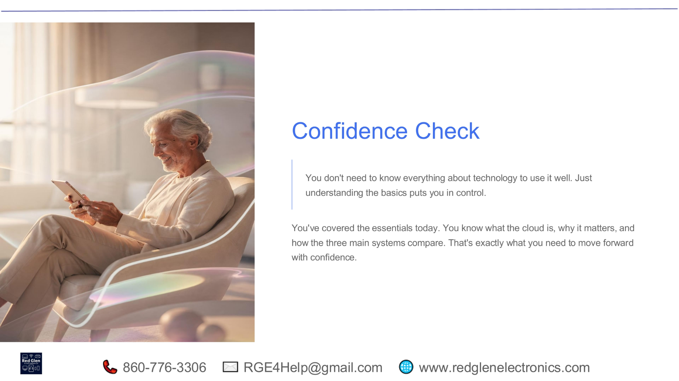
Notes:
You don't need to be a technology expert to use it effectively. Simply understanding the basics puts you firmly in control. Today, we've covered the essentials: what the cloud is, why it matters, and how the main systems compare. This foundational knowledge is exactly what you need to move forward with confidence, empowering you to manage your digital life securely and efficiently. You've gained valuable insights that will serve you well.

Slide 33
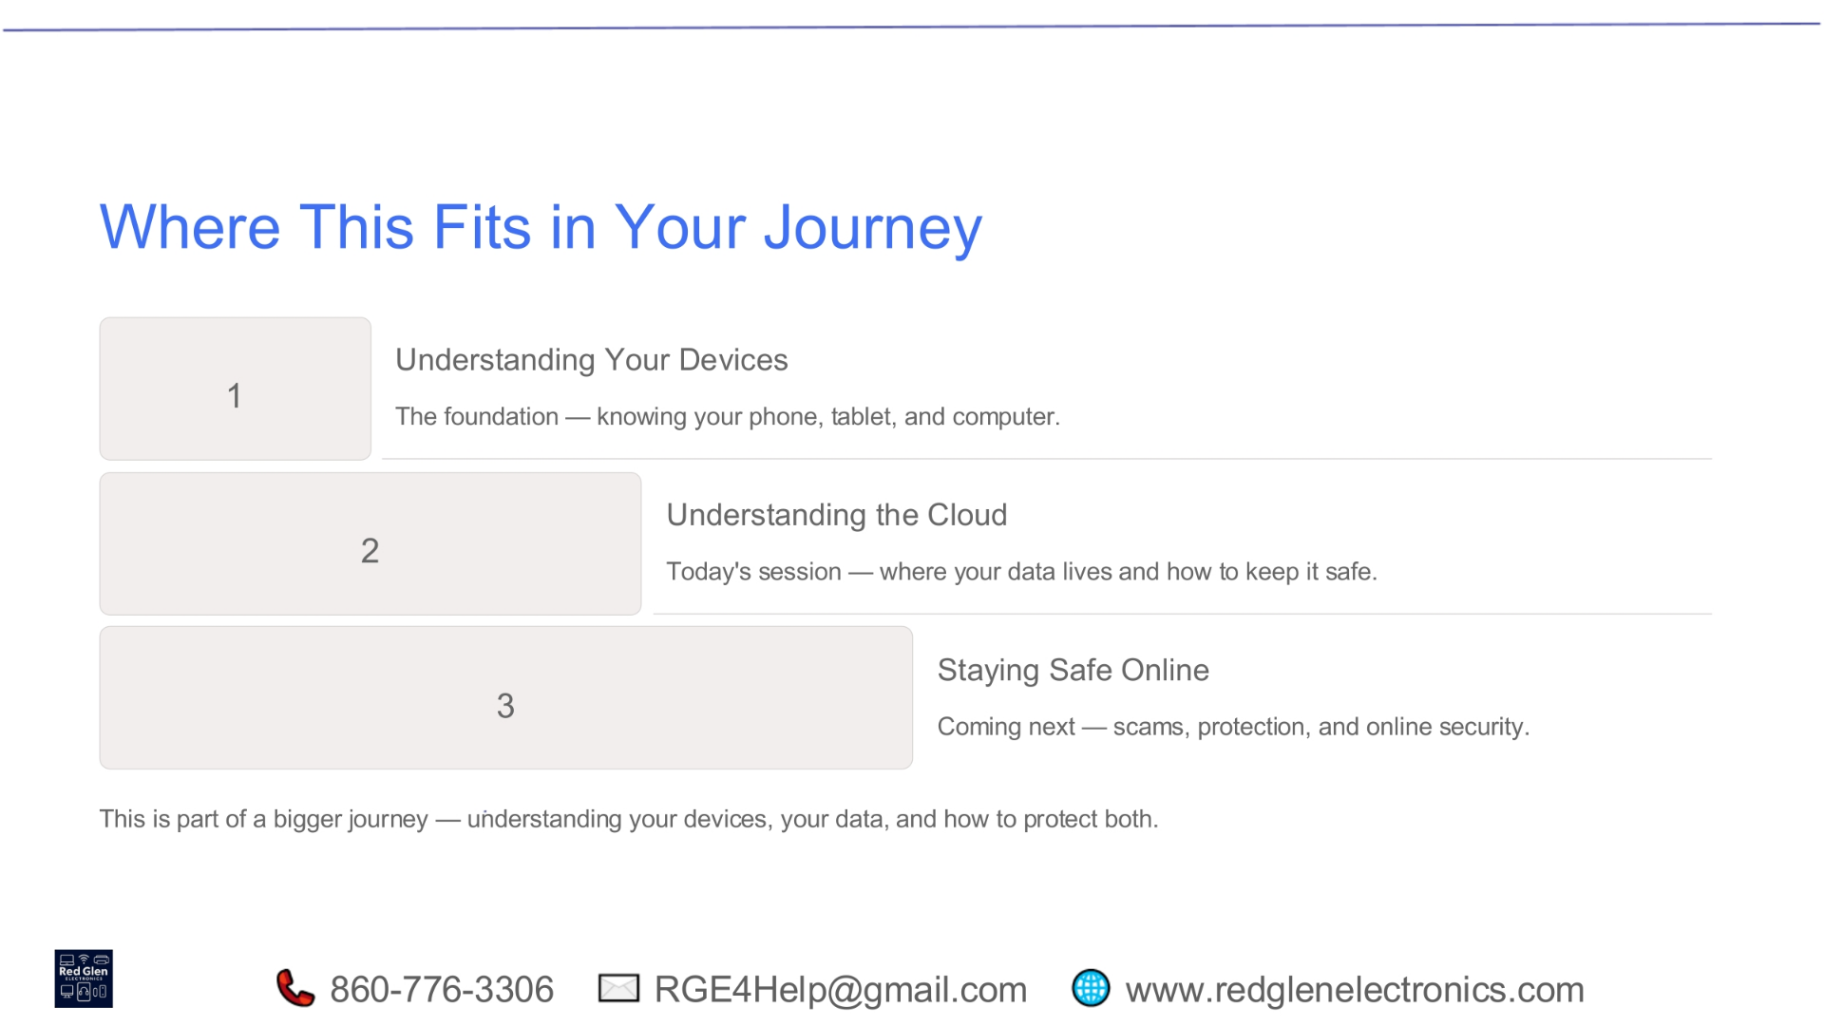
Notes:
This session is an important part of a larger journey towards digital literacy and security. We began by understanding your devices, which forms the foundation of knowing your phone, tablet, and computer. Today, we focused on understanding the cloud, exploring where your data lives and how to keep it safe. Looking ahead, our next step will be staying safe online, covering scams, protection strategies, and overall online security. This comprehensive approach ensures you're well-equipped for the digital world.

Slide 34
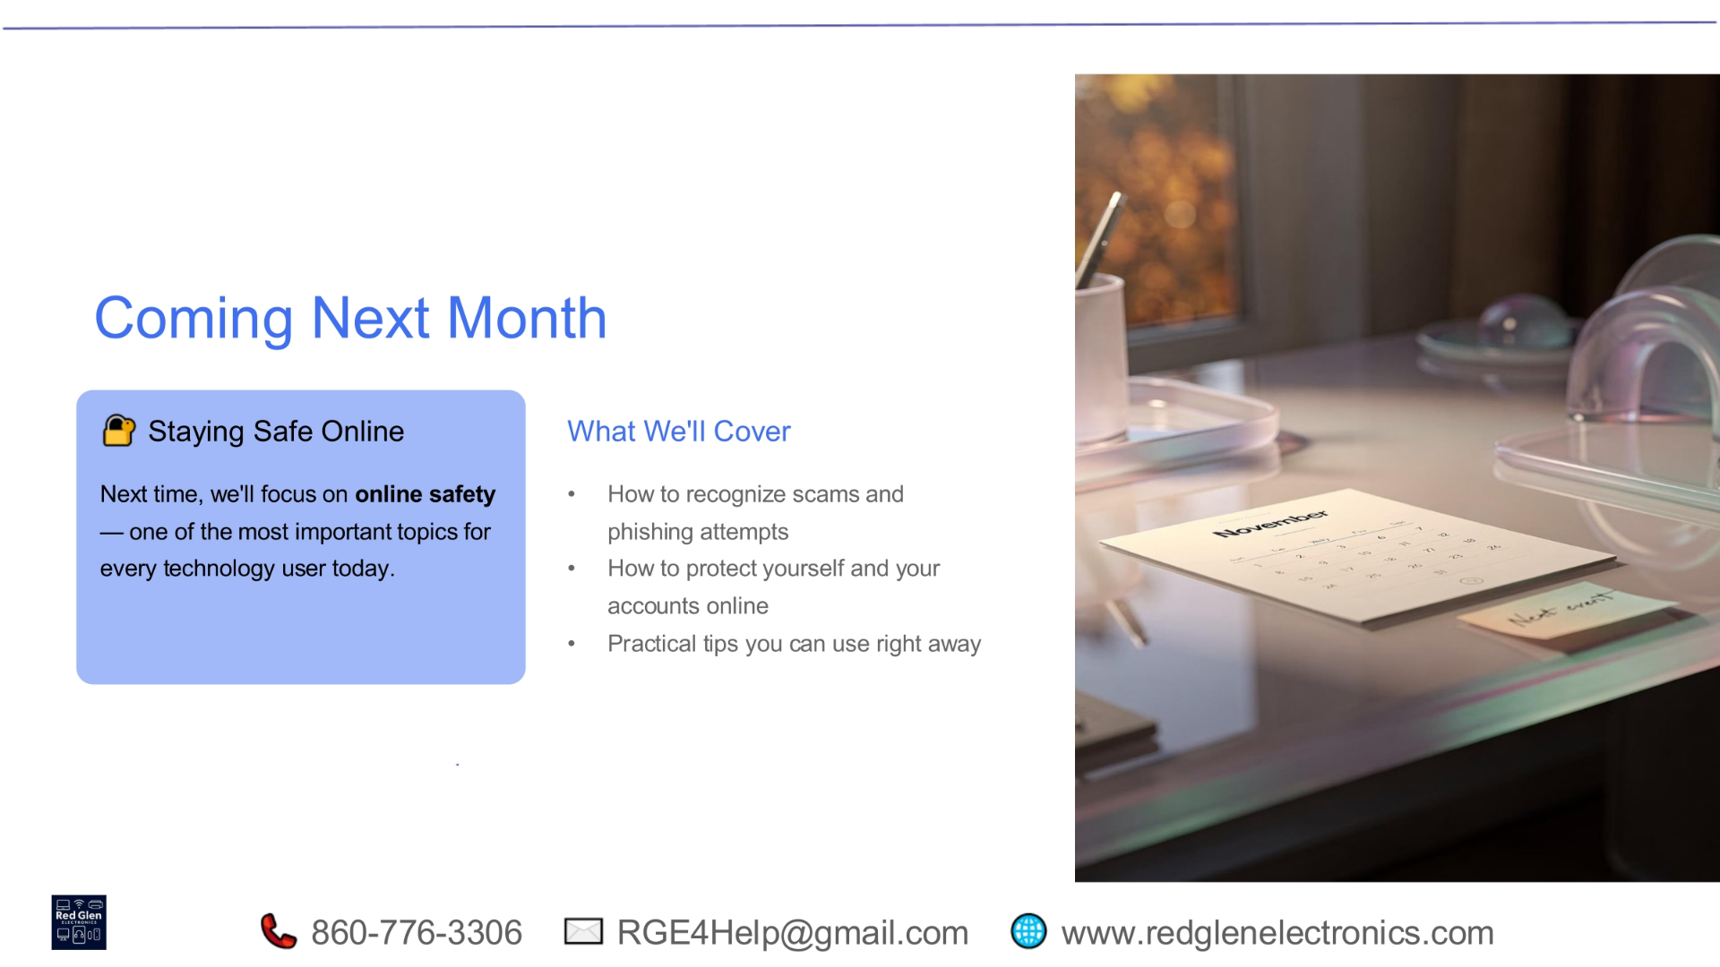
Notes:
Next month, our focus will shift to the critical topic of online safety, one of the most important subjects for every technology user today. We'll cover essential aspects such as how to recognize various scams and phishing attempts, providing you with the tools to identify and avoid them. We'll also discuss effective strategies to protect yourself and your accounts online, along with practical tips you can implement right away to enhance your digital security. Join us to strengthen your online defenses.

Slide 35
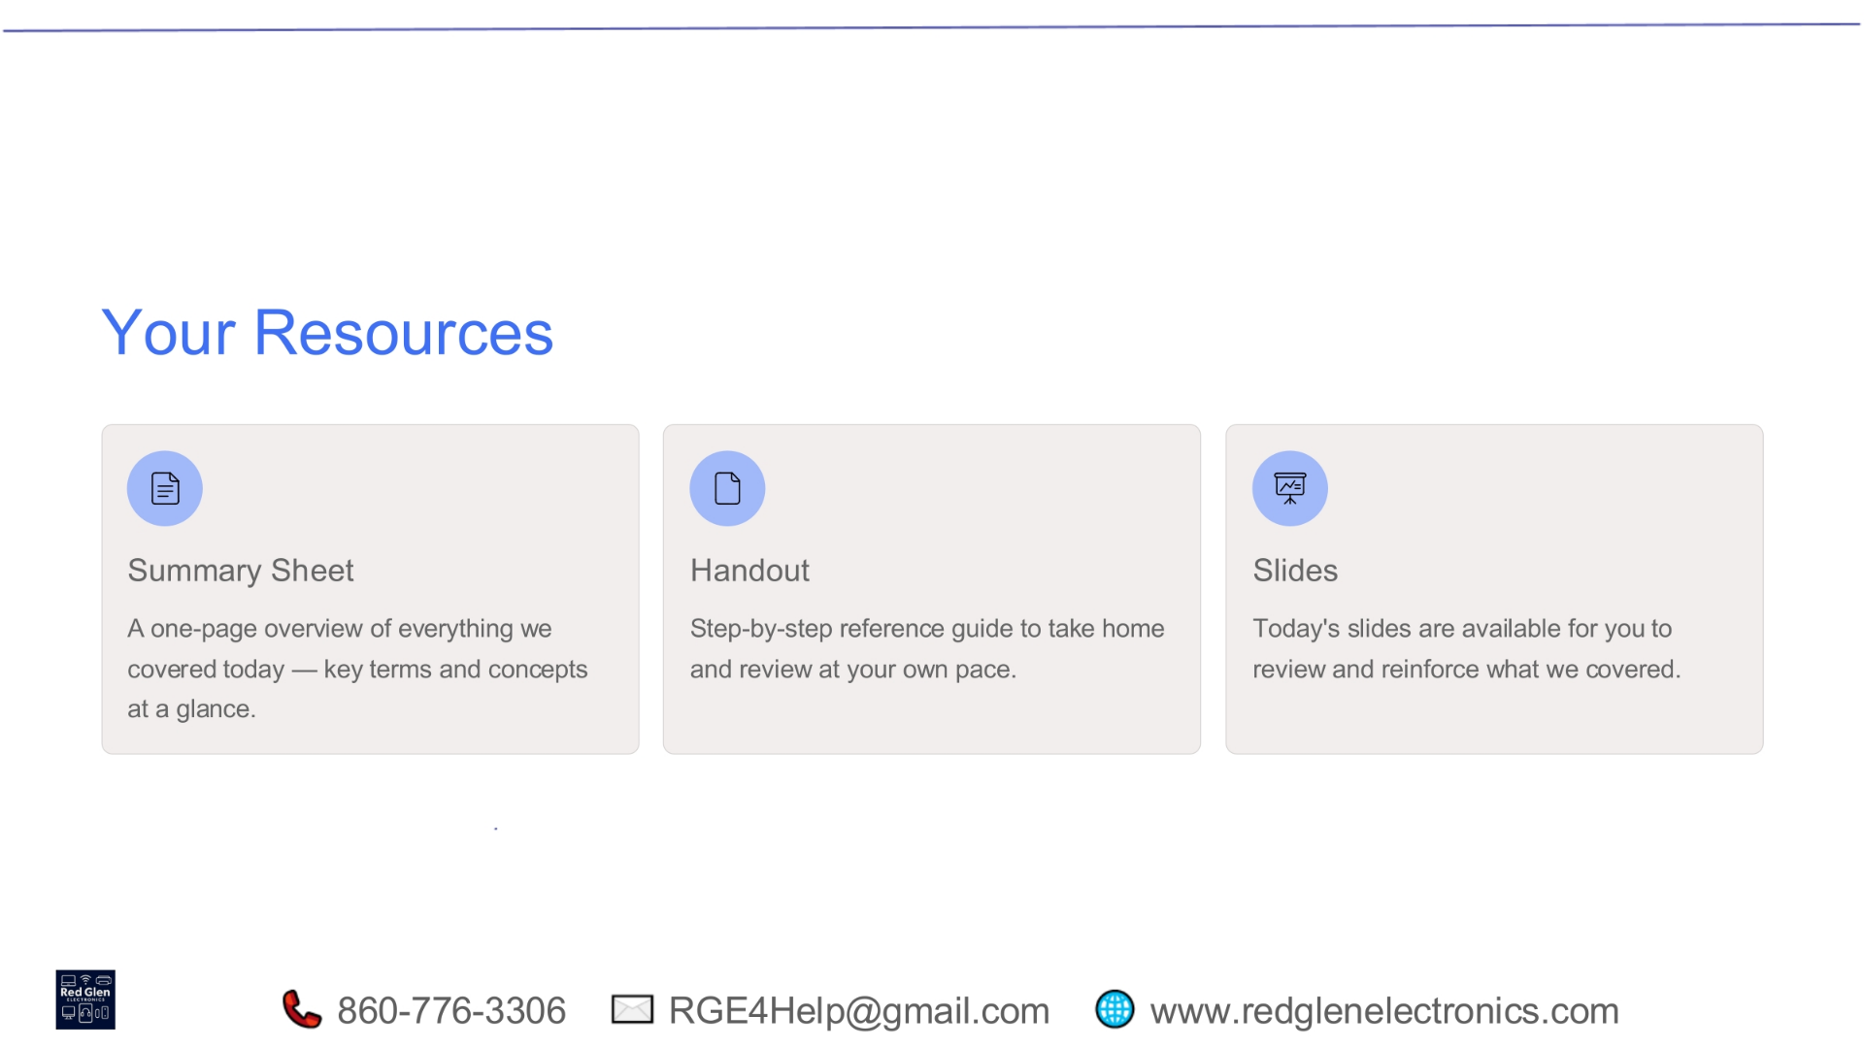
Notes:
To help you reinforce what you've learned today, we've provided several valuable resources. You'll receive a summary sheet, which offers a one-page overview of all the key terms and concepts we covered. There's also a detailed handout, serving as a step-by-step reference guide you can take home and review at your own pace. Additionally, today's presentation slides are available for you to access, allowing you to revisit the information and further solidify your understanding.

Slide 36
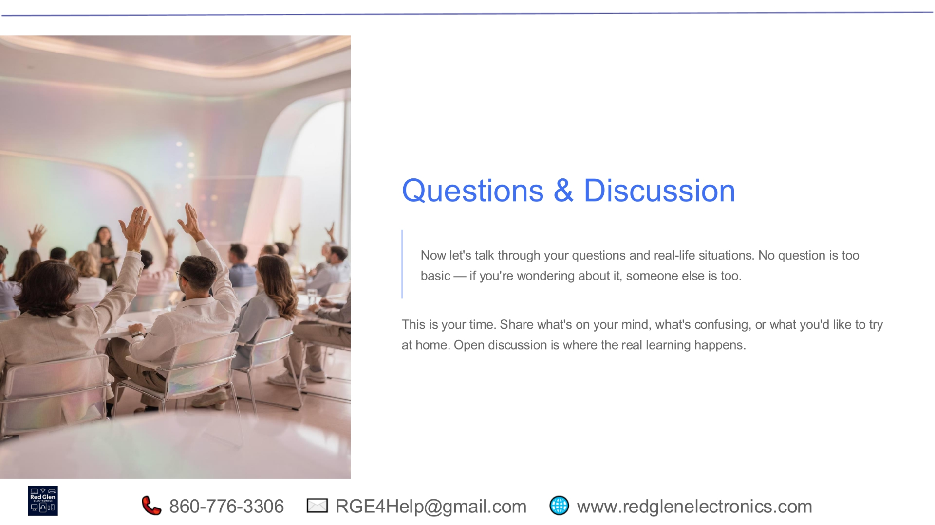
Notes:
Now, let's open the floor for your questions and discuss real-life situations. Remember, no question is too basic; if you're wondering about something, it's highly likely someone else is too. This is your dedicated time to share what's on your mind, clarify anything confusing, or discuss what you'd like to try at home. Open discussion is where the real learning happens, so please feel free to engage and share your thoughts.

Slide 37
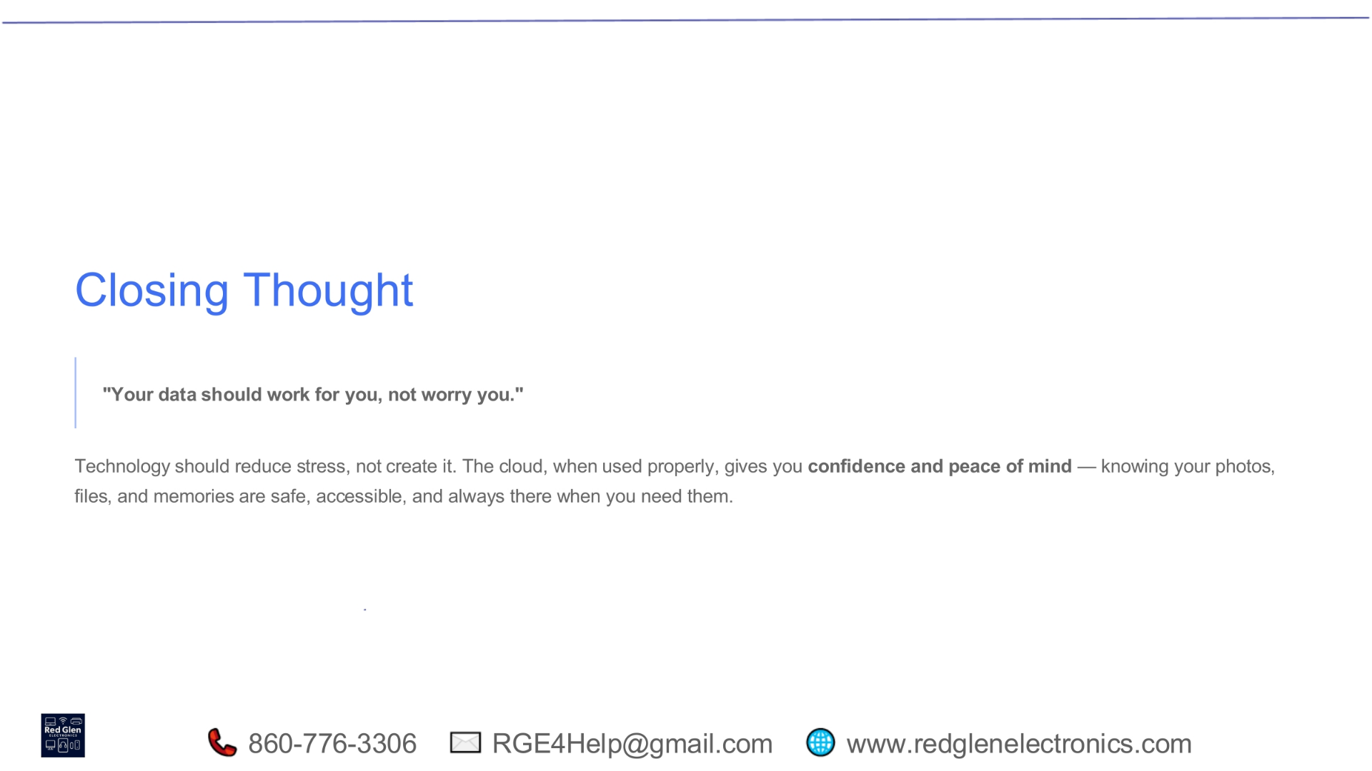
Notes:
Our final thought for today is simple yet profound: 'Your data should work for you, not worry you.' Technology should reduce stress, not add to it. When used correctly, the cloud offers great confidence and peace of mind. It makes sure your photos, files, and treasured memories are safe, easy to access, and always there exactly when you need them. Embrace the cloud to make your digital life simpler and free from unnecessary worry.

Slide 38
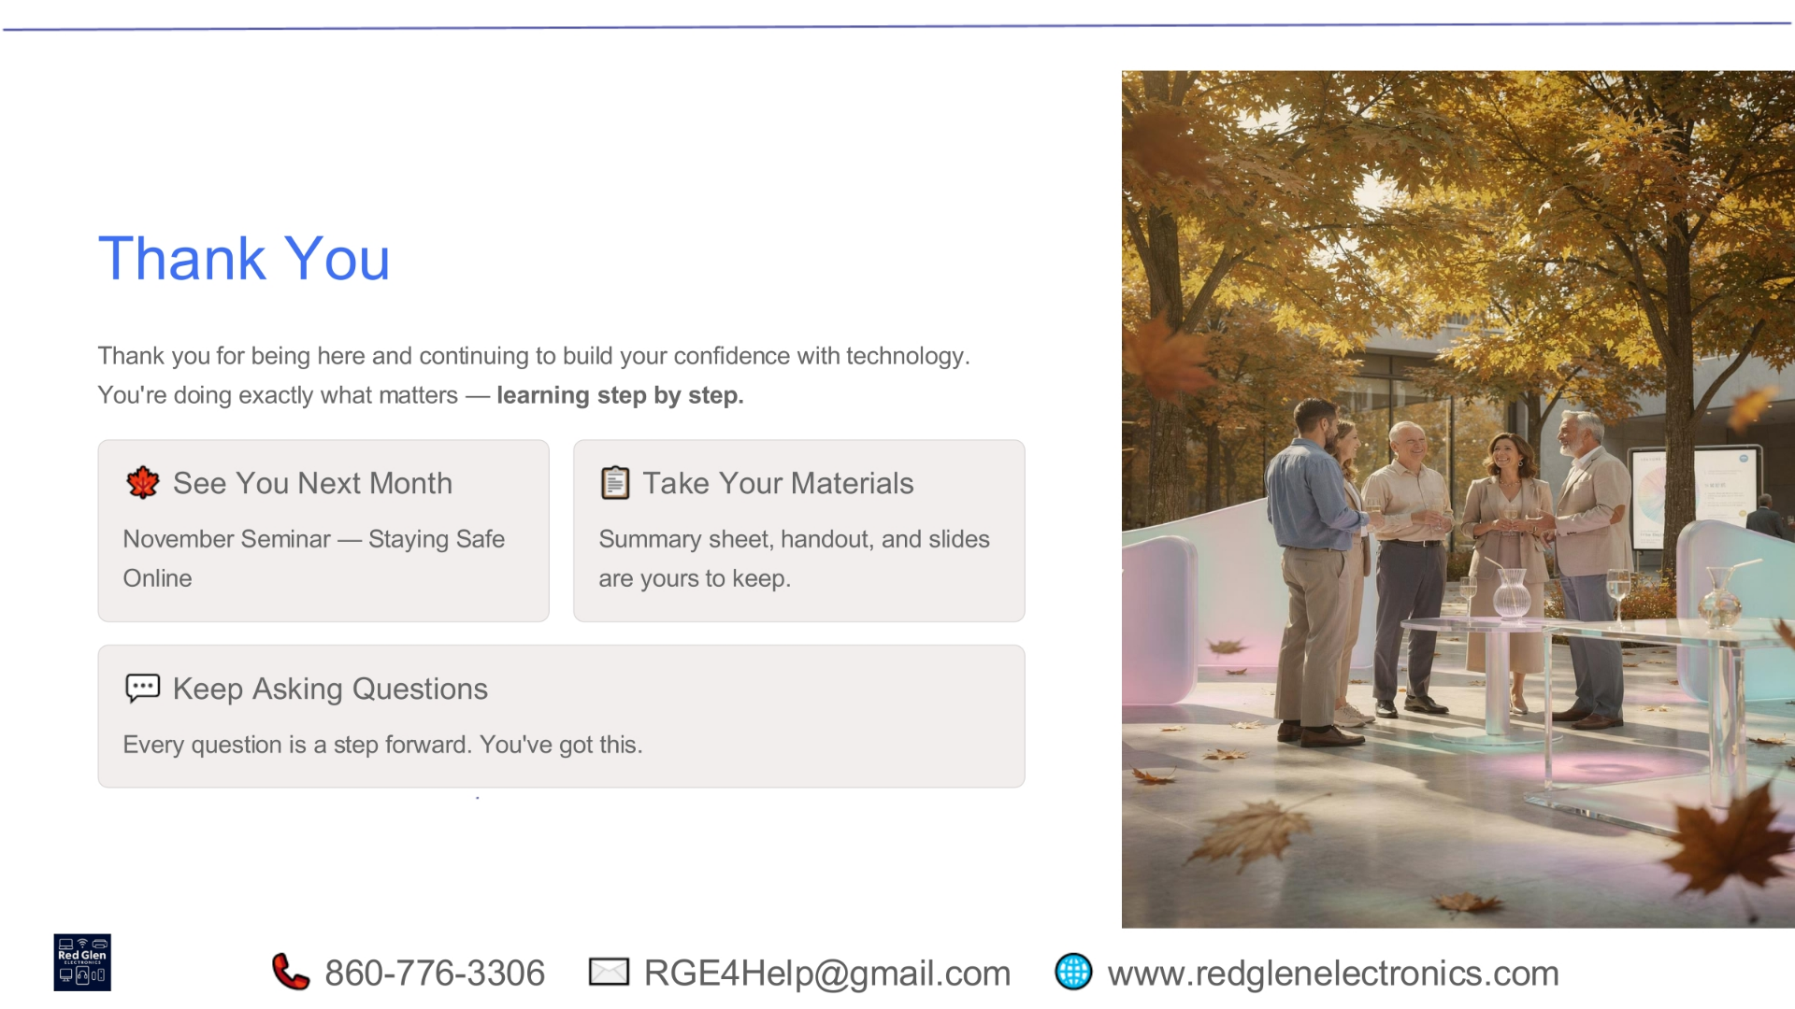
Notes:
Thank you for being here and continuing to build your confidence with technology. We look forward to seeing you next month for our online safety seminar. Please take your materials, and remember, every question is a step forward. You've got this!

Slide 39

Notes:
The cloud offers a powerful and secure solution for storing and accessing digital content, providing benefits like single live versions, constant updates, and simplified sharing over traditional attachments. To effectively leverage its features, users should understand cloud basics, choose a primary system, manage backups mindfully, prioritize account security and online safety, and utilize cloud links for data protection across multiple devices, ensuring their information is always available and accessible.

