Slide 1

Video Calling: Zoom, FaceTime & More
Connecting in High Definition
Reclaiming the "visit" in a digital world
Notes:
Welcome, everyone, and thank you for being here. Today we're discussing video calling—Zoom, FaceTime, and similar tools—but more importantly, we're discussing how to stay connected. This session is about reclaiming the "visit" in the digital world and making technology feel familiar rather than foreign.

Slide 2

Welcome, Cromwell Senior Center Members
A friendly, practical guide to confident digital connection
No jargon. No pressure. No tests.
Notes:
This is a friendly, practical session. There's no jargon, no pressure, and absolutely no tests. You don't need to remember everything today — you just need to feel more comfortable than you did when you walked in.

Slide 3
Meet Jim Kallaugher: CSC Member & Volunteer
Red Glen Electronics
Weekly Tech Tuesdays
Monthly Tech Presentations
Founder and operator, with
friendly “Home Tech Help for Hire” for Boomers.
Volunteer tech support and guidance to community members on Tuesday afternoons.
Conduct tech topic seminars for better understanding & to encourage confidence
With 25+ years of experience making technology clear, simple, and accessible.
Notes:
Hi, I’m Jim Kay-la-her, a Senior Center Member, Volunteer, and Home Tech Support Consultant
Red Glen Electronics:
I founded Red Glen Electronics as a friendly “Home Tech Help for Hire” for Boomers
Tech Tuesdays:
I‘m here every Tuesday afternoon for appointments.
I offer hands-on tech support or one-on-one training as a regular volunteer.
Monthly Tech Seminars:
Every month, I’ll lead tech topic seminars for a better understanding and to encourage confidence

Slide 4
What Today Is
An interactive discussion with practical "how-to" guidance
Step-by-step, at a comfortable pace
Questions encouraged throughout
Notes:
Today's conversation is a mix of hands-on guidance. We'll move step by step, at a comfortable pace, and I'll pause often. Questions are welcome at any time — if you're wondering it, chances are someone else is too.

Slide 5
Validating the Frustration
New technology can feel intimidating
Feeling unsure is normal
We'll walk through this together
Notes:
Let's say this out loud: new technology can feel intimidating. Feeling unsure or hesitant is completely normal. There's nothing wrong with you. We'll walk through this together.

Slide 6
Naming the Elephant
Modern tech assumes you're already an expert
That assumption is wrong
Learning slowly is not failure — it's wisdom
Notes:
Most modern technology assumes you're already an expert. That assumption is wrong. Learning slowly isn't failure — it's wisdom. Confidence comes from understanding, not speed.

Slide 7




The Analog-to-Digital Bridge
From the kitchen wall phone to the slab of glass
Older technology worked in straight lines
We're bringing that logic forward
Notes:
Many of us grew up with technology that worked in straight lines — like the kitchen wall phone. Today's devices are small computers, and they can feel like puzzles. Our goal is to bring that familiar logic forward.

Slide 8
Video Calls Start with an Invitation
Every video call begins with:
a link
a button
or an app icon
You're not late — you're just at the door
Notes:
Every video call begins with an invitation — usually a link, a button, or an app icon. If you ever feel lost, remember: you're not late, and you're not doing anything wrong. You're just standing at the door.

Slide 9
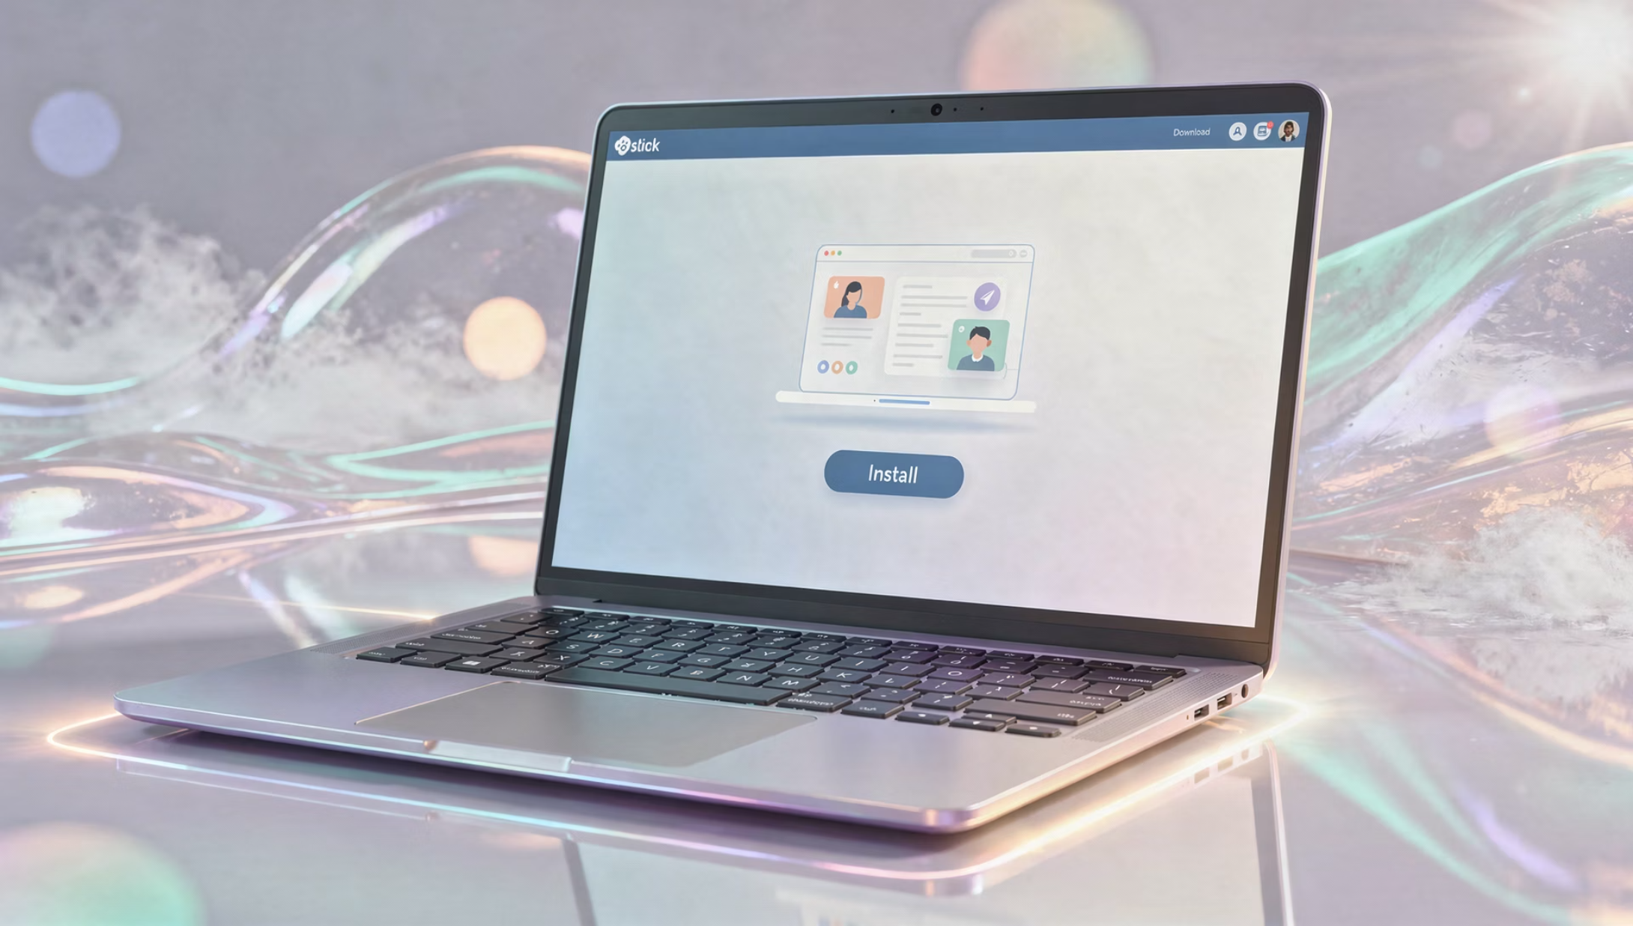
Installing Zoom (Desktop: Windows & Mac)
1
Click the Zoom link you're given
2
Download when prompted
3
Install once — Zoom remembers you
4
Future calls open automatically
Notes:
On a computer, Zoom installs the first time you click a meeting link. You'll download it once, install it once, and after that, Zoom remembers you. Future meetings open automatically.

Slide 10

Installing Zoom (Phone & Tablet)
Open the App Store (Apple) or Play Store (Android)
Search for Zoom
Install once
Zoom works the same across devices
Notes:
On phones and tablets, Zoom comes from the App Store or Play Store. You install it once, just like any other app. After that, it behaves the same way across all devices.

Slide 11
Joining a Zoom Call (Any Device)
Allow camera and microphone
Tap the meeting link
No account required to attend
Choose Join with Audio
If something doesn’t look right, you can always back out and try again.
Notes:
To join a Zoom call, tap the meeting link, allow the camera and microphone, and choose “Join with Audio.” You do not need an account just to attend. And if something doesn’t look right, you can always back out and try again.

Slide 12
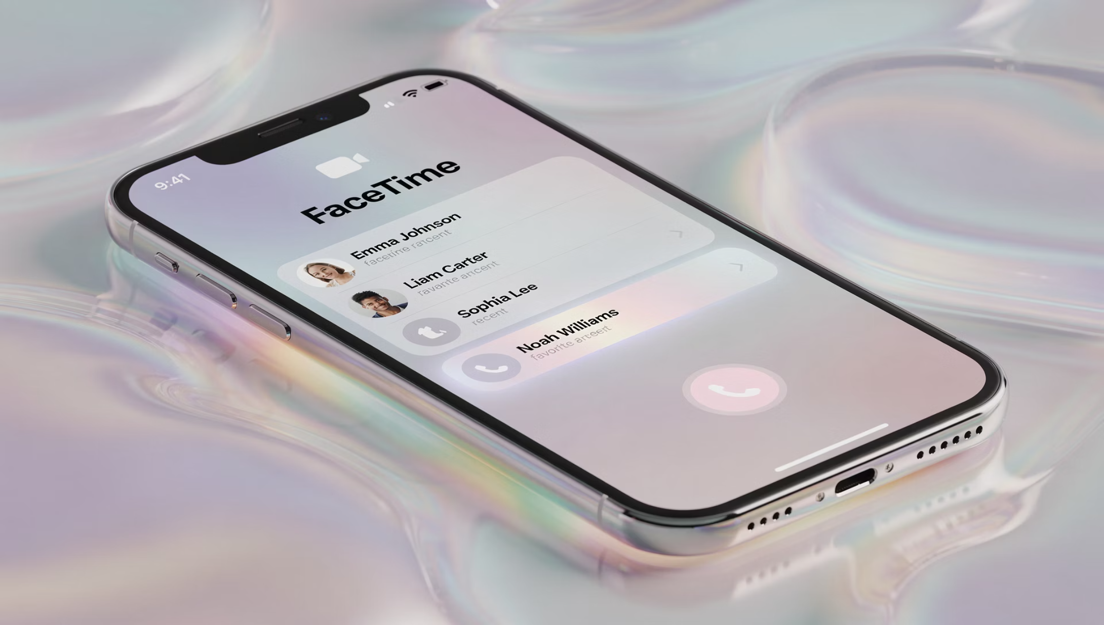
FaceTime on iPhone & iPad
1
Open the FaceTime app
2
Tap New FaceTime
3
Select a contact
4
The call starts immediately
Notes:
FaceTime is built into Apple devices. You open the app, choose a contact, and the call starts immediately. It’s designed for quick, casual visits — like a digital knock on the door.

Slide 13

FaceTime on macOS
1
2
3
4
Open the FaceTime app
Sign in with your Apple ID (one time)
Choose a contact
Click Video
Notes:
On a Mac, FaceTime works the same way. You sign in with your Apple ID once, choose a contact, and click video. Your Mac, iPhone, and iPad can all work together seamlessly.

Slide 14
Zoom vs FaceTime
One-on-one, casual → FaceTime
Groups, meetings, classes → Zoom
Mixed devices → Zoom
Apple-only family chats → FaceTime
Notes:
FaceTime is best for one-on-one, casual conversations with other Apple users. Zoom is better suited for group meetings and mixed-device environments. Neither is better — they're just different tools for different situations.

Slide 15
Choosing the Right Tool
FaceTime is a digital drop-in
Zoom is a reserved table
Casual, spontaneous, personal
Scheduled, structured, group-friendly
Both are useful — choose what fits the moment
Notes:
Think of FaceTime as a drop-in visit and Zoom as a reserved table. Both are useful. The goal is to choose the tool that fits the moment, not to master every option.

Slide 16
Chip's Quick Reference: Getting Into the Call
Look for a link, button, or app
Tap once — don't double-guess
Allow camera and microphone
If stuck, close it and try again
You're not breaking anything — you're just visiting
Notes:
If you remember nothing else, remember this: look for a link, button, or app. Tap once. Allow the camera and microphone. And if you get stuck, close it and try again. You're not breaking anything — you're just visiting.

Slide 17

The Art of Being Seen
Why your environment matters more than the app
Good lighting beats expensive hardware
Notes:
How you appear on a video call matters more than the app itself. Your environment — lighting, camera height, and background — sets the tone of the visit.

Slide 18
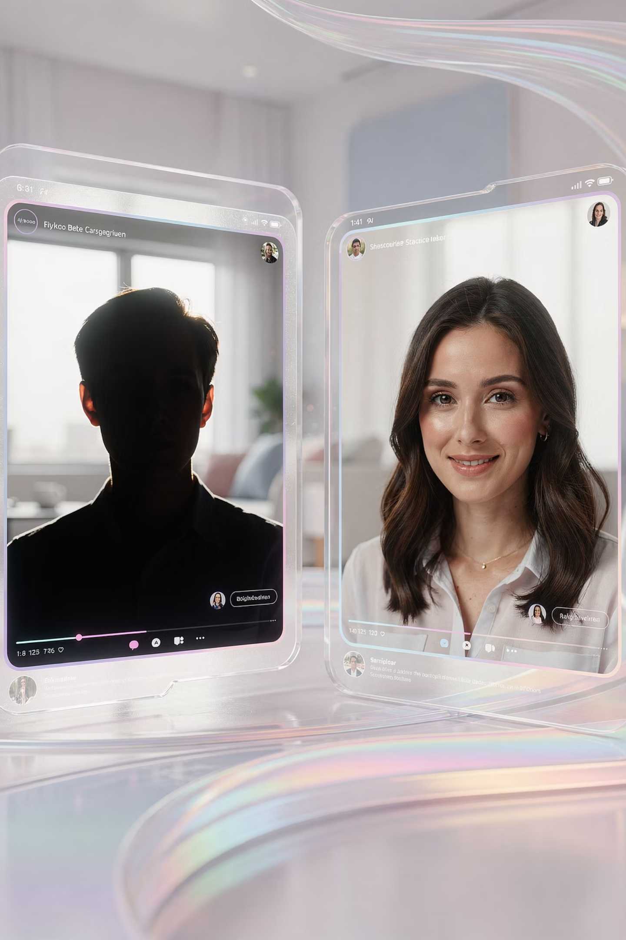



Lighting: Face the Light
Light source in front, not behind
Avoid silhouettes
Clarity creates connection
Notes:
Always place your light source in front of you, not behind. A window or lamp in front of your face makes a huge difference. This single change improves most video calls instantly.

Slide 19



Shadow vs Clarity
Back-lit: distant and shadowy
Front-lit: clear and welcoming
Clarity is what care looks like on screen
Notes:
When light is behind you, the camera can’t see your face clearly. When light is in front, you look warm and present. Clarity is what care looks like on screen.

Slide 20


Camera Height Matters
Talking to the ceiling feels impersonal
Bring the camera to eye level
Books or boxes work just fine
Notes:
When the camera points up at the ceiling, the conversation feels distant. Bringing the camera to eye level—using books or a box—makes the interaction feel human and natural.

Slide 21
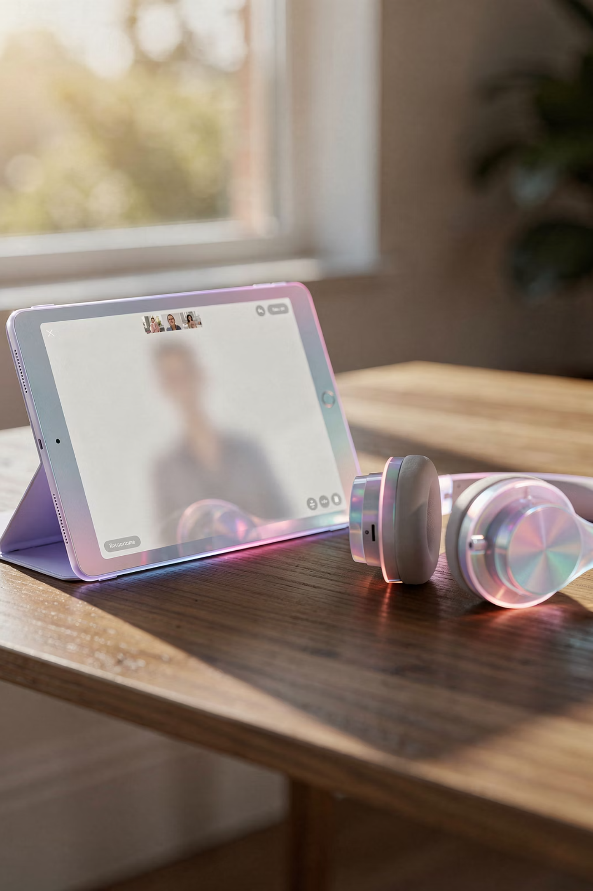
Sound, Etiquette & Confidence on Video
Notes:
. Sound, Etiquette & Confidence on Video

Slide 22


Simple Backgrounds
Busy backgrounds distract
Keep it calm and uncluttered
You are the focus
Notes:
When the camera points up at the ceiling, the conversation feels distant. Bringing the camera to eye level—using books or a box—makes the interaction feel human and natural.

Slide 23

The Sound of Connection
Audio is the hidden half of every call
Clear sound matters more than perfect video
Notes:
Audio is the hidden half of every video call. Clear sound matters more than perfect video. People forgive fuzzy pictures, but not confusing audio

Slide 24
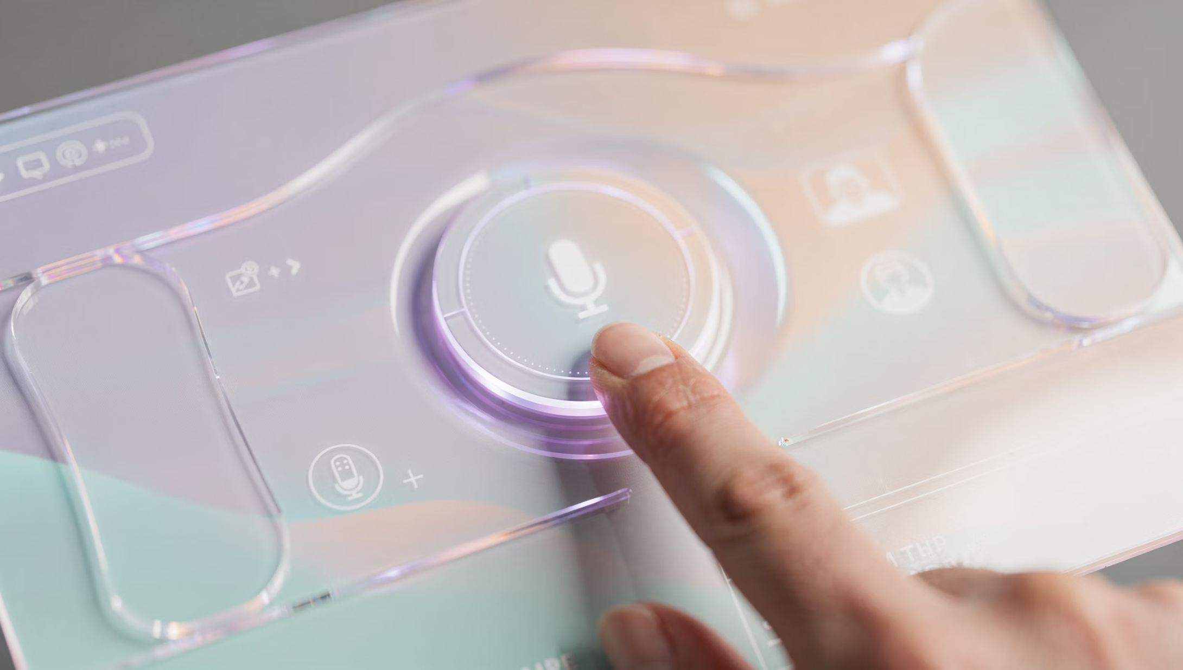
The Mute Button
Mute protects everyone
Think of it as closing the door when a truck drives by
Unmute when speaking
Notes:
Mute is your friend. Think of it as closing the door when a truck drives by. Stay muted when you're not speaking, and unmute when it's your turn.

Slide 25
When to Use Mute
Background noise travels easily
Dogs
Doorbells
TVs
Side conversations
Mute keeps the visit respectful
Notes:
Background noise travels easily — dogs, doorbells, TVs, side conversations. Using mute keeps the visit respectful and focused.

Slide 26
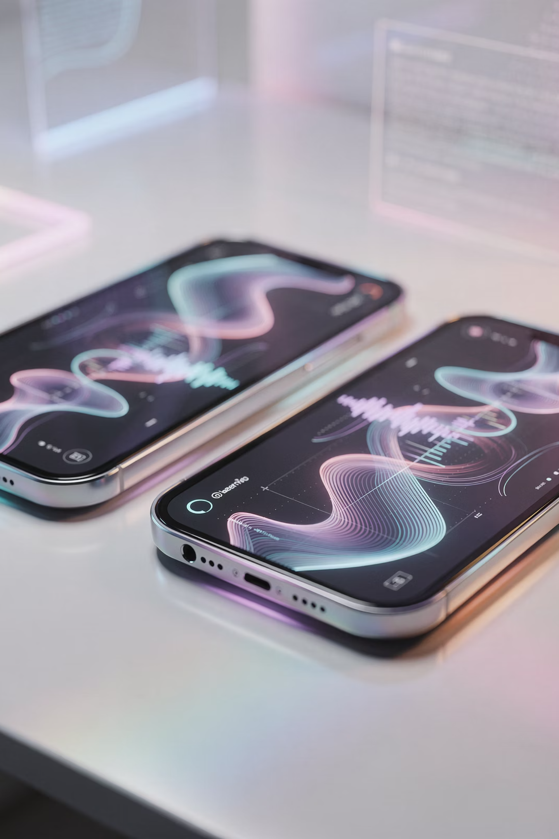
Echoes and Feedback
Two devices in one room will fight each other
This is physics — not user error
Turn volume off on one device
Notes:
If two devices are in the same room on the same call, they’ll create echoes or squealing sounds. This is physics, not user error. Turning the volume off on one device fixes it.

Slide 27
Video Etiquette
Being present in a digital room
Moving from "user" to "guest"
Notes:
Video calls are shared spaces. Being present, attentive, and respectful turns you from a “user” into a guest in a digital room.

Slide 28

Eye Contact on Video
Look at the camera, not yourself
The lens is the other person's eye
It feels strange — but it works
Notes:
t feels natural to look at your own face, but eye contact happens when you look at the camera lens. It may feel odd at first, but it creates a genuine connection.

Slide 29

Staying Grounded
Avoid walking around with the phone
Shaky video makes viewers uncomfortable
Set the device down when possible
Notes:
Walking around with a phone makes viewers uncomfortable. If you need to move, do it slowly. When possible, set the device down so the picture stays steady.

Slide 30



The Early Bird Advantage
Join five minutes early
Check lighting and sound
Settle in before the visit begins
Notes:
Joining five minutes early gives you time to check lighting, sound, and comfort. That small cushion reduces stress and builds confidence.

Slide 31

When Technology Trips
Freezes and glitches happen
It's usually the internet — not you
Pause before reacting
Notes:
Freezes and glitches happen. Most of the time it’s the internet, not you. Pause for a moment before reacting.

Slide 32
The Restart Rule
Turning it off and back on still works
Leave and re-join
If something feels stuck
Notes:
If something feels stuck, leave the call and re-join. Turning it off and back on still works — even after decades in IT.

Slide 33
Discussion & Questions
Your turn
No question is too small
We learn in layers
Notes:
Now it's your turn. No question is too small. Learning happens in layers, and curiosity is always welcome.

Slide 34

Admitting We're Human
No one knows everything
Honesty beats pretending
We'll figure it out together
Notes:
No one knows everything. Honesty beats pretending. If we don't know an answer, we'll find it together.

Slide 35

Case Study: The Grandparent Connection
A tablet without coaching becomes a puzzle
1
2
With guidance, it becomes a lifeline
Confidence is the goal
3
Notes:
A tablet without guidance becomes a puzzle. With hands-on coaching, it becomes a lifeline. Confidence — not perfection — is the goal.

Slide 36
The Video Call Victory Checklist
Face the light
Camera at eye level
Use mute wisely
Choose the right tool
Notes:
Face the light.
Camera at eye level.
Use mute wisely.
Choose the right tool.

Slide 37

We've Got Your 6
You're not doing this alone
Support continues beyond today
RGE is your wingman
Notes:
You're not doing this alone. Red Glen Electronics is your wingman, and support doesn't stop when the seminar ends.

Slide 38
Curiosity Is a Virtue
Ask "why"
Ignore jargon
Understanding builds confidence
Notes:
Keep asking why. Ignore jargon. Understanding builds confidence over time.

Slide 39
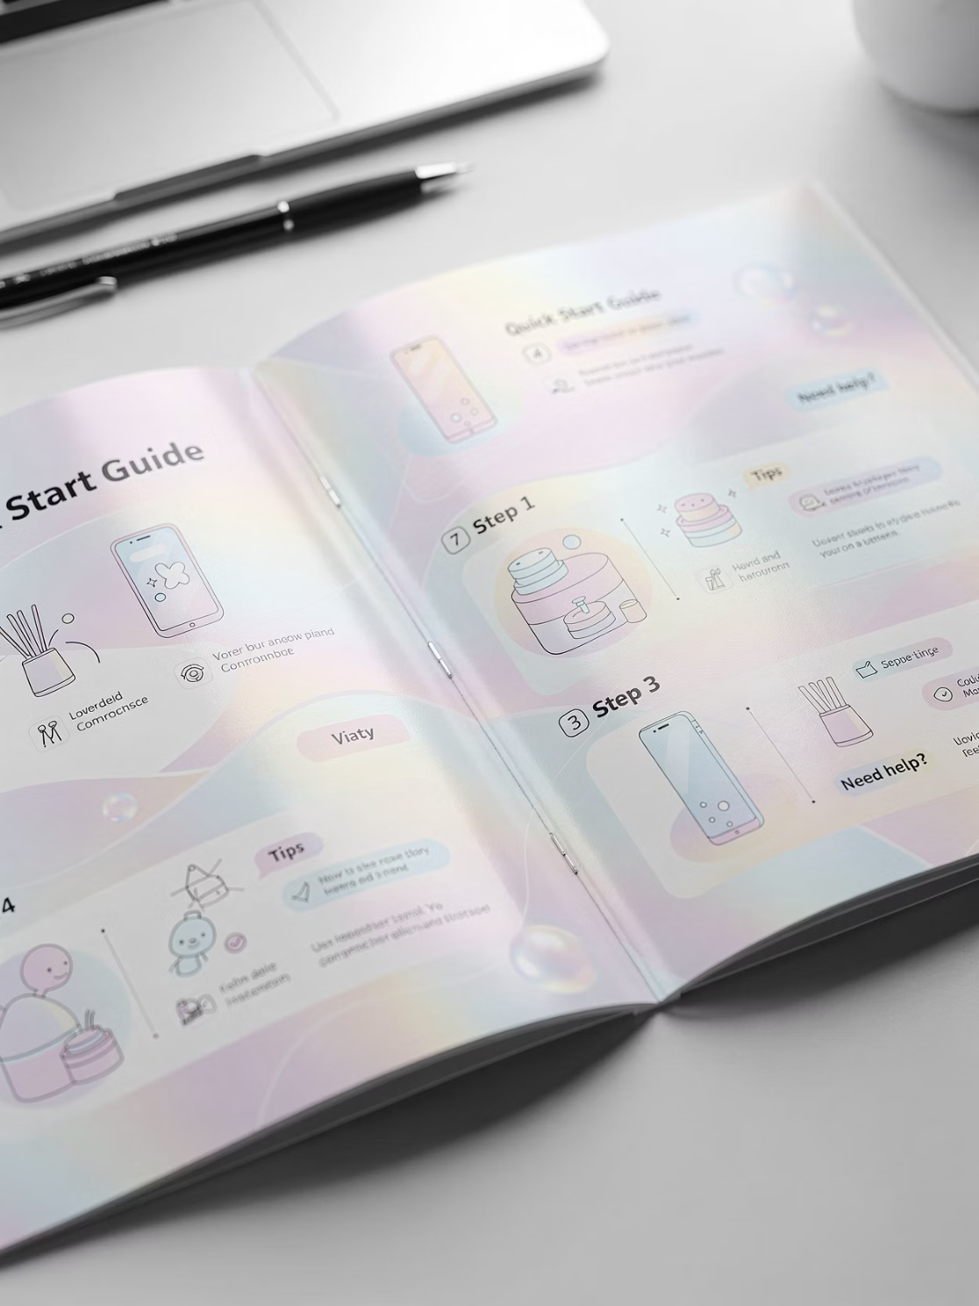
Clarity Is Care
Clear instructions reduce anxiety
Technology should serve you
Not the other way around
Notes:
Clear instructions reduce anxiety. Technology should serve you — not the other way around.

Slide 40
Thank You for Your Time
You showed up
You learned something new
That matters
Notes:
ou showed up. You learned something new. That matters.

Slide 41

Next Steps
Practice with someone you trust
Try one improvement at a time
Progress beats perfection
Go call someone you love
Technology is just the bridge
Notes:
Practice with someone you trust. Try one improvement at a time. Progress beats perfection.
Go call someone you love. Technology is just the bridge.

