Slide 1
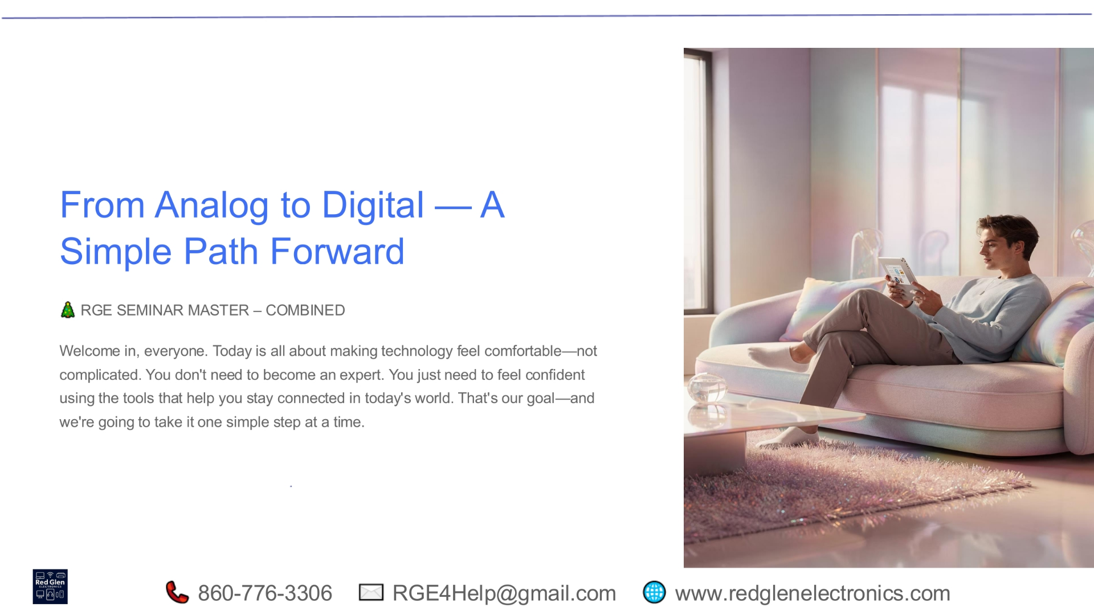
Notes:
Welcome to our seminar, 'From Analog to Digital: A Simple Path Forward.' Our goal today is to make technology feel comfortable and accessible, not complicated. You don't need to be an expert; you just need confidence in using tools that keep you connected. We'll guide you through this journey one simple step at a time, ensuring you feel empowered in today's digital world.

Slide 2
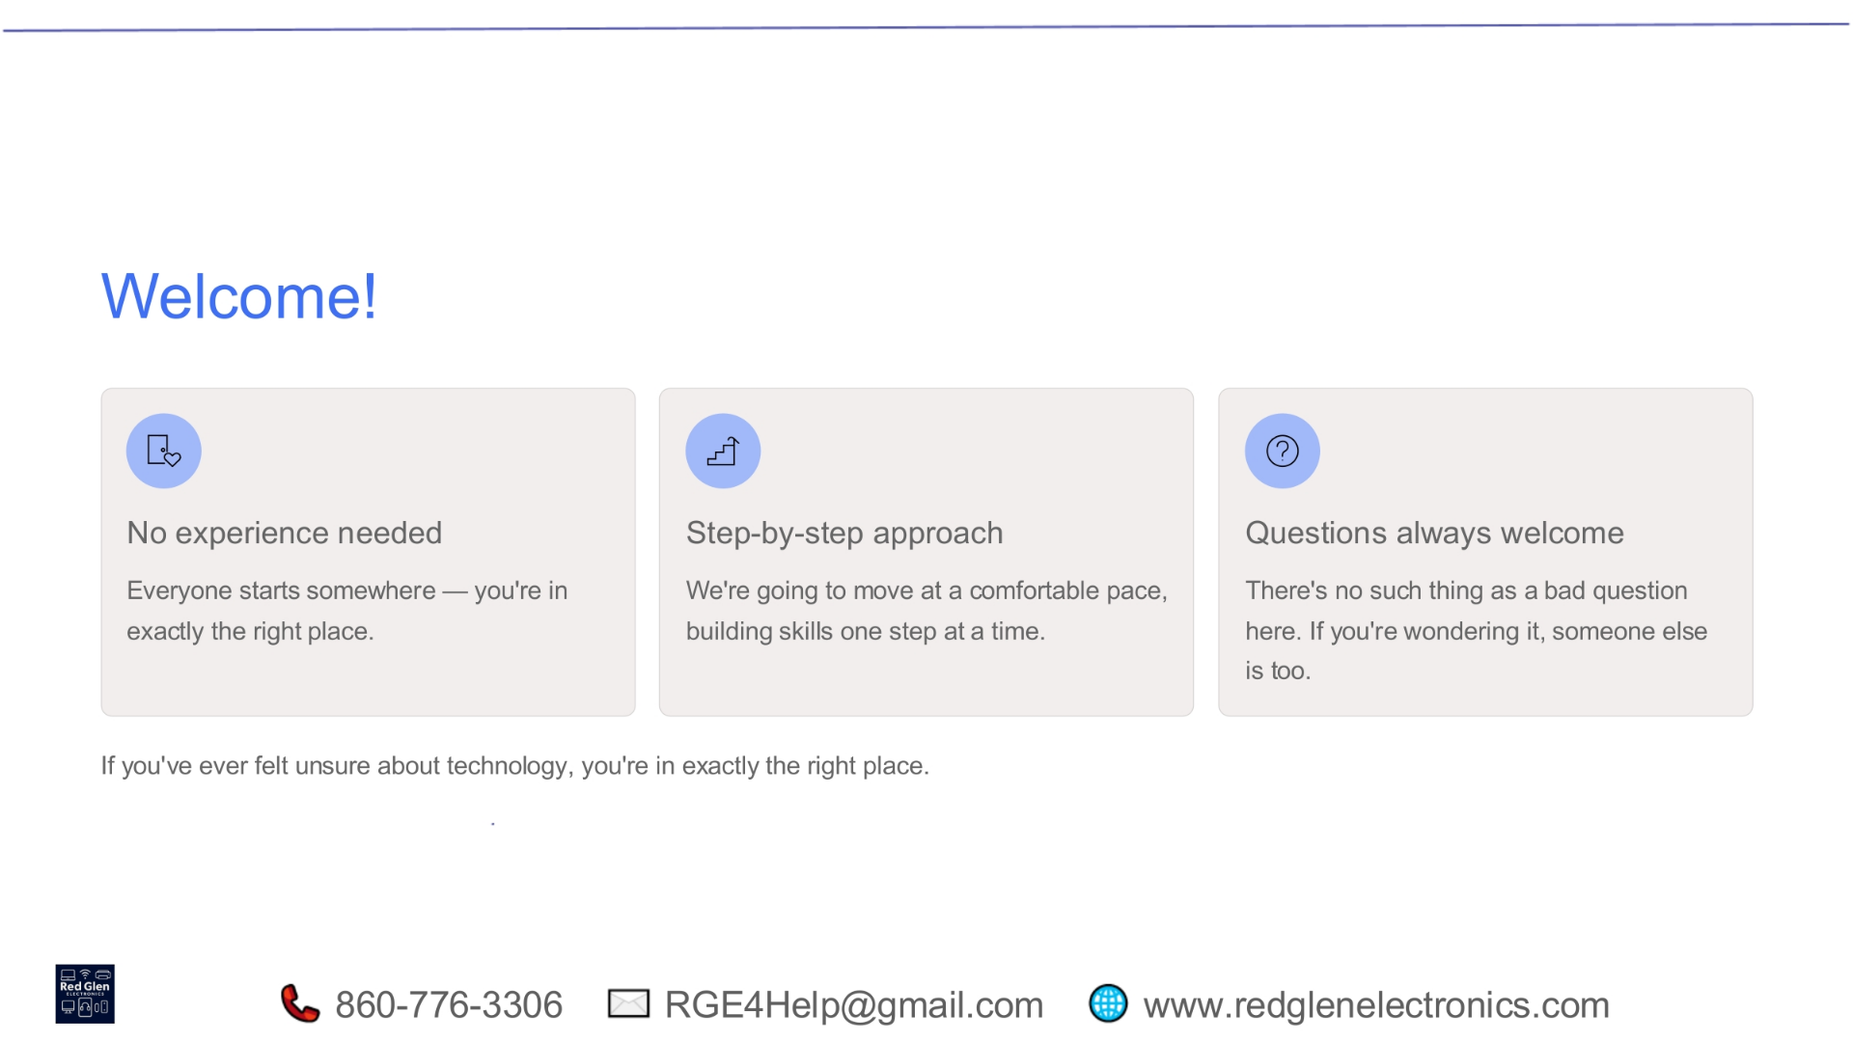
Notes:
We extend a warm welcome to everyone joining us. There's no need for prior experience; everyone starts somewhere, and you're in exactly the right place to begin your digital journey. We'll adopt a comfortable, step-by-step approach, building your skills gradually. Remember, questions are always welcome here; if you're wondering about something, chances are someone else is too.

Slide 3
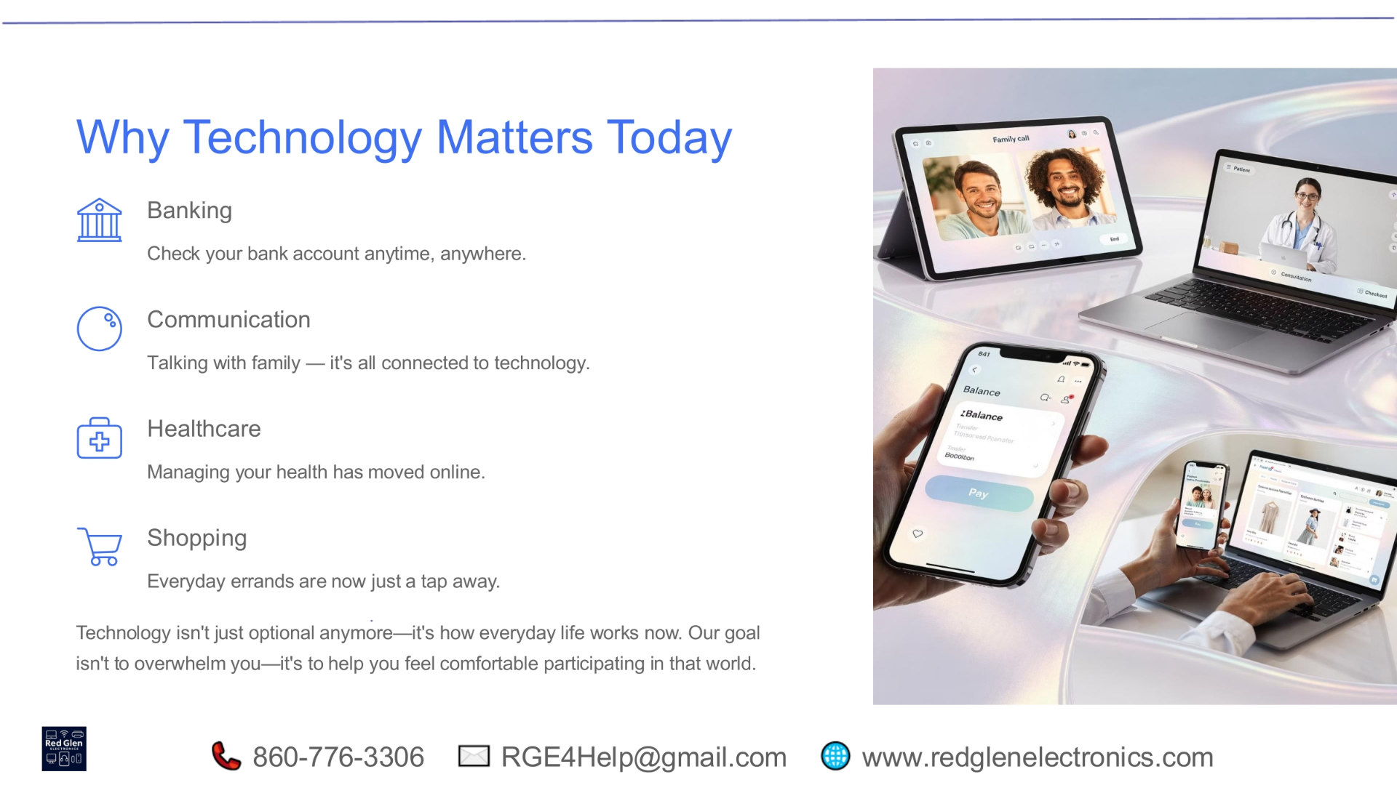
Notes:
Technology is no longer optional; it's integrated into nearly every aspect of our daily lives. From managing your banking and staying in communication with family, to overseeing your healthcare and handling everyday shopping, digital tools make these tasks simpler and more convenient. Our aim is to help you comfortably participate in this evolving world without feeling overwhelmed.

Slide 4
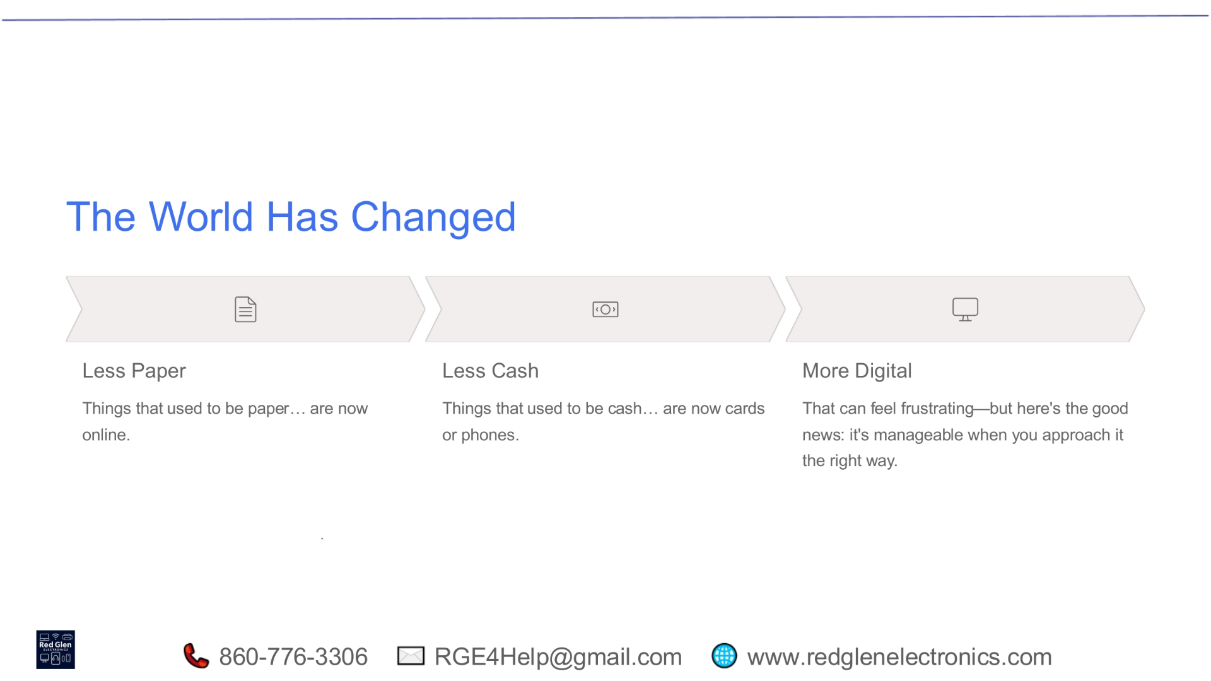
Notes:
The way we interact with the world has fundamentally changed. We've moved from relying on physical paper documents to digital files, and from using cash to preferring cards or mobile payments. This shift to a more digital environment might seem daunting, but the good news is that it's entirely manageable when approached with the right mindset and tools.

Slide 5
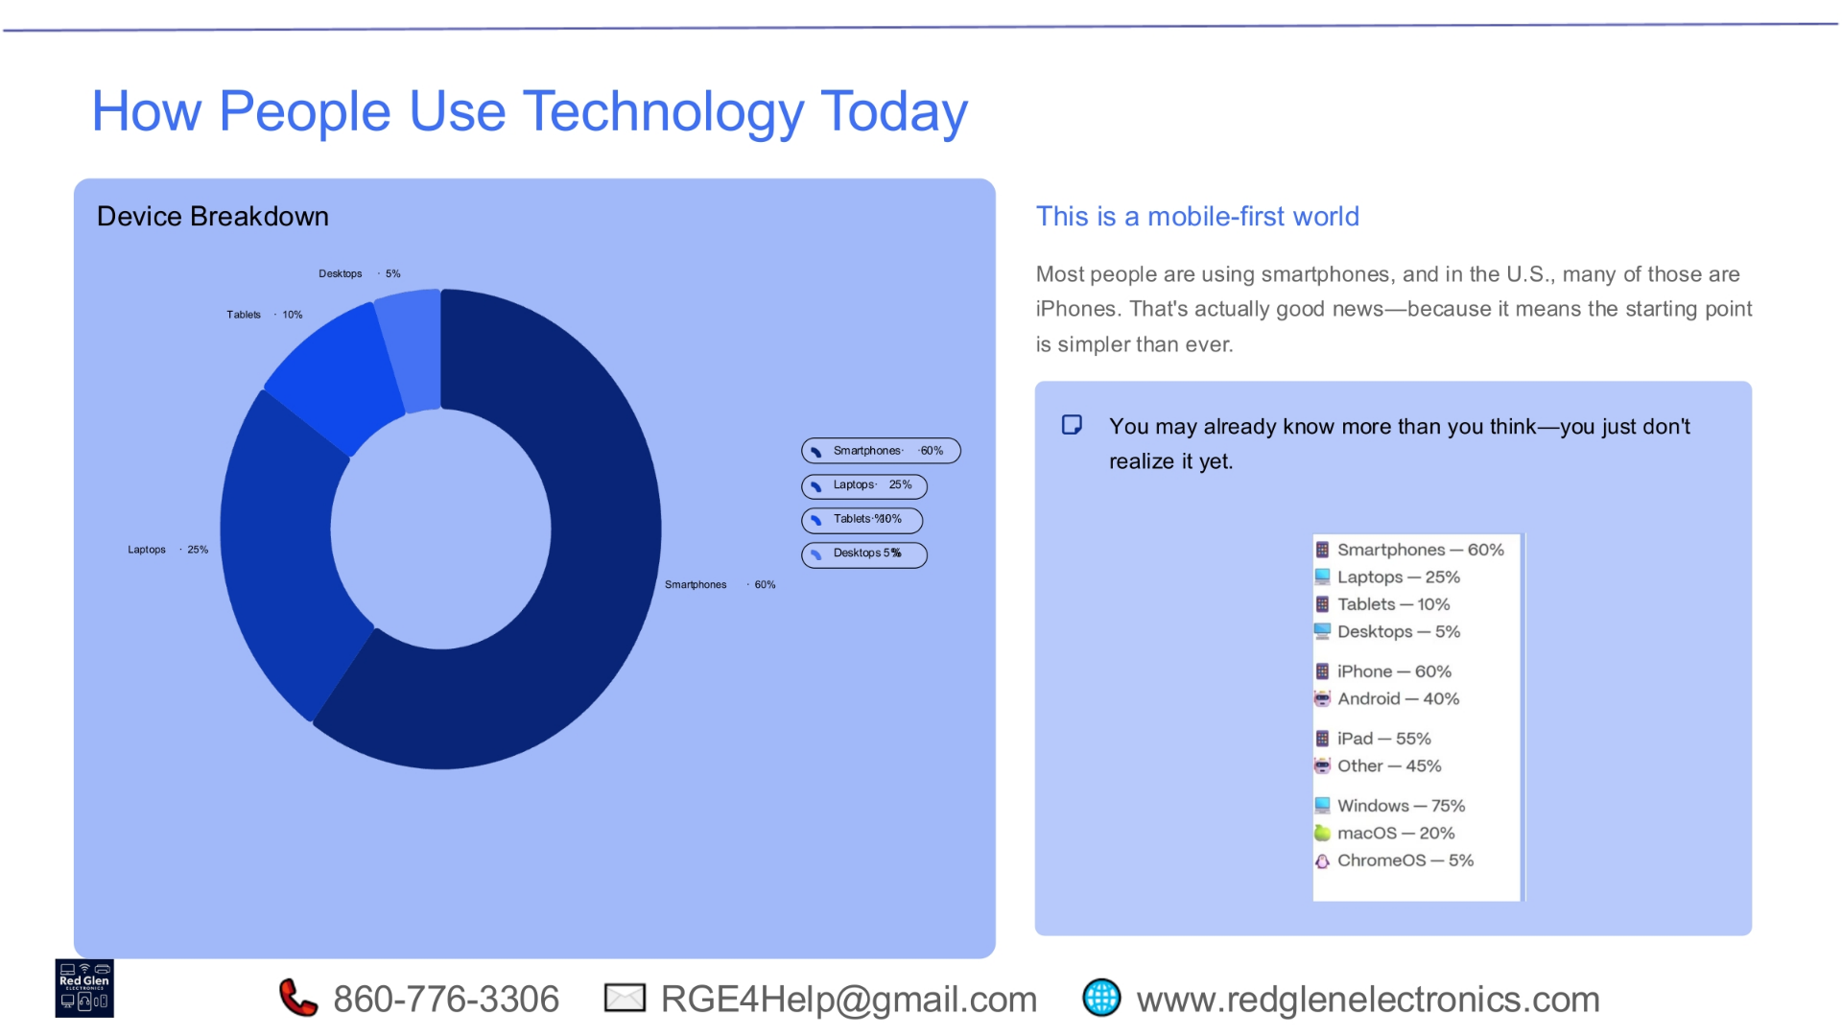
Notes:
Today's world is largely mobile-first, with smartphones being the most common device, accounting for 60% of usage. Laptops follow at 25%, tablets at 10%, and desktops at 5%. This prevalence of smartphones, especially iPhones in the U.S., simplifies the starting point for many. You likely already possess more technological understanding than you realize, and we're here to help you unlock that potential.

Slide 6
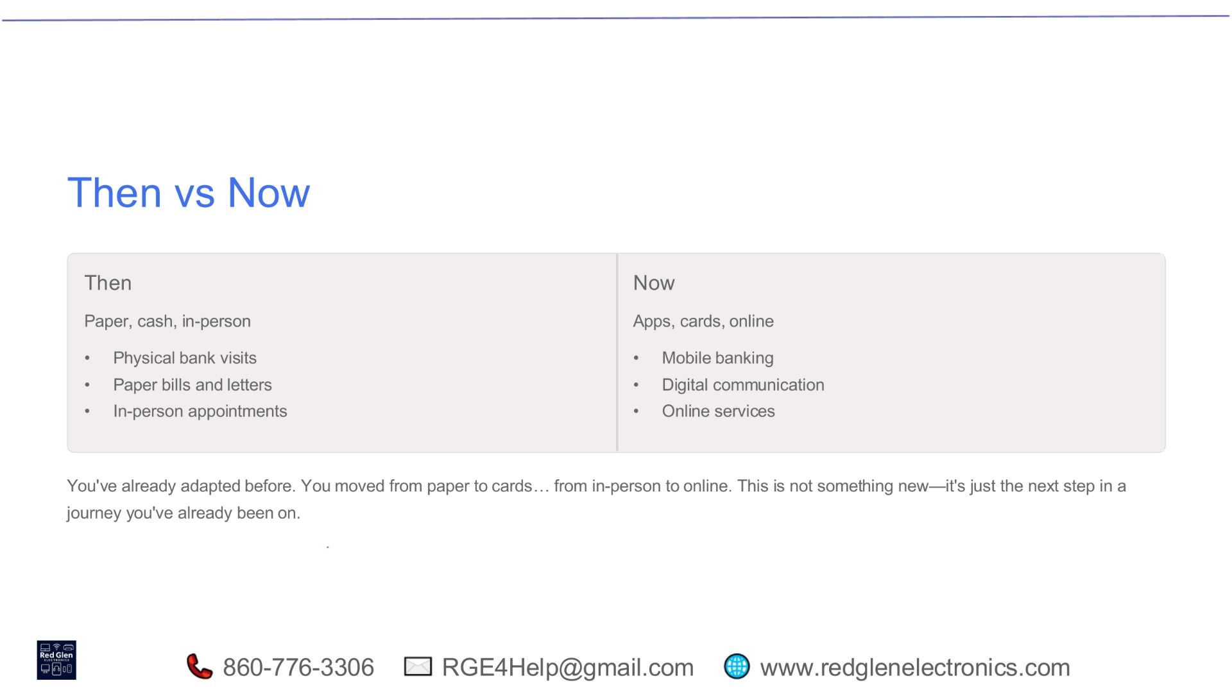
Notes:
Consider how much has changed from 'then' to 'now.' We've transitioned from physical bank visits, paper bills, and in-person appointments to mobile banking, digital communication, and a wide array of online services. This isn't a completely new journey; you've already adapted from paper to cards and from in-person interactions to online. This is simply the next logical step in that ongoing evolution.

Slide 7
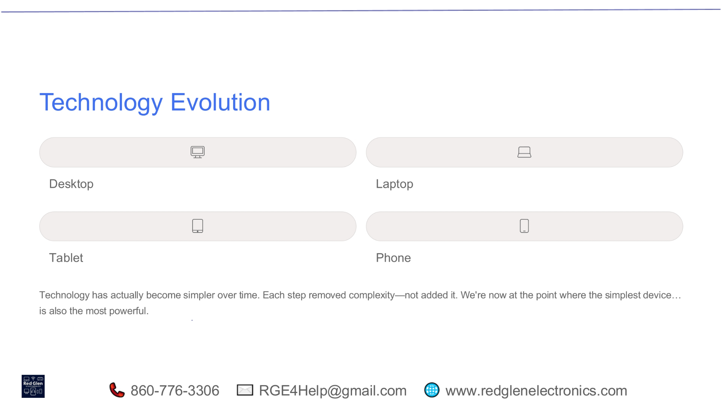
Notes:
Technology has actually become simpler over time, not more complex. Each evolutionary step, from desktops to laptops, then to tablets, and finally to phones, has removed complexity rather than adding it. We've reached a point where the simplest device, the smartphone, is also incredibly powerful, offering immense capabilities in a user-friendly package.

Slide 8
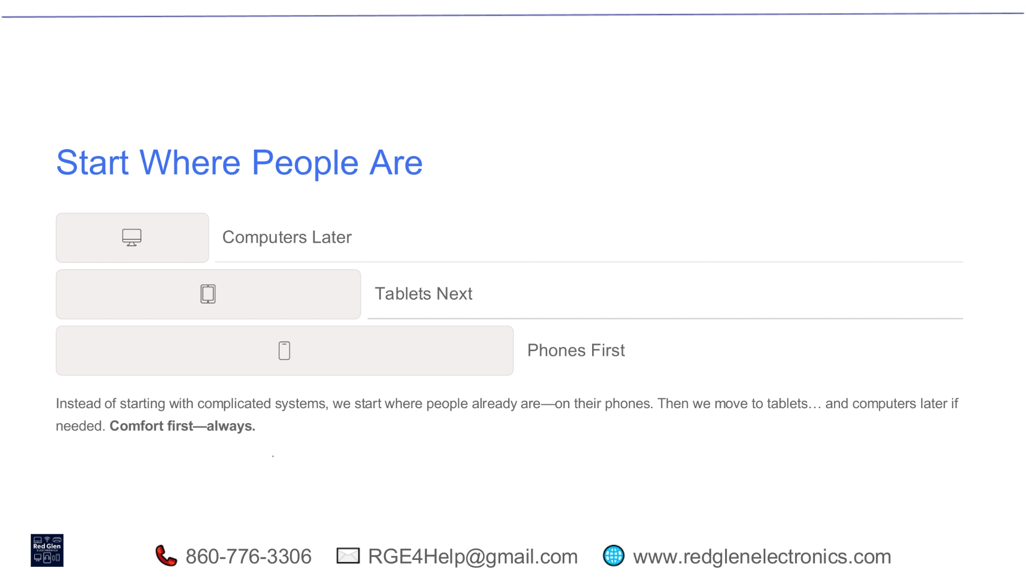
Notes:
Our approach prioritizes comfort and familiarity. Instead of diving into complicated systems, we begin where most people already are: with their phones. Once comfortable there, we can gradually move to tablets, and then to computers if needed. This strategy ensures that learning feels natural and intuitive, always putting your comfort first.

Slide 9
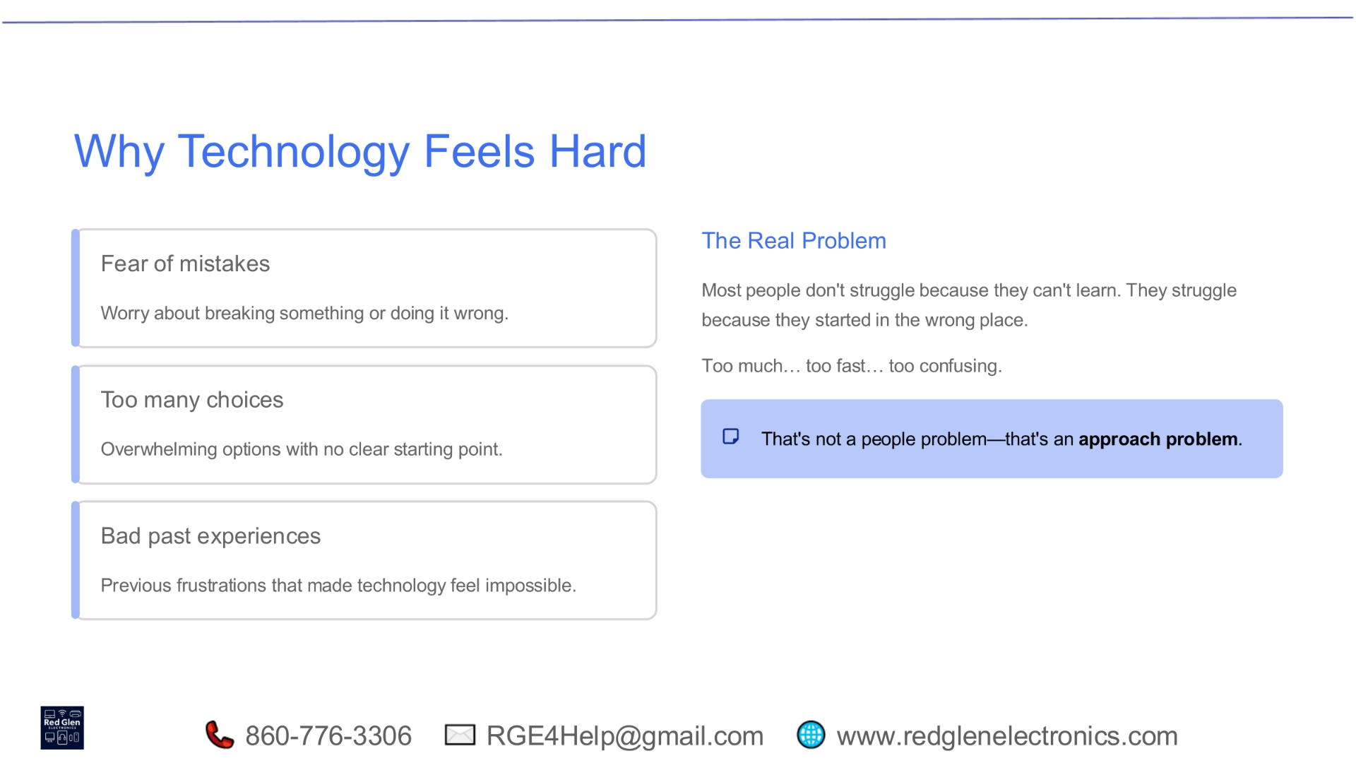
Notes:
Many people find technology challenging due to a fear of making mistakes, the overwhelming number of choices, or negative past experiences. The real problem isn't a lack of ability to learn, but rather starting in the wrong place, encountering too much information too quickly, or finding it too confusing. This isn't a personal failing; it's an issue with the approach to learning.

Slide 10
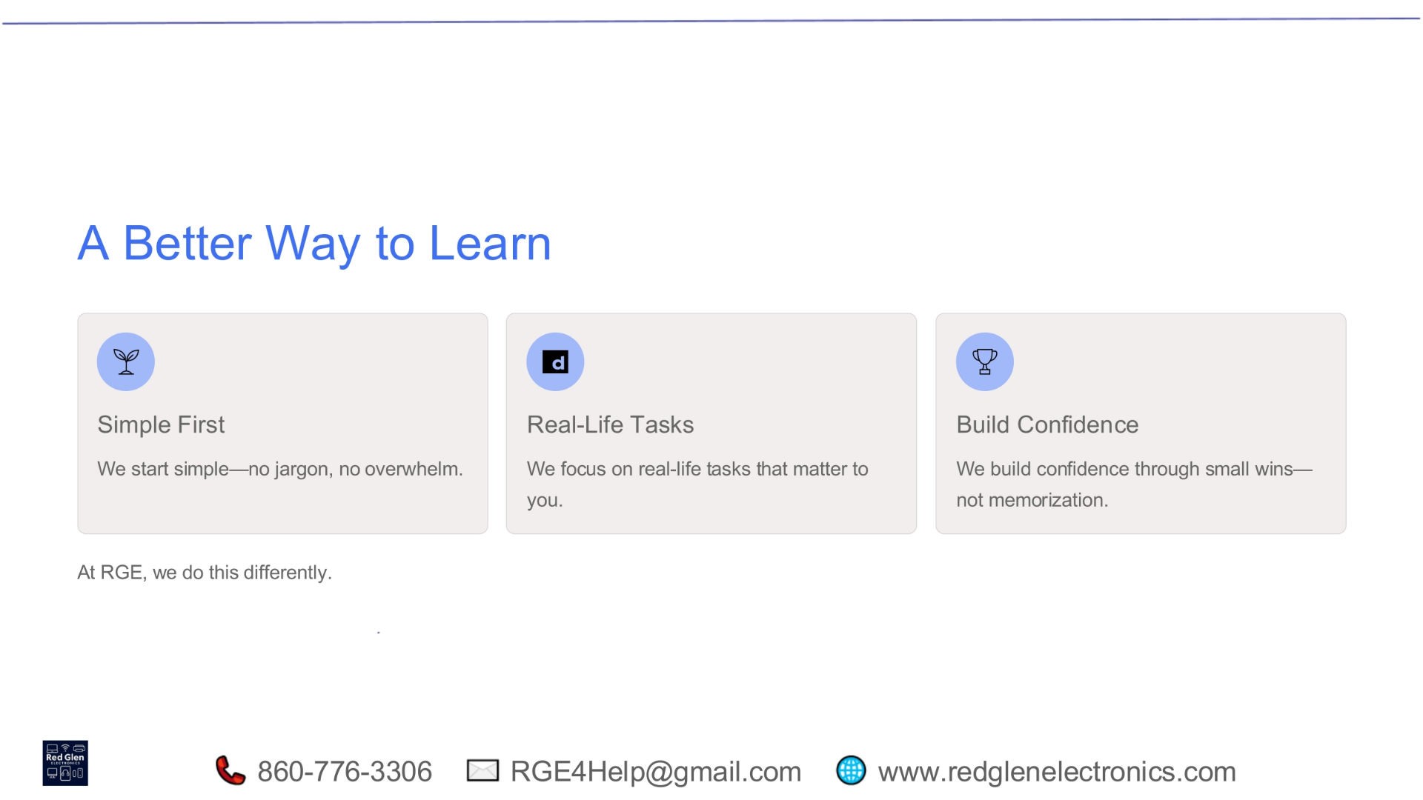
Notes:
At RGE, we offer a different, more effective way to learn. We start simple, avoiding jargon and overwhelm. Our focus is on real-life tasks that genuinely matter to you, making the learning relevant and practical. This method helps build confidence through small, achievable wins, rather than relying on rote memorization.

Slide 11
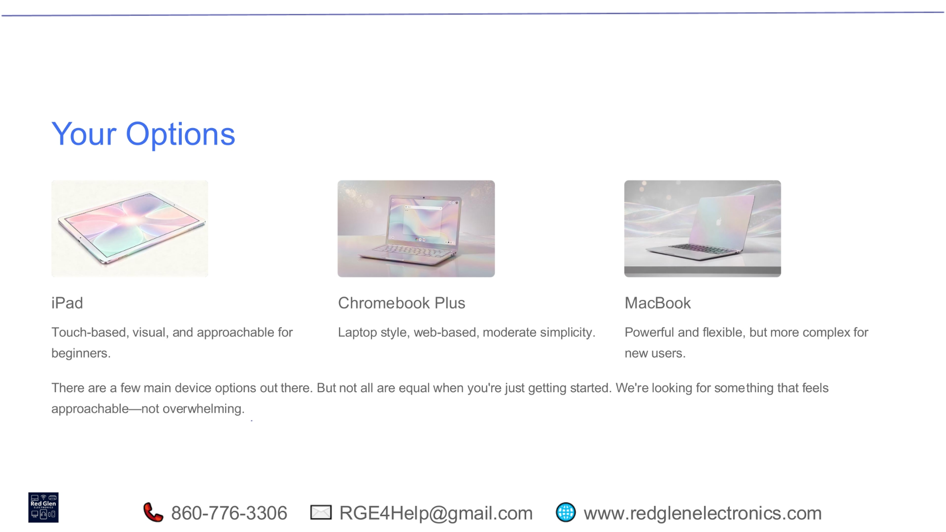
Notes:
When considering your device options, there are a few main choices, but not all are ideal for beginners. The iPad is touch-based, visual, and highly approachable. Chromebook Plus offers a laptop-style, web-based experience with moderate simplicity. MacBooks are powerful and flexible, but generally more complex for new users. We aim to help you find a device that feels approachable, not overwhelming.

Slide 12
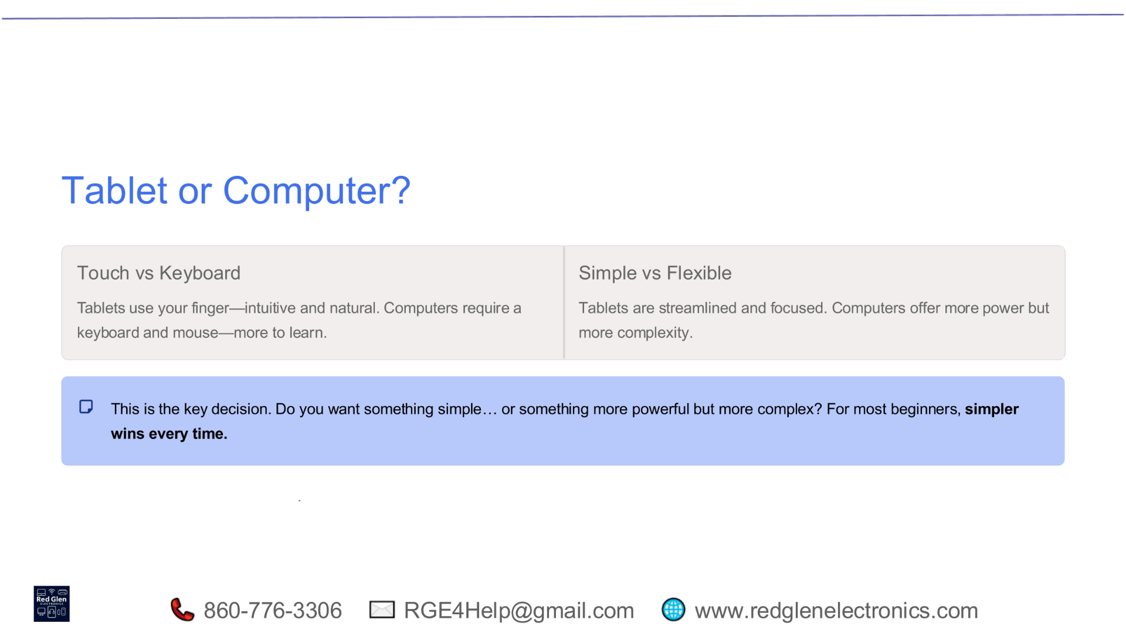
Notes:
A key decision point is choosing between a tablet and a computer. Tablets are touch-based, intuitive, and natural to use, while computers require a keyboard and mouse, which can involve a steeper learning curve. Tablets are streamlined and focused, whereas computers offer more power but also greater complexity. For most beginners, simplicity is the winning factor every time.

Slide 13
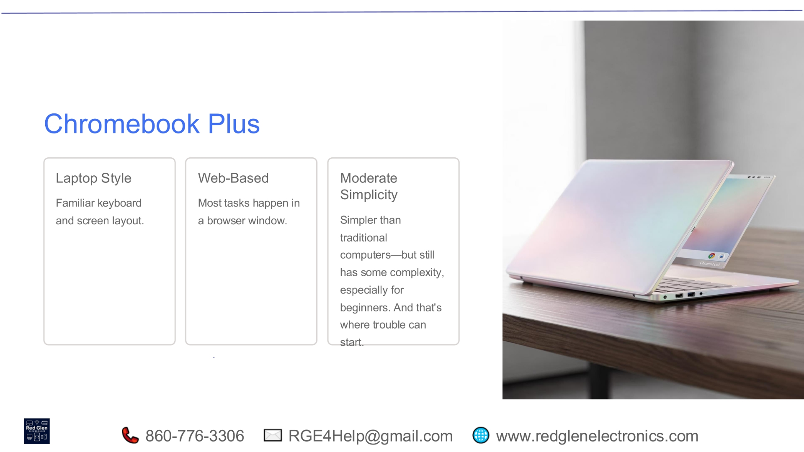
Notes:
The Chromebook Plus offers a familiar laptop-style experience with a traditional keyboard and screen layout. It's primarily web-based, meaning most tasks are performed within a browser window. While simpler than traditional computers, it still presents some complexity, especially for beginners, which can sometimes lead to initial difficulties.

Slide 14
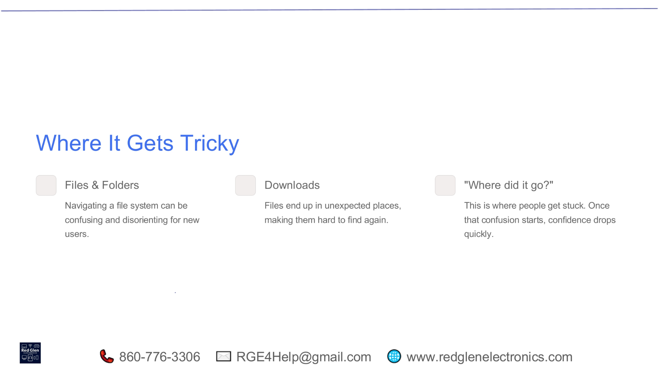
Notes:
Technology can become tricky when dealing with files and folders, as navigating a complex file system can be confusing and disorienting for new users. Downloads often end up in unexpected places, making them hard to locate again. This common frustration, often expressed as 'Where did it go?', can quickly erode confidence once confusion sets in.

Slide 15
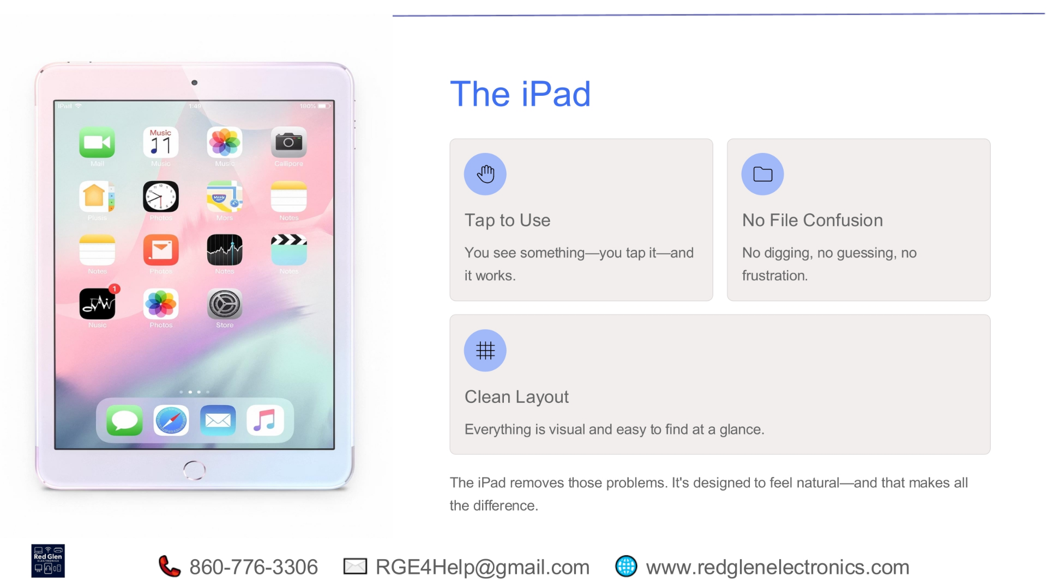
Notes:
The iPad is built to overcome common technological challenges. It's very intuitive: you see something, tap it, and it works. This prevents file confusion, so there's no searching, guessing, or frustration. With its simple, visual layout, everything is easy to locate instantly. The iPad's natural design greatly enhances user experience.

Slide 16
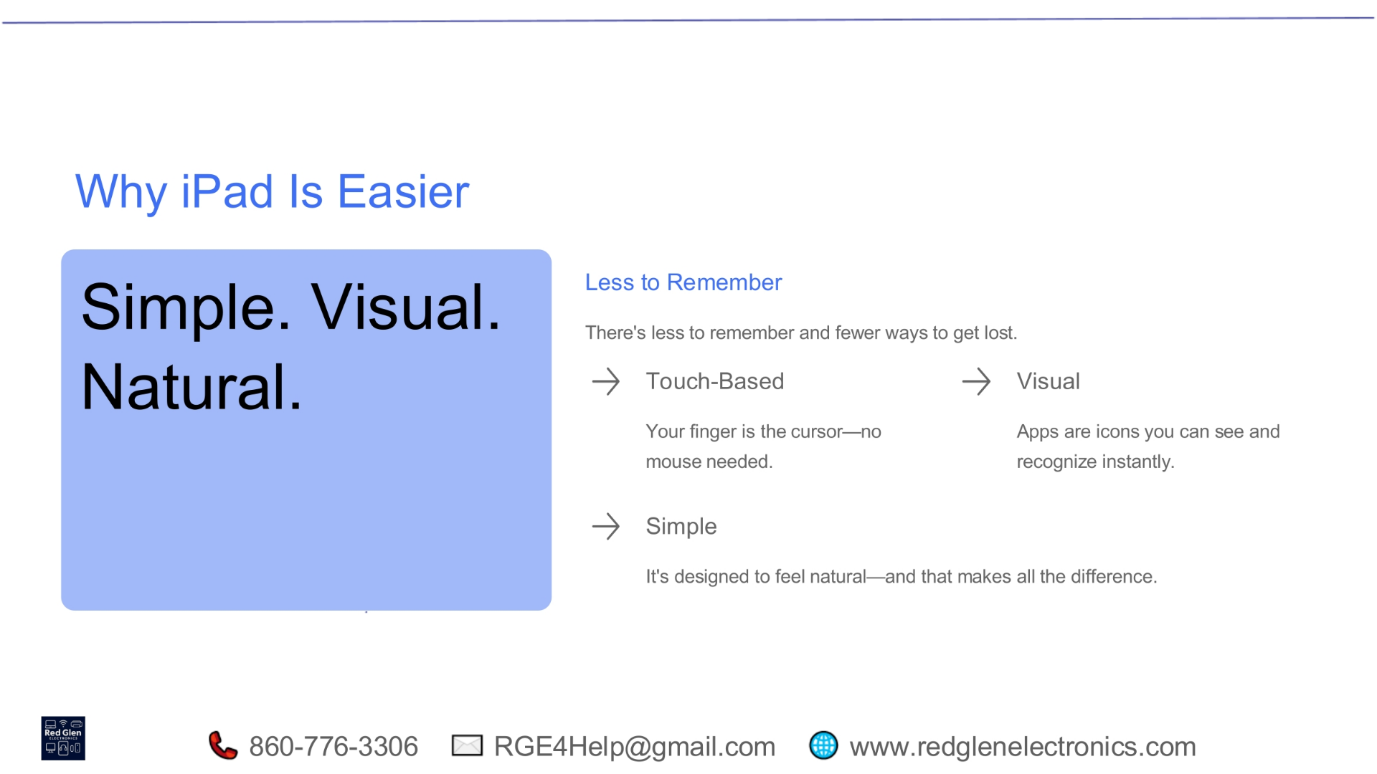
Notes:
The iPad's ease of use stems from its simple, visual, and natural design, which means there's less to remember and fewer ways to get lost. It's touch-based, so your finger acts as the cursor, eliminating the need for a mouse. Apps are represented by clear icons you can recognize instantly. This natural and intuitive design truly makes all the difference for users.

Slide 17
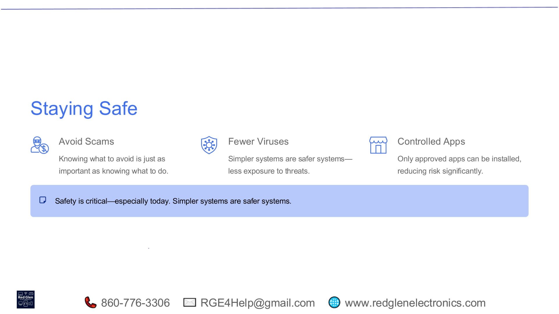
Notes:
Staying safe online is critically important today. It's essential to know what to avoid, just as much as knowing what to do. Simpler systems, like the iPad, inherently offer fewer viruses and less exposure to threats. Additionally, controlled app environments, where only approved applications can be installed, significantly reduce security risks. Simpler systems are indeed safer systems.

Slide 18
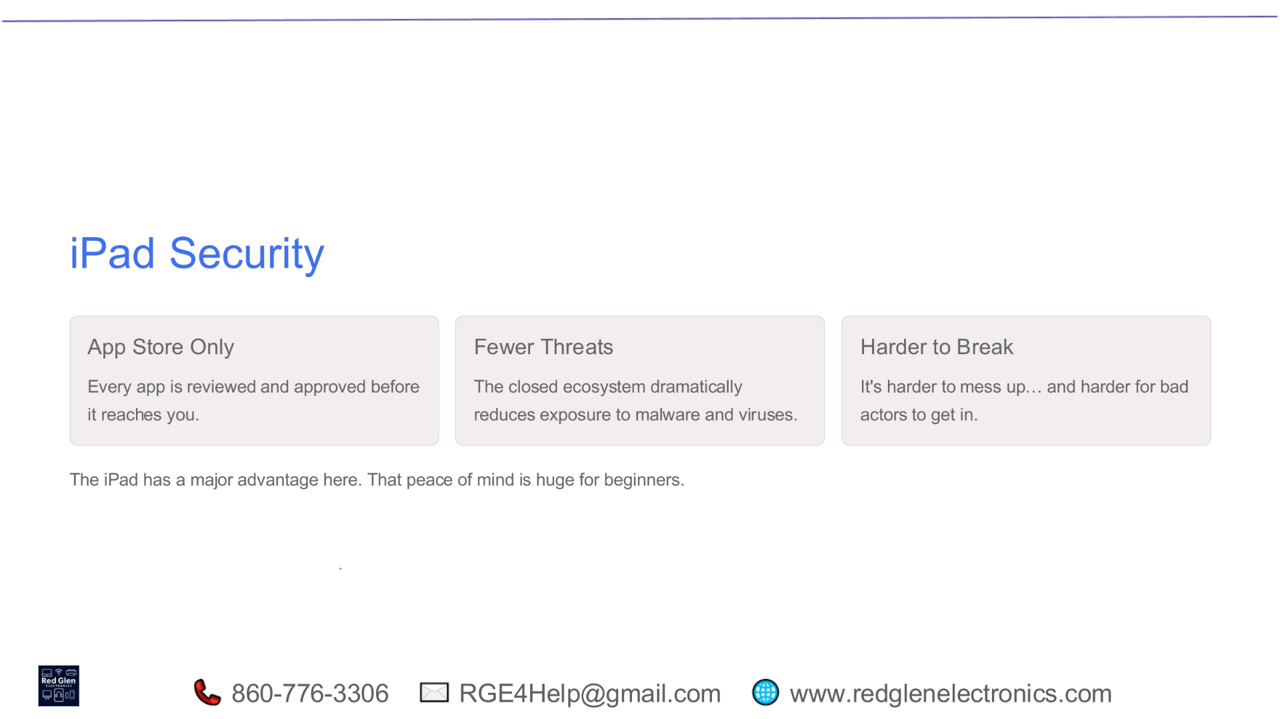
Notes:
iPad security offers significant advantages, providing great peace of mind for beginners. All apps are available exclusively through the App Store, where every application is reviewed and approved before it reaches you. This closed ecosystem dramatically reduces exposure to malware and viruses, making it much harder for things to go wrong or for malicious actors to gain access.

Slide 19
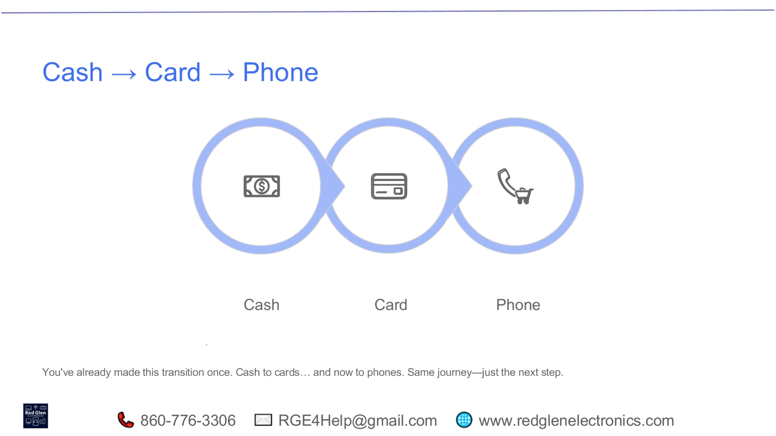
Notes:
You've already navigated similar transitions in your life. Think about how you moved from using cash to relying on cards, and now, increasingly, to using your phone for payments. This progression from cash to cards and then to phones is the same journey of adapting to new technology; it's simply the next logical step in that familiar process.

Slide 20
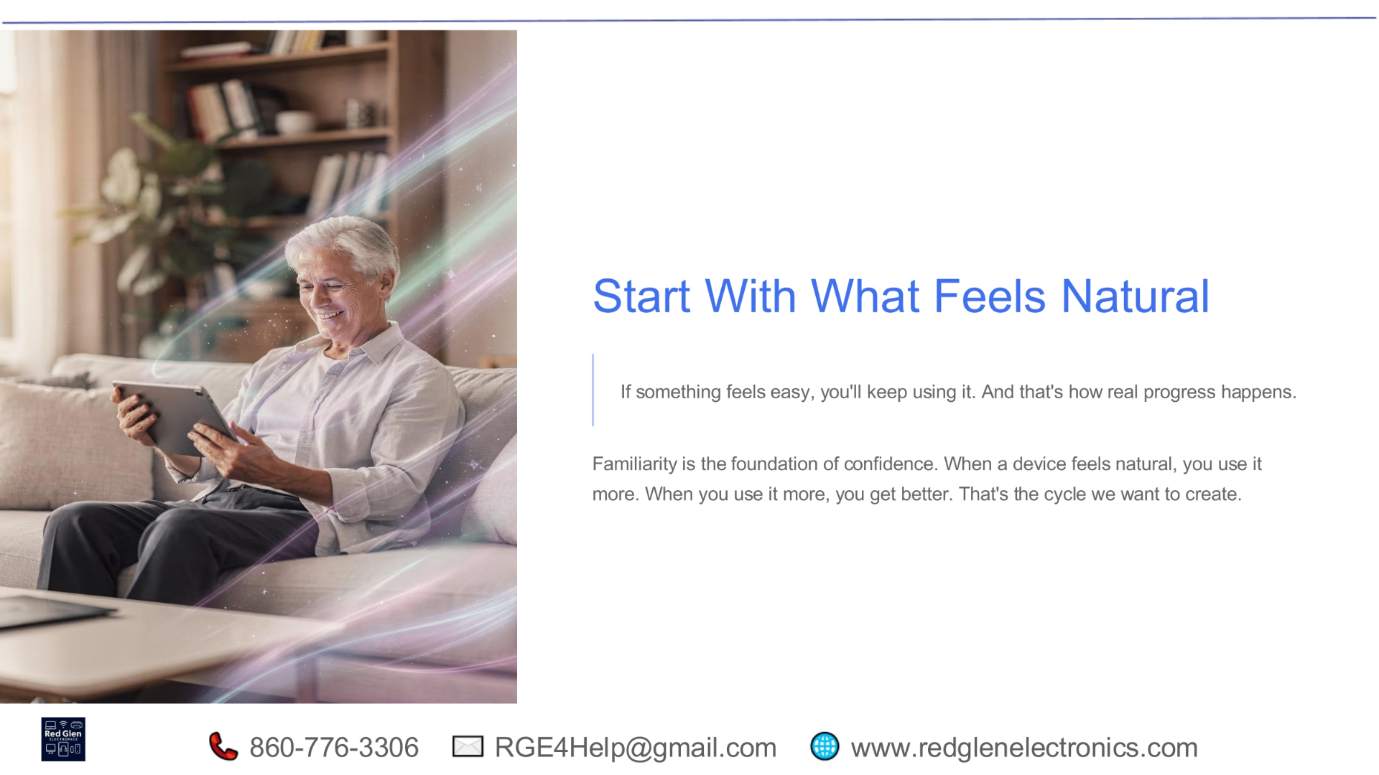
Notes:
The key to embracing new technology is to start with what feels natural. If a device or process feels easy and intuitive, you're far more likely to keep using it, and that's how real progress happens. Familiarity builds confidence. The more natural a device feels, the more you'll use it, and the more proficient you'll become. This positive cycle is precisely what we aim to cultivate.

Slide 21
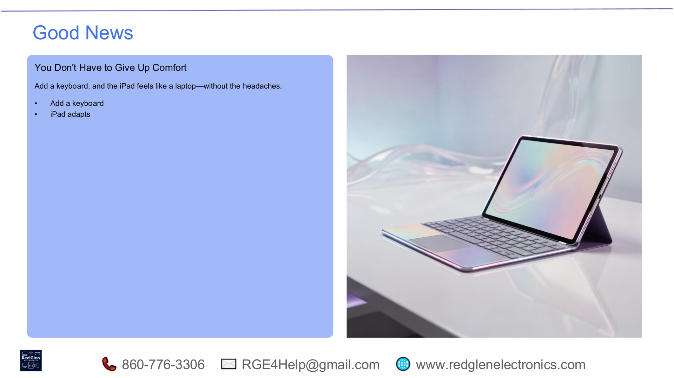
Notes:
We're starting with some good news: you don't have to sacrifice comfort when using technology. By simply adding a keyboard, your iPad can feel just like a laptop, but without the common frustrations. This adaptability means you get the best of both worlds, making your device experience much more enjoyable.

Slide 22
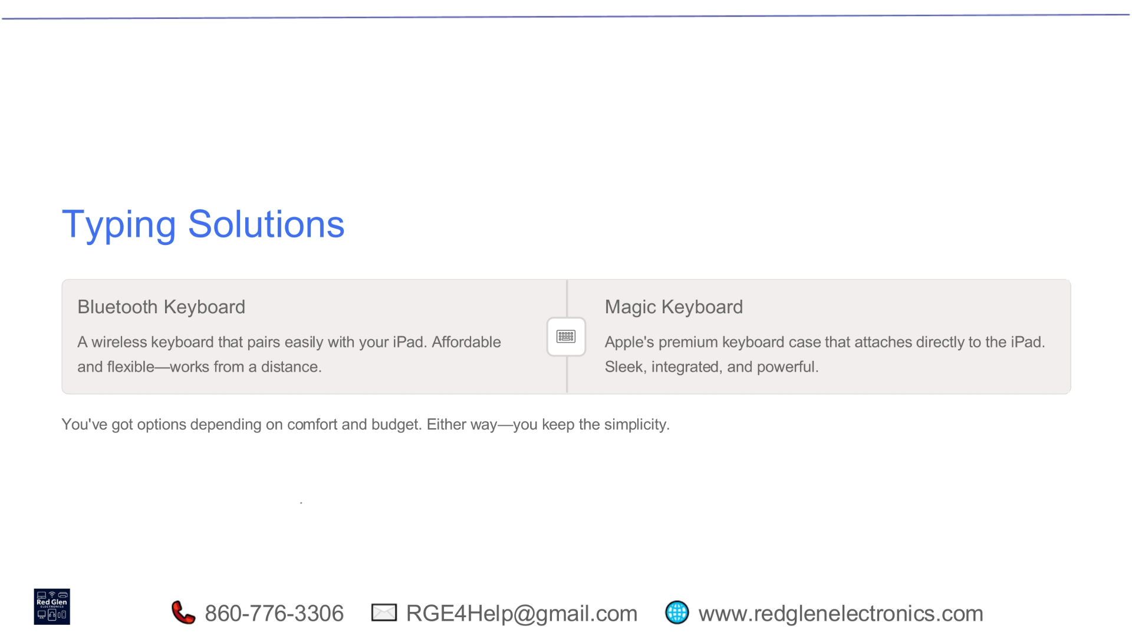
Notes:
When it comes to typing, you have excellent solutions available. A Bluetooth keyboard offers a wireless, affordable, and flexible option, allowing you to work comfortably from a distance. For a more integrated experience, the Magic Keyboard is Apple's premium case that attaches directly to your iPad, providing a sleek, powerful, and seamless setup. You have options to suit your comfort and budget, all while maintaining simplicity.

Slide 23
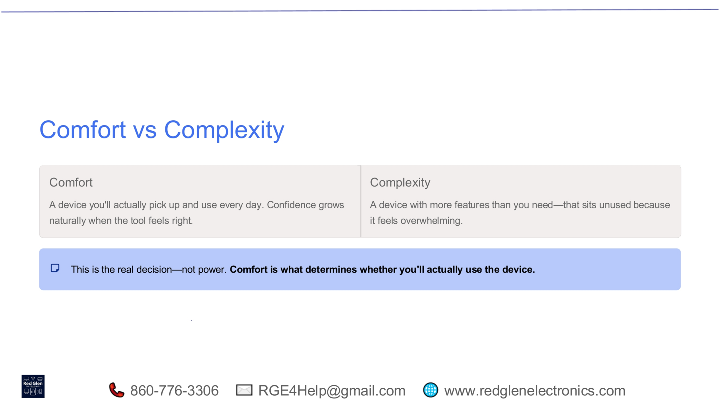
Notes:
The real decision in technology isn't about raw power, but about comfort versus complexity. A comfortable device is one you'll actually use every day, fostering confidence naturally. Conversely, a complex device with too many unused features can feel overwhelming and often sits idle. Prioritizing comfort ensures you engage with your technology consistently and effectively.

Slide 24
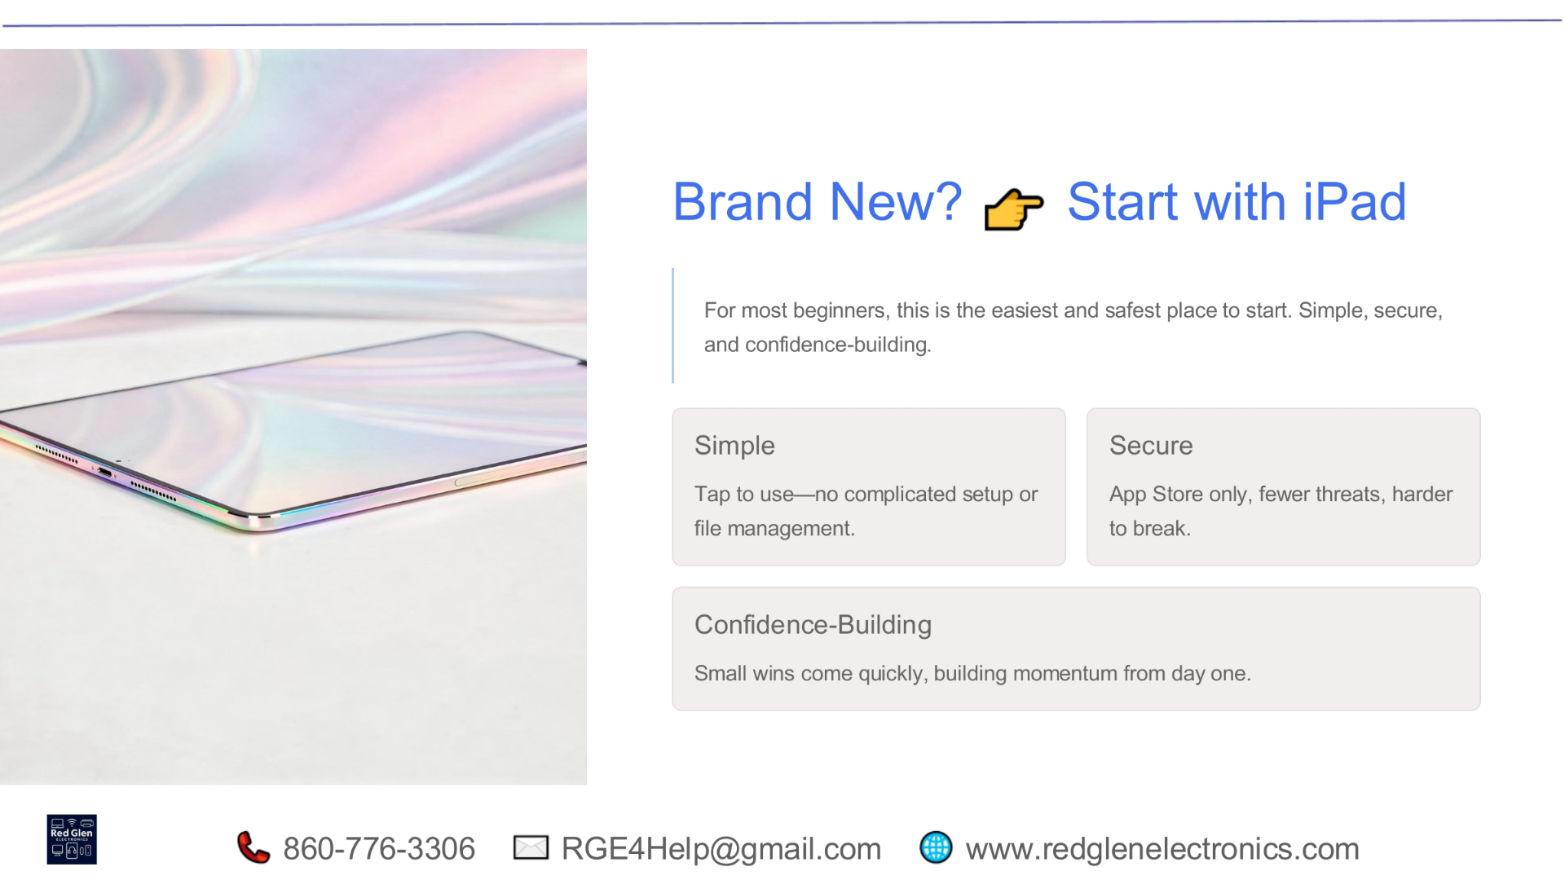
Notes:
If you're new to technology, starting with an iPad is often the easiest and safest path. It's designed to be simple, allowing you to tap and use without complicated setup or file management. The iPad is also secure, relying on the App Store for applications, which means fewer threats. This approach builds confidence quickly, giving you small wins from day one.

Slide 25
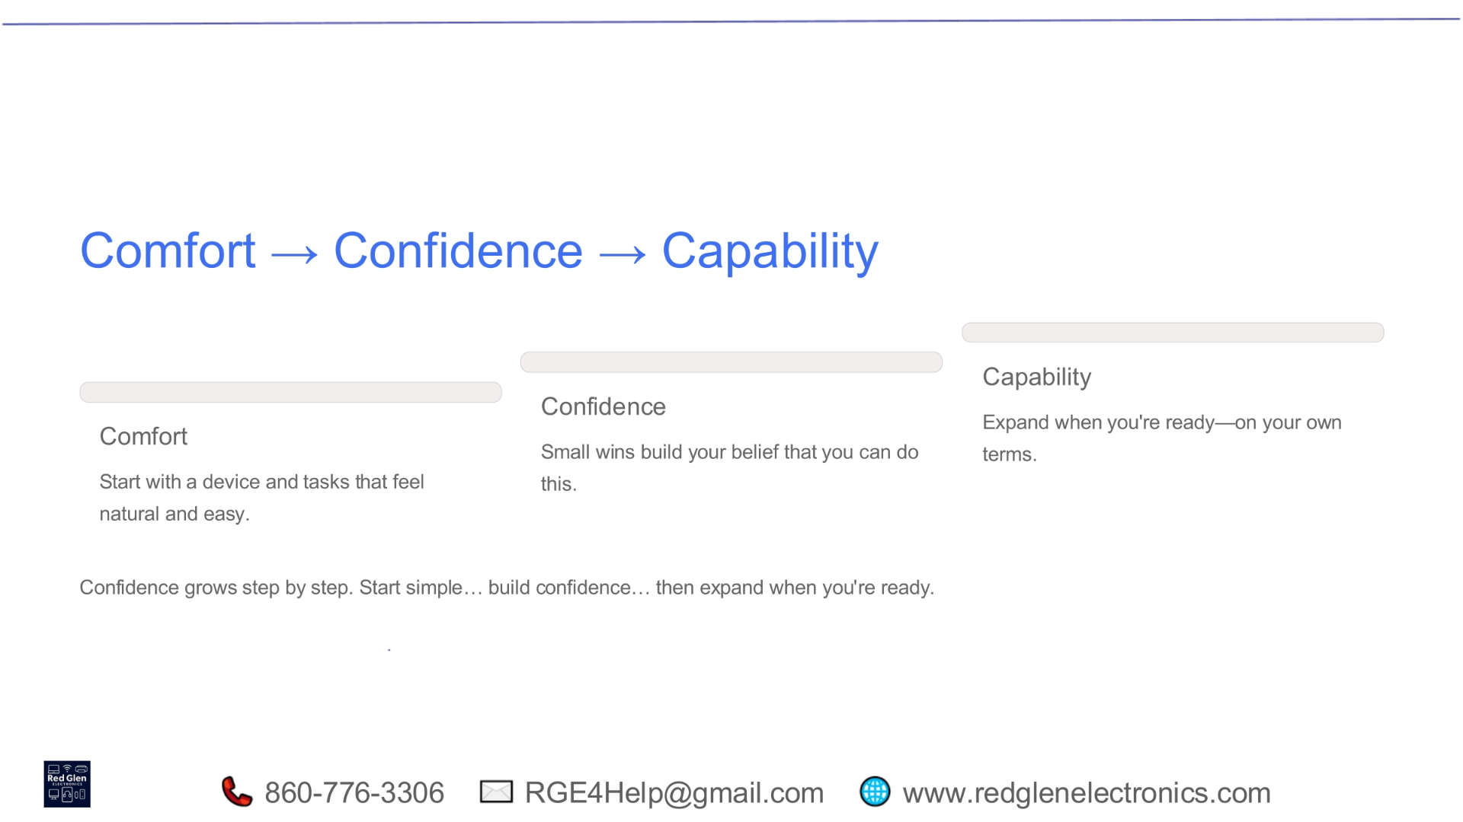
Notes:
The journey with technology naturally progresses from comfort to confidence, and then to expanded capability. Begin with a device and tasks that feel natural and easy. As you achieve small wins, your belief in your abilities grows, building confidence. Once you're confident, you can expand your skills and capabilities on your own terms, step by step, without feeling rushed.

Slide 26
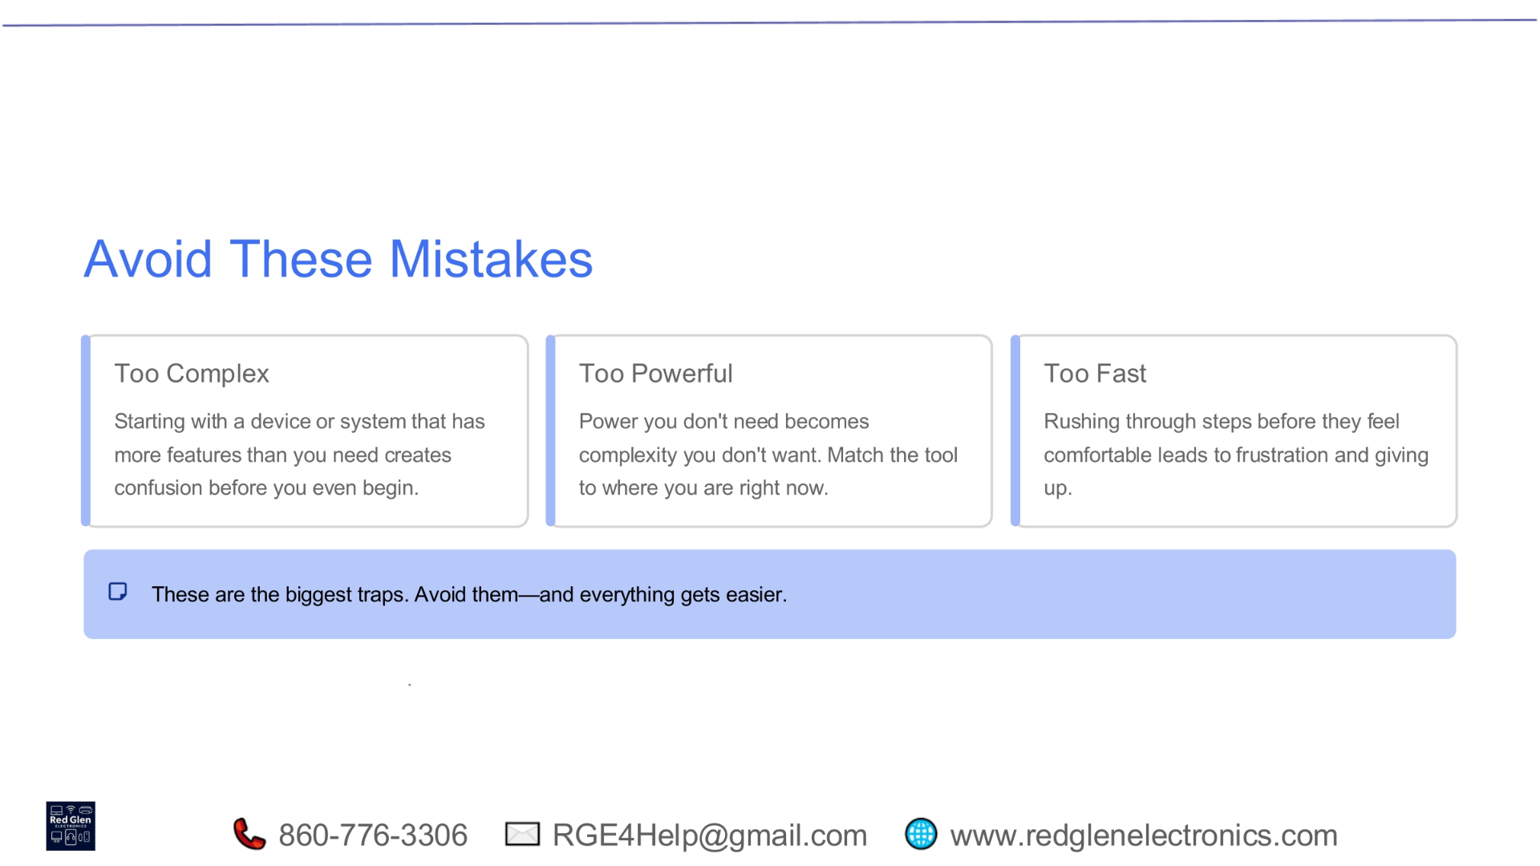
Notes:
To ensure a smooth experience, avoid common mistakes. Don't start with a device that's too complex, as excessive features can create confusion. Similarly, a device that's too powerful for your current needs can introduce unnecessary complexity. Finally, avoid rushing through steps before you feel comfortable, as this often leads to frustration. Steering clear of these traps will make your technology journey much easier.

Slide 27
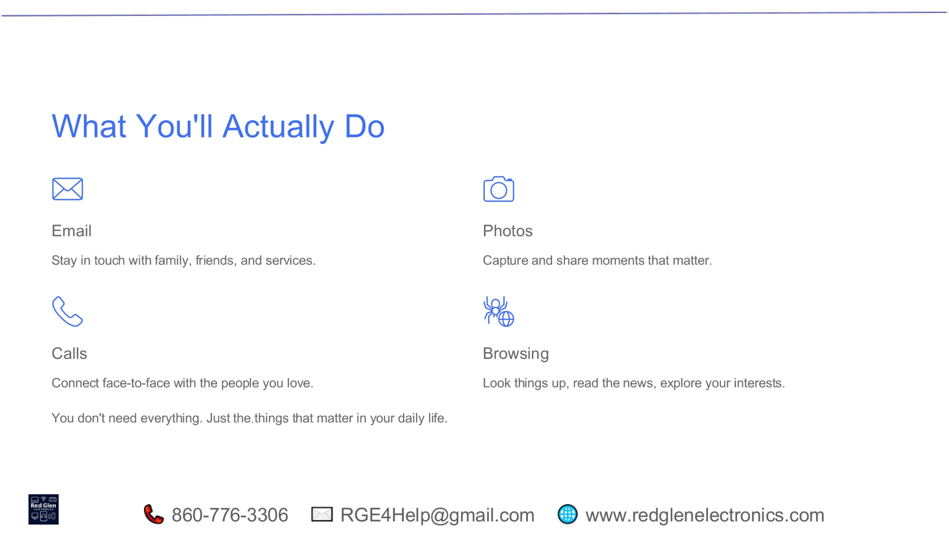
Notes:
Focus on what you'll actually do with your device. You'll use it for email to stay in touch with family, friends, and services. You'll capture and share important moments with photos. You'll connect face-to-face with loved ones through calls. And you'll explore interests, read news, and look things up through browsing. You don't need every feature; just the ones that matter in your daily life.

Slide 28
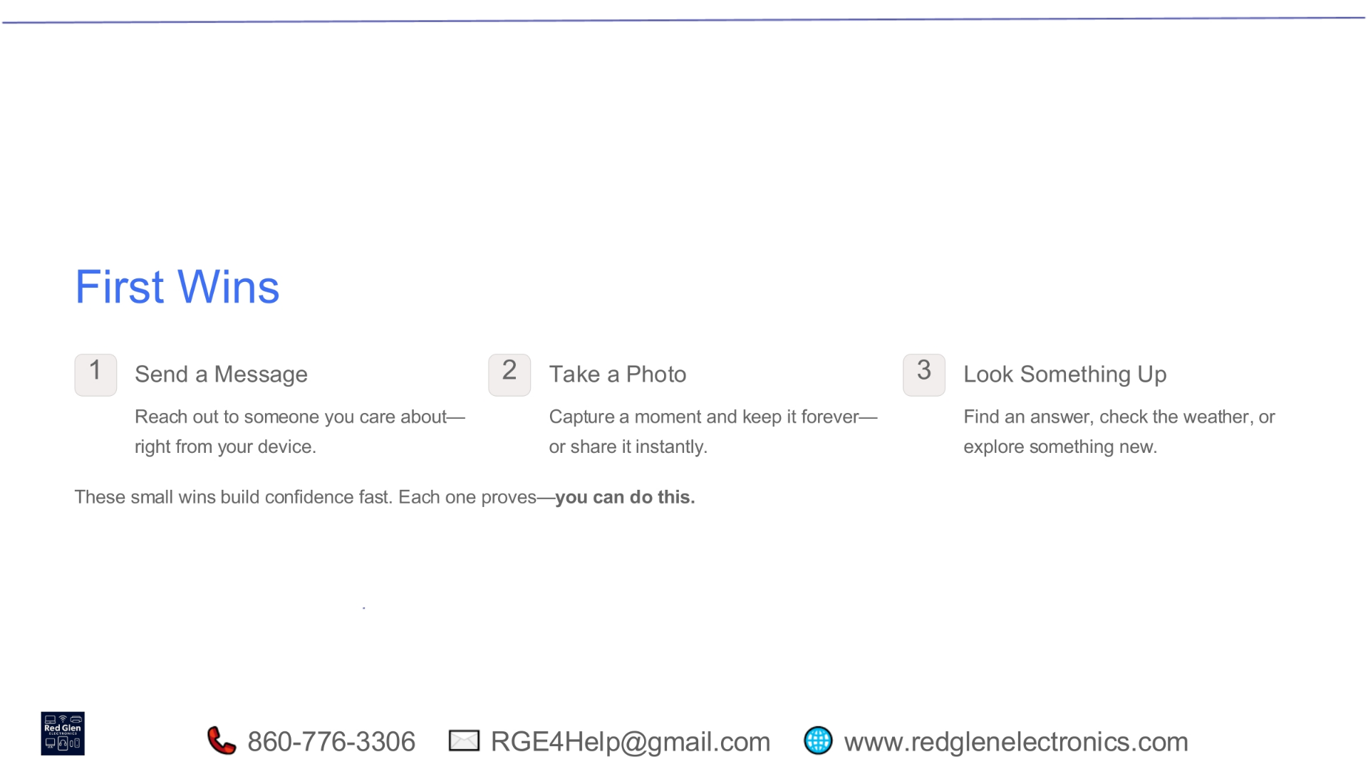
Notes:
Achieving small, early successes builds confidence quickly. Your first wins might include sending a message to someone you care about directly from your device. Another quick win is taking a photo, capturing a moment, and instantly sharing it. You can also easily look something up, whether it's finding an answer, checking the weather, or exploring something new. Each of these small accomplishments proves you can do this.

Slide 29
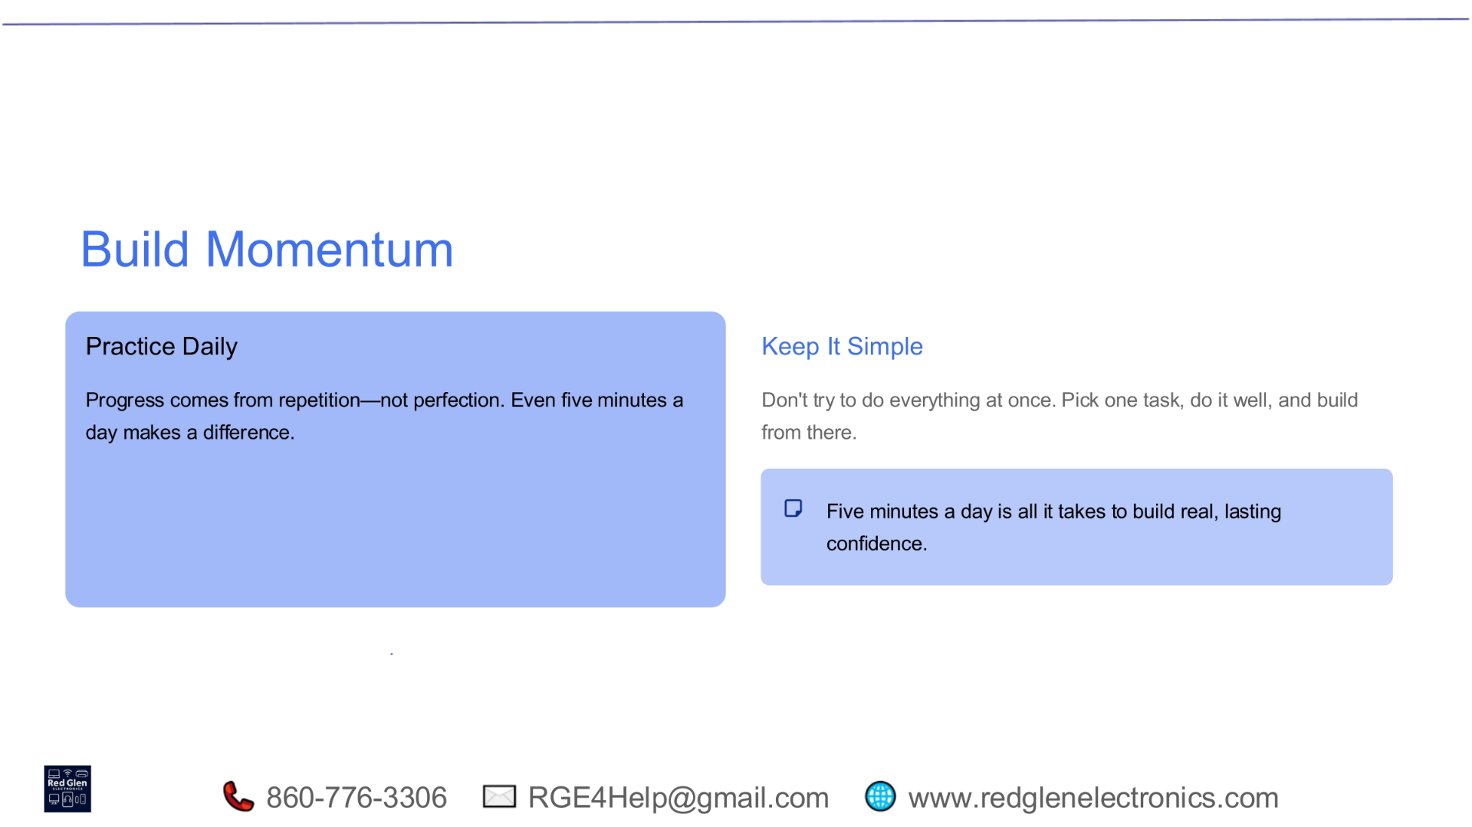
Notes:
Building momentum is key to sustained progress. Practice daily, remembering that progress comes from repetition, not perfection. Even dedicating just five minutes a day can make a significant difference. The goal is to keep it simple: don't try to master everything at once. Pick one task, do it well, and gradually build your skills from there. Five minutes a day is truly all it takes to build real, lasting confidence.

Slide 30
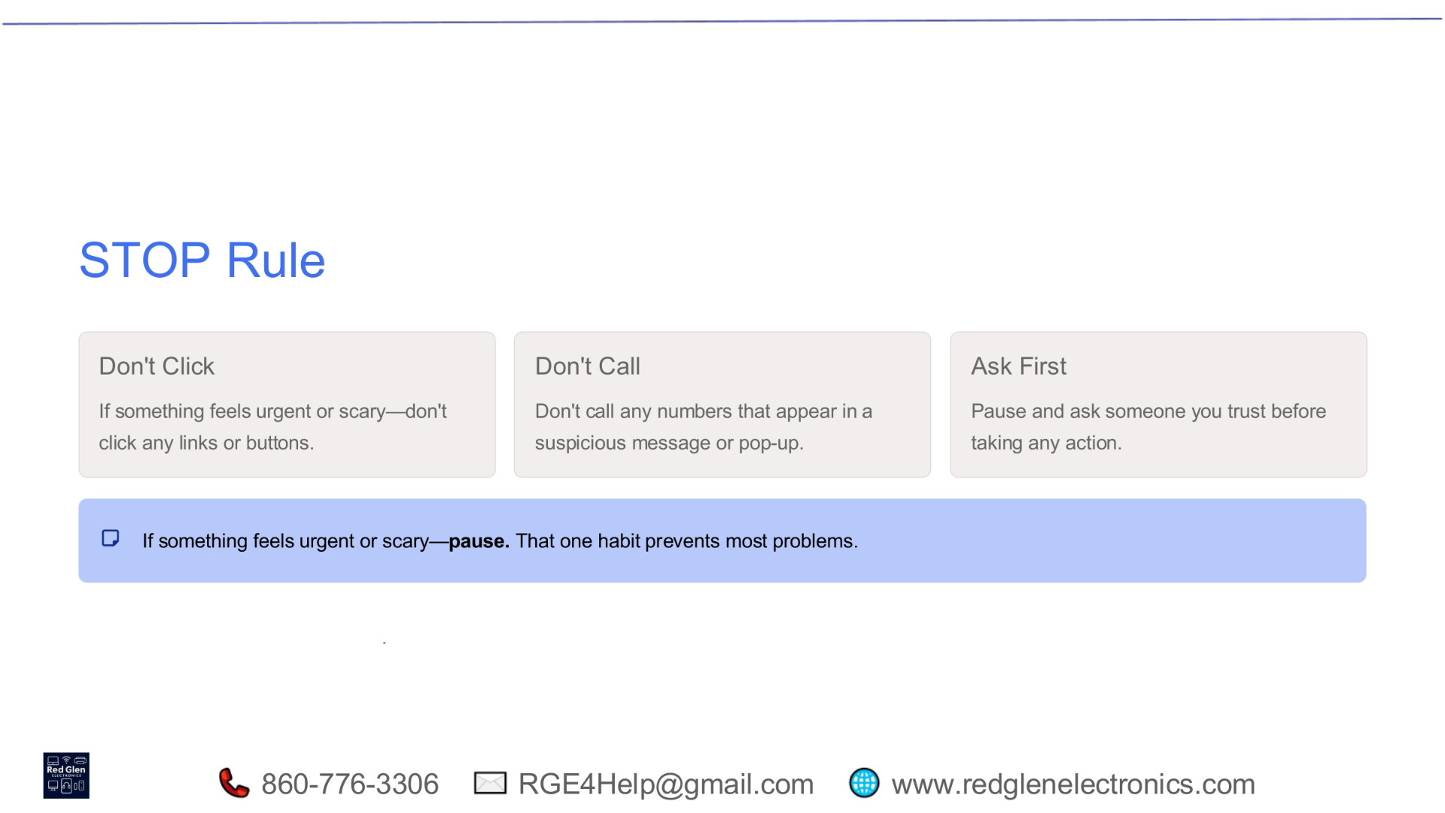
Notes:
To stay safe online, remember the STOP Rule. First, don't click any links or buttons if something feels urgent or scary. Second, don't call any numbers that appear in suspicious messages or pop-ups. Third, always ask someone you trust before taking any action. If something feels urgent or scary, simply pause. That one habit alone can prevent most problems and keep you secure.

Slide 31
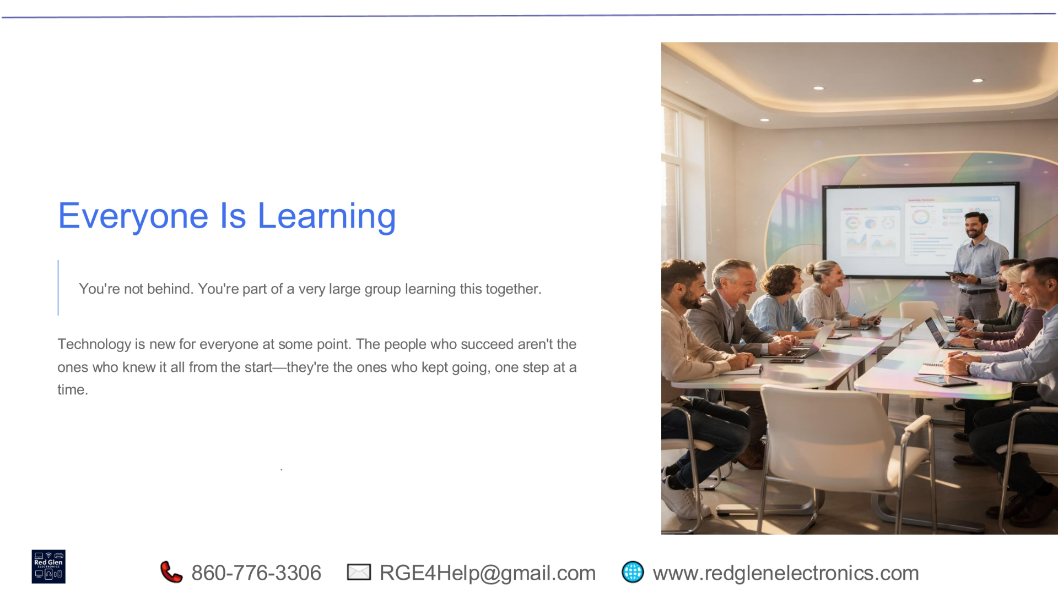
Notes:
It's important to remember that everyone is learning. You are not behind; you're part of a very large group navigating technology together. Technology is new for everyone at some point in their journey. The people who truly succeed aren't those who knew everything from the start, but rather those who kept going, taking one step at a time, consistently building their knowledge and skills.

Slide 32
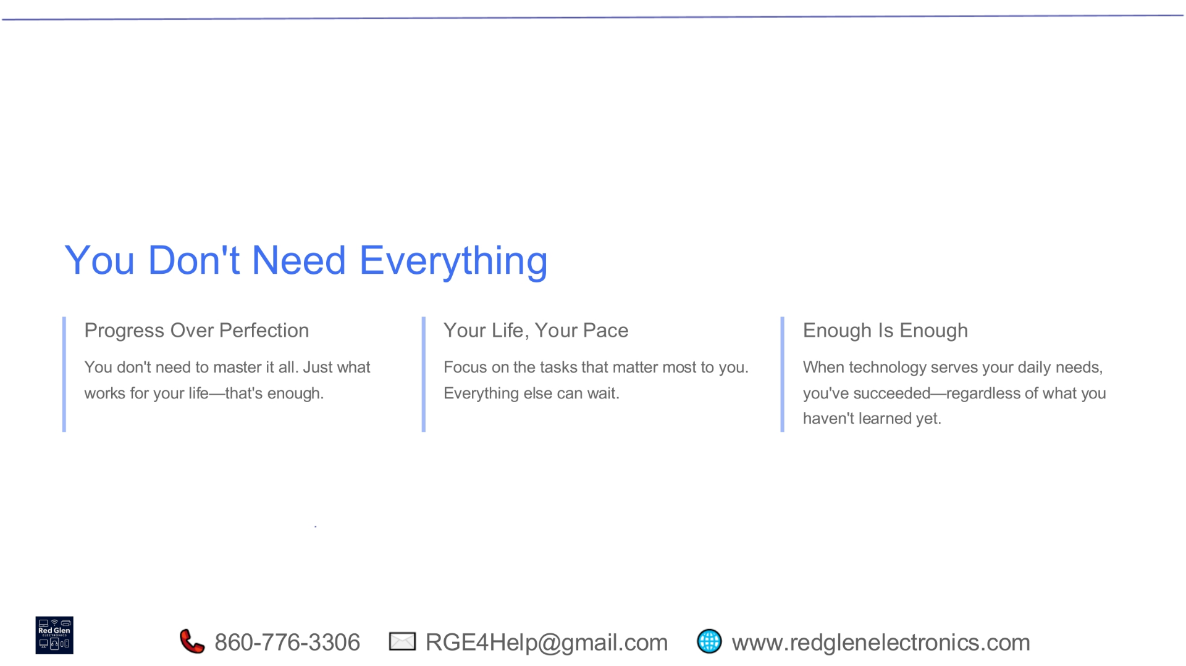
Notes:
You don't need to master every aspect of technology. Focus on progress over perfection, concentrating on what works for your life. Embrace your own pace, prioritizing the tasks that matter most to you, knowing that everything else can wait. When technology effectively serves your daily needs, you've succeeded, regardless of what you haven't learned yet. Enough is truly enough.

Slide 33
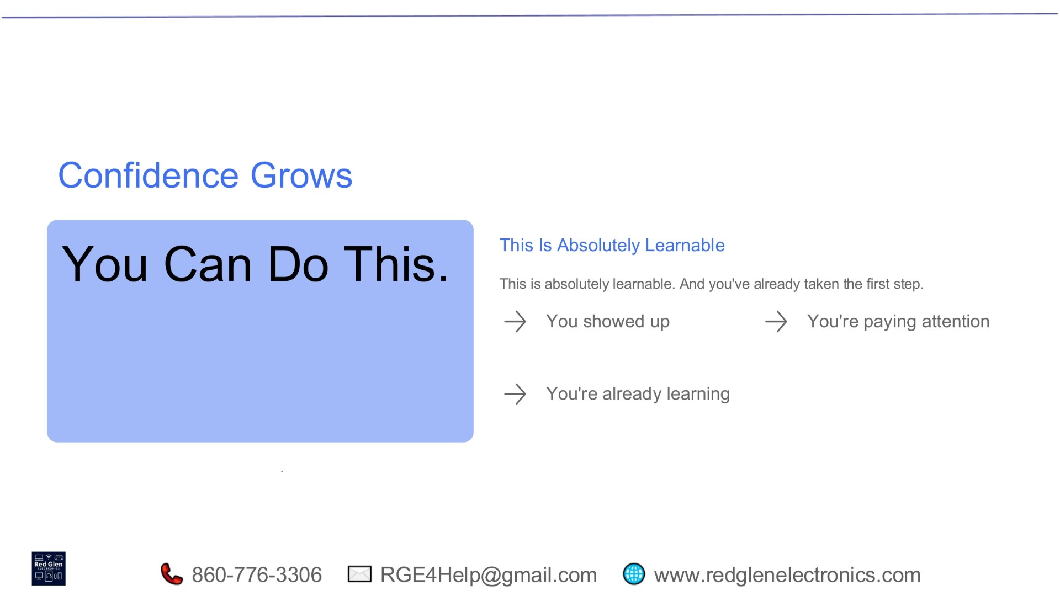
Notes:
Confidence in using technology grows with every step you take. You absolutely can do this. This journey is entirely learnable, and you've already taken the crucial first step by being here. The fact that you showed up, are paying attention, and are already learning demonstrates your commitment and capability. Keep engaging, and your confidence will continue to build.

Slide 34
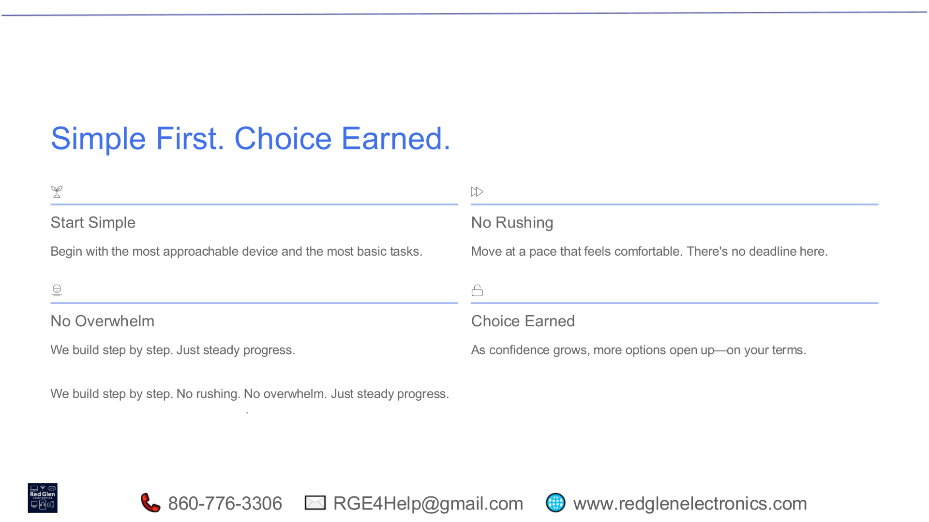
Notes:
Our approach emphasizes starting simple, with choices earned as you progress. Begin with the most approachable device and the most basic tasks. There's no need for rushing; move at a pace that feels comfortable, as there's no deadline. Avoid overwhelm by building step by step, focusing on steady progress. As your confidence grows, more options will open up to you on your own terms.

Slide 35
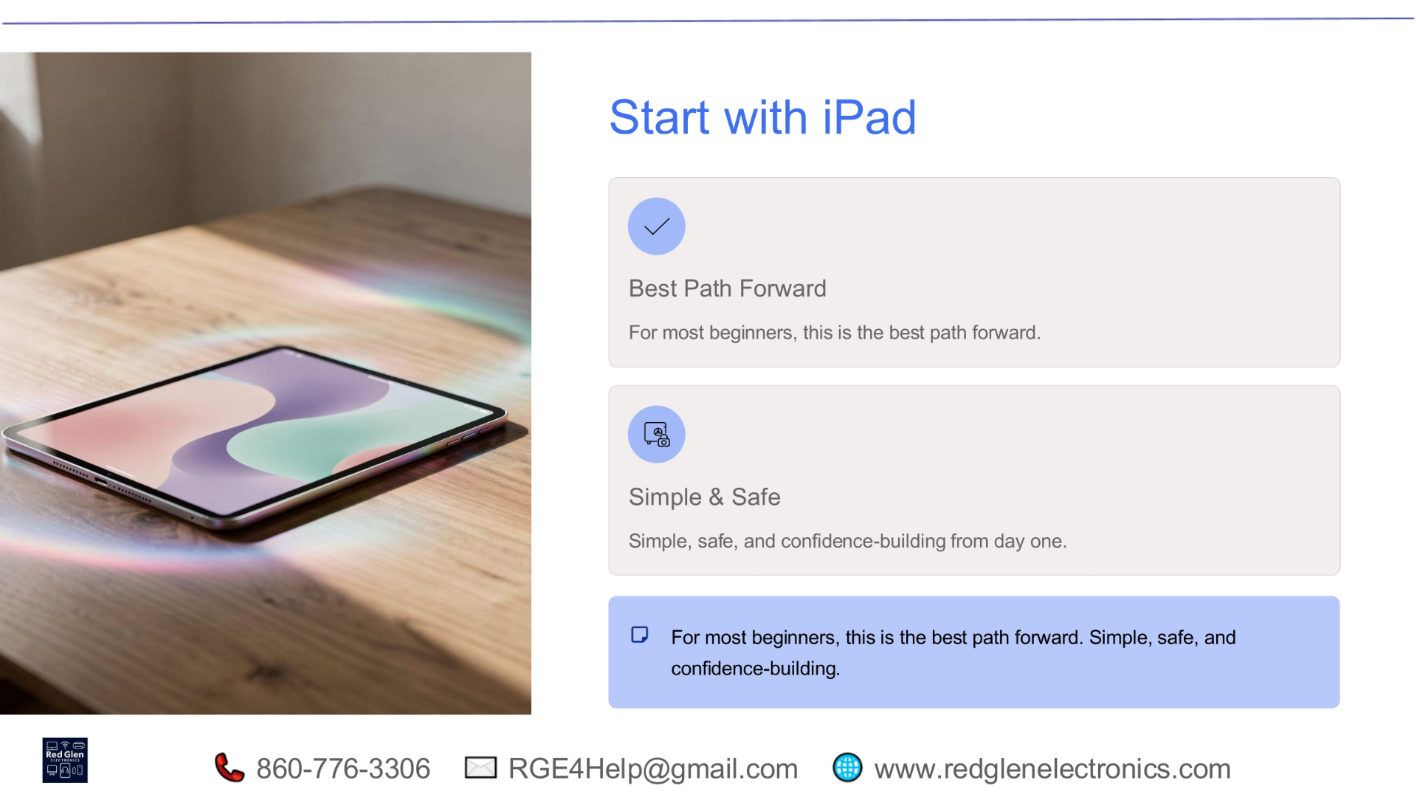
Notes:
For most beginners, starting with an iPad represents the best path forward. It's designed to be simple, safe, and confidence-building right from day one. The intuitive interface and controlled environment make it an ideal entry point into the world of personal technology. This approach ensures a positive and empowering initial experience, setting you up for future success.

Slide 36
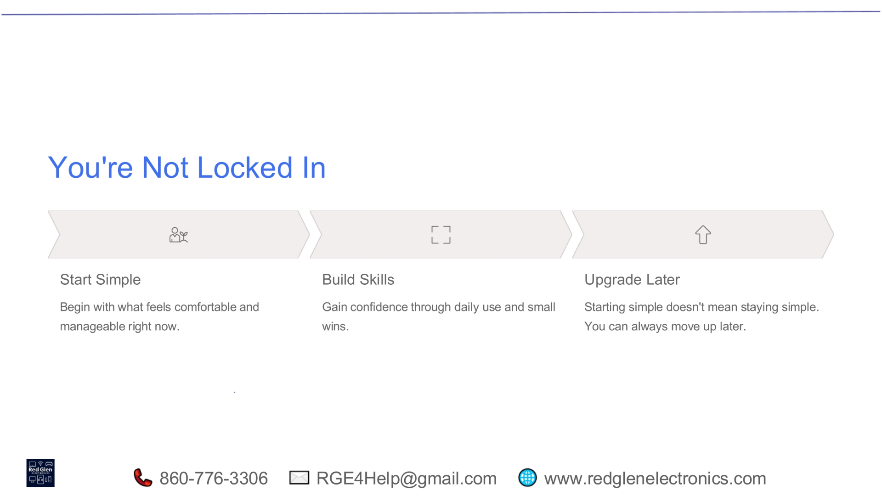
Notes:
Rest assured, you're not locked into your initial choices. The journey begins by starting simple, focusing on what feels comfortable and manageable right now. As you gain confidence through daily use and small wins, you'll build essential skills. Later, when you're ready, you can always upgrade. Starting simple doesn't mean staying simple; you have the flexibility to move up and expand your capabilities.

Slide 37
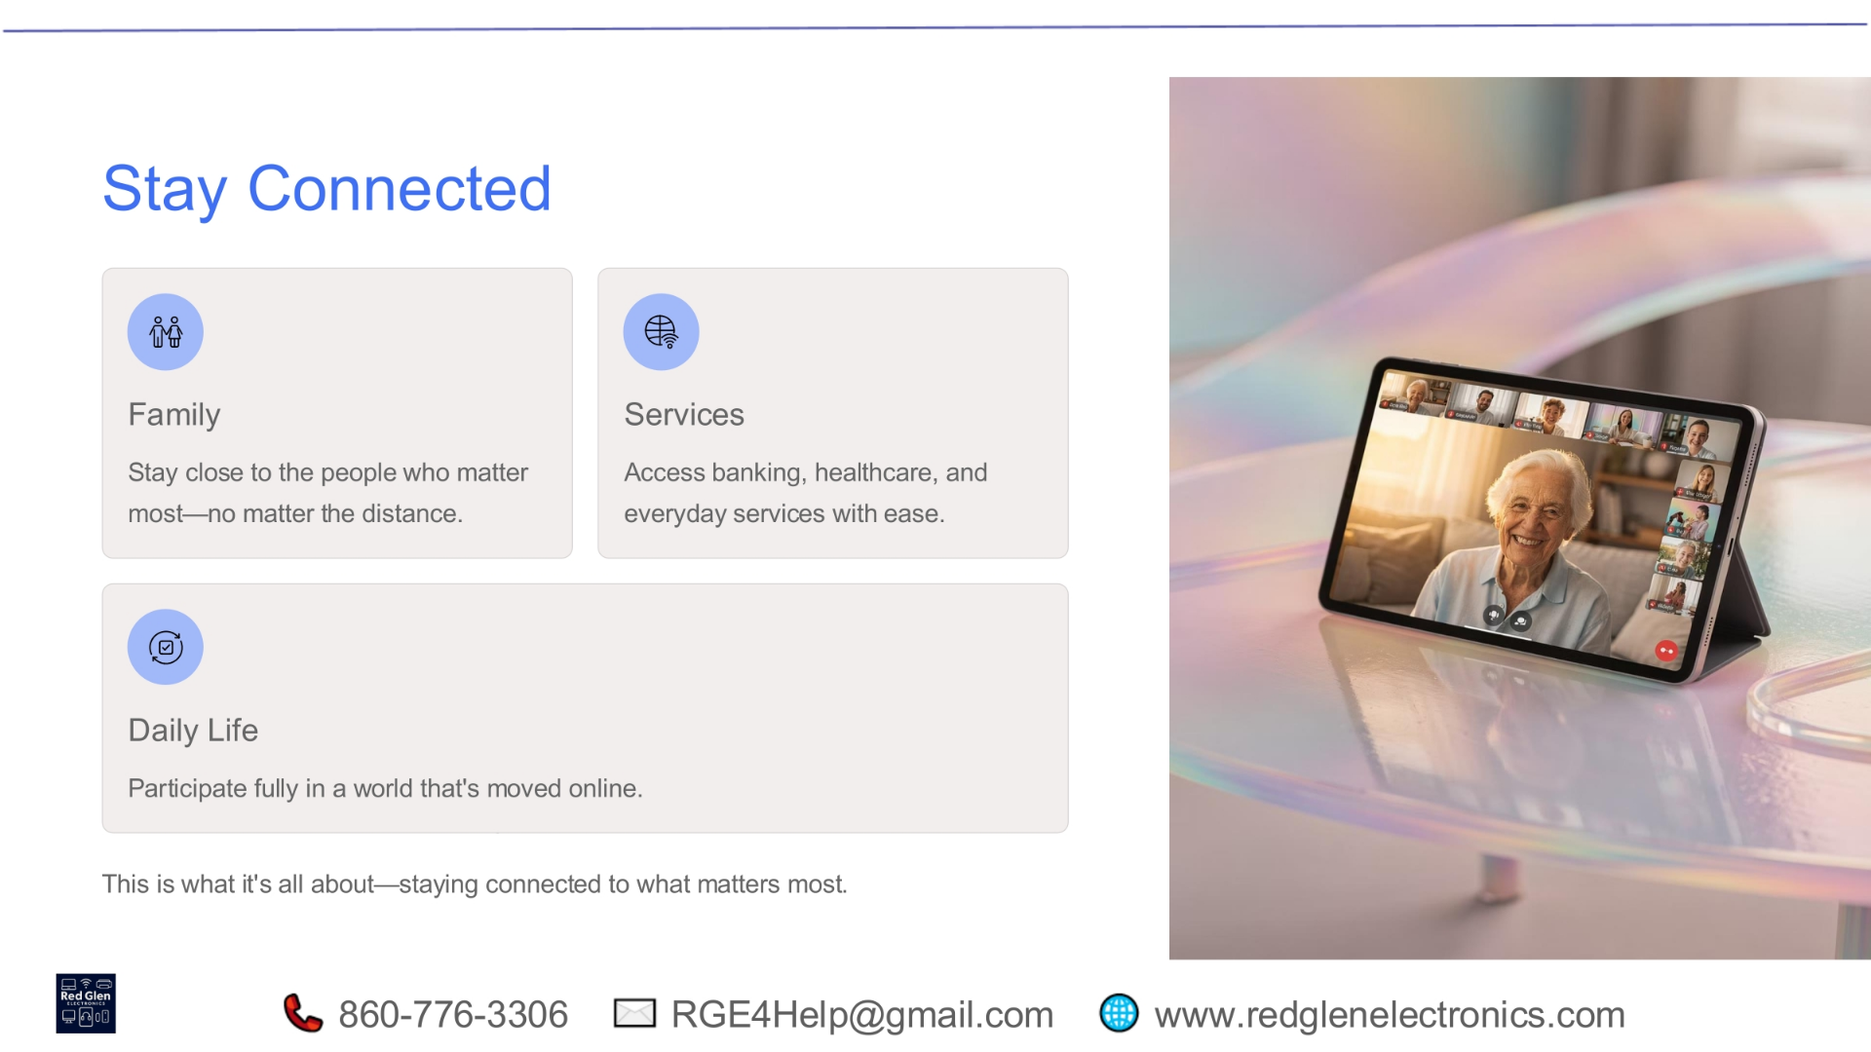
Notes:
Staying connected is what technology is truly all about. It allows you to remain close to family, no matter the distance. You can easily access essential services like banking and healthcare, simplifying everyday tasks. Furthermore, technology enables you to participate fully in a world that has increasingly moved online. Ultimately, it's about maintaining those vital connections that matter most in your life.

Slide 38
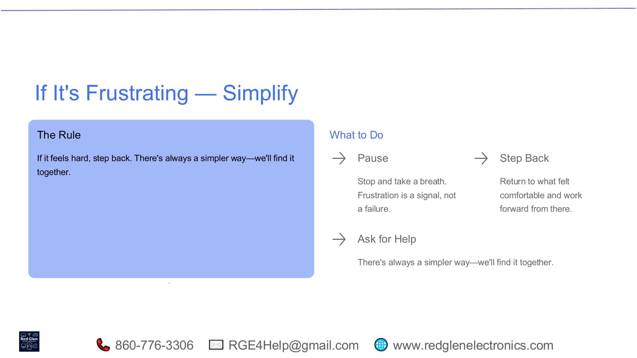
Notes:
If you ever find technology frustrating, remember the rule: simplify. If something feels hard, step back. There's always a simpler way. We'll find it together. When frustration arises, pause and take a breath; it's a signal, not a failure. Then, step back to what felt comfortable and work forward from there. Don't hesitate to ask for help; we're here to guide you to a simpler solution.

Slide 39
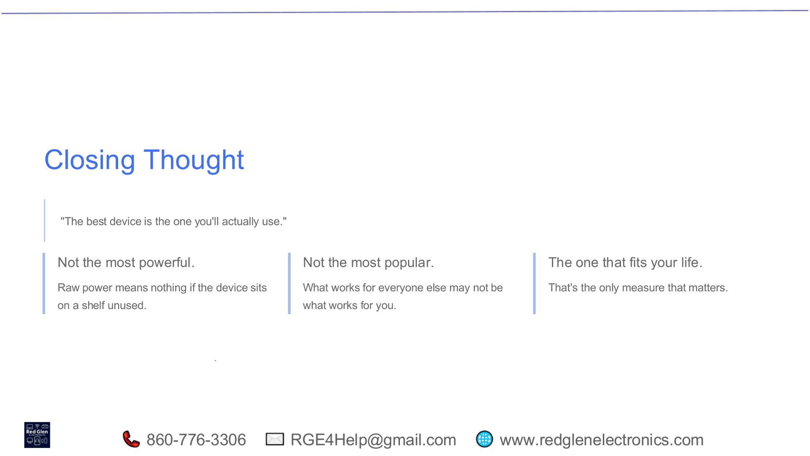
Notes:
As we conclude, remember this important thought: the best device is truly the one you'll actually use. It's not about having the most powerful technology, as raw power is meaningless if the device sits unused. Nor is it about owning the most popular device, as what works for others may not work for you. The only measure that truly matters is finding the technology that fits your life and enhances it.

Slide 40
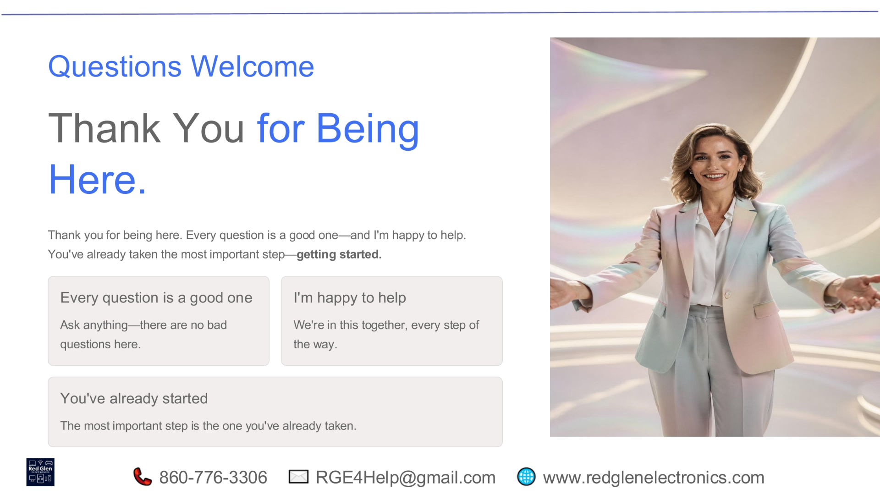
Notes:
Thank you for being here today. Every question is a good one, and I'm happy to help you on your journey. You've already taken the most important step by getting started. We're in this together, every step of the way. Please feel free to ask anything; there are no bad questions here.

