Slide 1

Notes:
Welcome to this essential guide for mastering your iPad, making it a comfortable, safe, and incredibly useful tool that seamlessly integrates into your daily life. This guide will cover crucial topics like connecting to Wi-Fi, understanding email and message safety, managing app permissions, and using security features, empowering you to use your device confidently and safely.

Slide 2
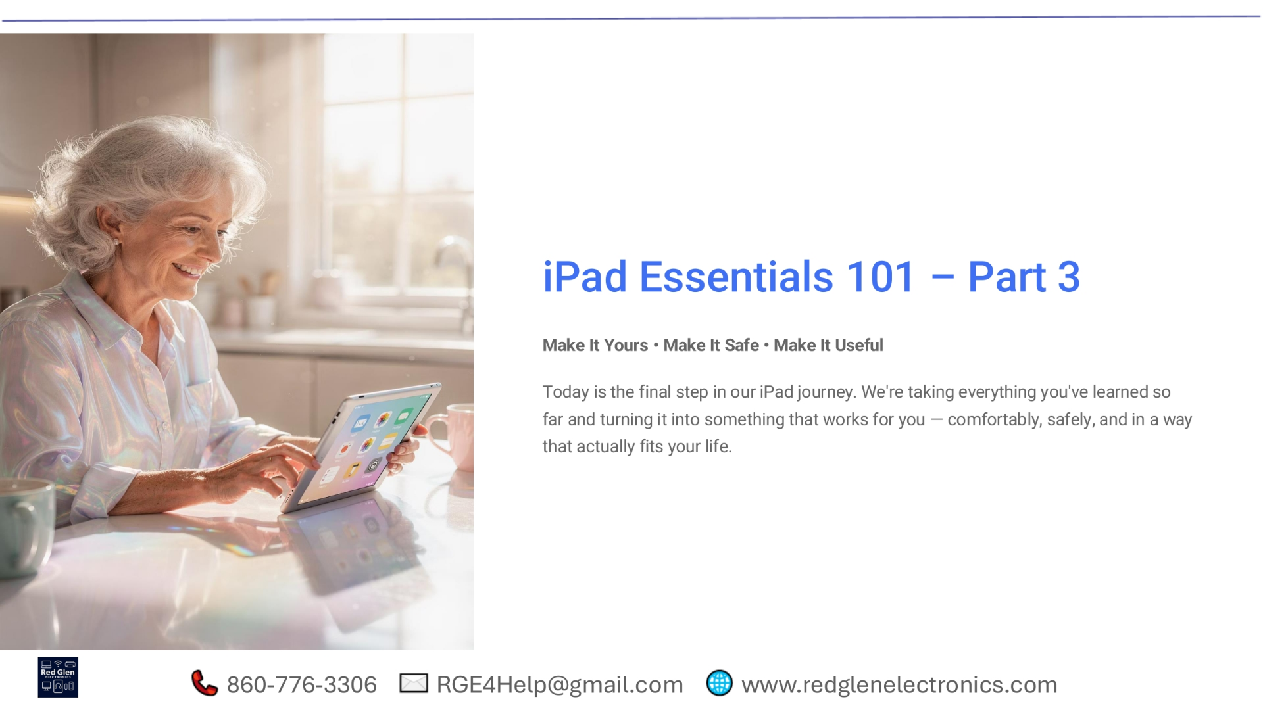
Notes:
Welcome to iPad Essentials 101, Part 3. This session focuses on making your iPad truly yours, ensuring it's safe, and maximizing its usefulness in your daily life. We'll cover personalization, security, and practical applications.

Slide 3
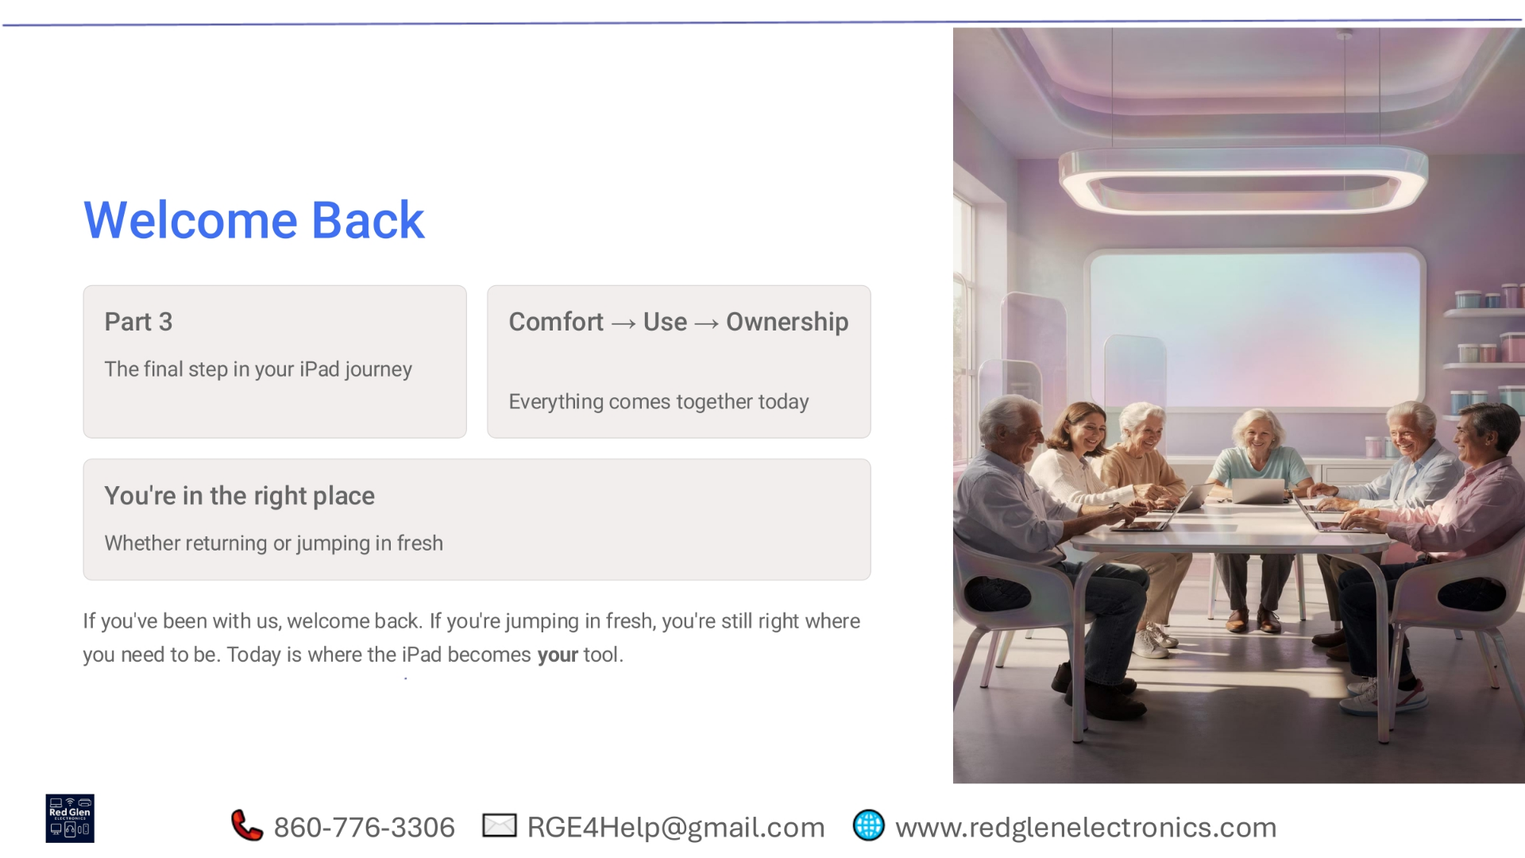
Notes:
Welcome back to our iPad journey. Whether you've been with us from the start or are just joining, you're in the right place. Today, we're bringing everything together, moving from comfort to confident use and ultimately, ownership. Your iPad will truly become your personalized tool.

Slide 4
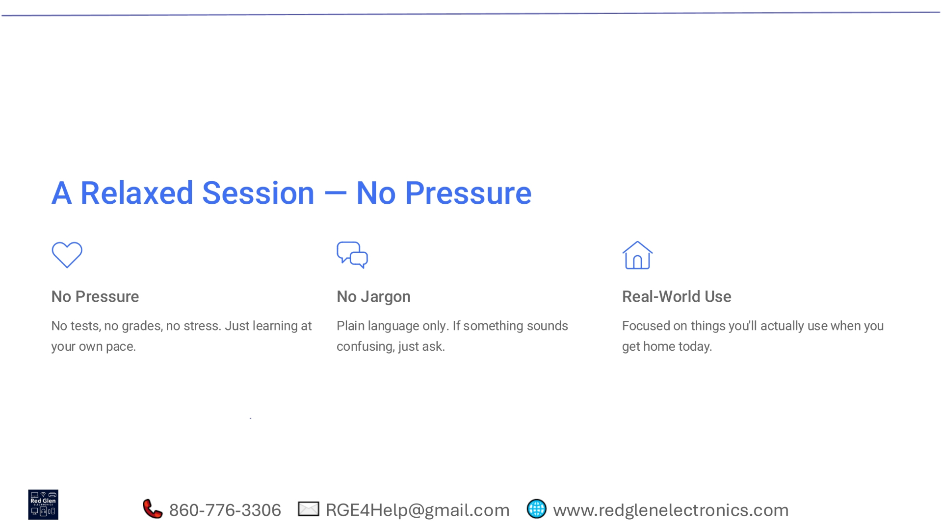
Notes:
This session is designed to be relaxed and pressure-free. There are no tests or grades, allowing you to learn at your own pace. We'll use plain language, avoiding jargon, so please ask if anything is unclear. Our focus is on real-world applications you'll use every day.

Slide 5
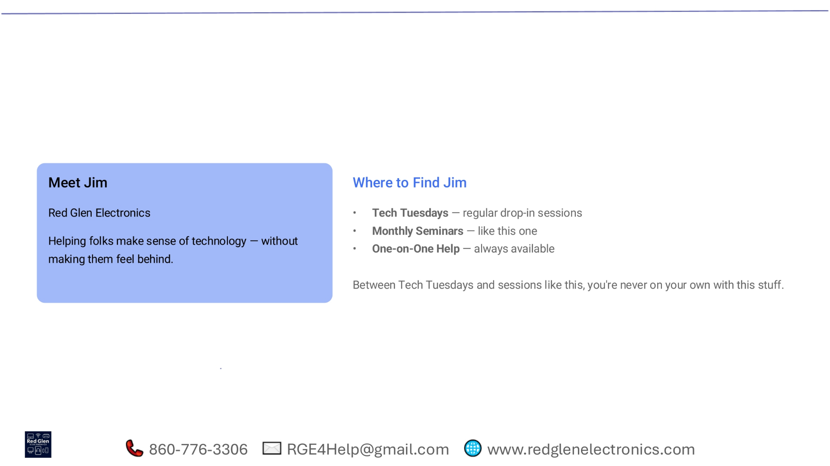
Notes:
Meet Jim Kay-la-her from Red Glen Electronics. His mission is to help everyone understand technology without feeling left behind. You can find Jim at Tech Tuesdays for regular drop-in sessions, monthly seminars like this one, or through one-on-one help. You're never on your own with your tech questions.

Slide 6
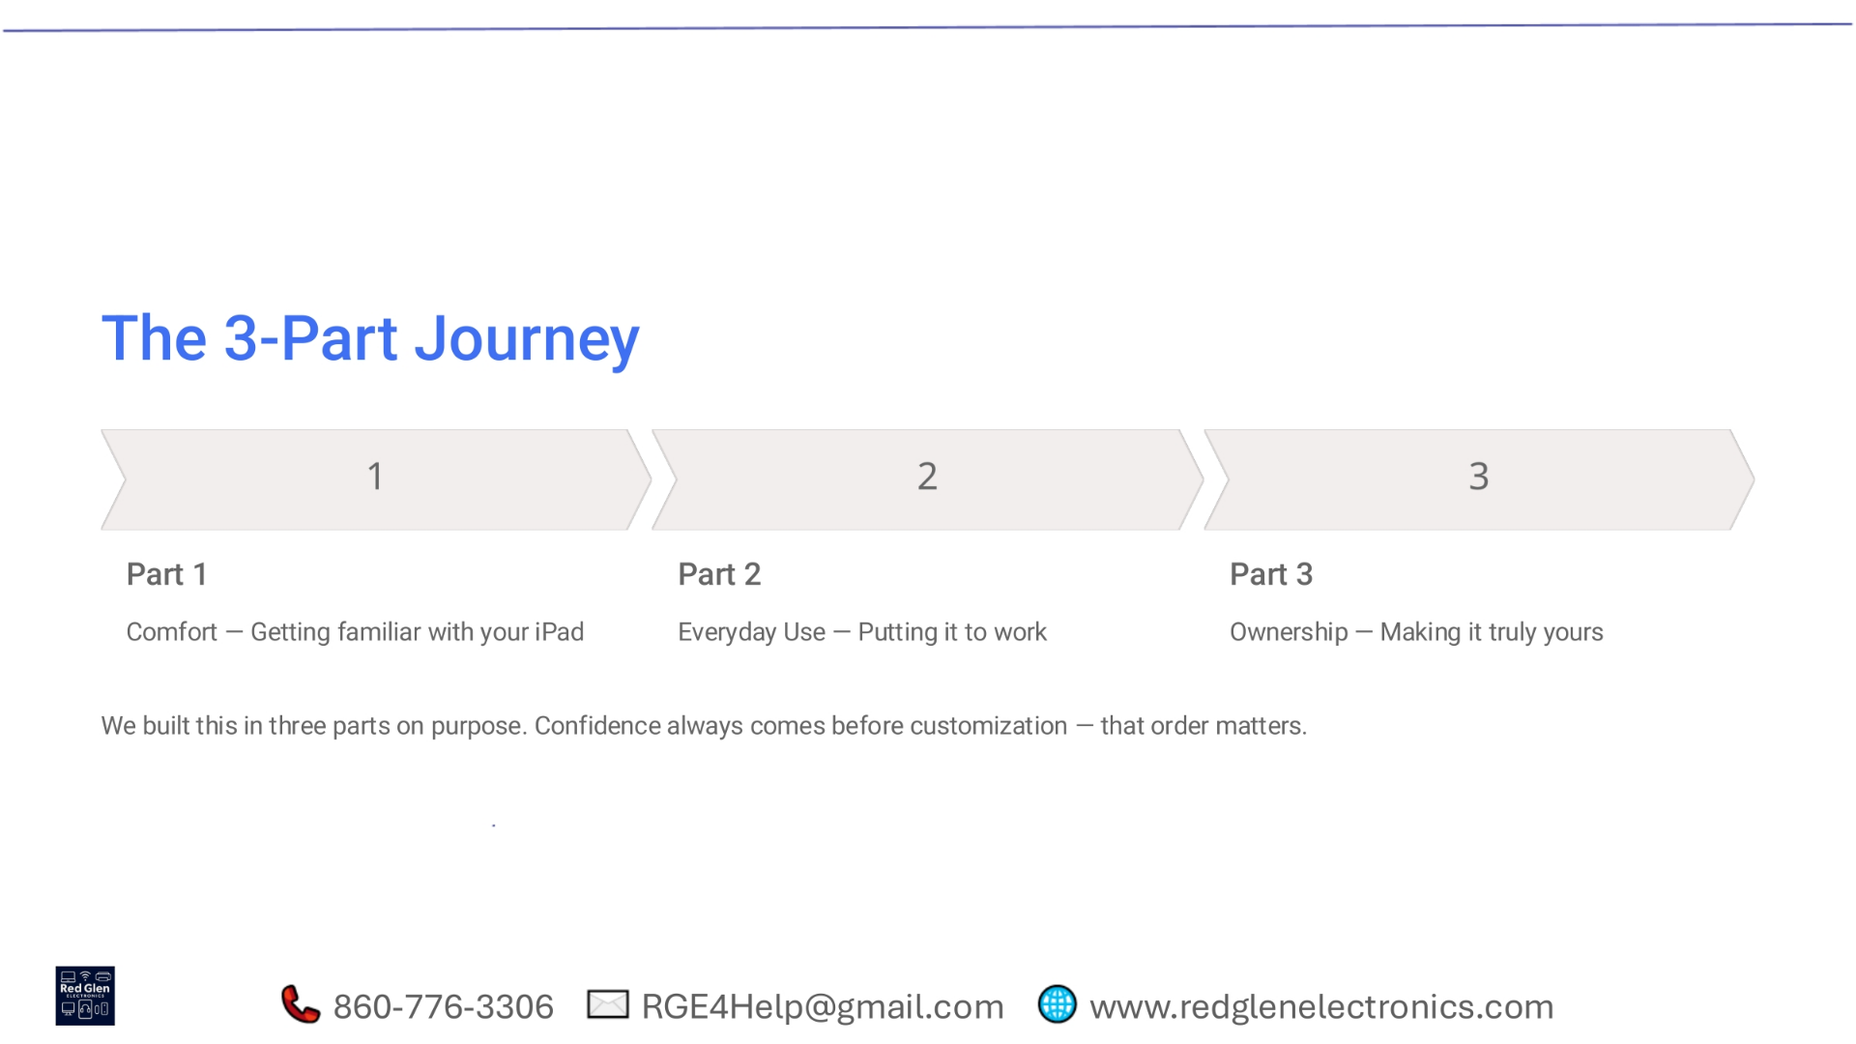
Notes:
Our iPad journey is structured in three parts. Part 1 focused on comfort and getting familiar with your device. Part 2 covered everyday use, putting your iPad to work. Now, in Part 3, we're all about ownership, making your iPad truly yours. This progression ensures confidence before customization.

Slide 7
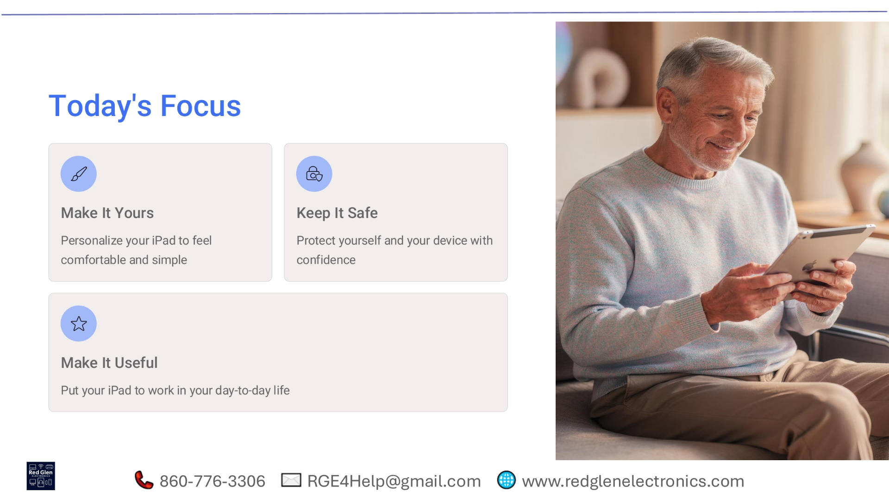
Notes:
Today, we're focusing on three key areas. First, 'Make It Yours' by personalizing your iPad for comfort and simplicity. Second, 'Keep It Safe' by protecting yourself and your device with confidence. Finally, 'Make It Useful' by integrating your iPad into your day-to-day life effectively.

Slide 8
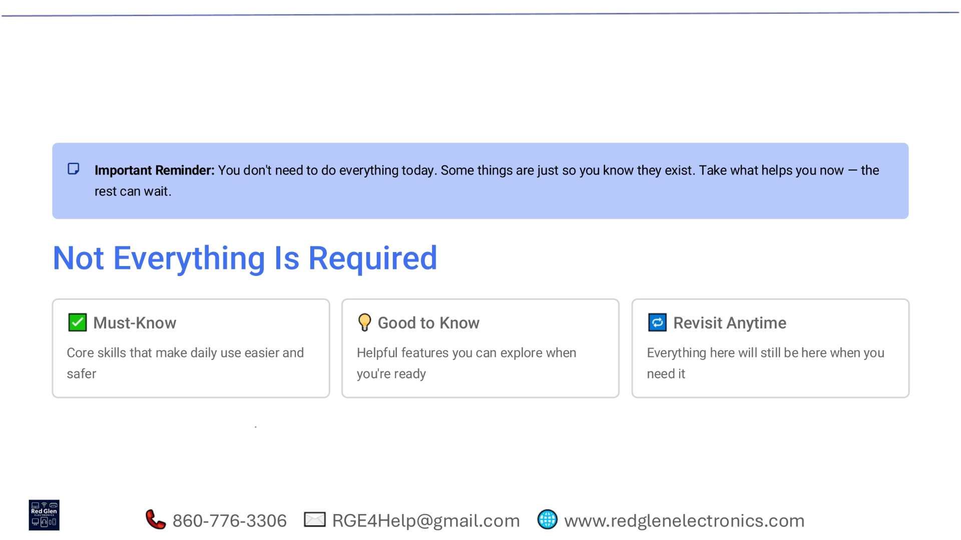
Notes:
It's important to remember that you don't need to master everything today. Some features are simply good to know, allowing you to explore them when you're ready. Focus on the 'Must-Know' core skills that enhance daily use and safety. Everything covered here will be available to revisit anytime you need it.

Slide 9

Notes:
There's no finish line in this learning process. We encourage you to go at your own pace, focusing on what works best for you and leaving the rest for later. This approach helps ensure the information truly sticks and becomes a natural part of your iPad experience.

Slide 10
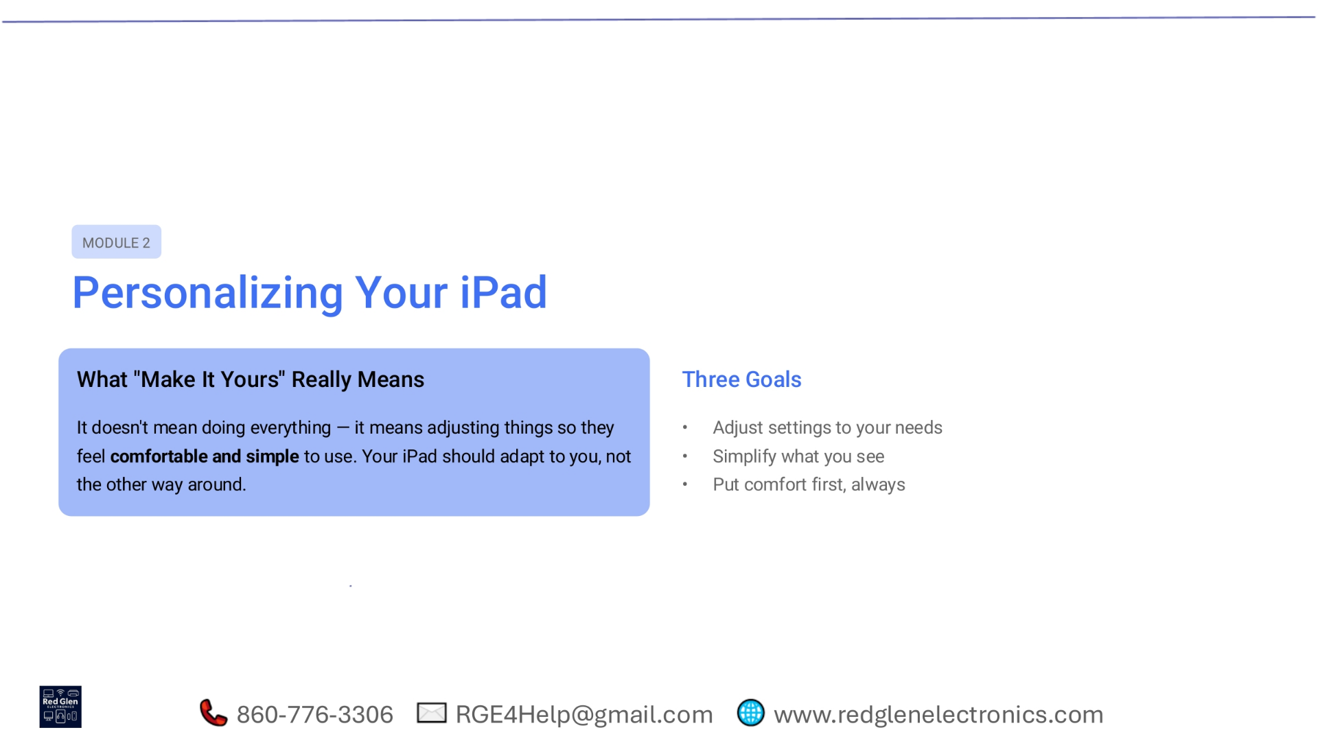
Notes:
Module 2 is all about personalizing your iPad. This means adjusting settings to make your device comfortable and simple to use, rather than forcing yourself to adapt to it. Our three goals are to adjust settings to your needs, simplify what you see, and always prioritize your comfort.

Slide 11
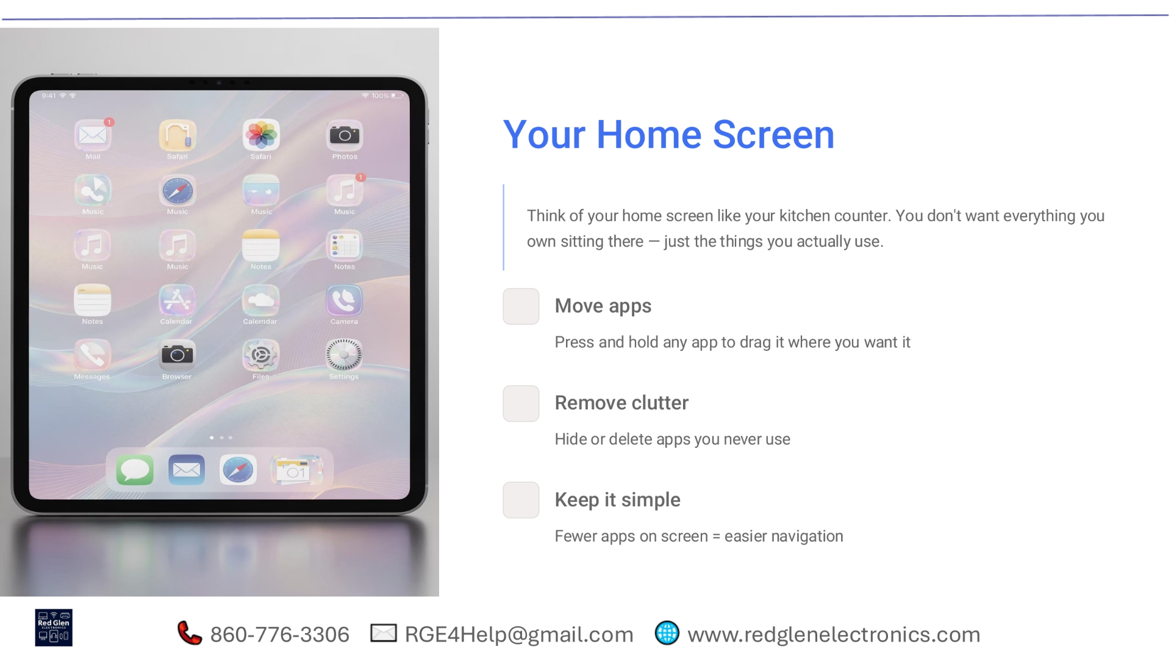
Notes:
Think of your iPad's home screen like your kitchen counter. You only want the things you actually use readily available. We'll learn how to move apps to your preferred locations, remove clutter by hiding or deleting unused apps, and keep it simple for easier navigation with fewer apps on screen.

Slide 12
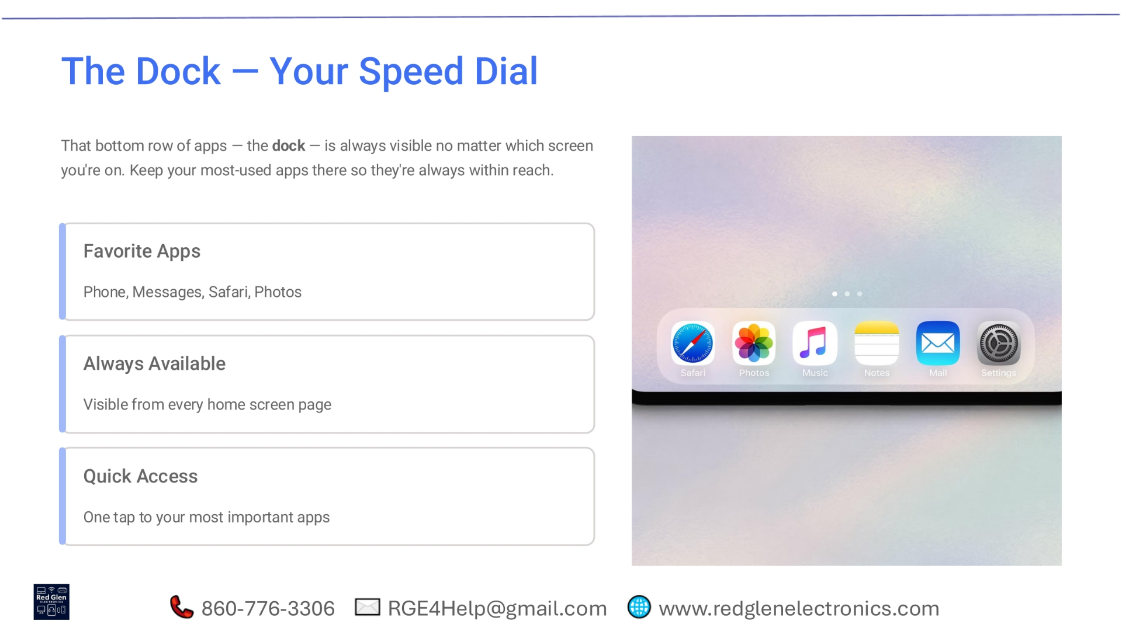
Notes:
The dock, that bottom row of apps, acts like your speed dial. It's always visible, no matter which screen you're on, keeping your most-used apps within easy reach. This allows for quick access to your favorite apps like Phone, Messages, Safari, and Photos with just one tap from any home screen page.

Slide 13
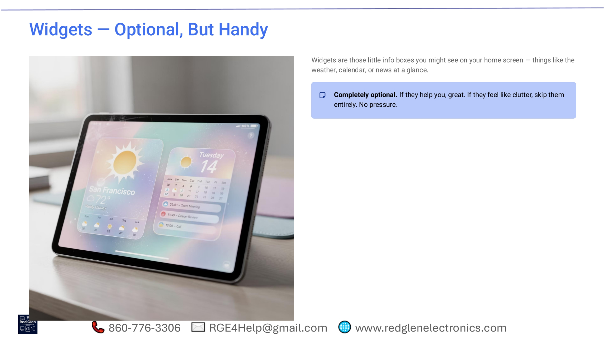
Notes:
Widgets are those small information boxes you might see on your home screen, displaying things like weather, calendar events, or news at a glance. They are completely optional. If they enhance your experience, that's great. If they feel like clutter, feel free to skip them entirely; there's no pressure to use them.

Slide 14
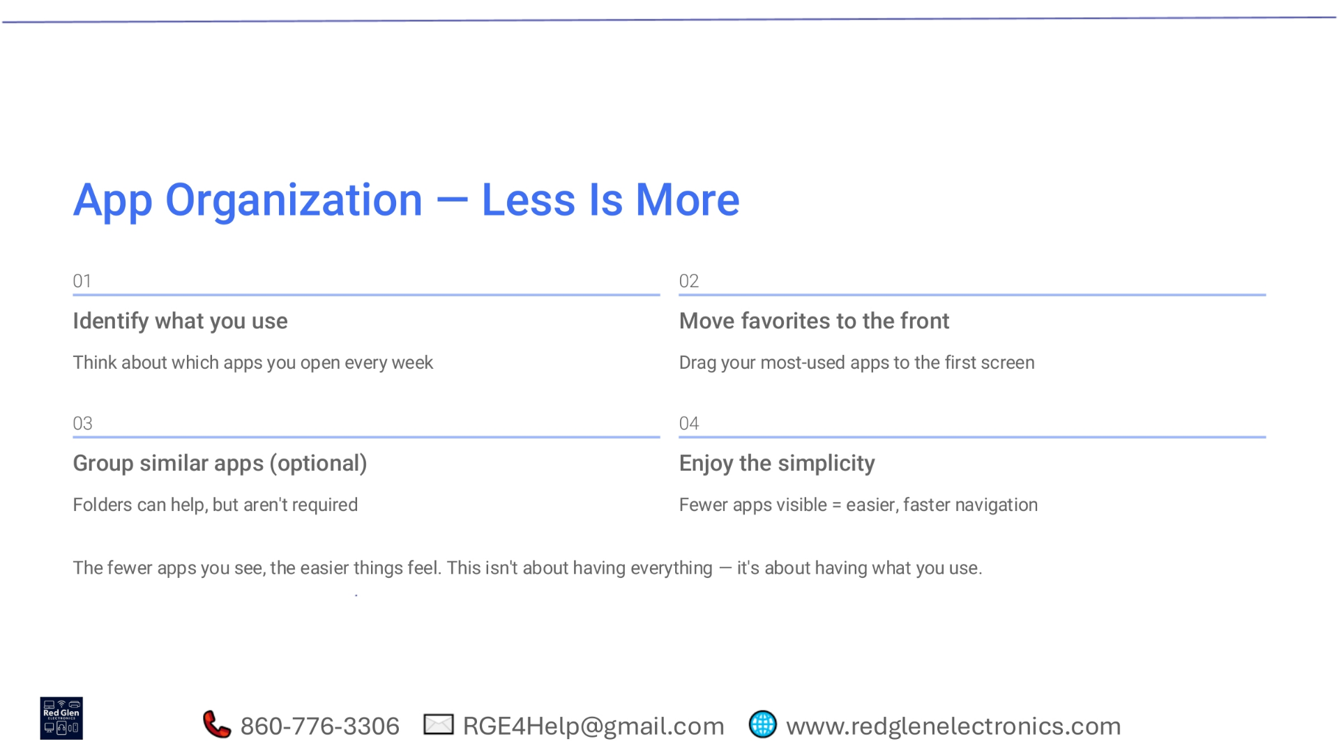
Notes:
When organizing your apps, remember that less is often more. Start by identifying the apps you use most frequently each week. Then, move your favorites to the first screen for easy access. You can optionally group similar apps into folders, but it's not required. Ultimately, fewer visible apps lead to easier and faster navigation.

Slide 15
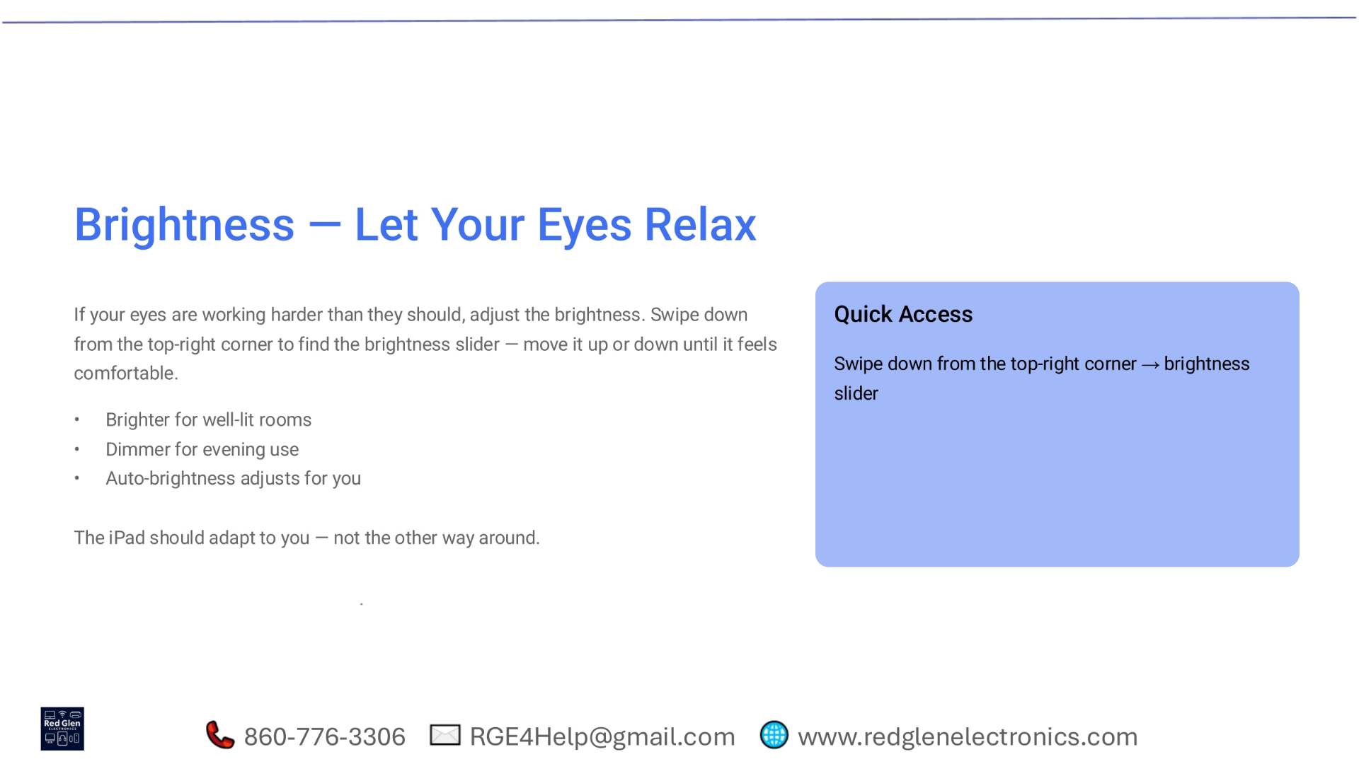
Notes:
To ensure your eyes are comfortable, adjust your iPad's brightness. Swipe down from the top-right corner to access the brightness slider and set it to a comfortable level. You can make it brighter for well-lit rooms, dimmer for evening use, or let auto-brightness adjust for you. Your iPad should adapt to you.

Slide 16
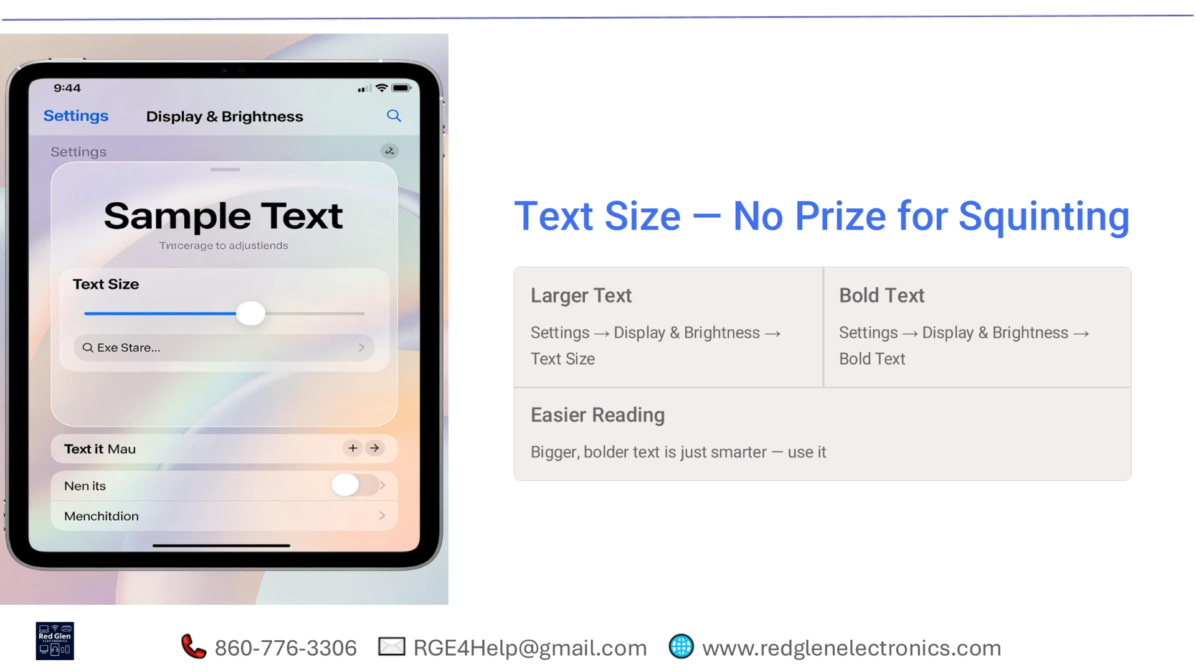
Notes:
There's no need to squint when using your iPad. You can easily adjust the text size for easier reading. Navigate to Settings, then Display & Brightness, and select Text Size to increase it. You can also enable Bold Text from the same menu for even greater clarity. Bigger, bolder text is simply smarter to use.

Slide 17
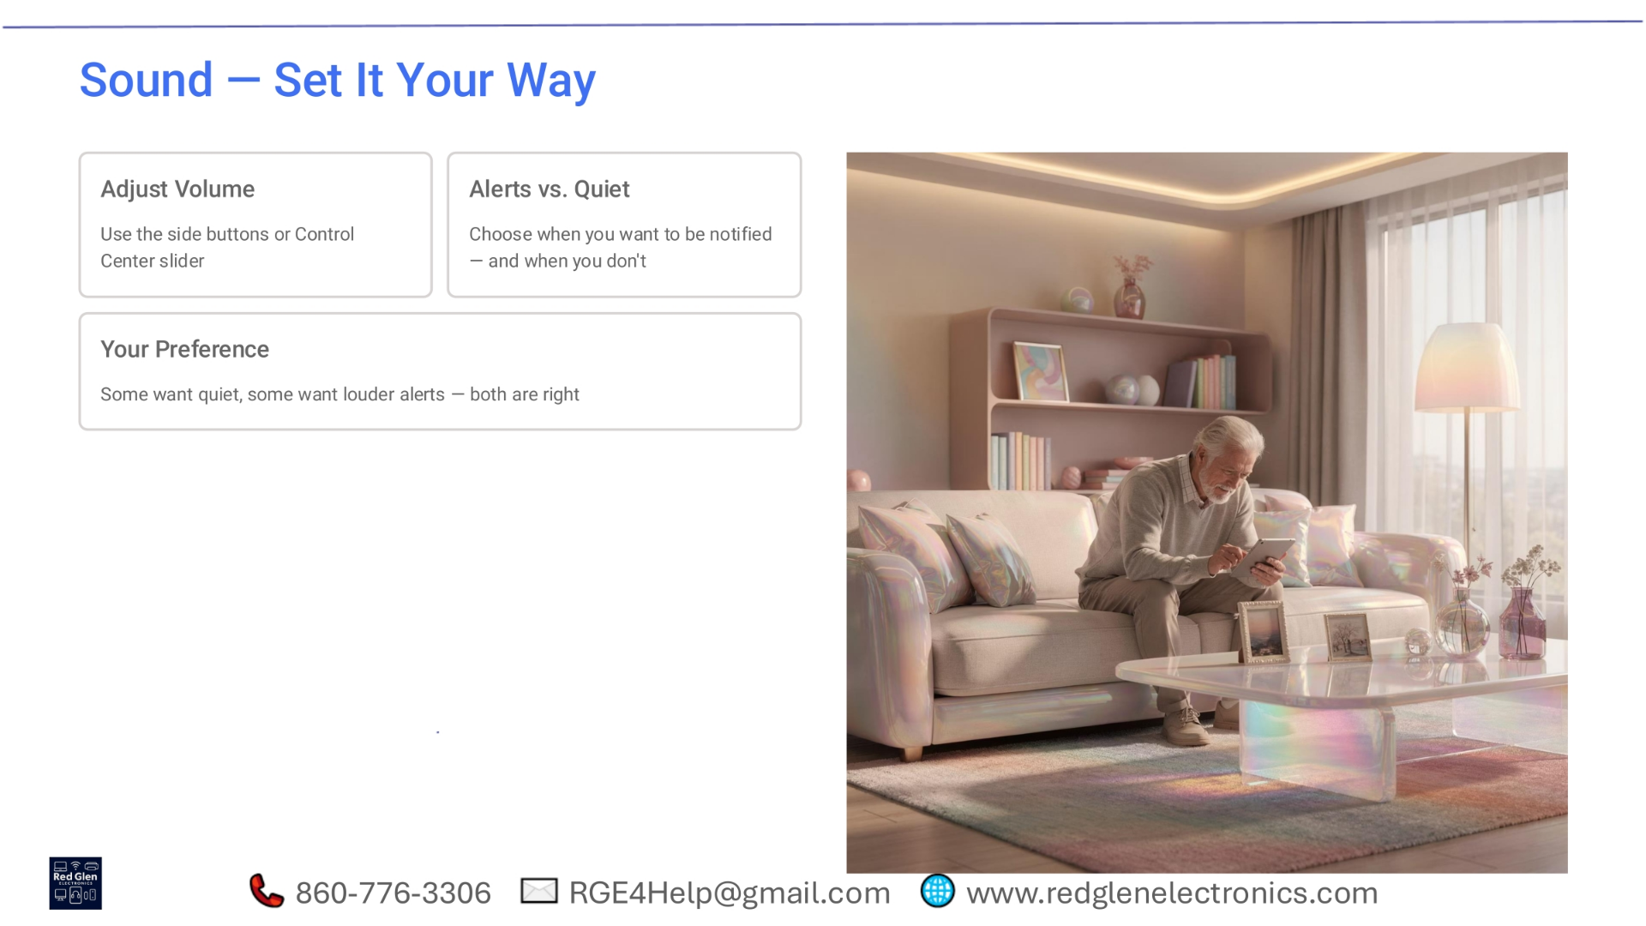
Notes:
Customize your iPad's sound settings to suit your preferences. You can adjust the volume using the side buttons or the Control Center slider. Decide when you want to receive alerts and when you prefer quiet. Whether you like quiet notifications or louder alerts, both preferences are perfectly valid.

Slide 18
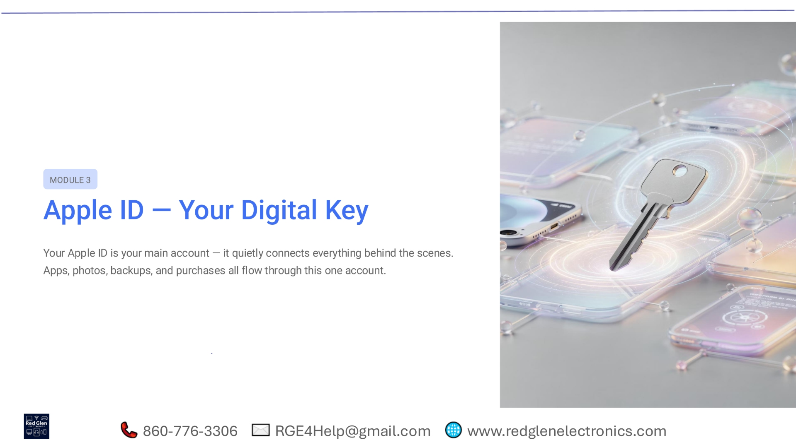
Notes:
Module 3 introduces your Apple ID, which acts as your digital key. This is your main account, quietly connecting everything behind the scenes. All your apps, photos, backups, and purchases flow through this single account, making it a central part of your iPad experience.

Slide 19
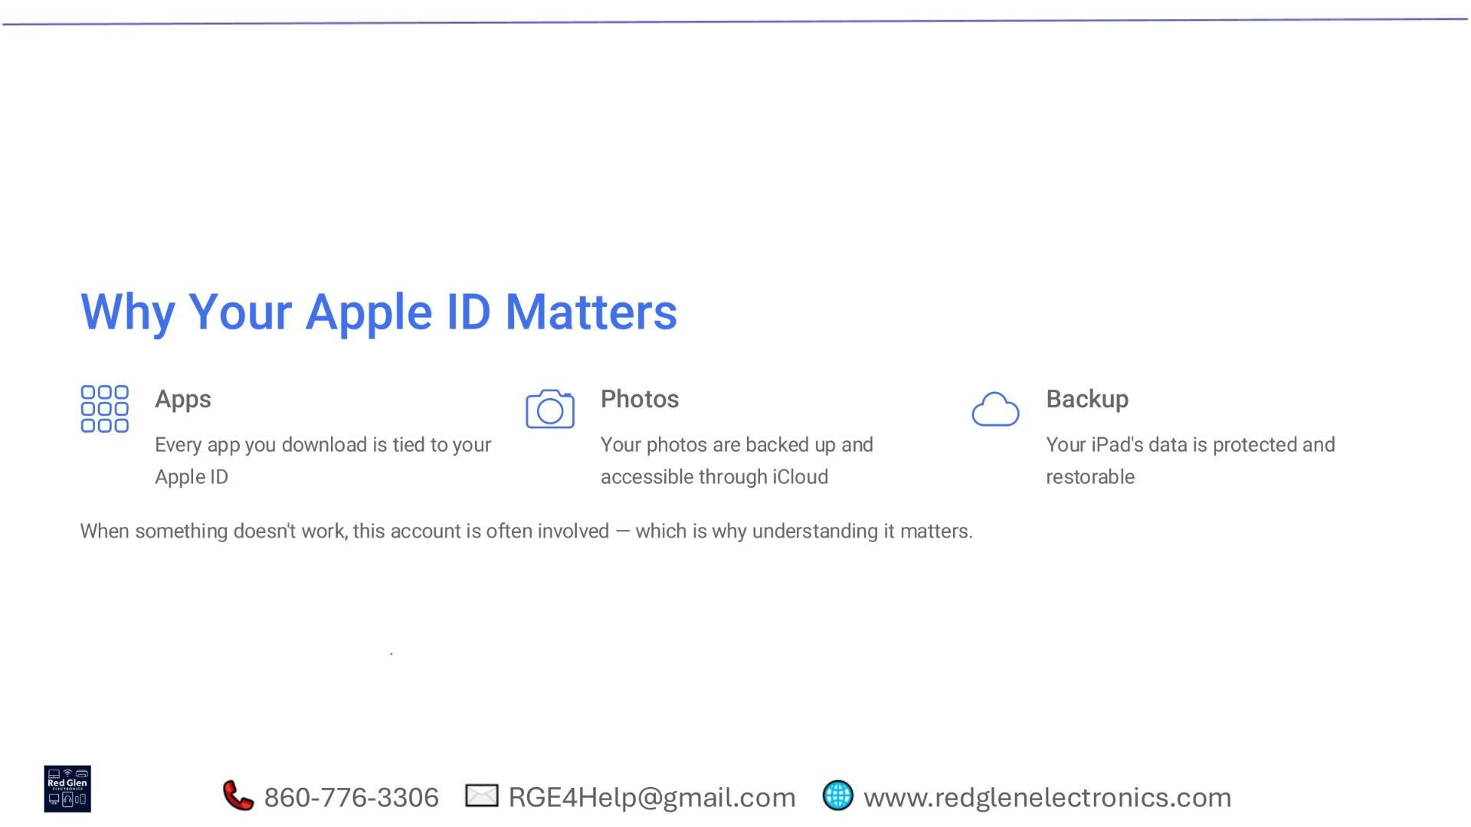
Notes:
Understanding your Apple ID is crucial because it underpins many essential functions. Every app you download is linked to it, your photos are backed up and accessible via iCloud, and your iPad's data is protected and restorable. When something isn't working as expected, your Apple ID is often involved.

Slide 20
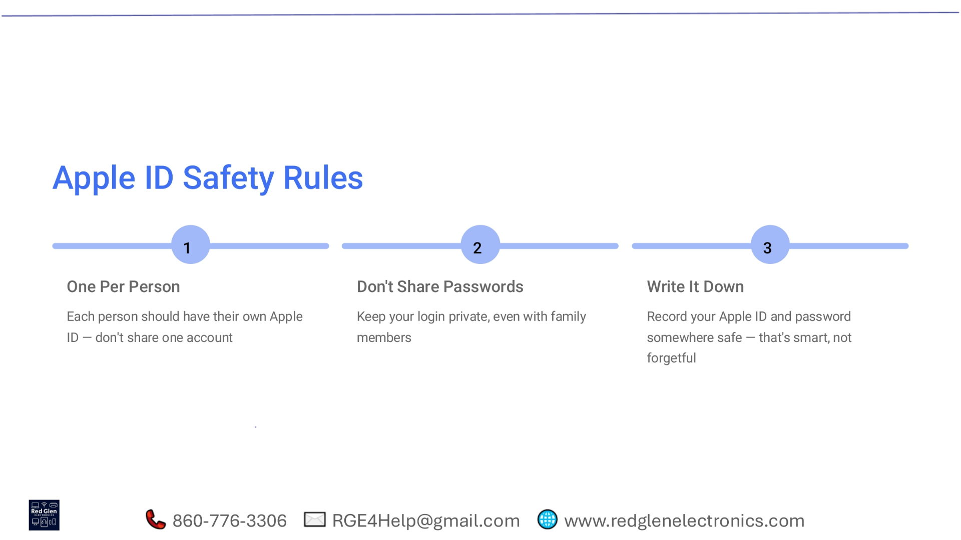
Notes:
To keep your Apple ID safe, follow these three rules. First, ensure each person has their own Apple ID; avoid sharing accounts. Second, keep your login private, even from family members. Third, record your Apple ID and password somewhere safe. Being smart about security prevents forgetfulness.

Slide 21
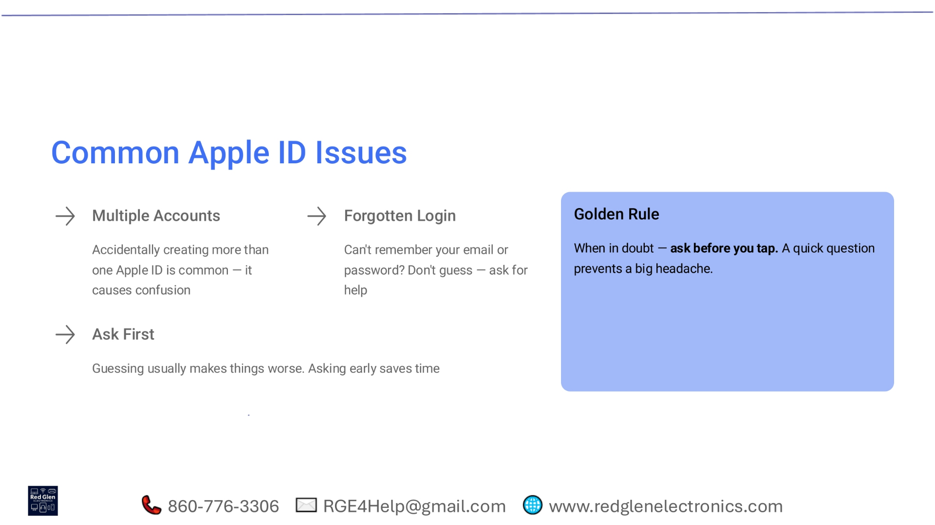
Notes:
Common Apple ID issues include accidentally creating multiple accounts, which can cause confusion, or forgetting your login details. If you can't remember your email or password, don't guess; always ask for help. The golden rule is: when in doubt, ask before you tap. A quick question can prevent a big headache.

Slide 22
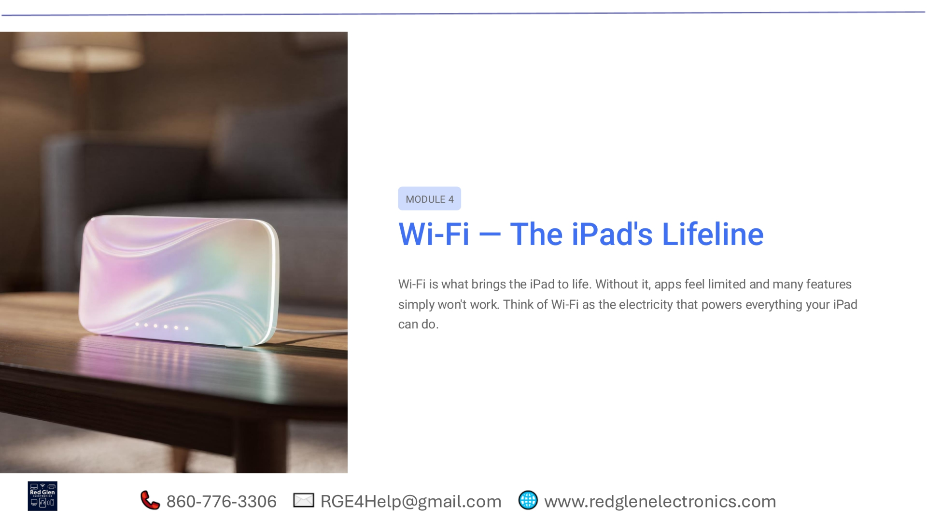
Notes:
Today, we're diving into Module 4, focusing on Wi-Fi, the iPad's lifeline. Wi-Fi is fundamental to your iPad's functionality, enabling apps and features to work seamlessly. Think of it as the essential power source that brings all your iPad's capabilities to life.

Slide 23
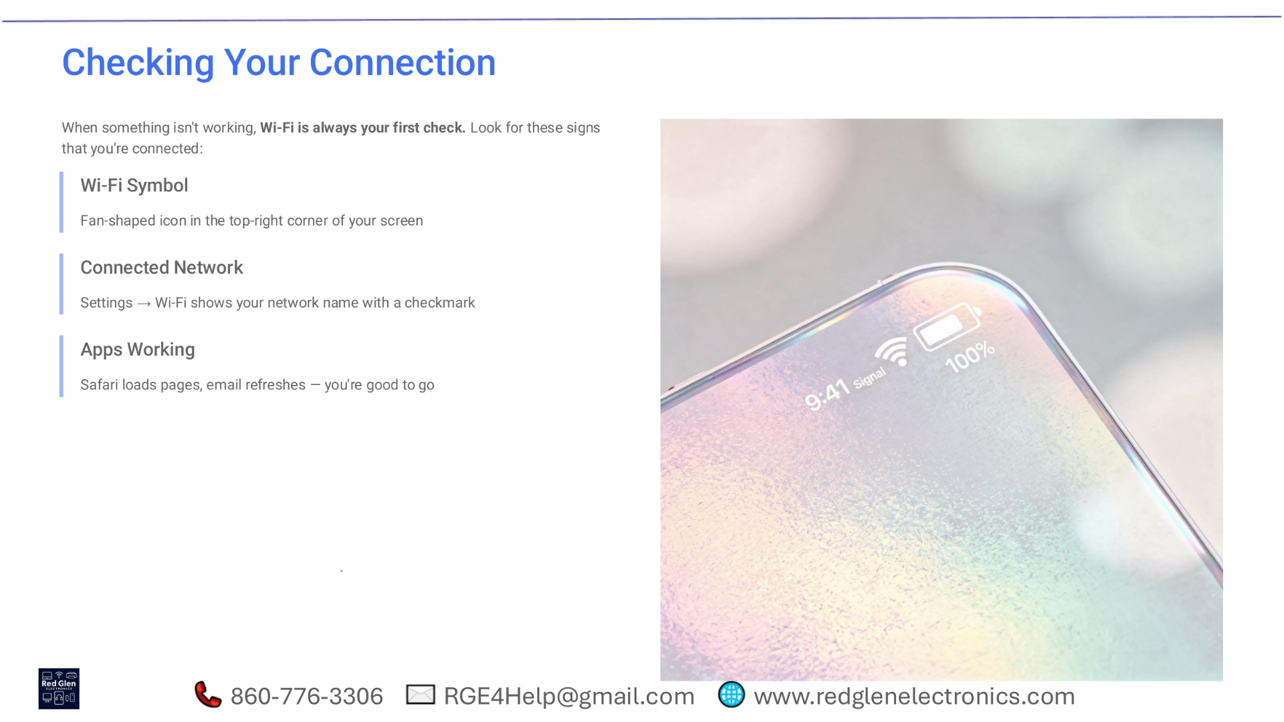
Notes:
When you encounter an issue, checking your Wi-Fi connection should always be your first step. Look for a few key indicators to confirm you're connected. First, the fan-shaped Wi-Fi symbol should appear in the top-right corner of your screen. Next, in Settings, under Wi-Fi, you should see your network name with a checkmark. Finally, if apps like Safari load pages and your email refreshes, you know your connection is working well.

Slide 24
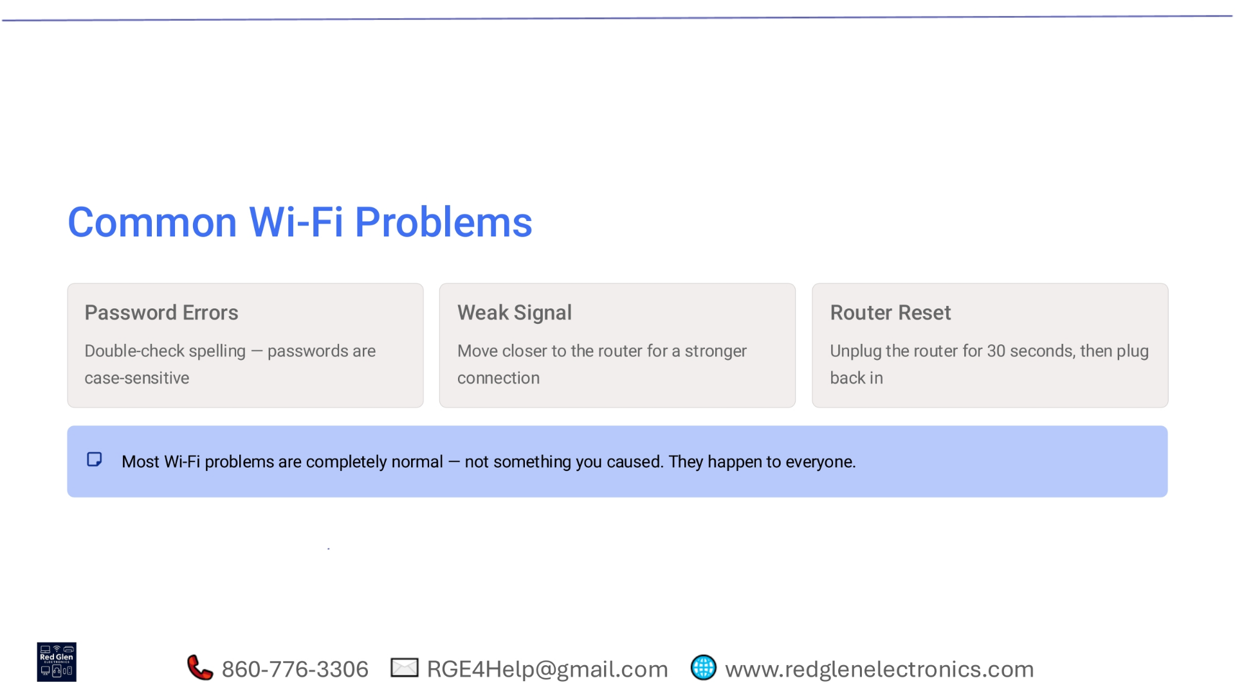
Notes:
It's completely normal to encounter common Wi-Fi problems, and they're usually easy to resolve. If you're facing password errors, double-check your spelling, as passwords are case-sensitive. For a weak signal, try moving closer to your Wi-Fi router to establish a stronger connection. If all else fails, a simple router reset can often fix many issues: unplug it for 30 seconds, then plug it back in. Remember, these issues happen to everyone and are not something you caused.

Slide 25
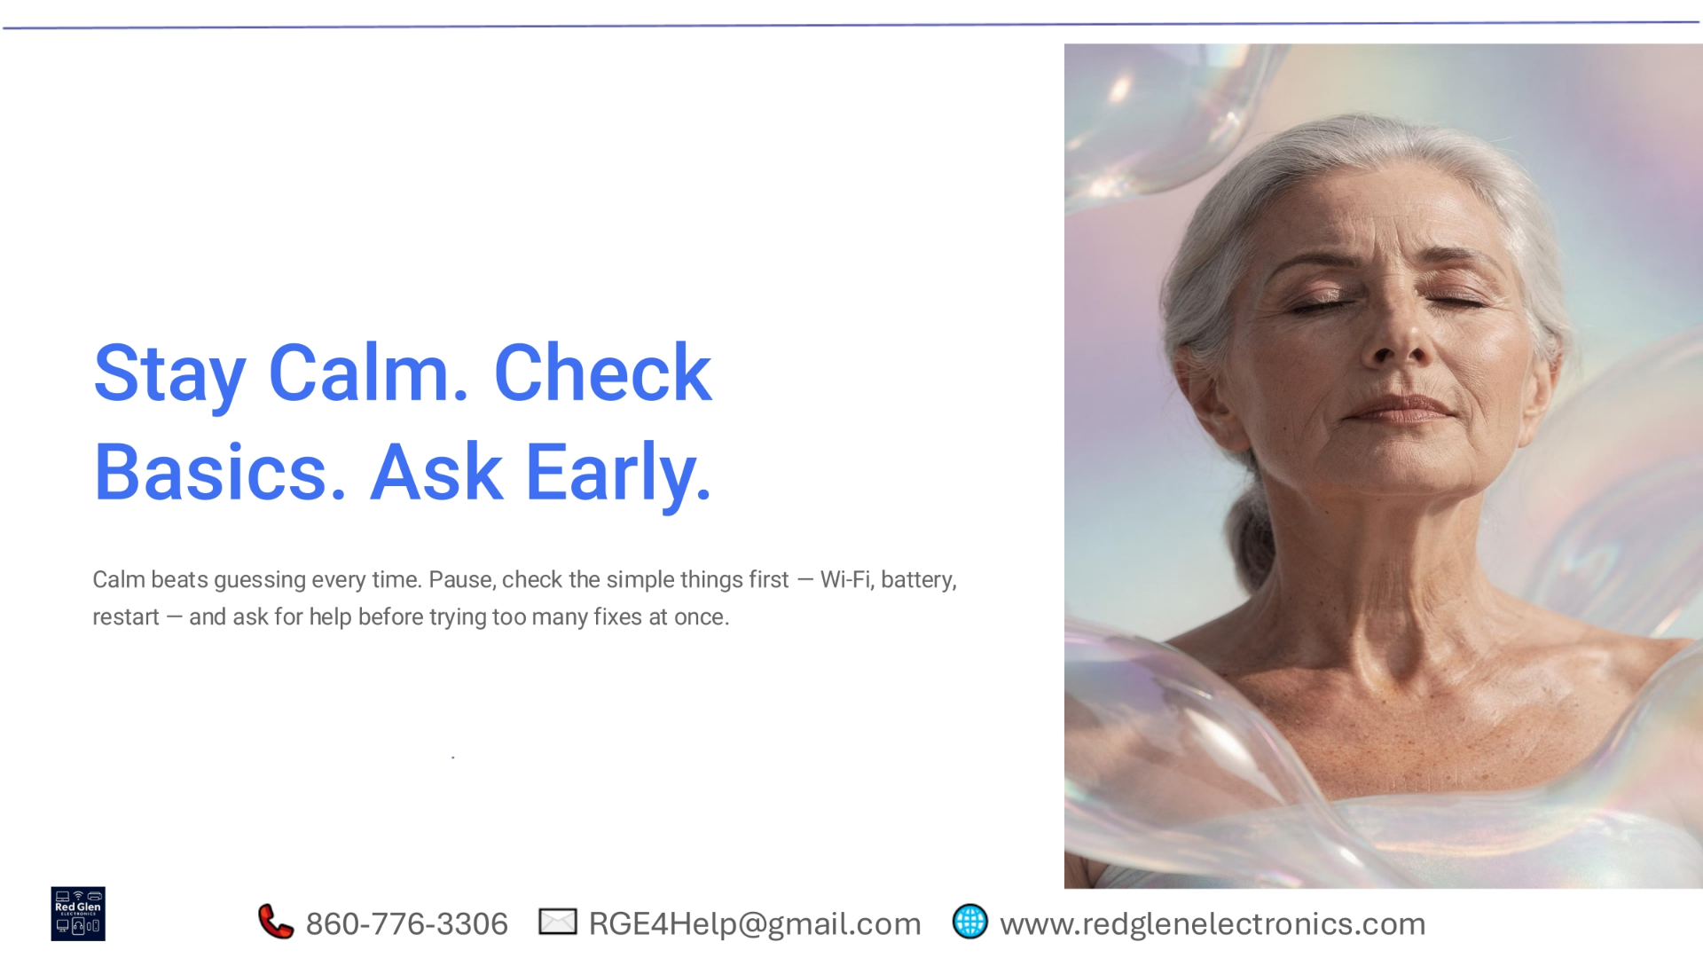
Notes:
When troubleshooting, a calm approach is always best. Instead of guessing, pause and check the simple things first. Verify your Wi-Fi connection, ensure your battery has charge, and try a quick restart. If these basic steps don't resolve the issue, don't hesitate to ask for help early on, rather than attempting too many fixes at once. This method often prevents further frustration and leads to quicker solutions.

Slide 26
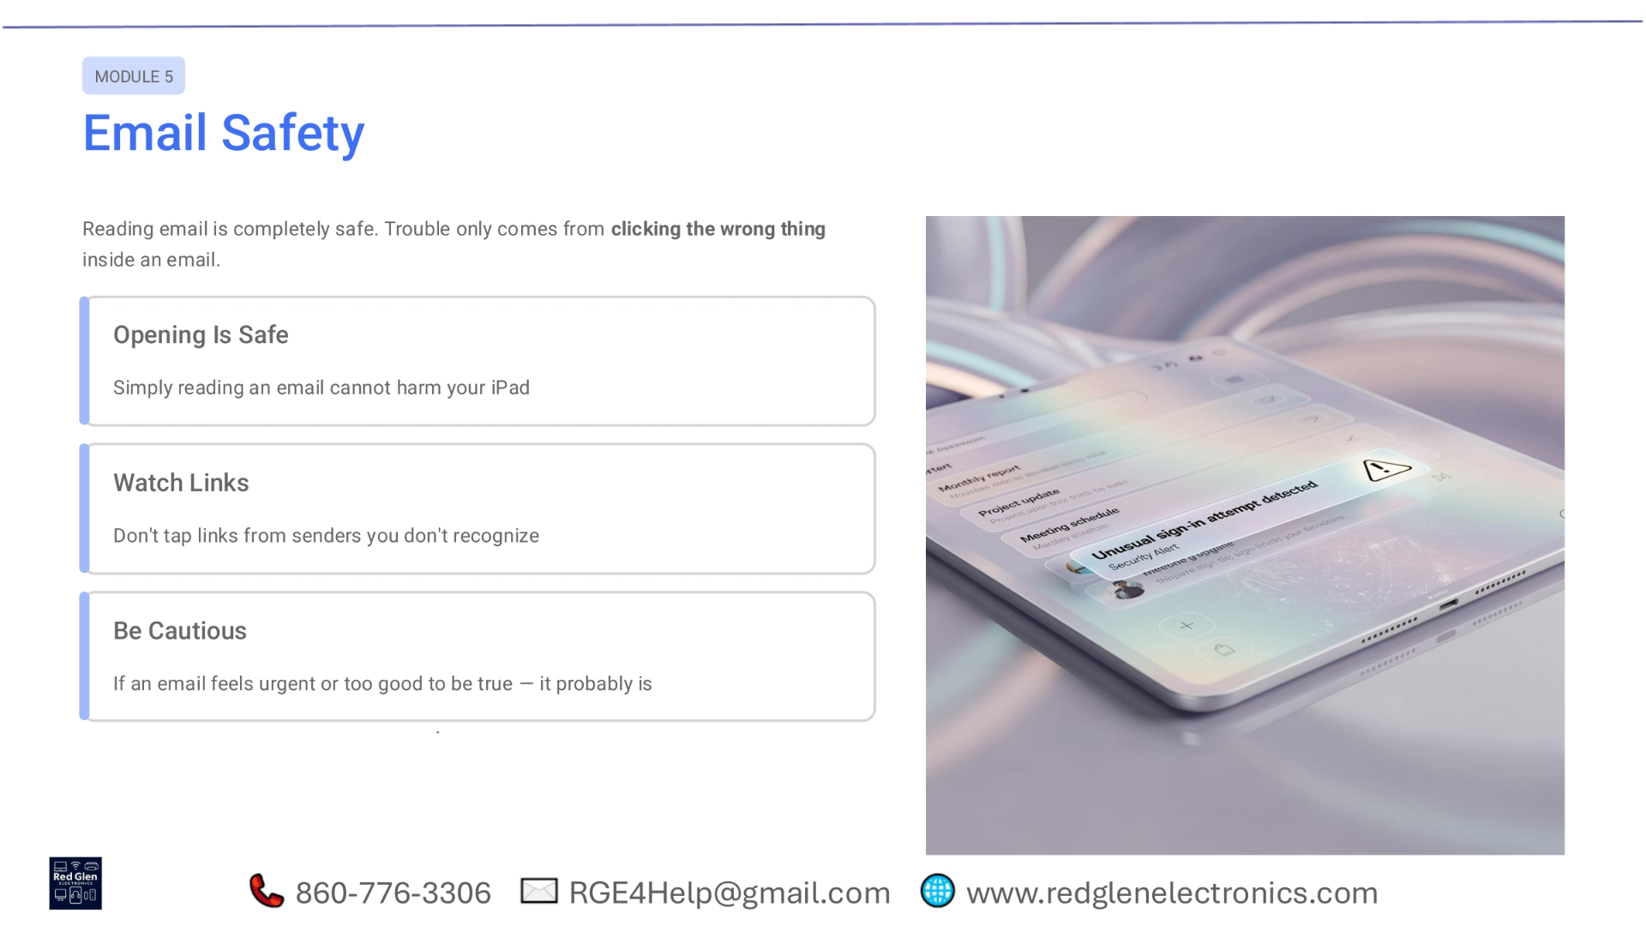
Notes:
Moving into Module 5, we'll discuss email safety. Simply opening an email is generally safe and won't harm your iPad. However, trouble arises when you click on the wrong things within an email. Always be cautious with links, especially from senders you don't recognize. If an email feels overly urgent or promises something too good to be true, it's likely a scam and should be treated with extreme caution.

Slide 27
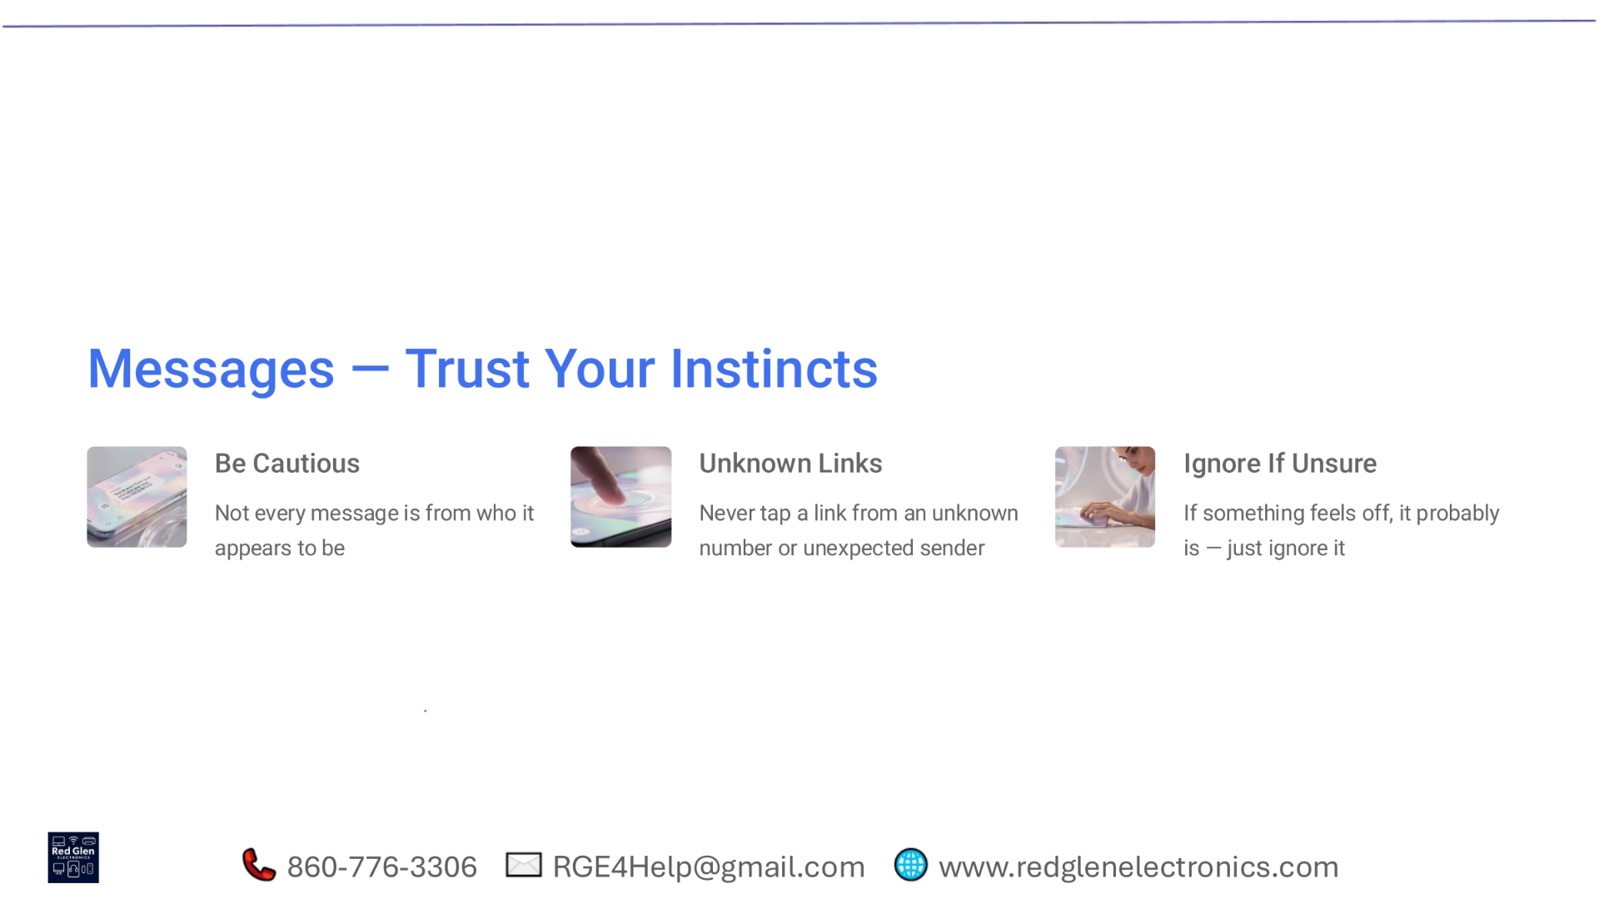
Notes:
When it comes to messages, trusting your instincts is key to staying safe. Be cautious, as not every message is truly from the person it claims to be. Never tap on links from unknown numbers or unexpected senders, as these can lead to security risks. If a message feels suspicious or 'off' in any way, it's best to ignore it entirely. Your intuition is a powerful tool for protecting your personal information.

Slide 28
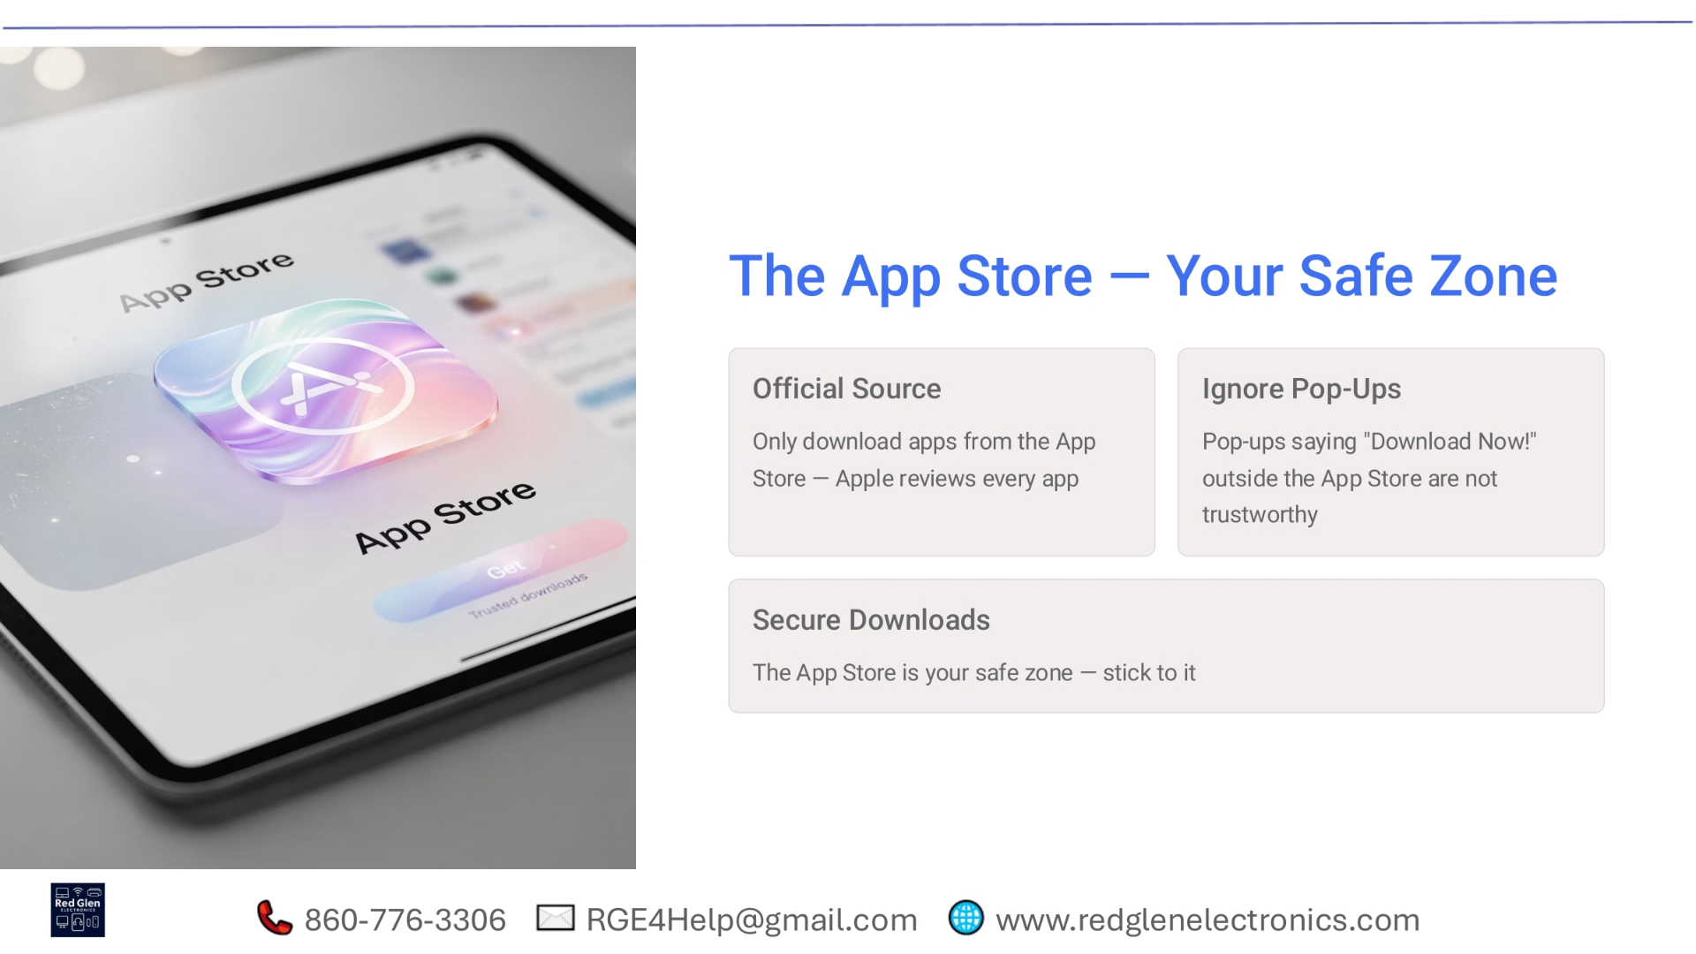
Notes:
The App Store is designed to be your safe zone for downloading applications. It's crucial to only download apps directly from the official App Store, as Apple rigorously reviews every app for security and functionality. Be wary of pop-ups outside the App Store that urge you to 'Download Now!' as these are not trustworthy. Sticking to the App Store ensures secure downloads and protects your iPad from potentially harmful software.

Slide 29
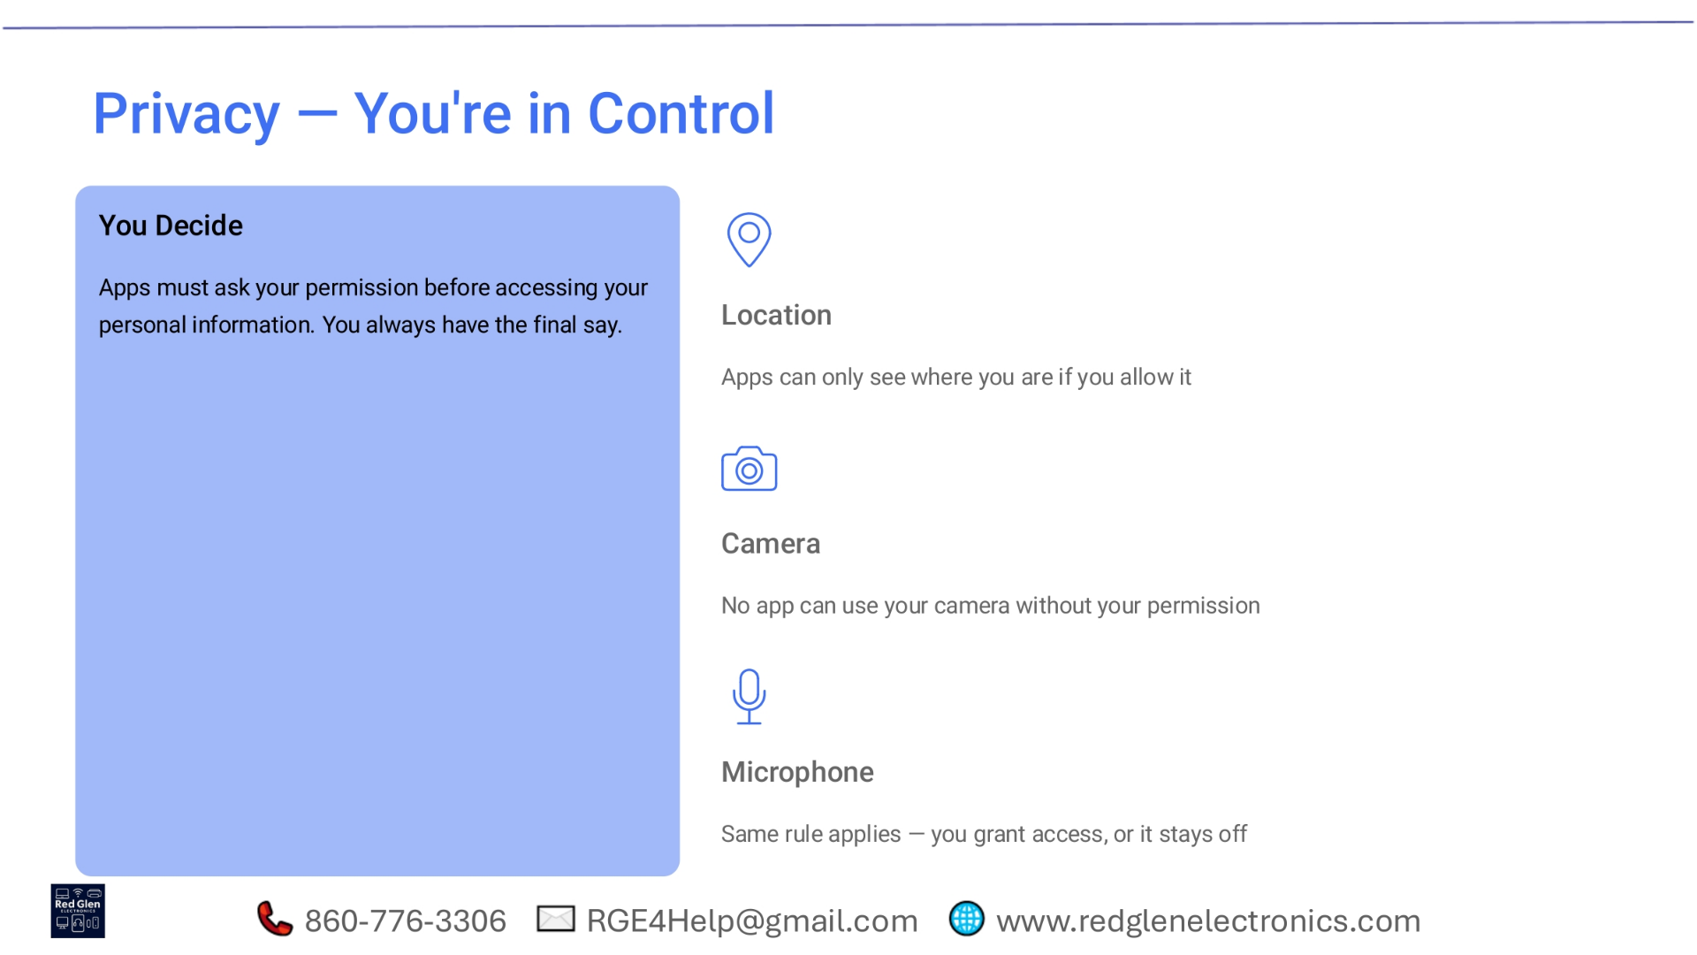
Notes:
When it comes to privacy, you are always in control of your personal information. Apps must explicitly ask for your permission before they can access sensitive data or features. For instance, an app can only see your location if you grant it permission. Similarly, no app can use your camera or microphone without your explicit consent. You always have the final say in what information apps can access, ensuring your privacy is protected.

Slide 30
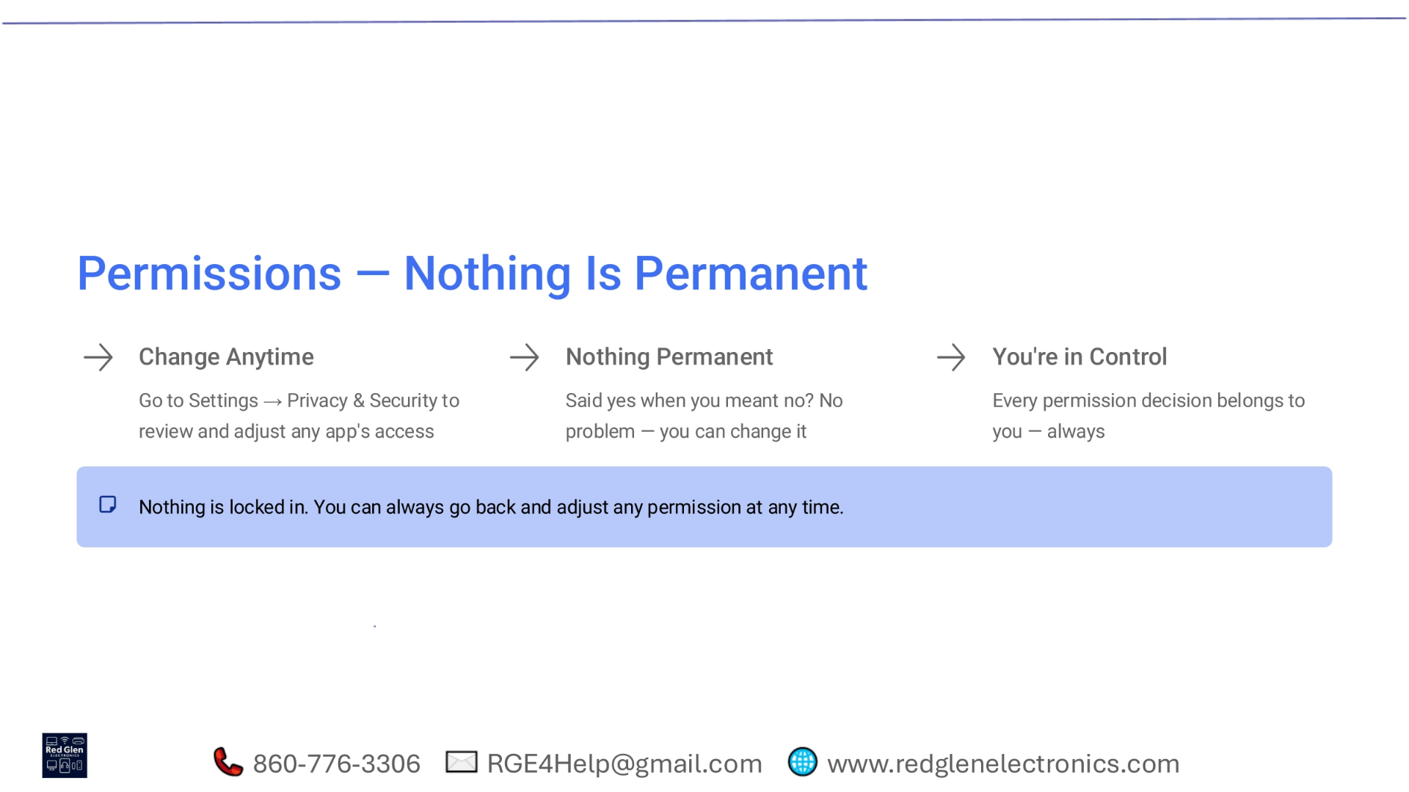
Notes:
Remember that nothing is permanent when it comes to app permissions. You can change access settings at any time. If you initially said yes to a permission but later change your mind, simply go to Settings, then Privacy & Security, to review and adjust any app's access. Every permission decision ultimately belongs to you, and you can always go back and modify them. This flexibility ensures you remain in full control of your device and data.

Slide 31
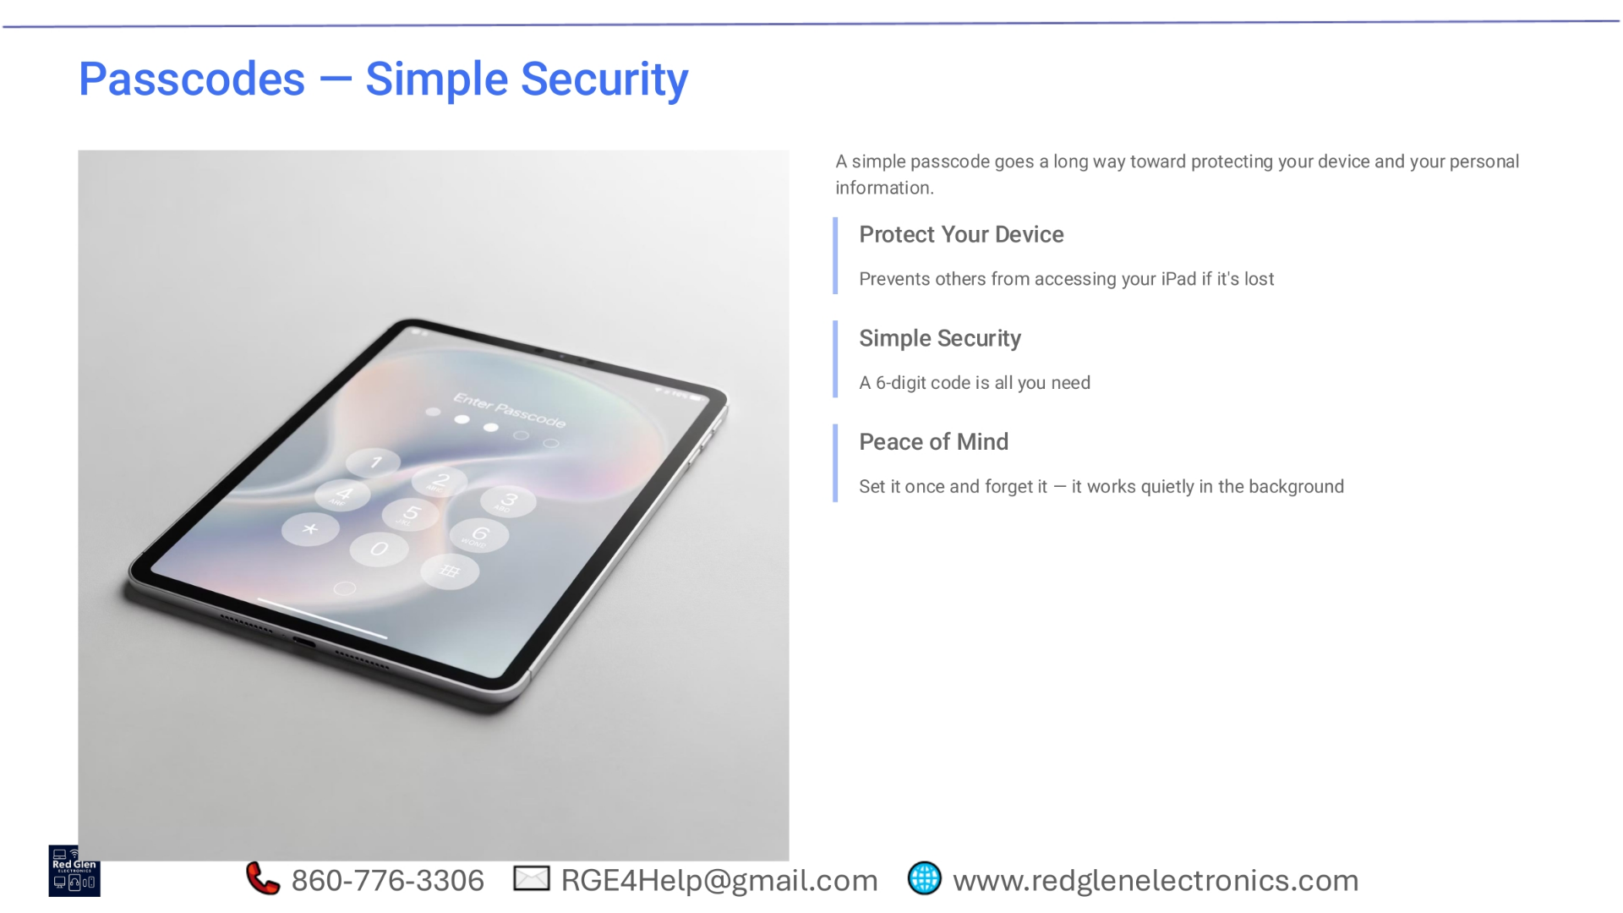
Notes:
Passcodes offer a simple yet effective layer of security for your iPad. A basic 6-digit code goes a long way in protecting your device and personal information. It prevents unauthorized access if your iPad is ever lost or stolen, safeguarding your data. Setting a passcode provides peace of mind; once it's configured, it works quietly in the background, constantly protecting your device without requiring further action.

Slide 32
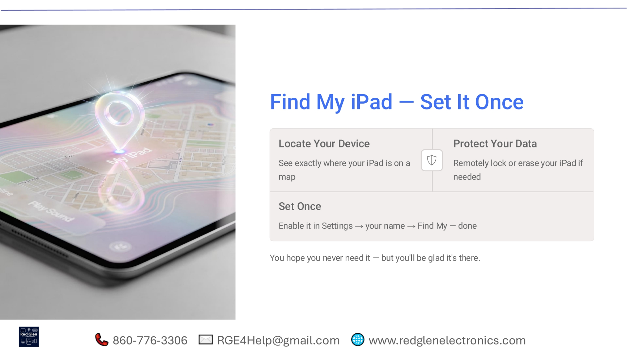
Notes:
The 'Find My iPad' feature is a powerful tool for both locating your device and protecting your data. Once enabled, you can see the exact location of your iPad on a map. In the unfortunate event that your iPad is lost or stolen, you can remotely lock it or even erase all your personal data to prevent unauthorized access. It's a feature you hope you never need, but setting it up once in your Settings under your name will provide invaluable peace of mind.

Slide 33
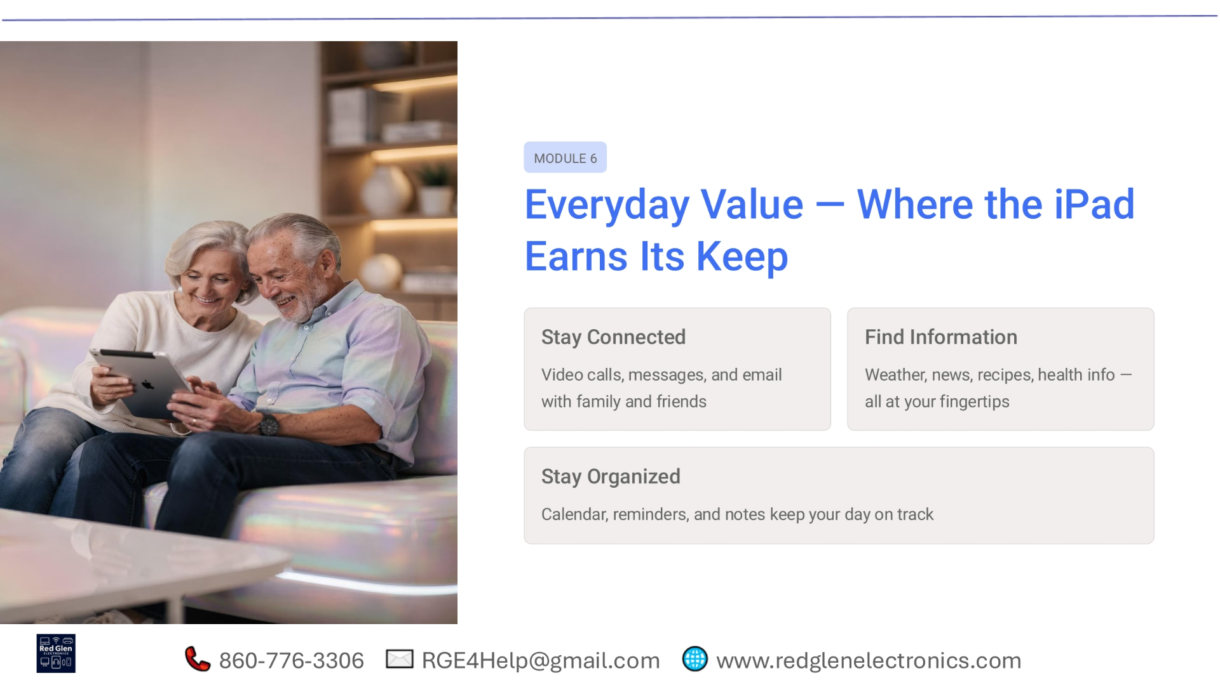
Notes:
Entering Module 6, we explore the everyday value of your iPad and how it truly earns its keep. It's an excellent tool for staying connected with loved ones through video calls, messages, and email. Your iPad also helps you find information quickly, whether it's checking the weather, reading news, finding recipes, or accessing health information. Furthermore, it assists in staying organized with its calendar, reminders, and notes features, keeping your day on track.

Slide 34
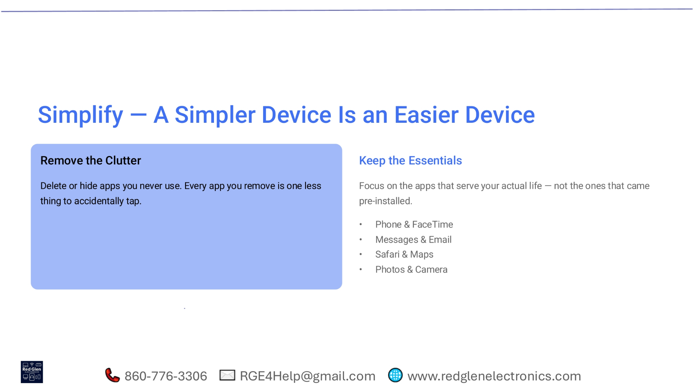
Notes:
Simplifying your iPad experience makes it much easier to use. Consider removing or hiding apps you never use to reduce clutter. Every app you remove means one less thing to accidentally tap, streamlining your interface. Instead, focus on keeping the essentials that truly serve your life, such as Phone and FaceTime, Messages and Email, Safari and Maps, and Photos and Camera. These core apps are often all you need for daily tasks.

Slide 35
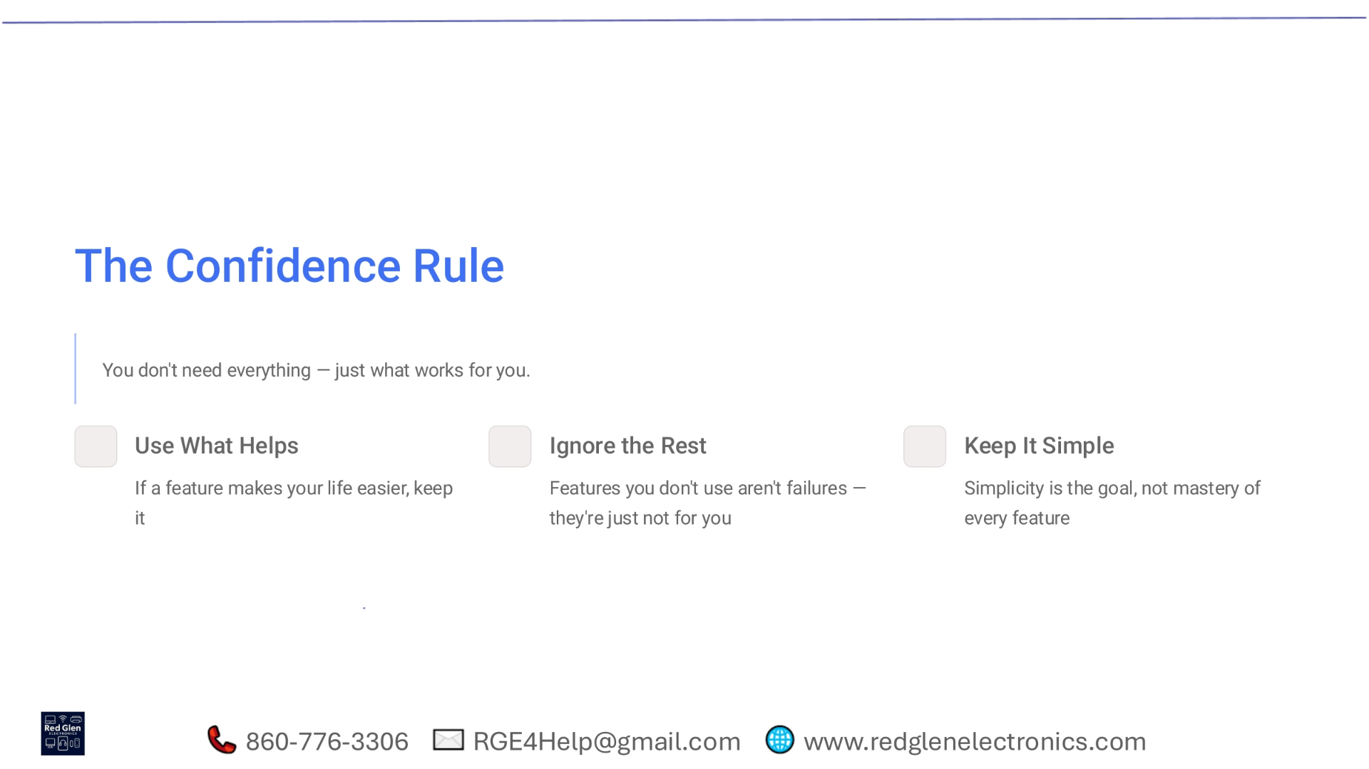
Notes:
Embrace the confidence rule: you don't need to master every single feature on your iPad; just focus on what works for you. Use what helps you, keeping any feature that genuinely makes your life easier. Feel free to ignore the rest; features you don't use aren't failures, they simply aren't for you. The ultimate goal is simplicity, not the mastery of every single function. Use your iPad in a way that feels natural and beneficial to you.

Slide 36
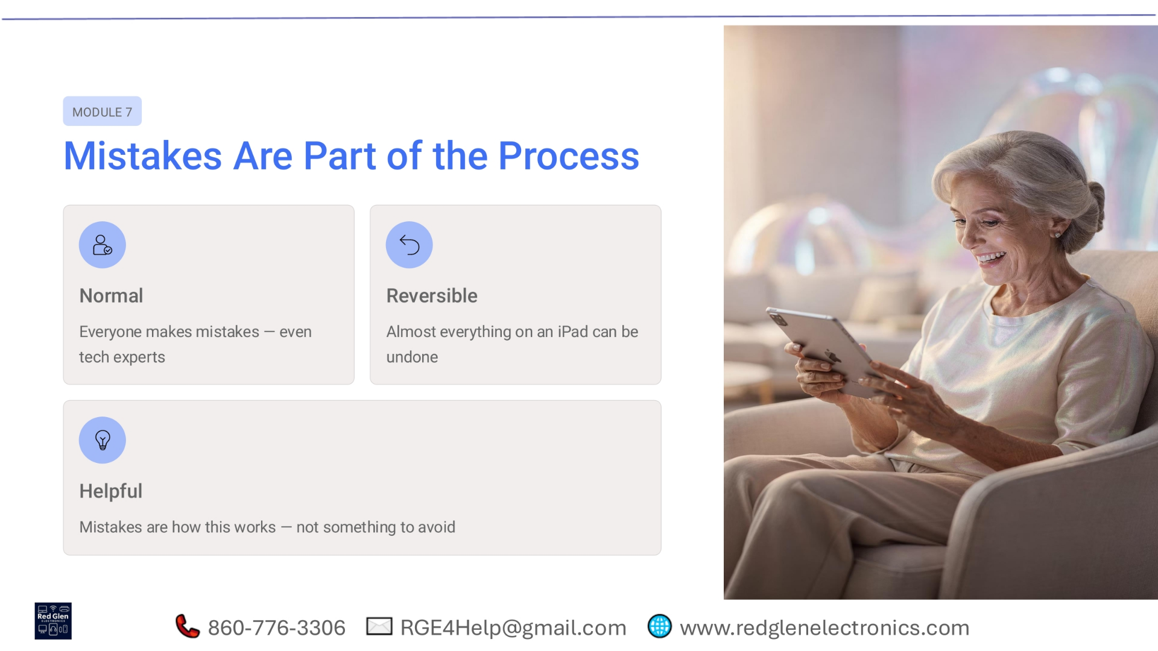
Notes:
In Module 7, we recognize that mistakes are a normal part of learning with technology. It's common for everyone, even tech experts, to make errors. The good news is that nearly everything on an iPad can be reversed, meaning you can usually undo any action. View mistakes as helpful learning opportunities rather than something to fear. They help you truly understand how your iPad works and build confidence.

Slide 37
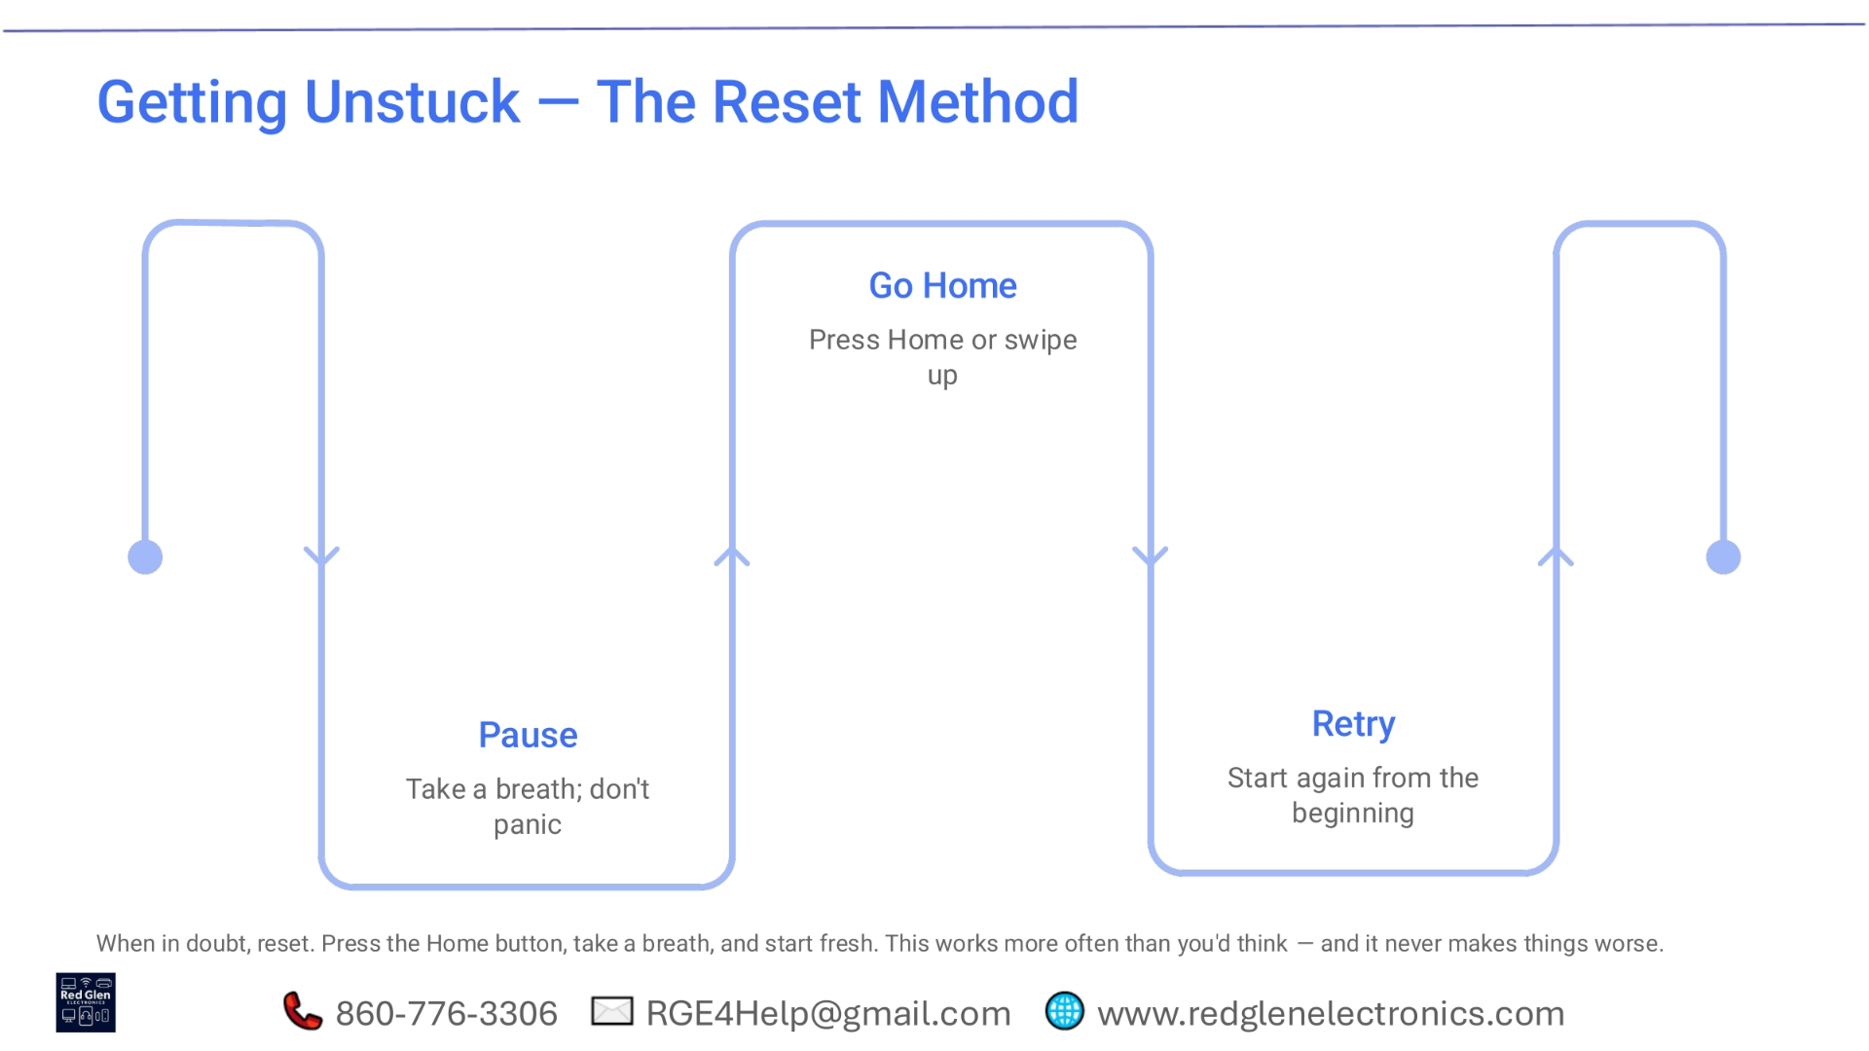
Notes:
When you find yourself stuck, the 'reset method' is a reliable approach. First, pause, take a breath, and avoid panicking. Next, try to go home by pressing the Home button or swiping up, which often resolves minor glitches. Finally, retry your task from the beginning. This method works more often than you might think and, crucially, it never makes things worse. Don't hesitate to press the Home button, take a breath, and start fresh.

Slide 38
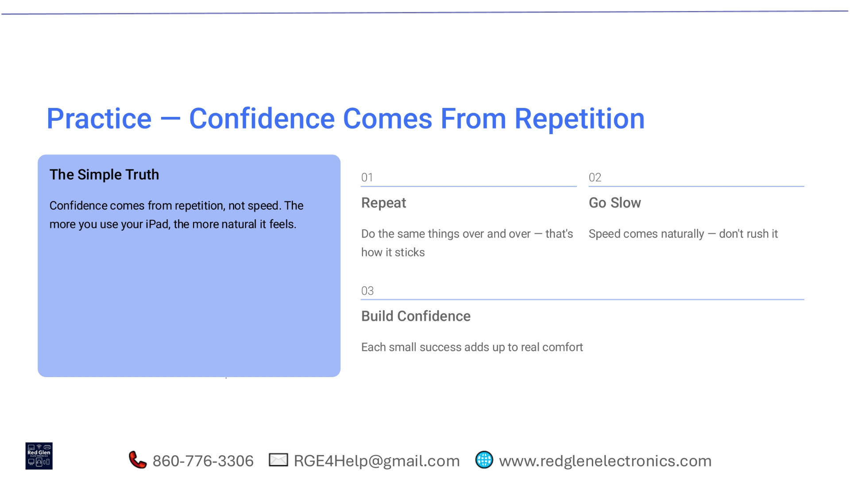
Notes:
The simple truth about building confidence with your iPad is that it comes from repetition, not speed. The more you use your device, the more natural and intuitive it will feel. Make an effort to repeat tasks and actions over and over; that's how new skills truly stick. Go slow initially, as speed comes naturally with practice. Each small success you achieve will build real comfort and confidence in using your iPad.

Slide 39
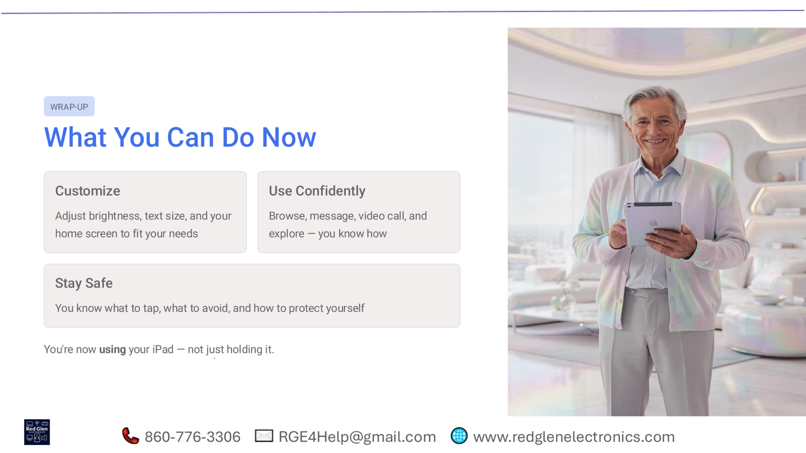
Notes:
As we wrap up, you now have the knowledge to truly use your iPad, not just hold it. You can customize your device by adjusting brightness, text size, and your home screen to fit your personal needs. You can use your iPad confidently to browse, message, video call, and explore, knowing how to navigate its features. Most importantly, you understand how to stay safe, recognizing what to tap, what to avoid, and how to protect yourself and your information.

Slide 40
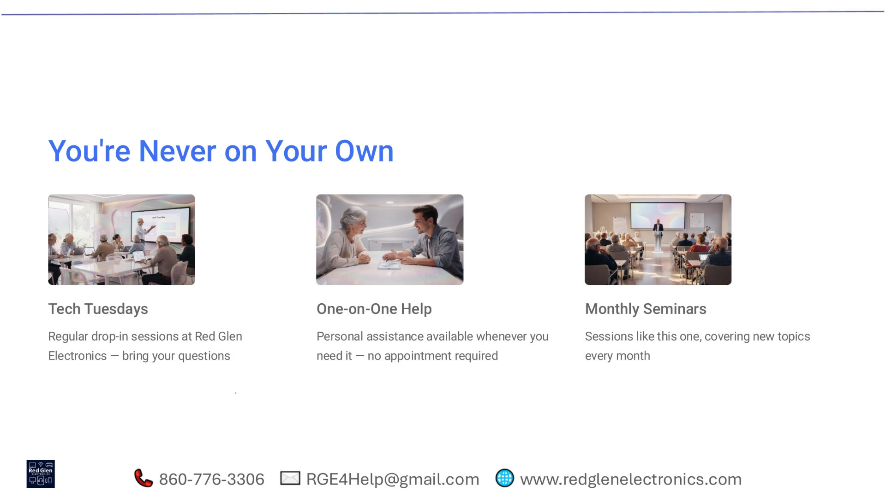
Notes:
Remember, you're never on your own when it comes to using your iPad. Red Glen Electronics offers ongoing support through various resources. Join us for Tech Tuesdays, our regular drop-in sessions where you can bring your questions and get immediate assistance. We also provide one-on-one help, offering personal assistance whenever you need it, with no appointment required. Additionally, we host monthly seminars, similar to this one, covering new topics to keep you informed and confident.

Slide 41
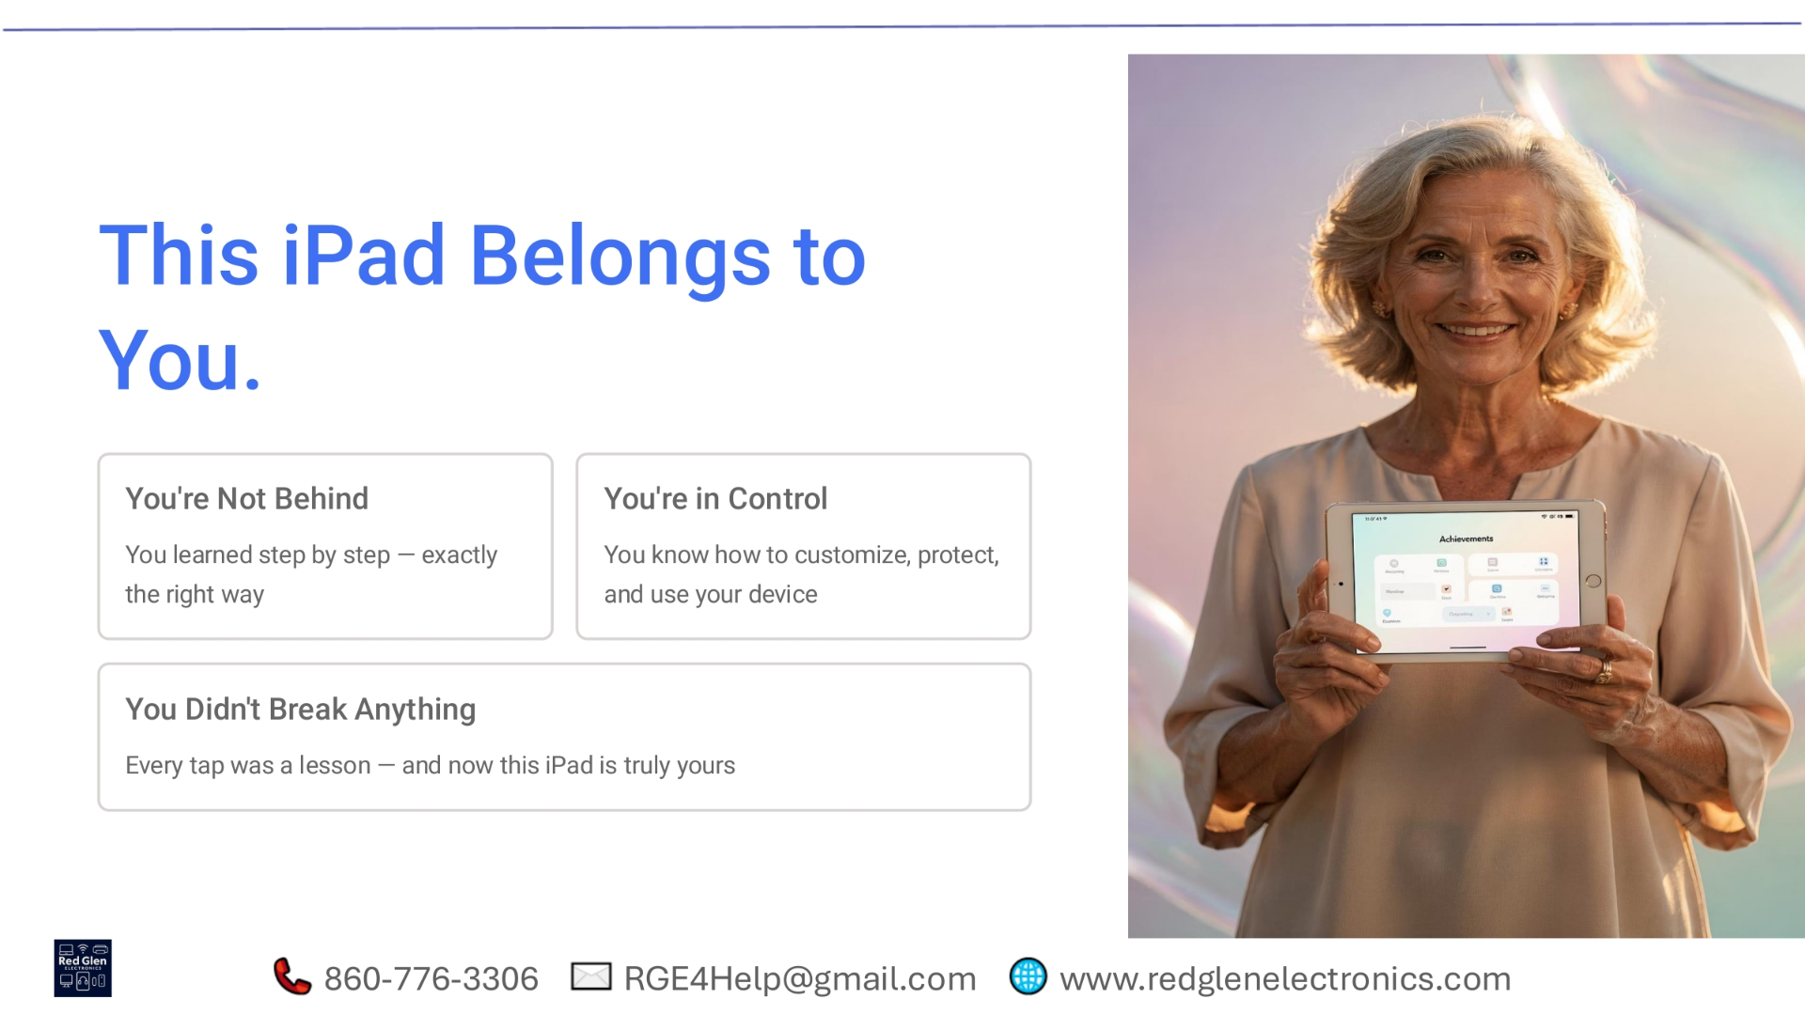
Notes:
Your iPad is now truly yours. You've learned how to customize, protect, and use it with confidence. Every interaction was a lesson, and you are now in control. Enjoy the full potential of your iPad.

Slide 42

Notes:
This comprehensive guide to iPad Essentials 101 focused on empowering users to confidently personalize their device for comfort and simplicity. Key topics included ensuring data safety through Apple ID best practices, managing app permissions, setting passcodes, and utilizing 'Find My iPad', alongside essential navigation for everyday tasks like Wi-Fi, email, and messages. Ultimately, the goal is to make your iPad a powerful, personal tool, with ongoing support for your learning journey.

