Slide 1

iPad Essentials 101 – Part 2
Everyday Use Made Simple
Welcome back, everybody. Today we move beyond getting comfortable with the iPad — now we start using it for the kinds of everyday things that actually matter. In other words, today is where the iPad starts earning its keep.

Slide 2
Welcome Back
Returning from Part 1?
Joining Us Fresh?
You've already got a nice foundation under your feet. Part 1 was about getting comfortable — Part 2 is about putting that comfort to work.
No worries, no secret password required — you're still in the right place. We'll cover everything you need for simple, practical everyday use.

Slide 3

No Pressure. Just Learning.
No Tests
Learn by Doing
No grades, no one standing in the back with a clipboard looking disappointed.
See what the iPad can do for you through hands-on, practical exploration.
Walk Out Ready
Leave with real skills you can use the minute you get home.

Slide 4
Meet Jim
Jim — Red Glen Electronics
How Jim Helps
Founder of RGE, helping everyday folks make sense of technology without the jargon, without the nonsense, and without making anybody feel behind the times.
Tech Tuesdays
Monthly Seminars
Regular drop-in sessions for hands-on help.
Structured learning like today's class.
One-on-One Help
Personal guidance at your own pace.

Slide 5

You Belong Here
Brand New?
Had It a While?
Welcome. We start from the beginning, no assumptions made.
Maybe it's been sitting on the table — that's fine too. Today we put it to use.
No Wrong Questions
There's no wrong pace, no wrong starting point, and definitely no wrong question.

Slide 6
The 3-Part Journey
Part 3 — Make It Yours
Part 2 — Everyday Use (Today)
Personalizing and customizing the iPad for your own needs and preferences.
Part 1 — Get Comfortable
Using the iPad for real-life tasks that actually matter day to day.
Getting familiar with the iPad itself — holding it, navigating, the basics.
Confidence first, then usefulness, then customization — the old-fashioned sensible order.

Slide 7

Today's Goal
The goal is simple: use your iPad with more ease, less hesitation, and more confidence. Small wins count. In fact, small wins are the whole game.
Use Your iPad
Keep It Simple
For real, practical everyday tasks.
No computer science required. Heaven forbid.
Build Confidence
One small win at a time.

Slide 8
Apps = Tools
Think of It This Way
Each Has a Job
Apps are tools — just like a drawer full of tools at home, each one has a purpose. You don't need to master every app on the iPad any more than you need to know how to use a chainsaw to butter toast.
Every app is built for a specific purpose.
Use What You Need
You just need the tools that help you do the jobs you care about.
Focus only on the apps that are useful to you.

Slide 9
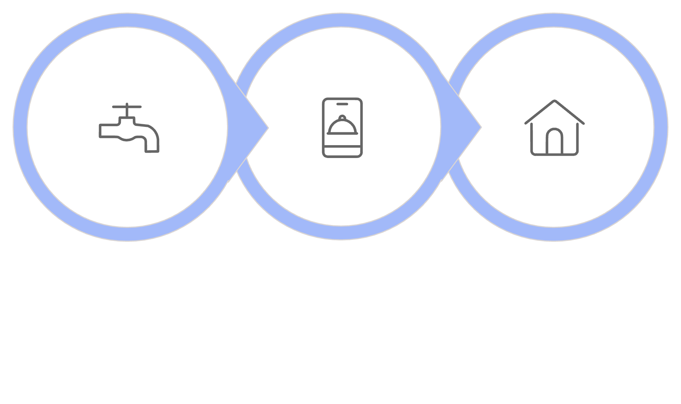
Opening & Closing Apps
Tap to Open
Use It
Return Home
Most apps follow this same simple rhythm. Once you get that basic pattern down, the iPad starts feeling a lot less mysterious. A lot of confidence comes from realizing that most things work the same general way.

Slide 10

Safari — Your Window to the Web
Browse
Visit any website — news, recipes, local businesses, and more.
Search
Look up anything you're curious about, quickly and easily.
Explore
Settle arguments, find directions, read the news — Safari is the front door to the online world, minus the squeaky hinges.

Slide 11
Searching the Web
Plain English Works Just Fine
Three Easy Steps
You don't need fancy computer language. Type naturally — the iPad doesn't expect elegance. It just wants a clue.
Type your question in the search bar
Tap the Search button
Pick a result that looks helpful
"weather tomorrow"
"best chicken soup recipe"
"nearest CVS"

Slide 12

Mail — Stay Connected
Email is still one of the handiest tools on the iPad. It lets you read messages, reply when needed, and keep up with family, friends, doctors, businesses, and organizations.
Read
Open and read messages at your own pace.
Reply
Respond when needed — no rush required.
Stay Connected
If you can open it, read it, and reply — you're already doing the important part.

Slide 13
Messages — Quick & Casual
Where Modern Communication Lives
Send Texts
Messages is quicker than email, more casual, and usually where family members send those three-word check-ins like "You home yet?"
Quick, casual messages to anyone.
It's one of the easiest ways to share a photo, send a short note, or stay in touch without making a whole production out of it.
Receive Replies
Responses come right back to the same conversation.
Share Photos
Send pictures directly from your iPad.

Slide 14
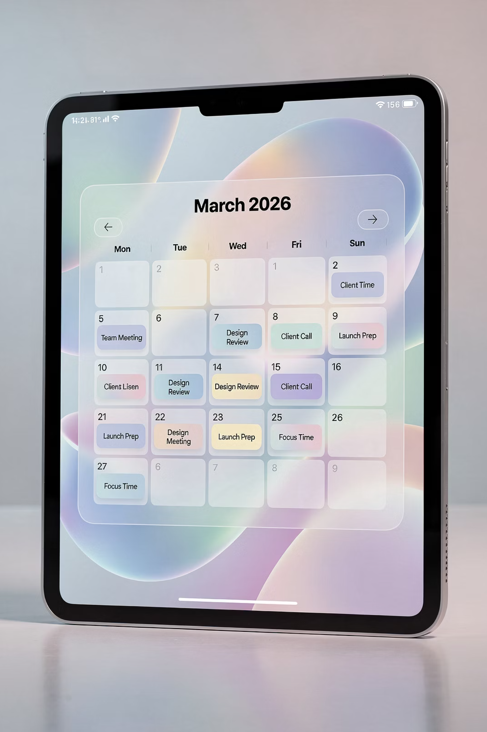
Calendar — Your Quiet Helper
A good calendar is like a dependable friend: not flashy, but awfully useful.
View Dates
Add Events
See your week or month at a glance — appointments, birthdays, family visits.
Haircuts, doctor visits, family gatherings — log them so you don't forget.
Reminders
Let the iPad keep track of what your brain shouldn't have to juggle alone.

Slide 15
Notes — The Unsung Hero
Write Anything
Why Notes Deserves More Credit
Grocery lists, phone numbers, password hints, questions for the doctor, gift ideas — it all fits here.
Write Anything
No format required, just type and go.
Best of all, it saves automatically — because forgetting to save is one of technology's oldest practical jokes.
Auto-Save
Nothing gets lost — ever.
Easy to Find
All your notes in one organized place.

Slide 16
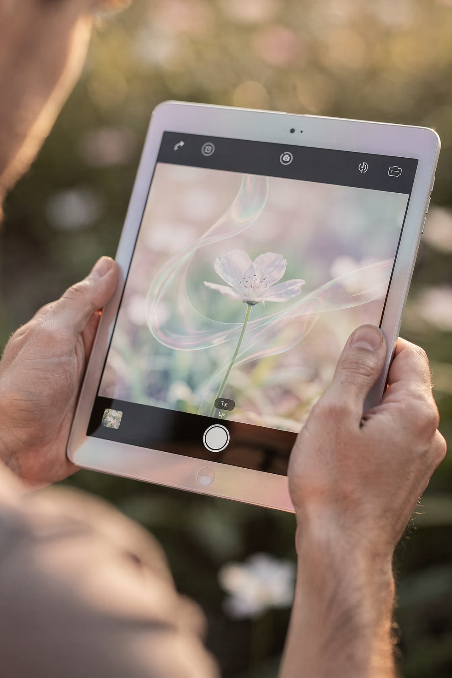

Camera Basics
The iPad camera is wonderfully simple at its core. Open the Camera app, aim it where you want, and tap the shutter button. That's the basic recipe.
You're not going to break anything by taking a picture. Worst case, you get a blurry shot of your thumb — which puts you in very good company.
01
02
Open Camera App
Aim
Find it on your Home screen and tap.
Point the iPad at what you want to capture.
03
Tap the Shutter
The big round button takes the photo.

Slide 17

Taking a Photo
Frame It. Tap. Done.
If what you want is on the screen, you're basically ready. Line it up, hold the iPad as steady as you can, and tap the button.
It doesn't have to be National Geographic. The goal is simply to capture the moment — the person, the receipt, the plant, or whatever you want to remember.

Slide 18
Front vs. Back Camera
📷 Back Camera
🤳 Front Camera
Better quality. Use this for taking pictures of things in front of you — scenery, people, documents, food.
For selfies & video calls. Points toward your face. If your own forehead suddenly fills the screen, don't panic — you just flipped the camera.
Switching between cameras is easy — look for the flip icon inside the Camera app. You didn't break the iPad. You just changed the view.

Slide 19
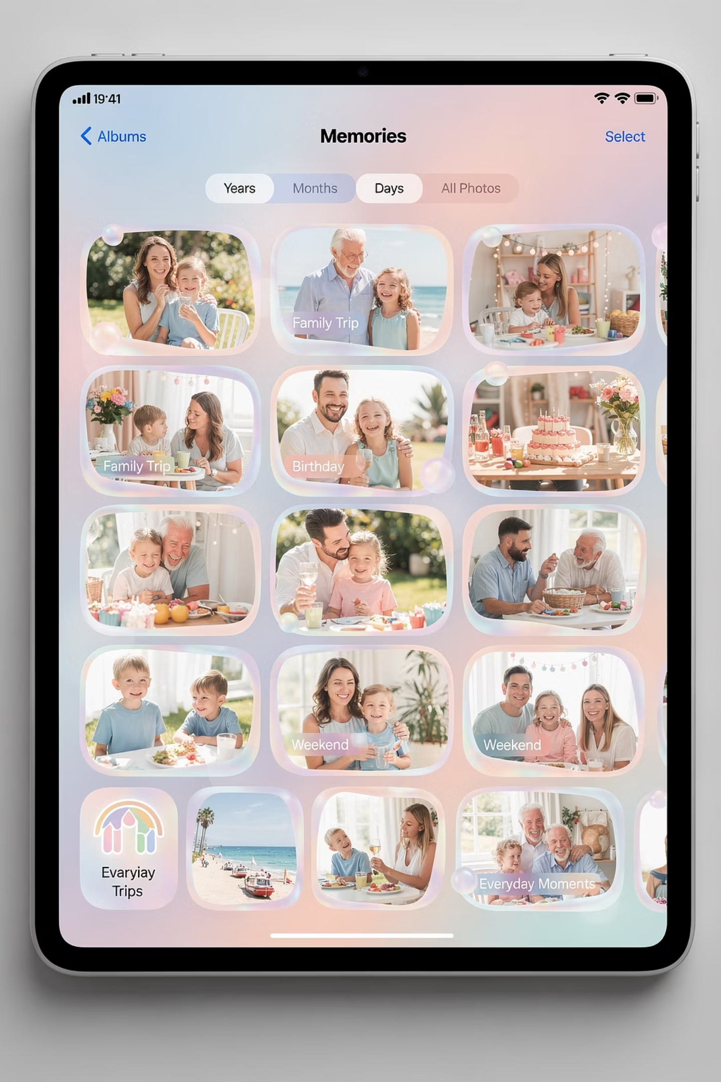
Where Photos Go
When you take a picture, it gets saved automatically into the Photos app. Think of it this way:
Camera App
The act of snapping the shot — your shutter, your moment.
Photos App
The album where everything lives afterward — stored automatically, one place.

Slide 20

Viewing Your Photos
Three Simple Moves
1
Tap
Open any photo to view it full screen.
2
Swipe
Swipe left or right to move through pictures.
3
Zoom
Pinch or spread two fingers to zoom in or out.
Tap, swipe, zoom. Three little moves that make you look like you know exactly what you're doing — and by then, you usually do.

Slide 21
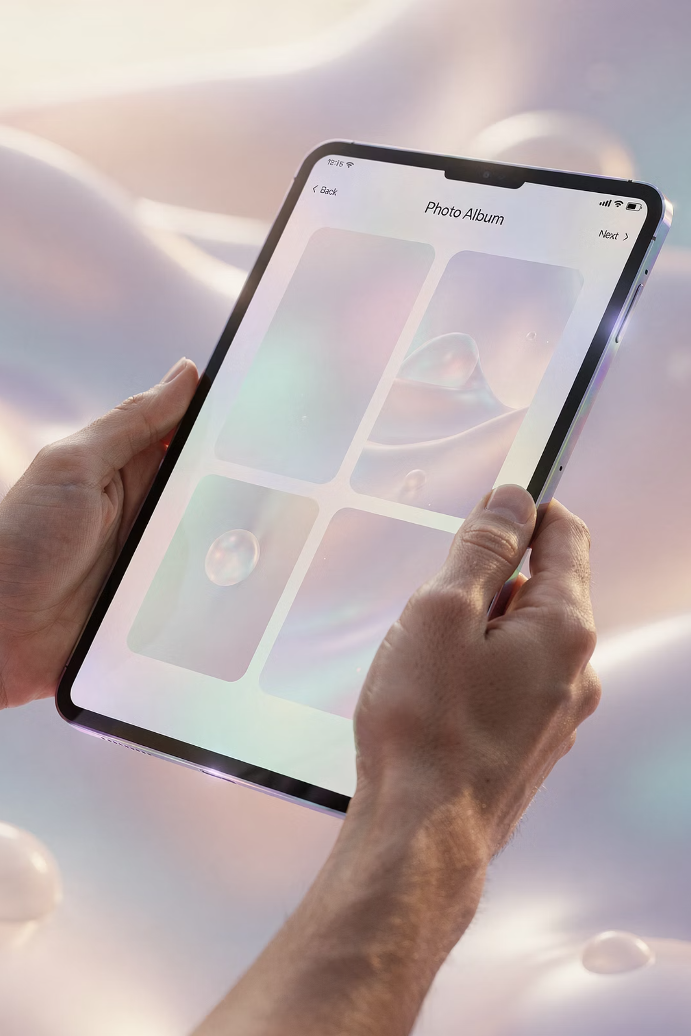
Slide 21 — Photo Reassurance
Safe to look
Nothing breaks
Nothing lost
Let's clear something up right here, because this one trips up a lot of people.
You cannot damage a photo by looking at it. You can't wear it out, you can't erase it by accident just by opening it.
So that little hesitation — that "what if I mess something up?" feeling — we're officially retiring that today.

Slide 22
Slide 22 — When Something Feels Lost
Key Points
Usually not gone
Just moved
Stay calm
When something feels lost on the iPad, it's almost never actually gone.
It's usually just moved, tucked away, or sitting somewhere you didn't expect.
So the first move isn't panic — it's pause. Calm beats guessing every single time.

Slide 23
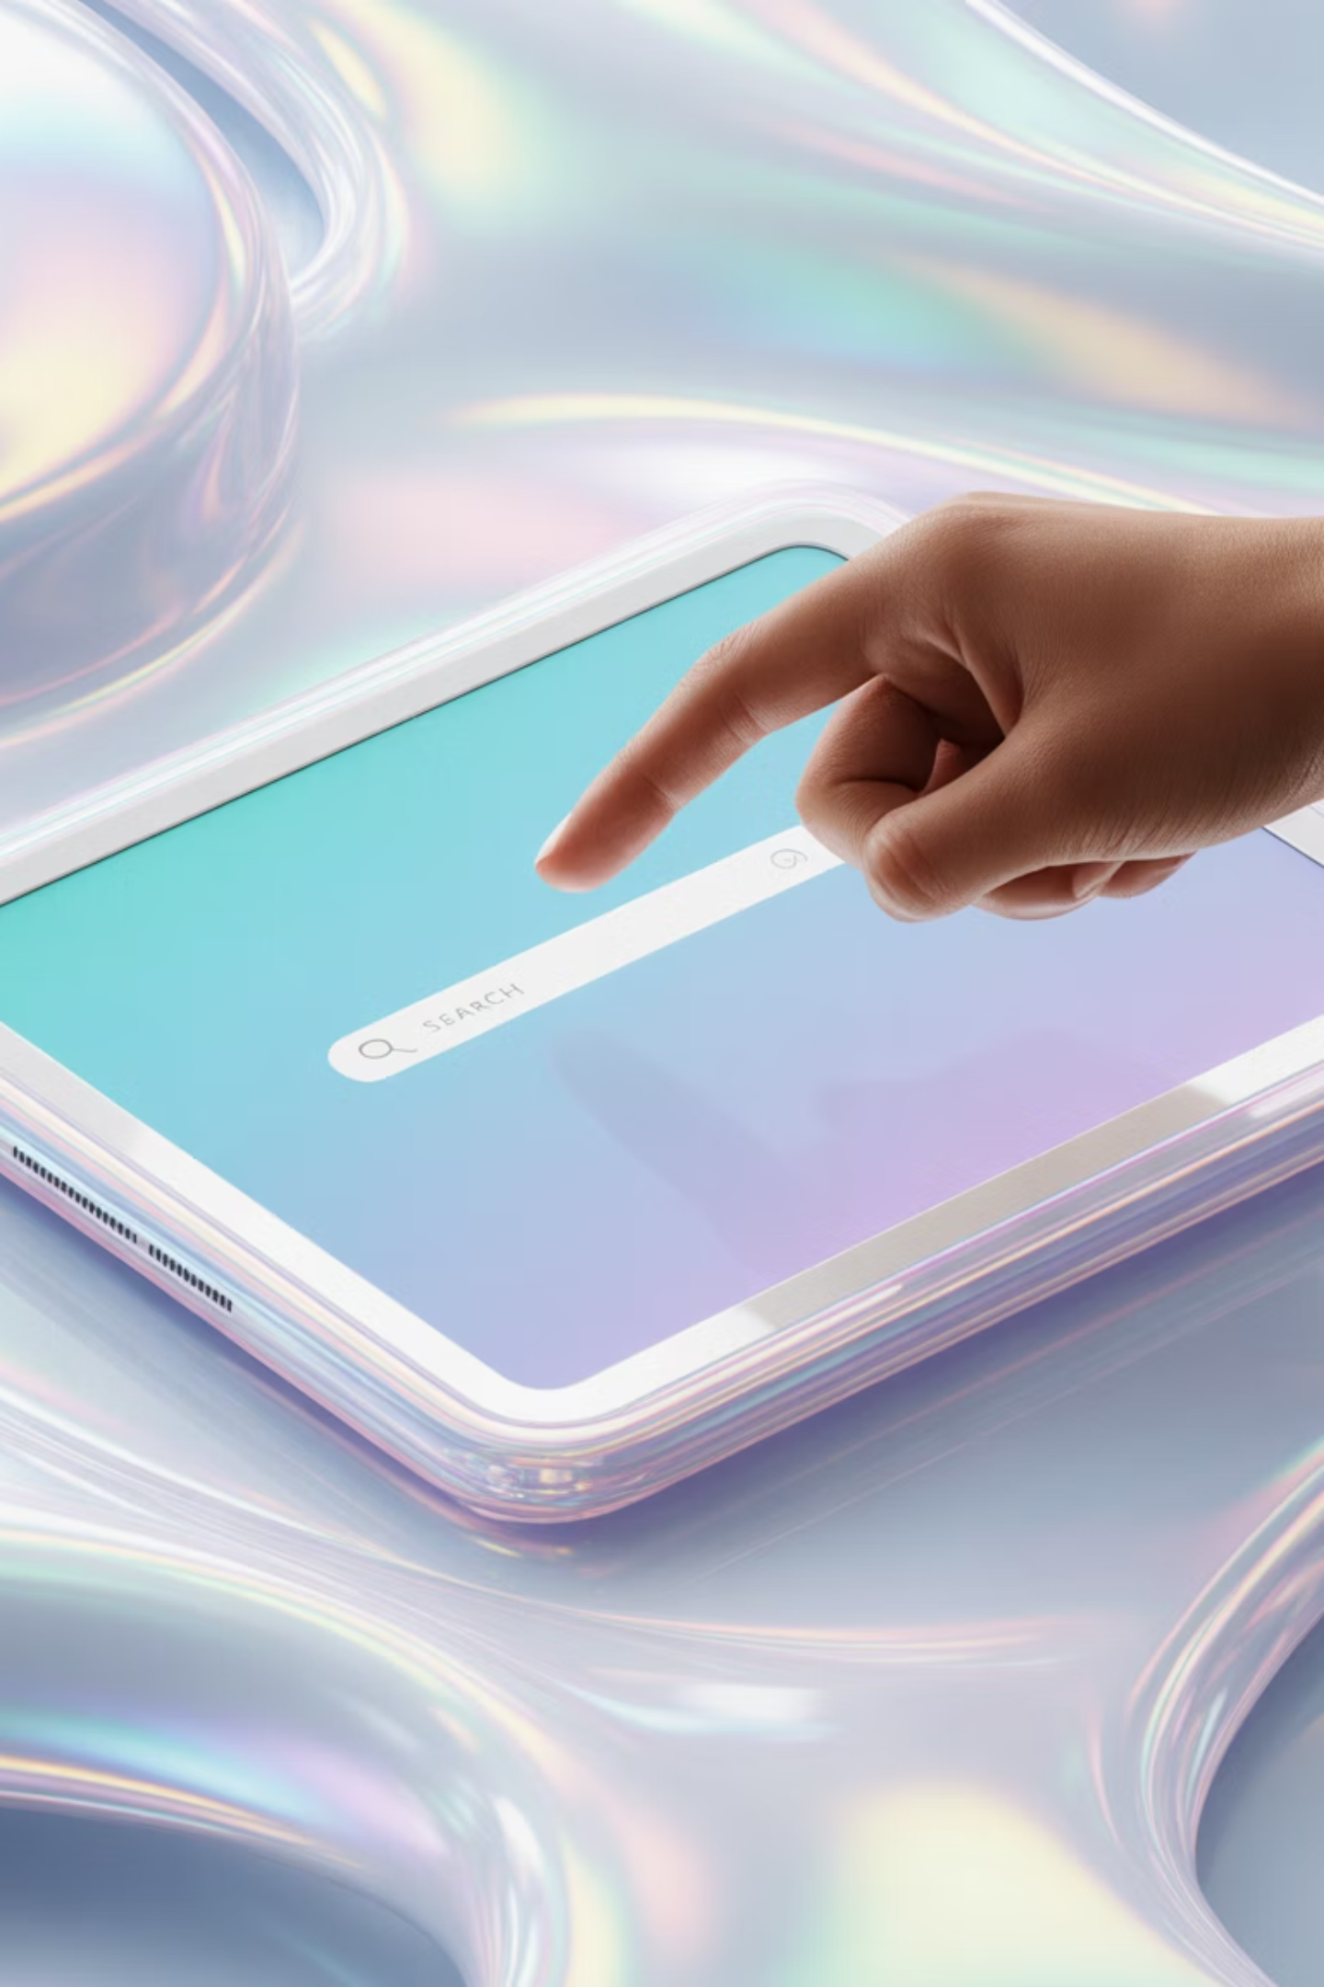



Slide 23 — Spotlight Search
Swipe down
Type
Find instantly
This right here is your secret weapon: search. Swipe down from the middle of the screen, type what you're looking for — an app, a name, a photo — and let the iPad do the heavy lifting.
If you remember one thing from this section, make it this: when in doubt, search it out.

Slide 24
Slide 24 — Finding Apps
Remember
Apps move
Use search
Don't panic
Apps don't disappear — they just wander a bit. Maybe they got moved to another screen, maybe tucked into a folder.
Instead of hunting screen by screen, just search for the app name and open it instantly.
Saves time, saves frustration, and saves your sanity.

Slide 25
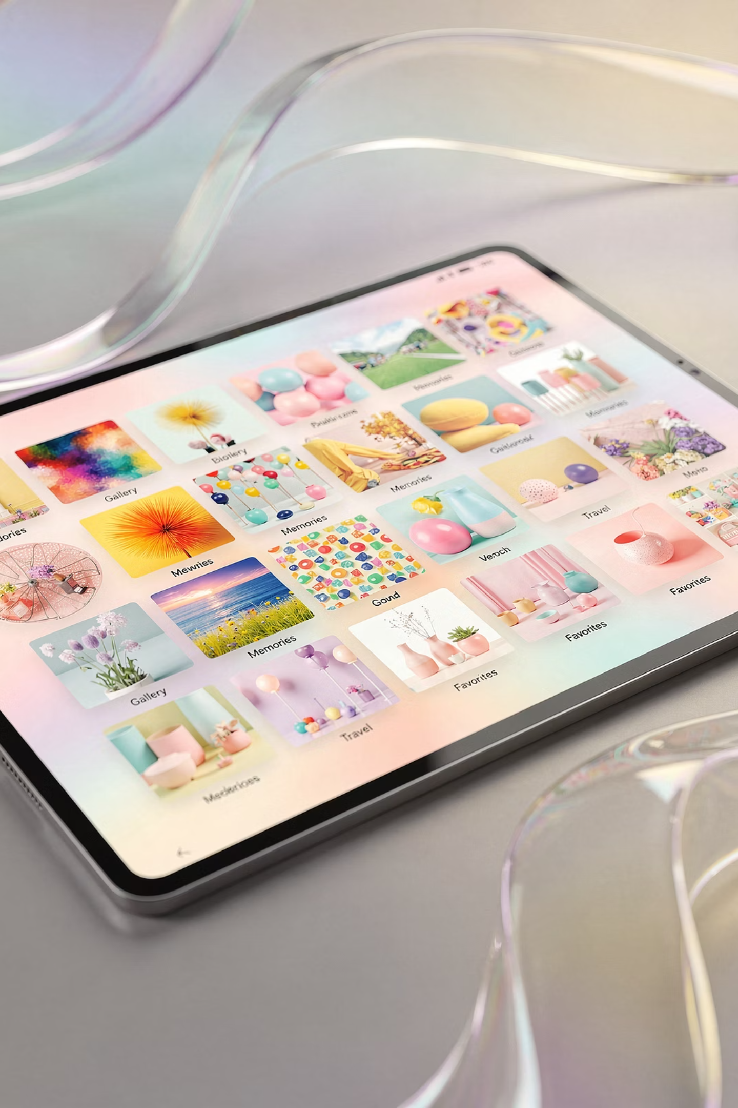
Slide 25 — Finding Photos
Photos app
Scroll
Almost always right where they belong — inside the Photos app.
You can scroll through them at your own pace.
Search
Use search if you remember something about the picture — like a place or a person.
Once you get used to how photos are organized, it starts to feel a lot less like a maze.
📤 MODULE 4 — Sharing

Slide 26
Slide 26 — Share Icon
The Share Button
Square with arrow
Sends a copy
Original stays
That little square with the arrow pointing up — that's your share button.
And here's the important part: when you share something, you're sending a copy — not the original.
Nothing disappears, nothing gets "used up." You're just making a duplicate to send along.

Slide 27
Slide 27 — Texting Photos
Quick
Easy
Convenient
Tap and send in seconds.
No fuss, no ceremony.
Great for one or two pictures to family or friends.
Texting photos is the fast and easy option. Tap, send, done — no fuss, no ceremony.
It's the digital version of "Hey, take a look at this."

Slide 28
Slide 28 — Emailing Photos
Why Email?
Better quality
Good for printing
Reliable
If the photo matters a little more — maybe you want to print it or keep better quality — email is the better route.
It keeps more detail and tends to be more reliable for important things.
Think of texting as quick sharing, and email as slightly more "formal delivery."

Slide 29
Slide 29 — Multiple Photos
01
02
03
Select several
Send together
Follow prompts
You're not limited to one photo at a time.
Select several and send them all together.
The iPad will guide you through it step by step.
Once you've done it once, it becomes second nature.

Slide 30
Slide 30 — Sharing Reminder
Pause first
Hard to undo
Think before sending
Before you send something, take a quick pause and make sure it's going where you want it to go.
Once it's sent, it's a lot harder to pull back.
A two-second pause can save a ten-minute headache.
Here's a little old-school wisdom that still applies: measure twice, cut once.
⚙️ MODULE 5 — Settings

Slide 31
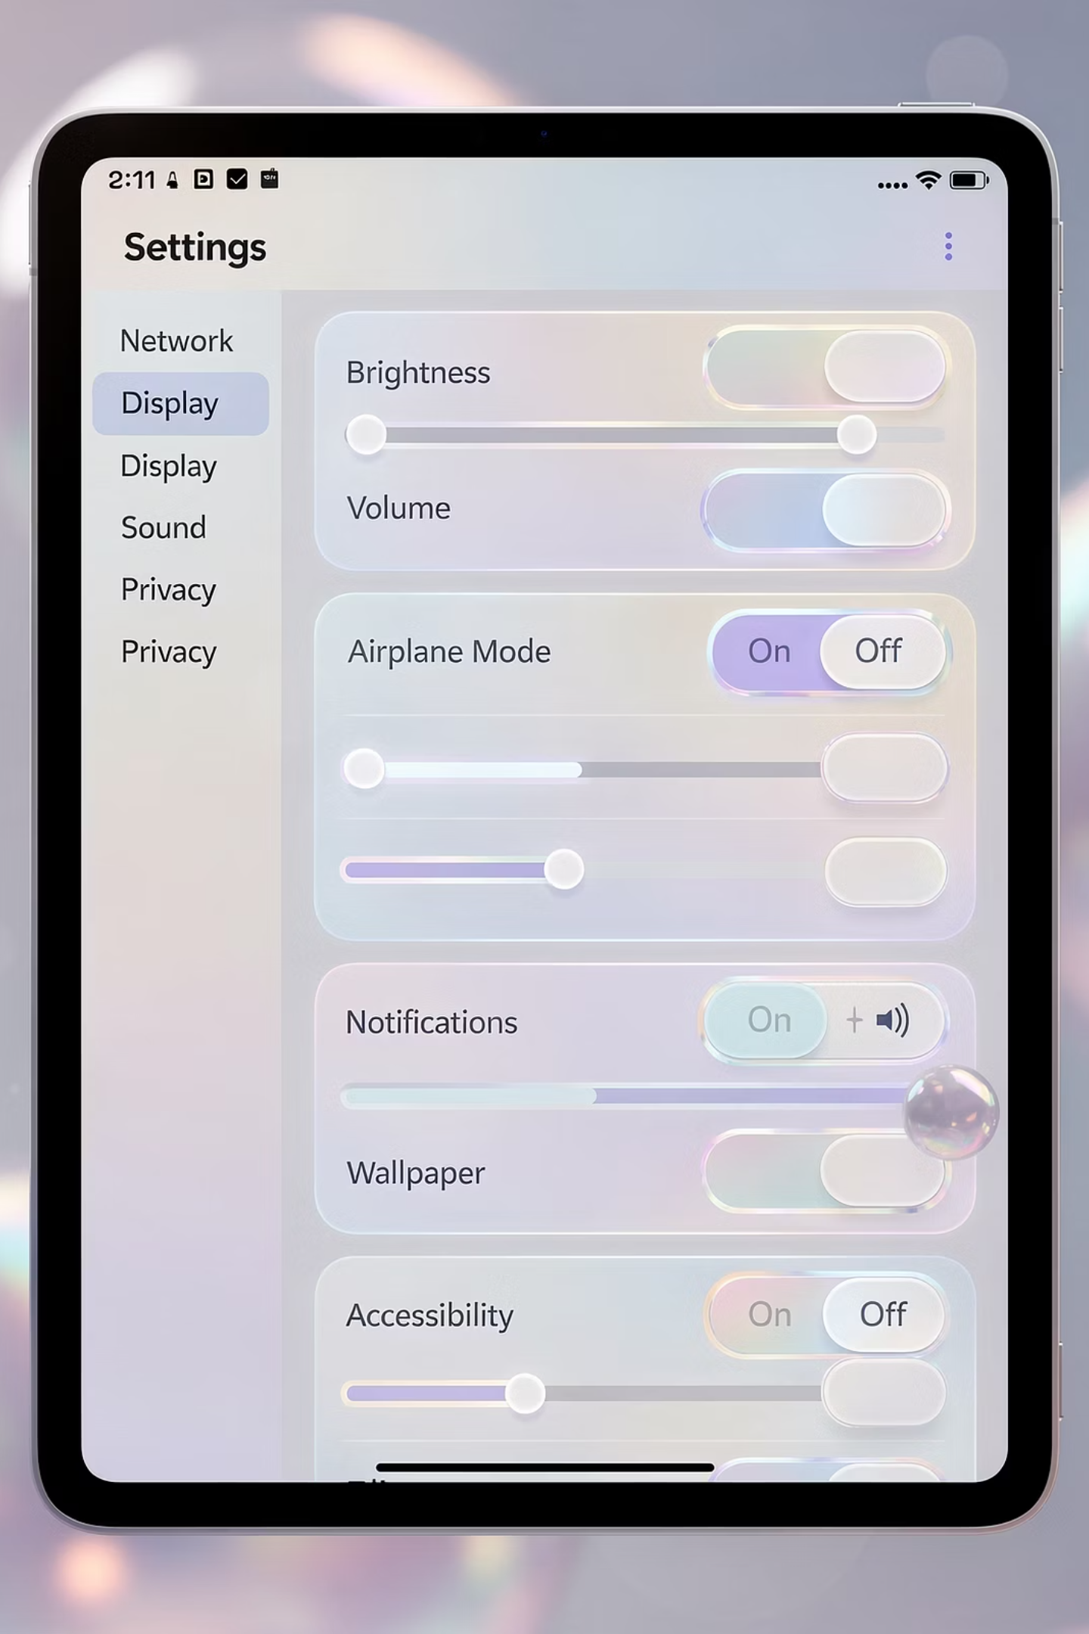
Slide 31 — Settings Overview
Key Points
Customize
Safe to explore
Nothing permanent
Settings is where you adjust how the iPad behaves — brightness, sound, connections, and more.
And the key thing to remember is this: it's safe to explore. You're not going to break anything by looking around.
Worst case, you change something and then change it right back.

Slide 32
Slide 32 — Brightness & Volume
Adjust screen
Control sound
Improve comfort
Too bright or too dim — you can adjust all of it to suit your eyes.
Too loud or too quiet — find the level that works for you.
Technology should adapt to you — not the other way around.
The goal is simple: make the iPad feel comfortable for you.

Slide 33
Slide 33 — Wi-Fi Check
1
Must be connected
2
Enables apps
3
First fix step
If something isn't working — email won't load, Safari won't open pages — the first thing to check is Wi-Fi.
No connection usually means no internet, and no internet means a lot of things won't work.
Before anything else, check Wi-Fi. It solves more problems than you'd think.
🧠 MODULE 6 — Confidence

Slide 34
Slide 34 — Mistakes Are Normal
Mistakes are…
Expected
Reversible
Helpful
Mistakes are not only normal — they're part of the process.
You tap the wrong thing, open the wrong app, close something by accident — it happens to everyone.
And the good news is, almost everything is reversible. That's how you learn.

Slide 35



Slide 35 — Getting Unstuck
Pause
Go home
Try again
Don't keep digging the hole deeper.
Press the Home button or swipe back to your main screen.
Start fresh. That simple reset solves a surprising number of problems.

Slide 36
Slide 36 — Practice Mindset
Repeat
1
Do it once, then again, then again.
Go slow
2
Take your time and let it sink in.
Build confidence
3
That's how this goes from "new" to "normal."
Confidence doesn't come from one perfect try — it comes from repetition.
🎯 WRAP-UP

Slide 37
Slide 37 — What You Can Do Now
Use apps
Take photos
Share safely
Open and navigate apps with confidence.
Capture and find your photos easily.
Send photos and messages with confidence.
At this point, you can open apps, take photos, find things, and share them with others. That's real, practical use — not theory.
You're already doing more than you were before you walked in.

Slide 38
Slide 38 — Accessibility
Built-in Tools
Larger text
Zoom
Comfort first
The iPad also has built-in tools to make things easier to see and use — larger text, zoom features, and more.
There's no prize for squinting. If something can be made clearer or easier, go ahead and use those features.
Comfort always comes first.

Slide 39
Slide 39 — Support
Tech Tuesdays
Help available
Ask anytime
Regular sessions to keep you moving forward.
Between Tech Tuesdays, seminars like this, and one-on-one help, there's always a place to ask questions and get a little guidance.
Sometimes all it takes is a quick answer to get you moving again.
Remember — you're not on your own with this.

Slide 40
