Slide 1
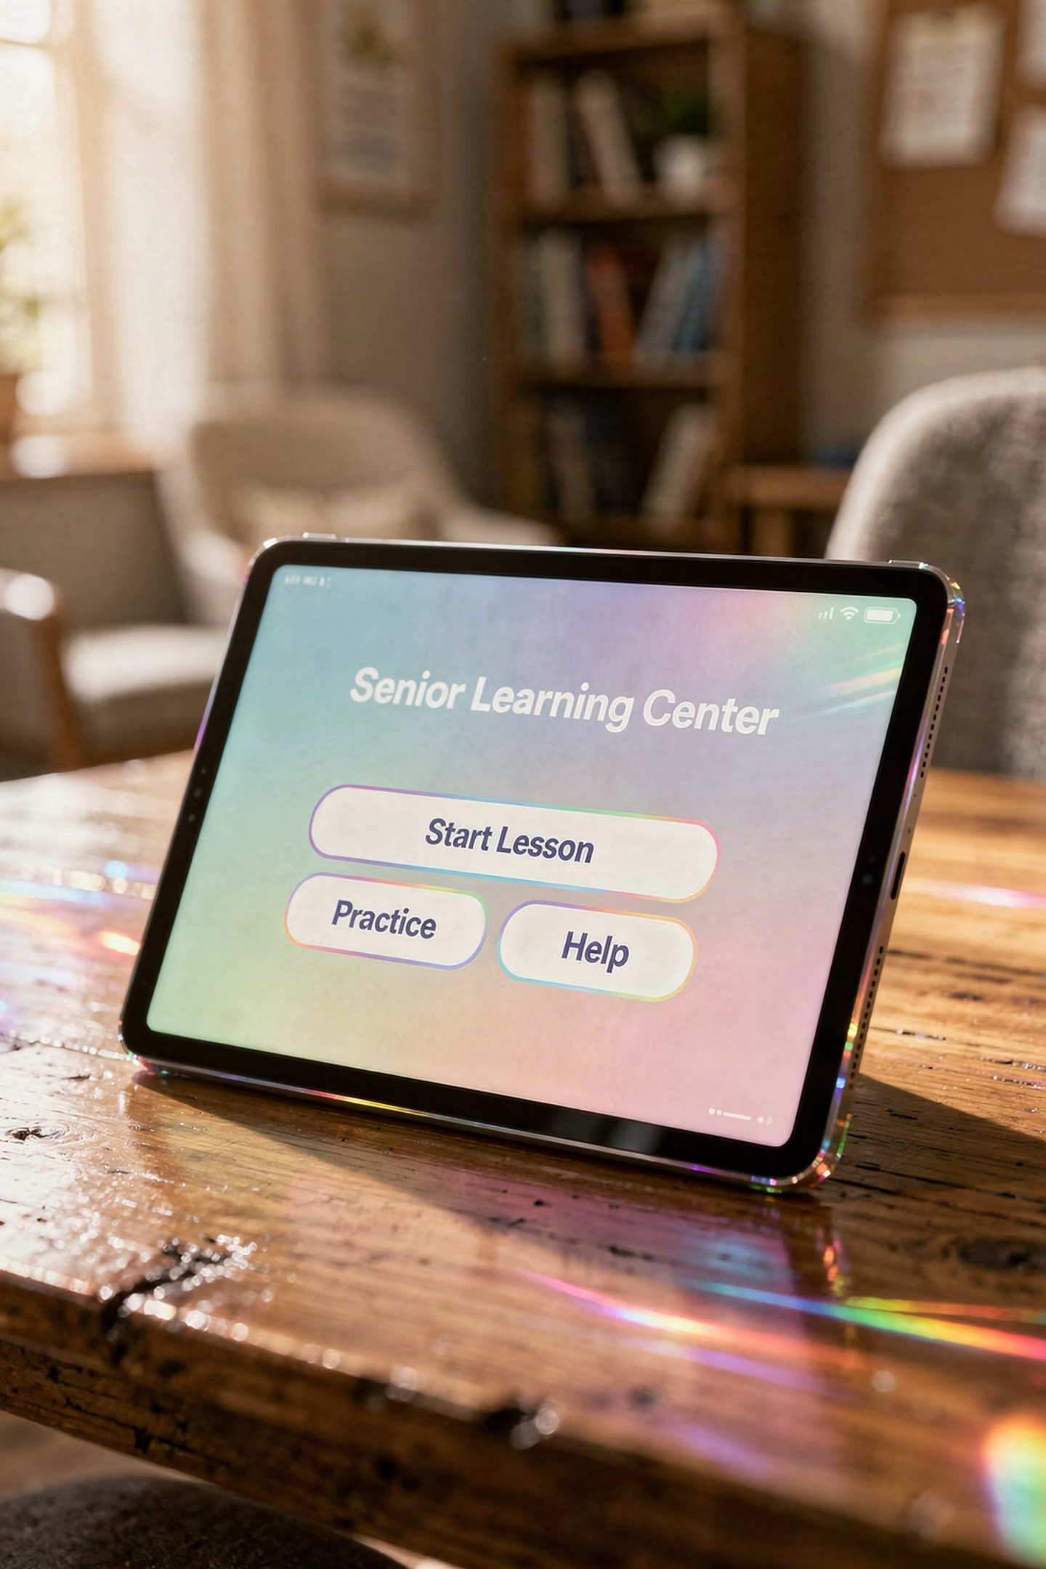
iPad Essentials 101 – Part 1

Slide 2

iPad Essentials 101 – Part 1
Getting Comfortable
A Beginner-Friendly Session
Welcome, and thanks for being here.
Today is about getting comfortable—not perfect, not fast—just comfortable.
If this device has ever felt a little intimidating, that ends today. We're going to take it one simple step at a time. Nothing fancy. Nothing overwhelming. Just steady progress.

Slide 3

Welcome CSC Members
Relaxed, no-pressure session
Practical everyday use
Welcome, Cromwell Senior Center members.
You're in the right place. This is a no-pressure session. You don't need to remember everything—we're just looking for a few things that click.
If you walk out of here feeling even a little more comfortable, that's a win.

Slide 4
Meet Jim Kallaugher: CSC Member & Volunteer
Red Glen Electronics
Weekly Tech Tuesdays
Monthly Tech Presentations
Founder and operator, with
friendly “Home Tech Help for Hire” for Boomers.
Volunteer tech support and guidance to community members on Tuesday afternoons.
Conduct tech topic seminars for better understanding & to encourage confidence
With 25+ years of experience making technology clear, simple, and accessible.

Slide 5
You Belong Here
You belong here
No wrong questions
No wrong pace
No matter your starting point. Some people are brand new, some have tried before. Doesn't matter.
Every question is a good question. Ask freely, ask often.
This is your pace, not anybody else's.

Slide 6



A 3-Part Journey
Part 1
Part 2
Part 3
Comfortable
Everyday Use
Make It Yours
We've split this into three parts for a reason.
Today is just about getting comfortable. Next time, we'll start using it more. And then we'll make it your own.
We're not trying to do everything today—and that's on purpose.

Slide 7
You Can't Break It
You can't break it
Mistakes are reversible
Nothing permanent
This is the most important idea of the day—you cannot break this iPad.
You might tap the wrong thing. You might end up somewhere strange. Happens to everyone.
Nothing explodes. Nothing disappears forever. Apple is not sending a squad car to your driveway.
Everything can be undone.

Slide 8
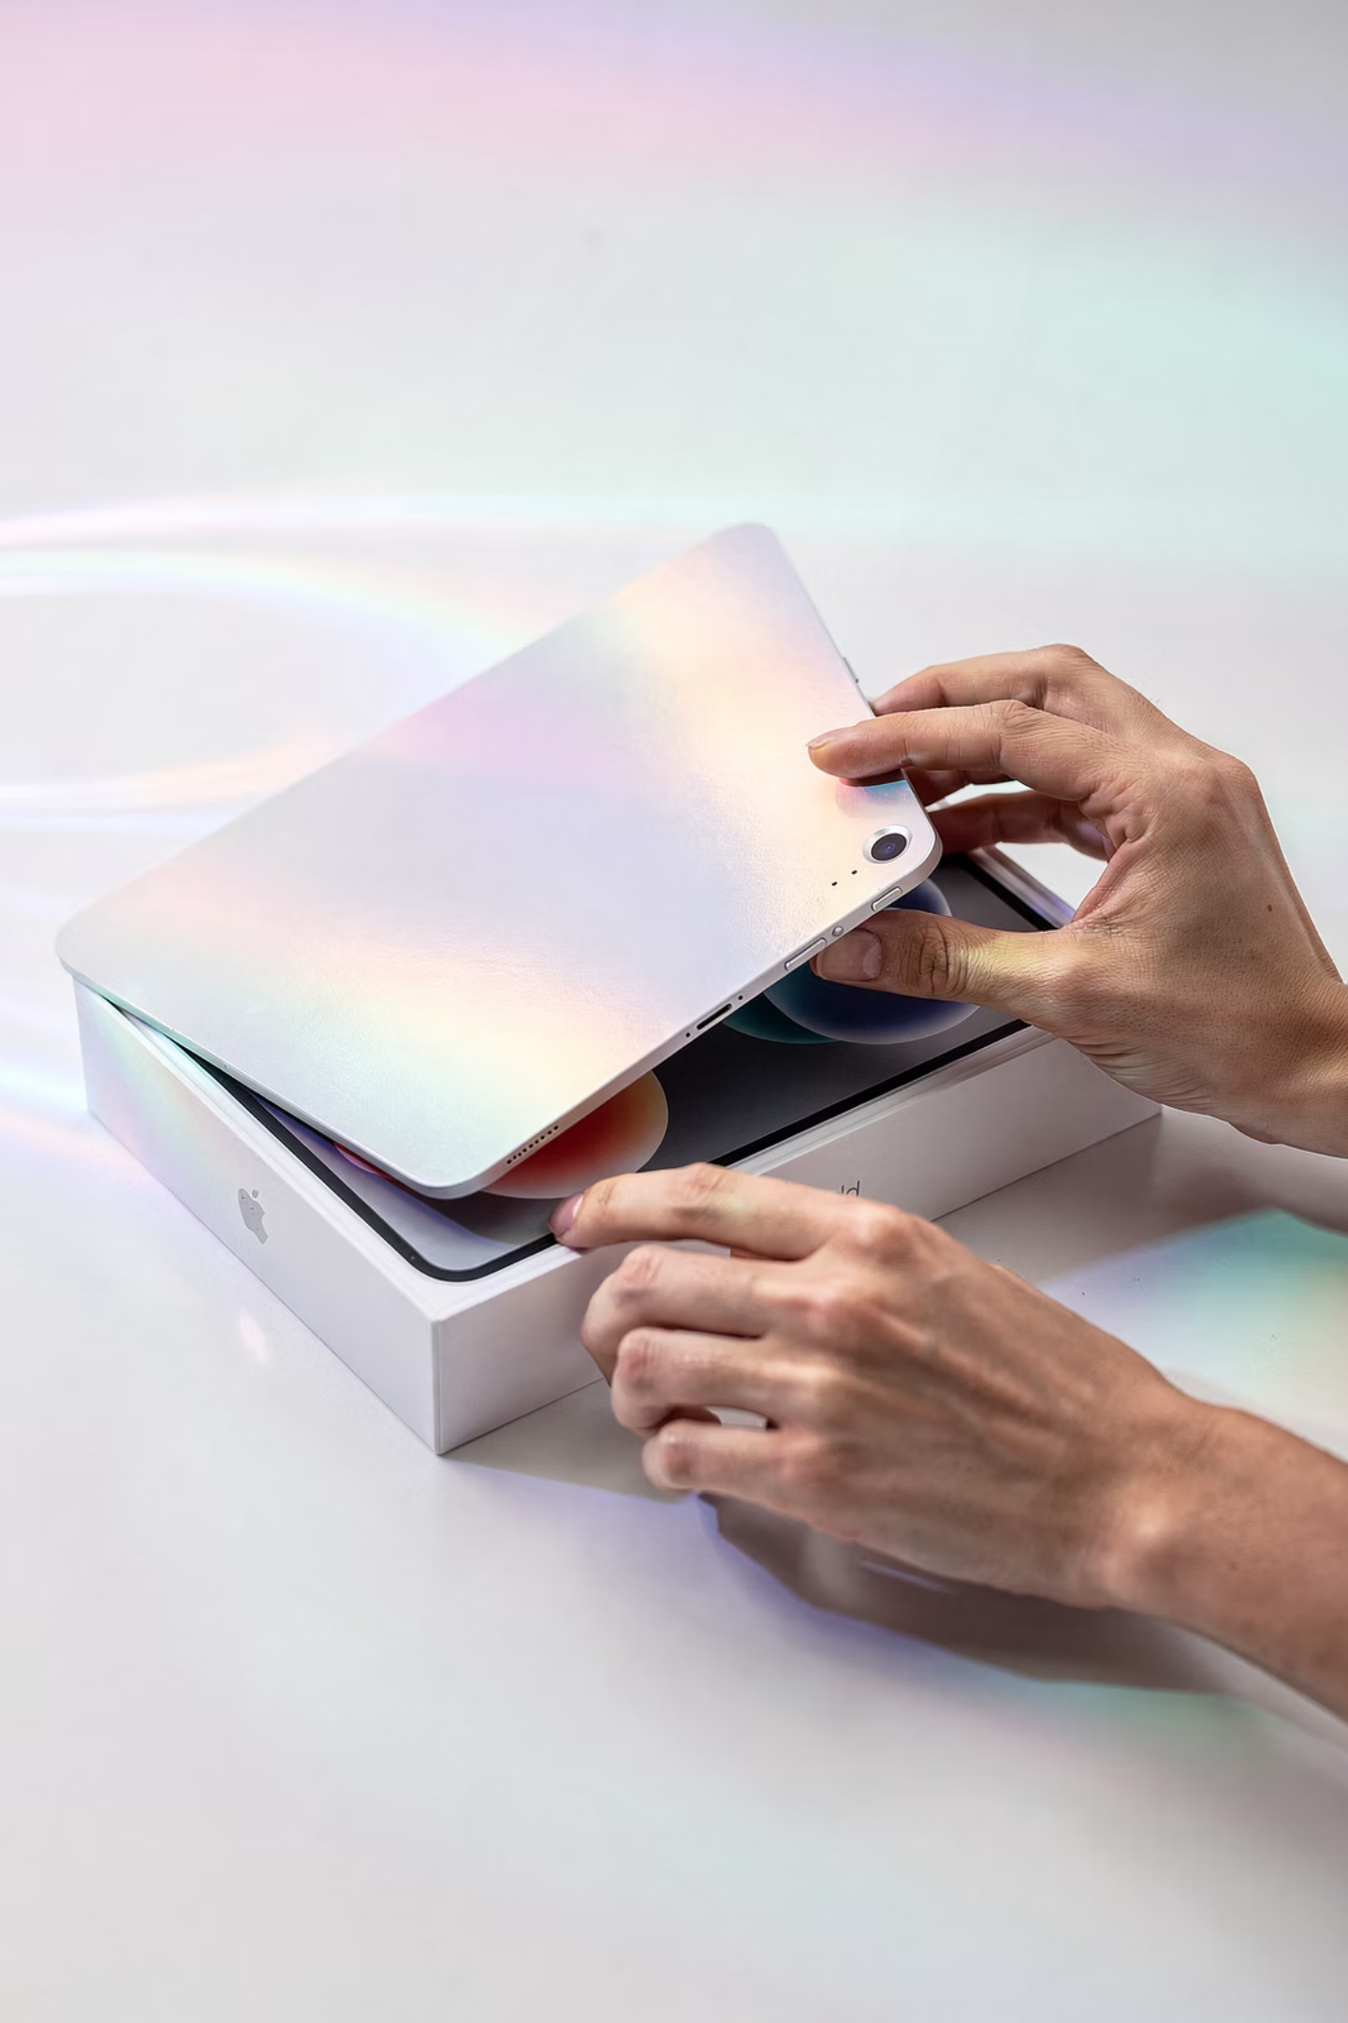
Unboxing
Take your time
There's no race here.
No rush
Look at it, hold it, get a feel for it.
Get familiar
Familiarity is the first step toward confidence.
Opening the iPad is your first step.

Slide 9
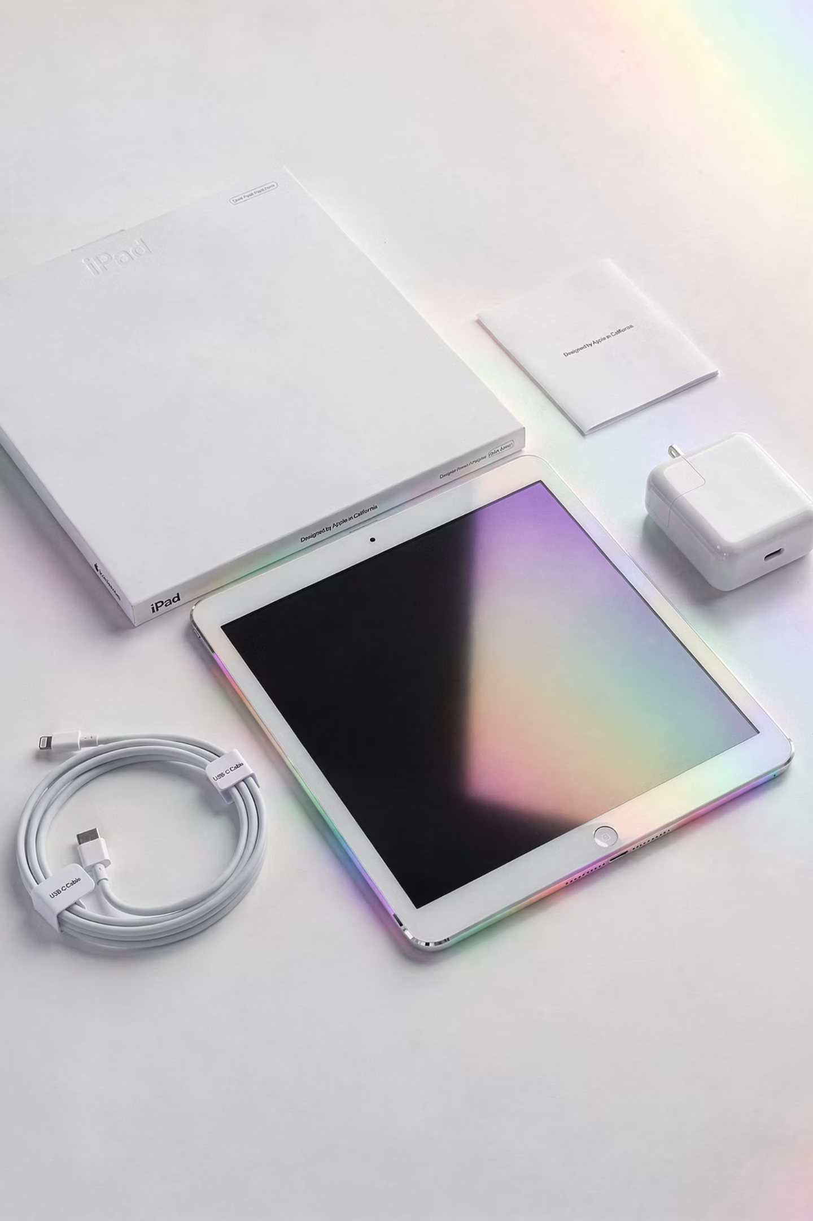
What's in the Box
iPad
Cable
Adapter
What you see is what you get—simple and straightforward.
No mystery parts, no extras you need to figure out.
Just the basics to get you going.

Slide 10

Meet Your iPad
Power
The button that starts everything.
Volume
Control what you hear.
Charging
Keep it powered up and ready.
Once you know where the buttons are, this stops feeling like a mystery.
Now it becomes a tool. And tools are meant to be used—not feared.

Slide 11
Turn On
01
02
03
Press button
See screen
Swipe
Press and hold the side button.
The display lights up.
Swipe to get started.
Press and hold the button, and you're in business.
That simple action is your starting point every time.

Slide 12

Apple Logo
Startup screen
Normal
Wait
When you see the Apple logo, everything is working exactly as it should.
That's your signal to just relax and let it load.

Slide 13
Setup Basics
1
2
3
Language
Region
Steps
Choose your preferred language.
Select your location.
Follow along one step at a time.
The setup walks you through everything.
You don't need to know what's coming next—it will guide you step by step.

Slide 14
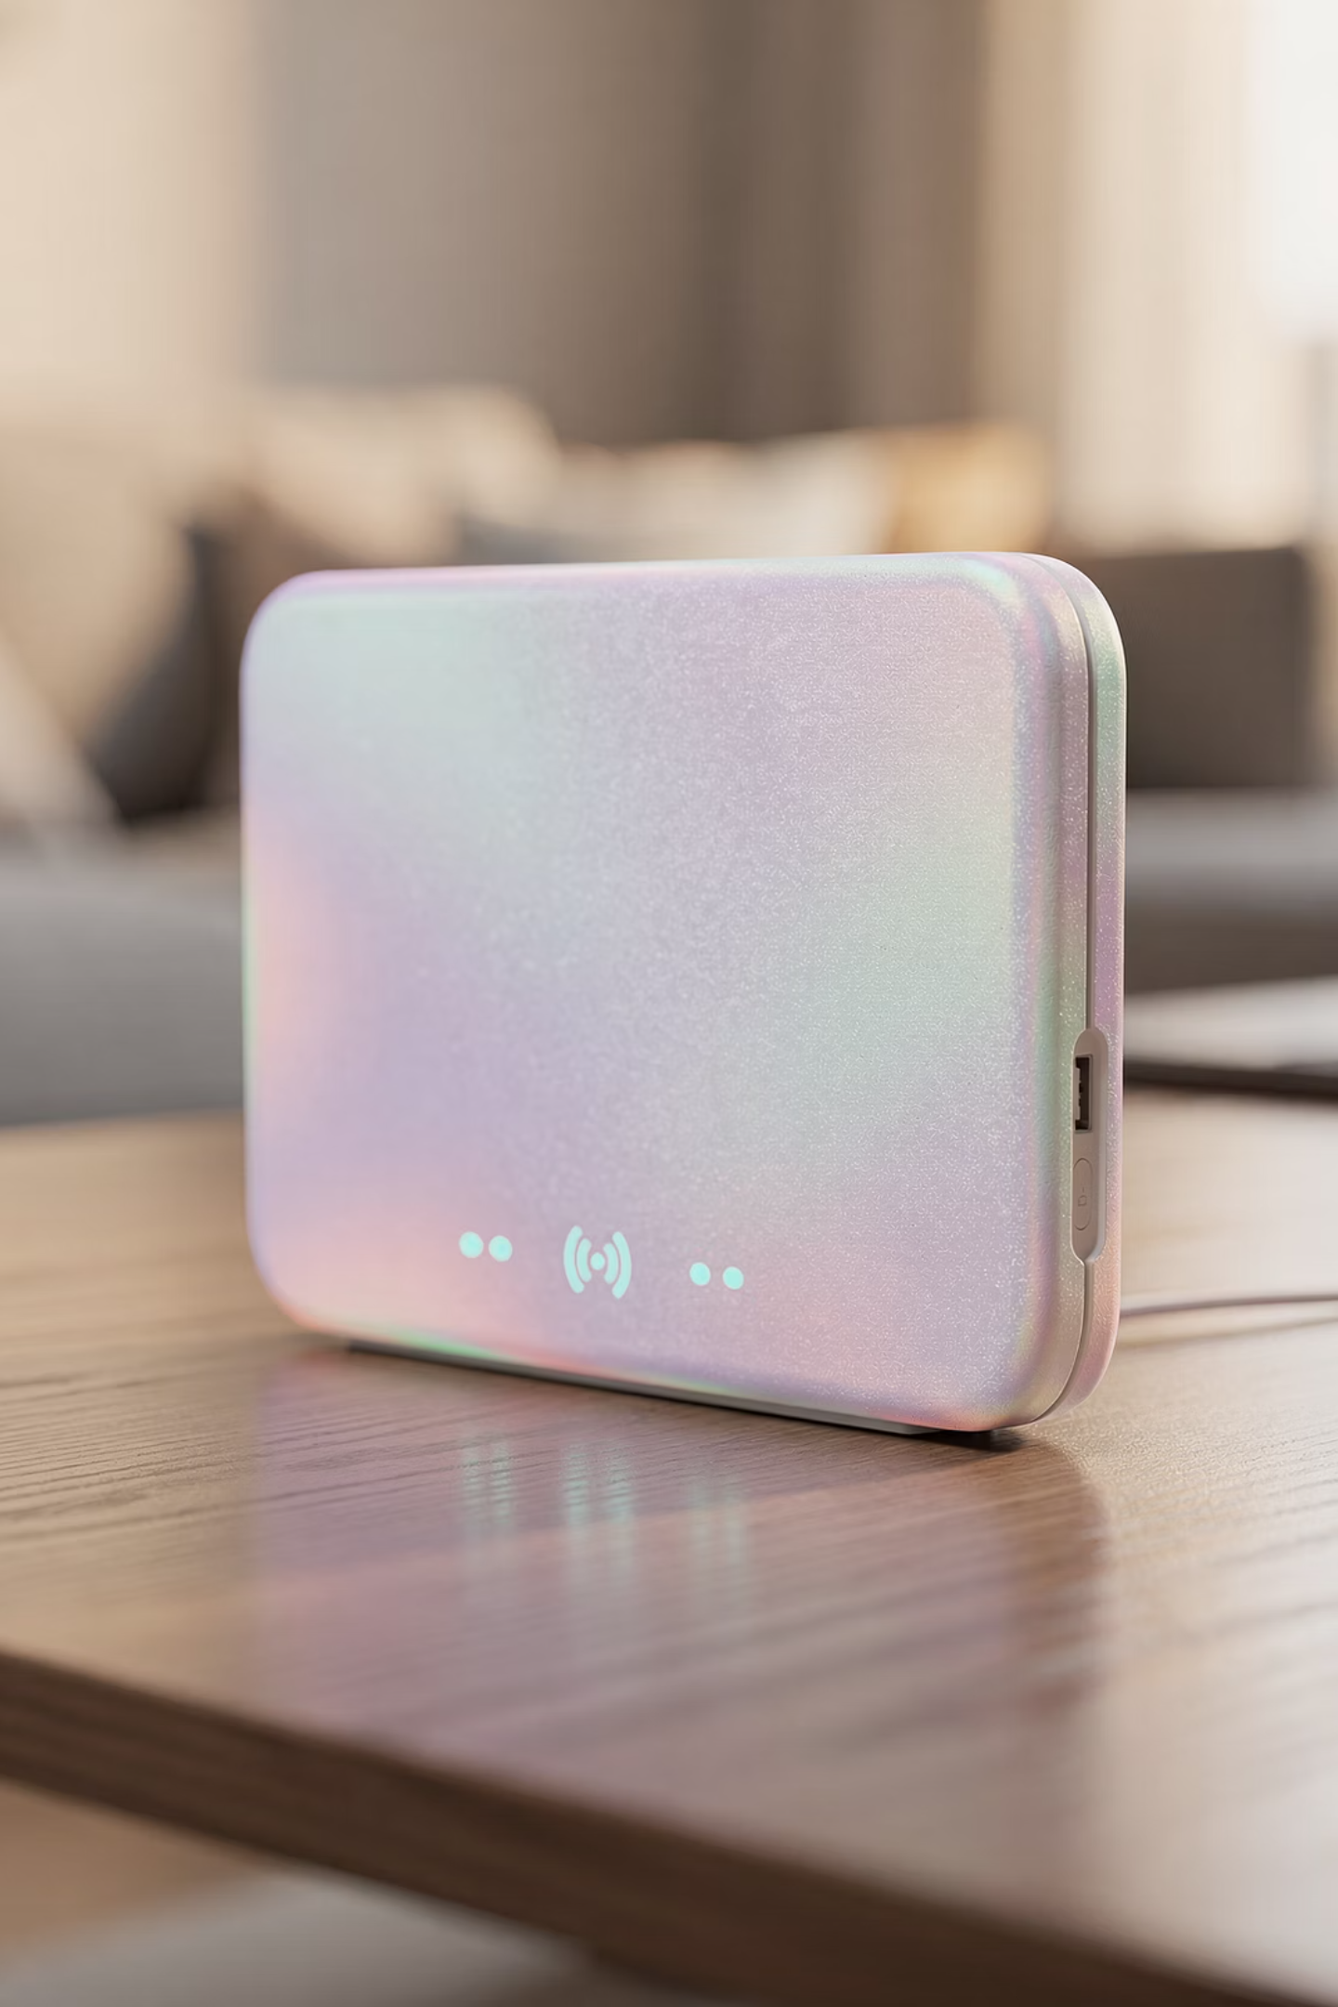
Wi-Fi
Connect
Internet access
Required
Wi-Fi is what brings this device to life.
Without it, it's limited. With it, it opens up the world.

Slide 15
Apple ID
Account
Access
Sync
Your personal Apple account.
Unlocks apps, music, and more.
Keeps everything connected and up to date.
Your Apple ID is your key.
It connects everything—apps, photos, settings—all tied to you.

Slide 16
Privacy
Choices
Flexible
Adjust later
You decide what to share.
Nothing is set in stone.
Change your mind anytime.
You are always in control.
Nothing here locks you in. You can change things later if needed.

Slide 17
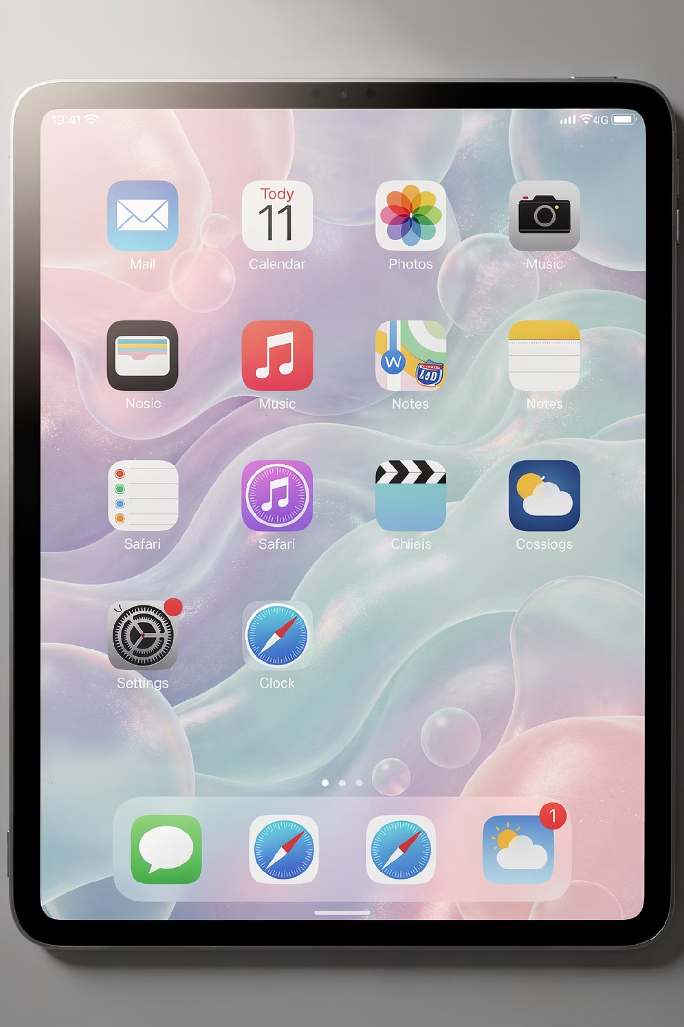
Home Screen
Starting point
Safe place
Return anytime
This is your home base.
If you ever feel lost, come back here. Think of it like your front door—everything starts and resets here.

Slide 18
Tap
The Core Action
Key Points
A tap is all it takes.
Light touch
Primary action
Simple
No pressure, no force—just a gentle touch.

Slide 19

Swipe
Slide finger
Glide your finger across the screen.
Navigate
Move between screens and pages.
Explore
At first it feels odd—then it becomes second nature.
Swiping lets you move around naturally.

Slide 20
Core Gestures
Tap
Swipe
Scroll
Home
These are your building blocks.
You don't need to master them today—just get comfortable seeing and trying them.

Slide 21
Practice
Try
Explore
Repeat
Give it a go—there's no wrong move.
Wander around and see what you find.
This is how learning happens.
This is your time to try things.
Nothing goes wrong here. This is how learning happens.

Slide 22
Open Apps
01
02
03
Tap icon
Use app
Return home
Find the app on your home screen and tap it.
Do what you need to do inside the app.
Come back to your home base when done.
Apps are just tools.
Tap to open, use it, and come back home. That's the whole cycle.

Slide 23
Comfort Practice
Slow pace
Repeat
Build confidence
Confidence comes from repetition—not speed.
Take your time.

Slide 24
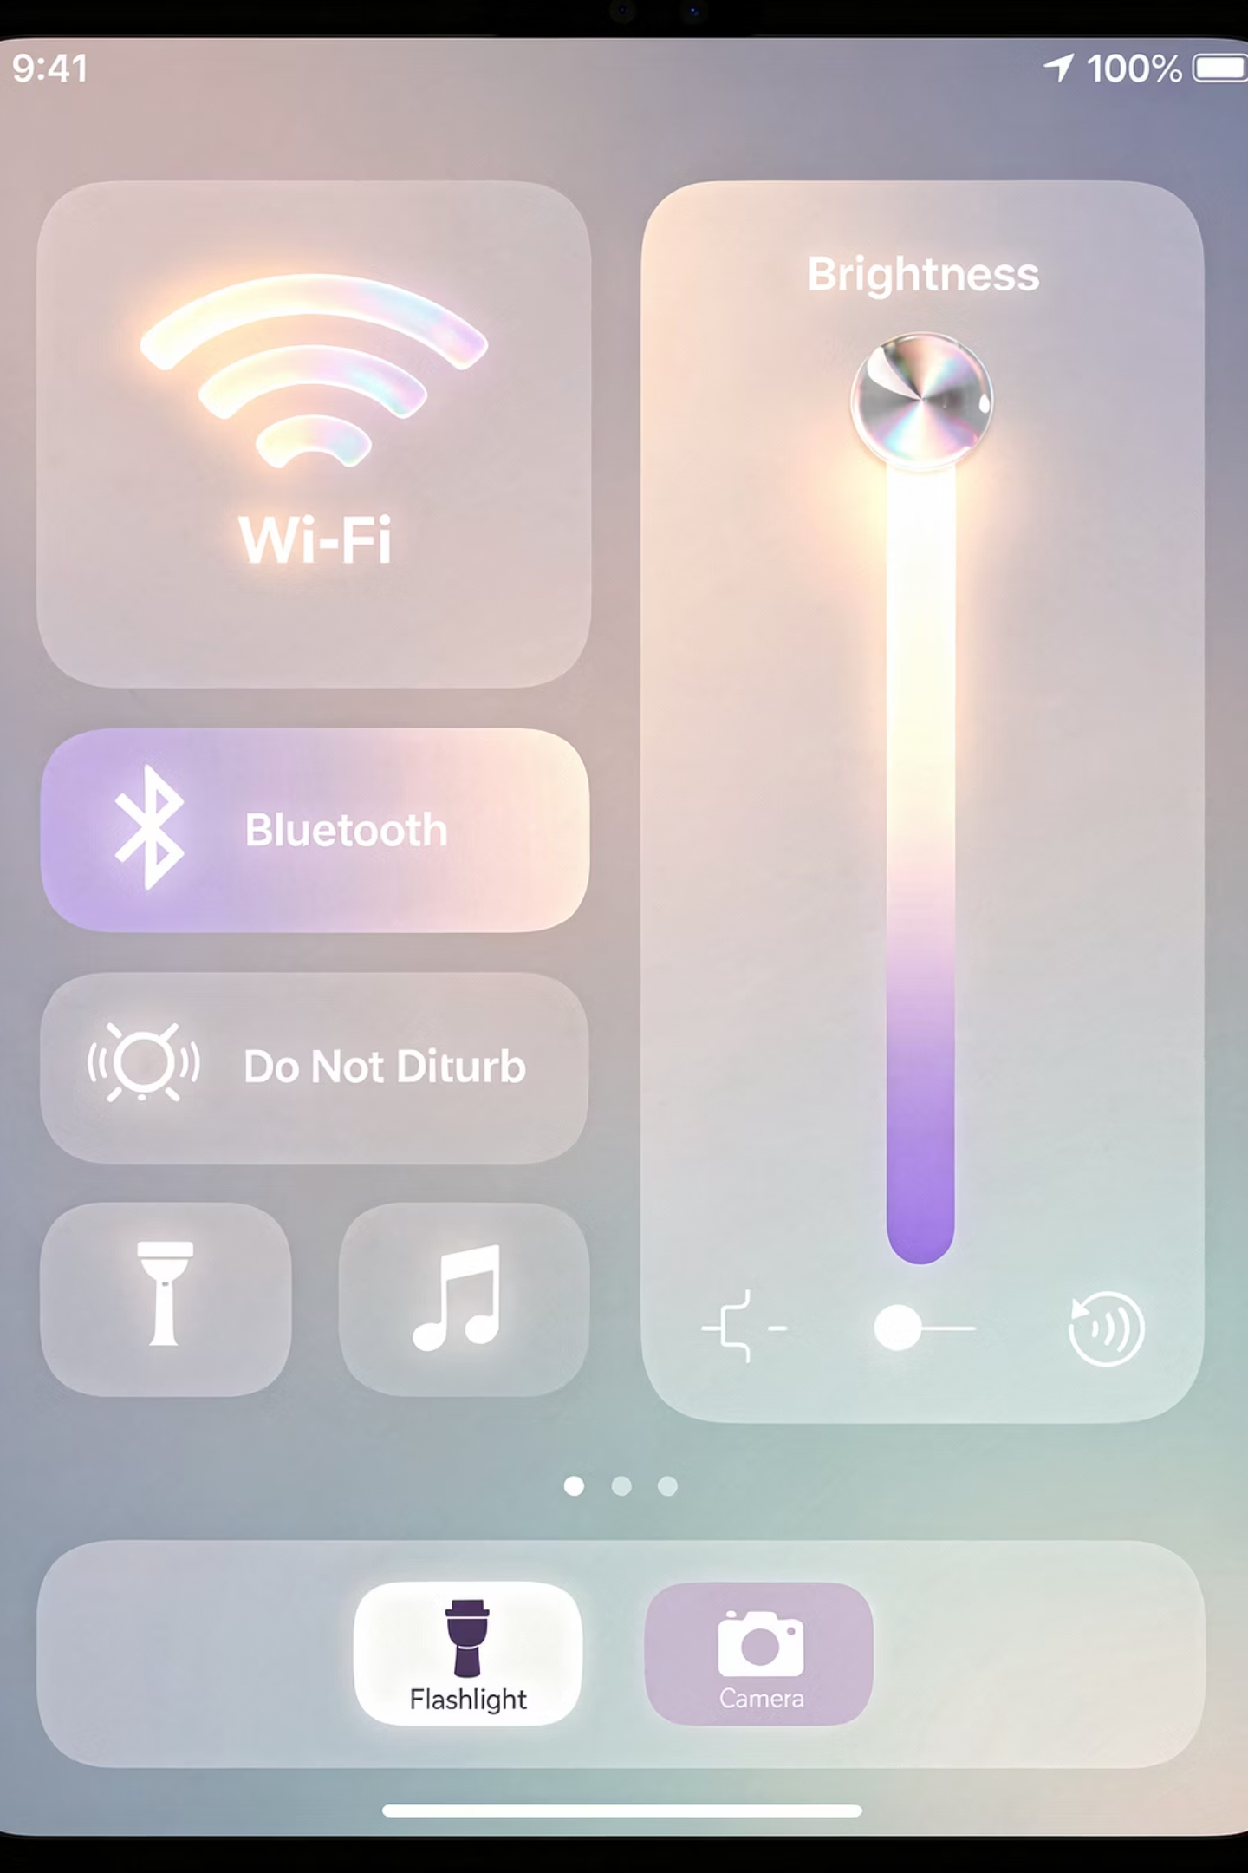
Control Center
Quick tools
Swipe access
Everything you need at a glance.
Open it with a simple swipe from the corner.
Settings
Adjust brightness, volume, and more.
Think of this as your shortcut panel.
Quick access without digging through menus.

Slide 25
Dock
Your Speed Dial
What It Does
The Dock is your speed dial.
Favorites — your go-to apps
Quick launch — one tap away
Always there — at the bottom of every screen
Your most-used apps are always right there.

Slide 26
App Library
All apps
Organized
Searchable
Every app you have is stored here.
Automatically sorted into categories.
Can't find something? Just search for it.
If you can't find something, it's not gone.
It's just stored differently.

Slide 27
Settings
Adjust
Explore safely
No risk
Customize how your iPad works for you.
Look around without worry.
Nothing breaks. Everything can be changed back.
Settings look intimidating—but they're safe.
You can explore without worry.

Slide 28
Notifications
Alerts
Messages
Manageable
You're in control of what gets your attention.

Slide 29
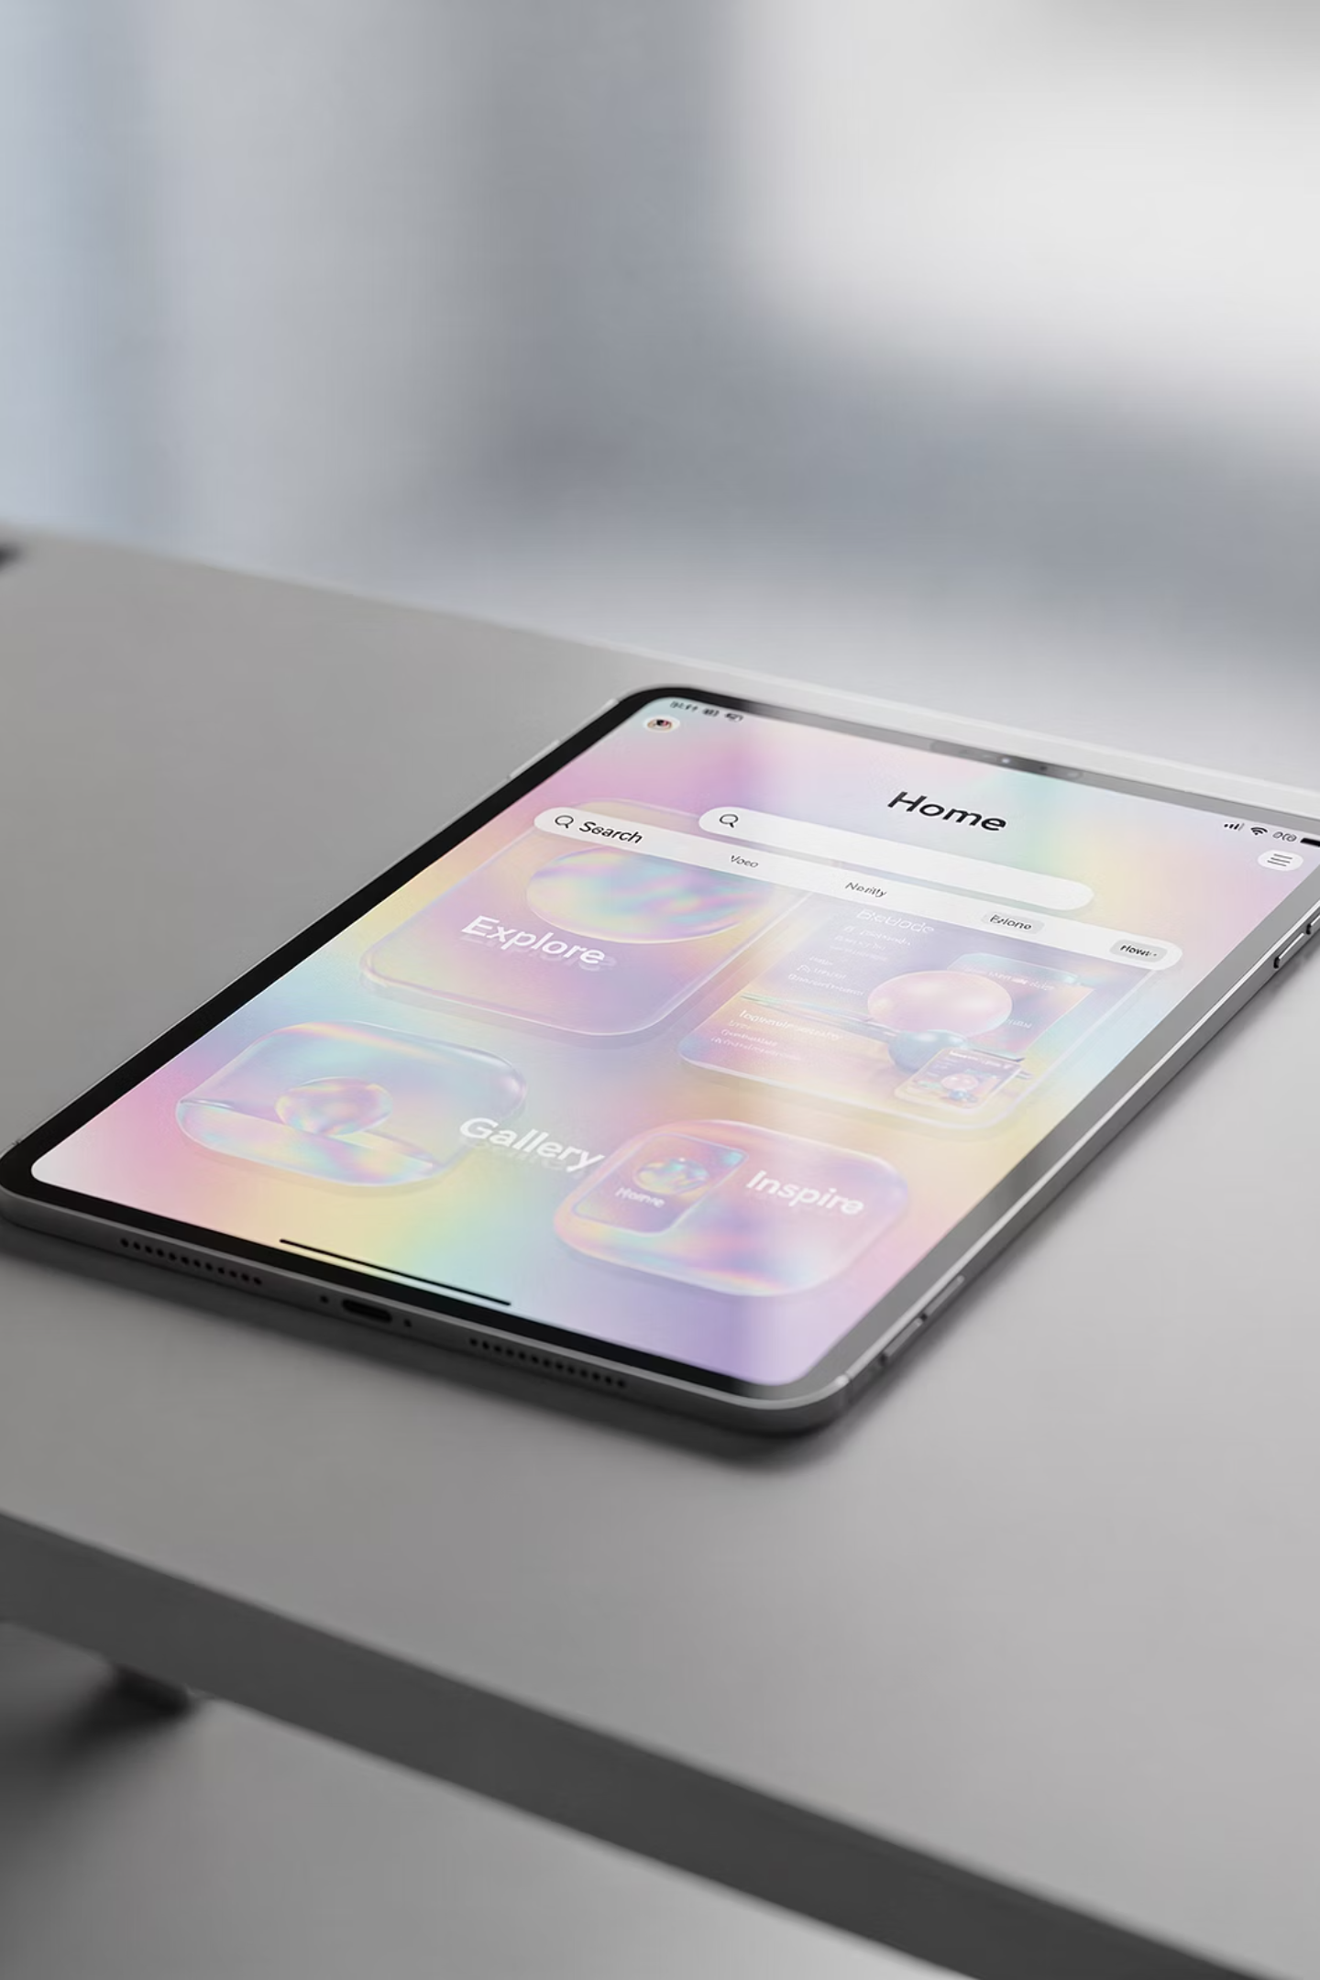
Safari
Browse
Visit any website with ease.
Search
Type a question or topic and find answers.
Explore
The whole internet is at your fingertips.
This is your window to the internet.
Simple and powerful.

Slide 30

Photos
View
Zoom
Swipe
Photos are meant to be enjoyed.
Simple gestures bring them to life.

Slide 31
Notes
Write
Save
Organize
Jot down anything you want to remember.
Everything saves automatically.
Keep your thoughts tidy and easy to find.
Notes quickly becomes a favorite.
Simple, reliable, always there.

Slide 32

Keyboard
On-screen
Tap typing
Flexible
Typing takes time.
And that's perfectly okay.

Slide 33
Typing Comfort
Slow
Accurate
Practice
There's no timer. Go at your own pace.
Focus on hitting the right keys, not speed.
Accuracy grows with time.
Slow and steady wins here.
Accuracy grows with time.

Slide 34
Siri
Just Talk
What You Can Do
If typing feels like too much—just talk.
Voice help — ask anything out loud
Ask — get answers instantly
Command — open apps, set reminders, and more
Siri is there to help.

Slide 35
Mistakes
Normal
Expected
Helpful
Mistakes aren't problems—they're part of learning.
Everyone makes them.

Slide 36
Getting Unstuck
01
02
03
Pause
Home
Retry
Take a breath. Don't panic.
Press the home button to return to your safe place.
Try again from a fresh start.
When something feels off—pause, go home, and reset.
That solves most situations.

Slide 37
Confidence
Grow
Explore
Every little success counts.
Repeat
Try new things without fear.
Do it again and again.
Confidence builds in small steps.
Every little success counts.

Slide 38

Review
You learned
You tried
You progressed
You've already made real progress today.
More than you probably expected.

Slide 39
Your Compass
Can't break it
No rush
Nothing is permanent. Everything is reversible.
Your pace is the right pace.
Mistakes OK
Stay curious
They're expected and helpful.
Curiosity is your greatest tool.
Keep these ideas with you—they'll guide everything you do going forward.

Slide 40

Wrap-Up
Great job
You showed up
You learned
You showed up. You tried. You learned.
That's how confidence is built—step by step.
And you've just taken the most important first step.

