Slide 1
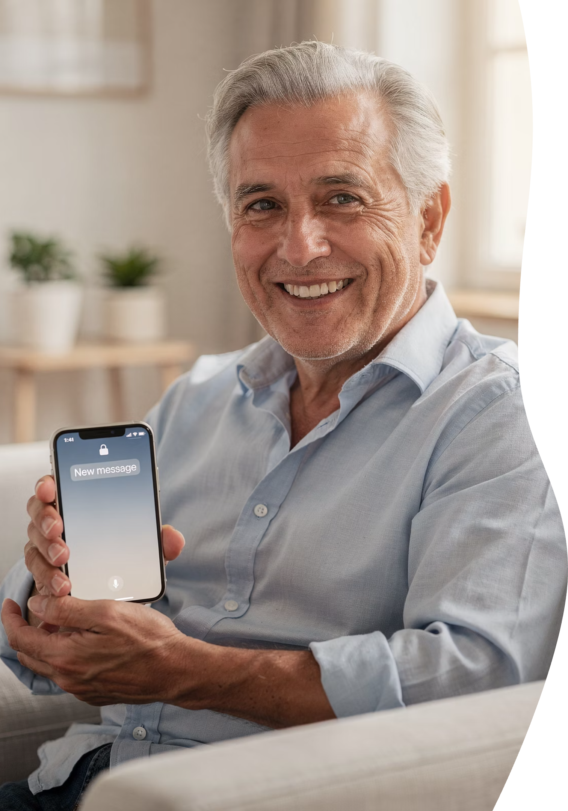
iPhone 101: Getting Comfortable with Your iPhone – Part 1
A beginner-friendly session
Notes:
Welcome, and thanks for being here.
Today’s session is called Getting Comfortable, and that wording is very intentional. This isn’t about mastering your iPhone or becoming an expert. It’s about reducing frustration and building confidence — one small step at a time.
If you leave today feeling even a little more at ease with your phone, we’ve done our job.
e 1 – iPhone 101: Getting Comfortable

Slide 2
Welcome, Cromwell Senior Center (CSC) Members
A friendly, practical introduction to iPhone 101 – Part 1
— no jargon, no pressure, and no tests!
Notes:
Whether you attended this live or you’re watching the replay later, you’re exactly where you should be.
This session was designed for real, everyday iPhone use — not the stuff buried in manuals or hidden in settings menus. We’re keeping this practical, friendly, and pressure-free.

Slide 3



Meet Jim Kallaugher: CSC Member & Volunteer
Red Glen Electronics
Weekly Tech Tuesdays
Monthly Tech Presentations
Founder and operator, with friendly “Home Tech Help for Hire” for Boomers.
Volunteer tech support and guidance to community members on Tuesday afternoons.
Conduct tech topic seminars for better understanding & to encourage confidence
With 25+ years of experience making technology clear, simple, and accessible.
Notes:
Hi, I’m Jim Kay-la-her, a Senior Center Member, Volunteer, and Home Tech Support Consultant
Red Glen Electronics:
I founded Red Glen Electronics as a friendly “Home Tech Help for Hire” for Boomers
Tech Tuesdays:
I‘m here every Tuesday afternoon for appointments.
I offer hands-on tech support or one-on-one training as a regular volunteer.
Monthly Tech Seminars:
Every month, I’ll lead tech topic seminars for a better understanding and to encourage confidence

Slide 4
You're Not Behind
Phones changed faster than people
Confusion is normal
Timing, not intelligence
Let's start with the most important point of the day: you are not behind. Phones changed at warp speed, and humans… did not. Confusion is the expected reaction, not a personal shortcoming.
Notes:
Let’s start with the most important point of the day: you are not behind.
Phones changed very quickly. People did not.
Feeling confused does not mean you’re bad at technology — it means you’re human. Confusion is the expected reaction, not a personal shortcoming.
If you’ve ever thought, “Everyone else seems to get this but me,” I can promise you — that thought is wildly inaccurate.

Slide 5
How Today Works
Presentation-based
No phone use required
Handouts provided
Today is a sit-back-and-relax session. You don't need to touch your phone unless you want to.
There's no pressure to follow along on your device right now.
You'll get handouts so there's no pressure to remember everything right now.
Notes:
This is a sit-back-and-relax session.
You don’t need to touch your phone unless you want to. You don’t need to follow along step by step. Handouts are provided so there’s no pressure to remember everything in one pass.
Think of this as a guided tour — not a driving test.

Slide 6
What We'll Cover Today
No deep settings
No app overload
Basics only
We're sticking to the basics — the things you actually use. No deep settings, no rabbit holes, and nothing that makes your shoulders tense up.
Notes:
We’re sticking to the basics — the things people actually use.
That means:
No deep settings
No app overload
No rabbit holes
If a topic tends to make shoulders tense up, we’re skipping it today — on purpose.

Slide 7
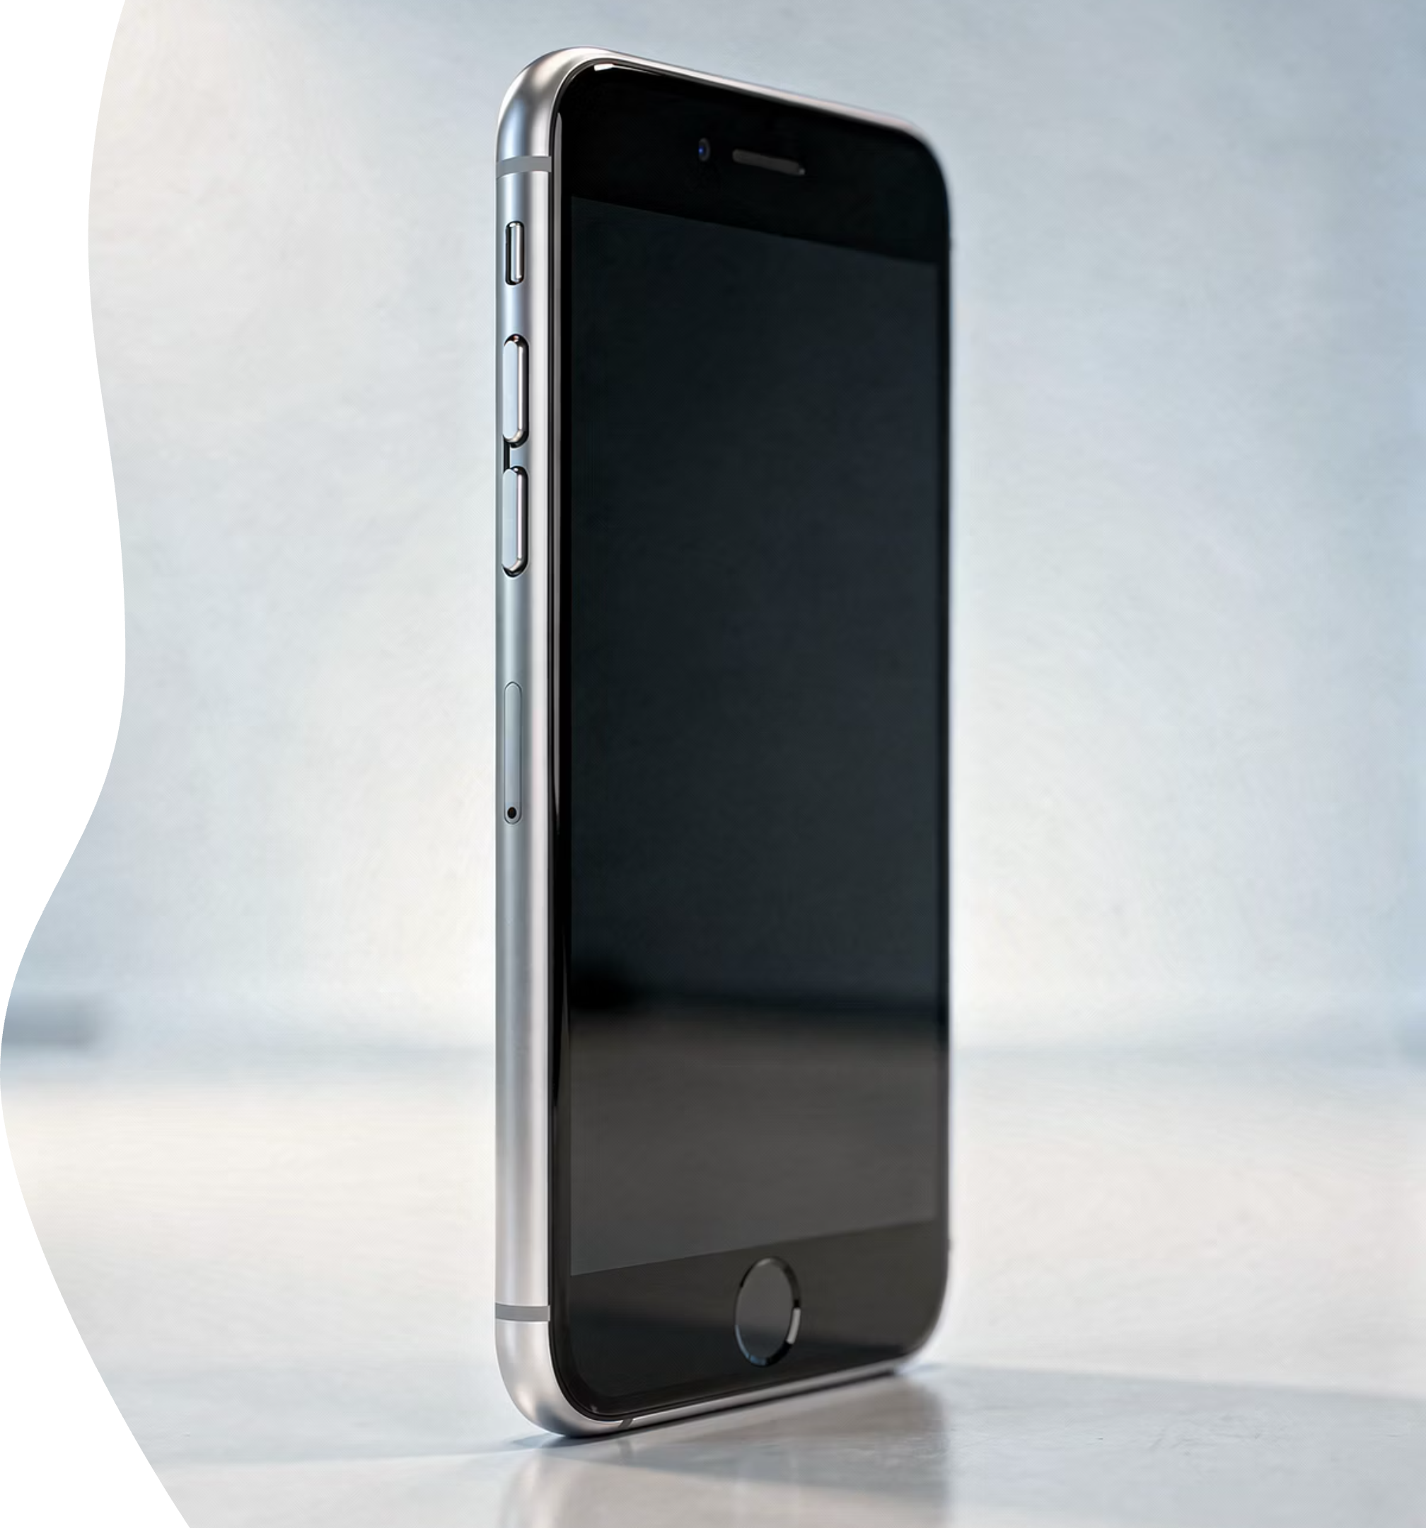
Meet Your iPhone
Screen
Side button
Volume buttons
Ring/Silent switch (if present)
Every phone looks mysterious until you name the parts. Once you know what these buttons actually do, the phone starts to feel a lot less intimidating.
Notes:
Every phone looks mysterious until you name the parts.
Once you understand what the buttons are and what they actually do, the phone starts feeling a lot less intimidating — and a lot more like a tool instead of a puzzle.

Slide 8
Power vs. Wake
Powering off ≠ waking the screen
Waking the screen is like glancing at a watch.
Two very different actions
Powering off is like shutting the house down for the night. Very different things.
This is one of the biggest sources of confusion.
Notes:
This is one of the biggest sources of confusion, so it’s worth slowing down here.
Waking the screen is like glancing at your watch. Powering the phone off is like shutting the house down for the night.
Very different actions — and mixing them up is completely normal.

Slide 9

Turning the Phone Off Safely
01
02
Side button + volume
Swipe to power off
Press and hold both buttons together
Slide the power off slider to the right
Important: Turning your phone off is safe. It won't erase anything, it won't break anything, and Apple will not send someone to your house.
Notes:
Turning your phone off is safe.
It won’t erase anything. It won’t break anything. And Apple will not send someone to your house.
This is one of those worries people carry quietly, so I like to say it out loud.

Slide 10
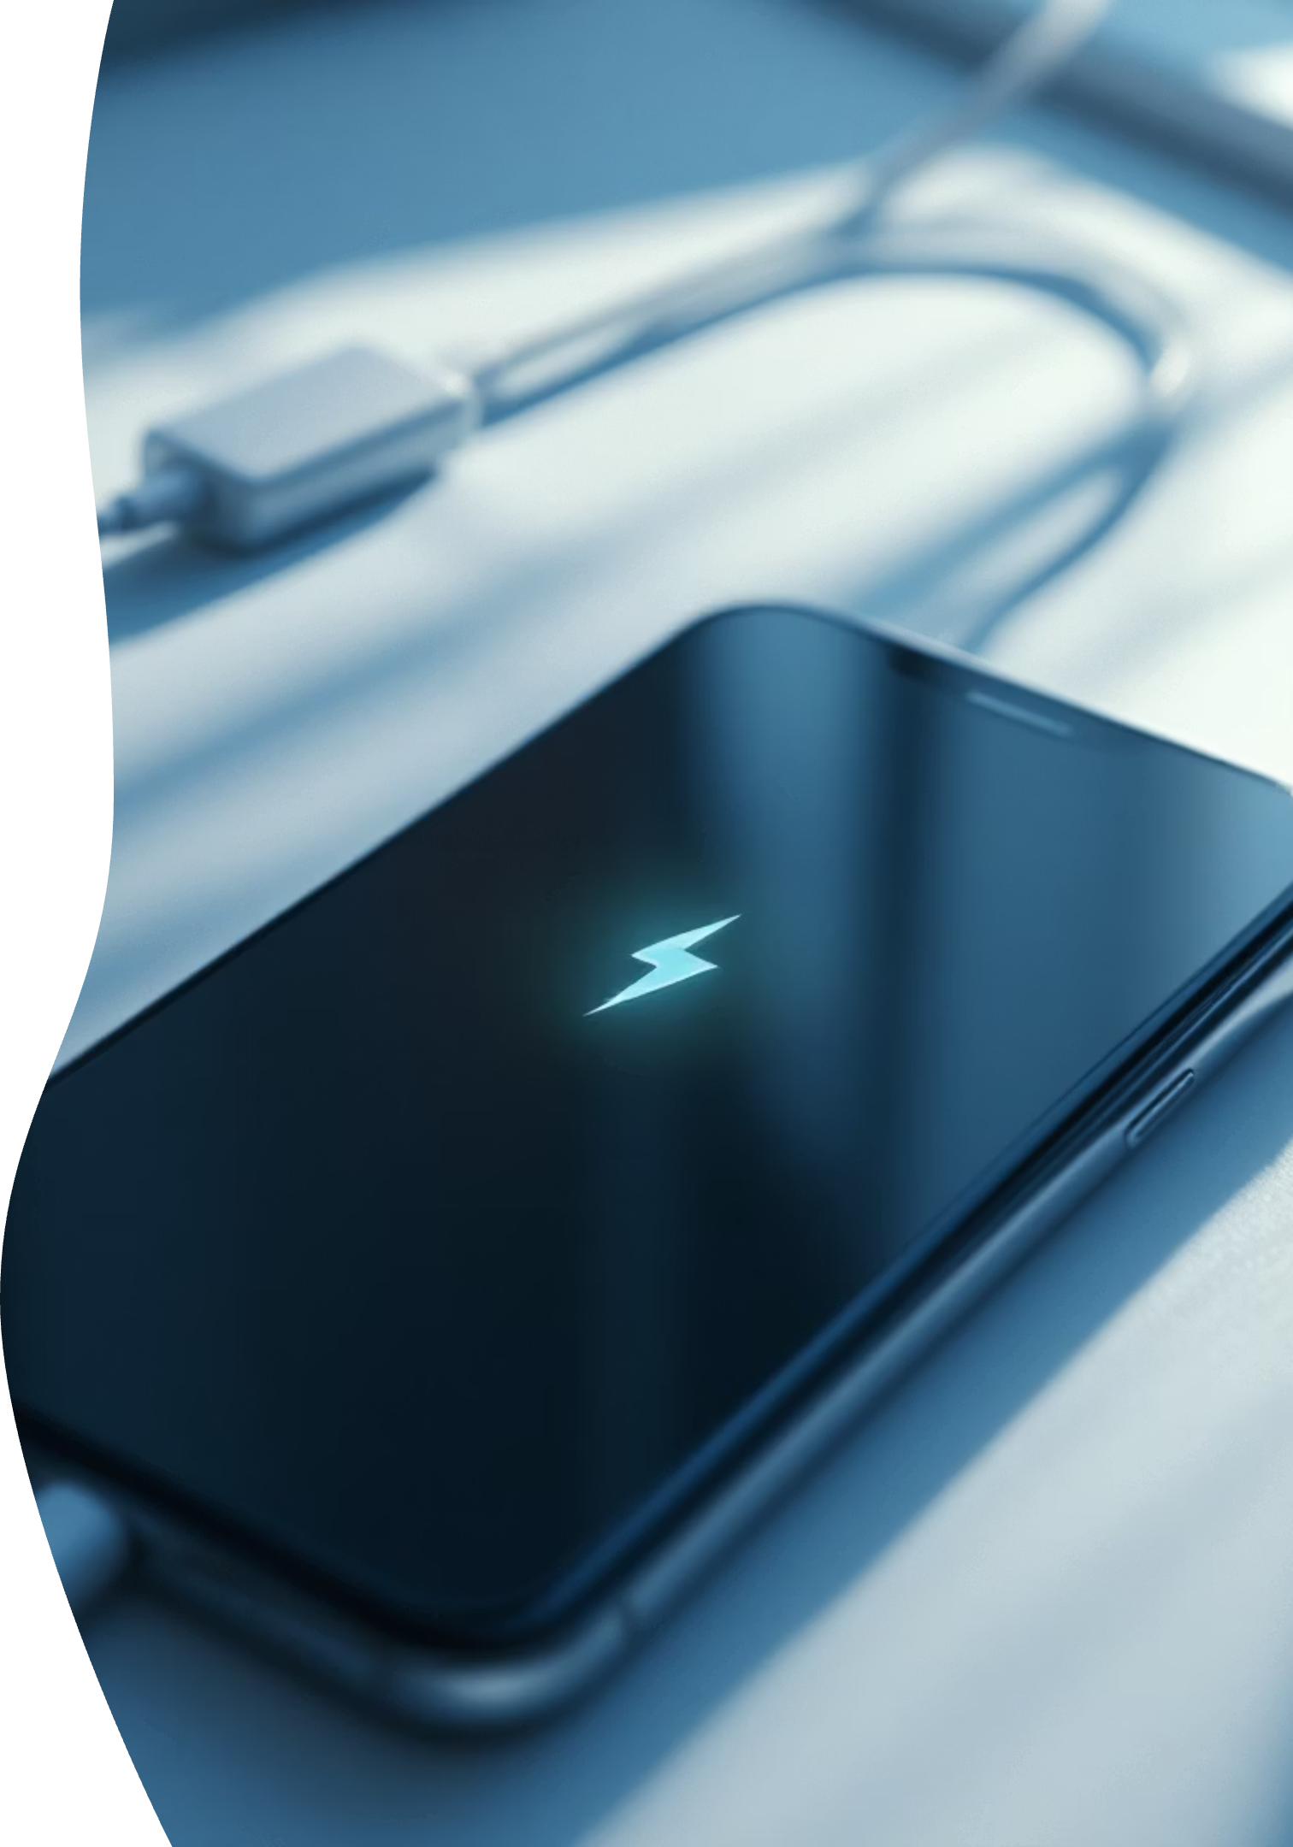
Charging Basics
Cable fits one way
Lightning bolt = charging
If it takes a couple tries to plug the cable in… welcome to the club.
If you see the lightning bolt, you're doing it right.
Notes:
If it takes a couple tries to plug the cable in, welcome to the club.
Look for the lightning bolt — that’s your confirmation that everything is working properly. If you see it, you’re doing it right.

Slide 11
Silent Switch Explained
Orange showing = silent
Phone still works
If your phone ever "stopped ringing," this switch is usually the culprit.
Orange means silent — not broken, not angry, just quiet.
Notes:
If your phone ever “stopped ringing,” this little switch is usually the reason.
Orange showing means silent — not broken, not angry, just quiet. The phone still works exactly the same.

Slide 12



Touch Gestures
Tap
Swipe
Press and hold
Quick touch to select or open
Slide your finger to scroll or navigate
Touch and wait for options
These three gestures are about 90% of iPhone use. If you can tap, swipe, and hold, you're already ahead of the game.
Scrolling Without Fear
You can't break anything
You can always scroll back
Scrolling is safe. There is no edge of the internet.
You can't fall off, and nothing bad happens if you scroll too far.
Notes:
Touch Gestures
Most iPhone use comes down to three gestures:
Tap
Swipe
Press and hold
If you can do those three things, you already know about 90% of what you need. Scrolling without fear Scrolling is safe.
There is no edge of the internet. You can’t fall off, and nothing bad happens if you scroll too far. You can always scroll back.
This alone relieves more stress than people realize.

Slide 13


The Back Button Mystery
Top-left arrow
Edge swipe
Look for the arrow in the upper left corner
Swipe from the left edge of the screen
Apple doesn't label the back button clearly, which keeps life interesting. The arrow and the edge swipe are your escape hatches.
Notes:
Apple keeps life interesting by not labeling the back button clearly.
Your escape hatches are:
The arrow in the upper-left corner
Or swiping in from the left edge of the screen
When in doubt, try one of those.

Slide 14
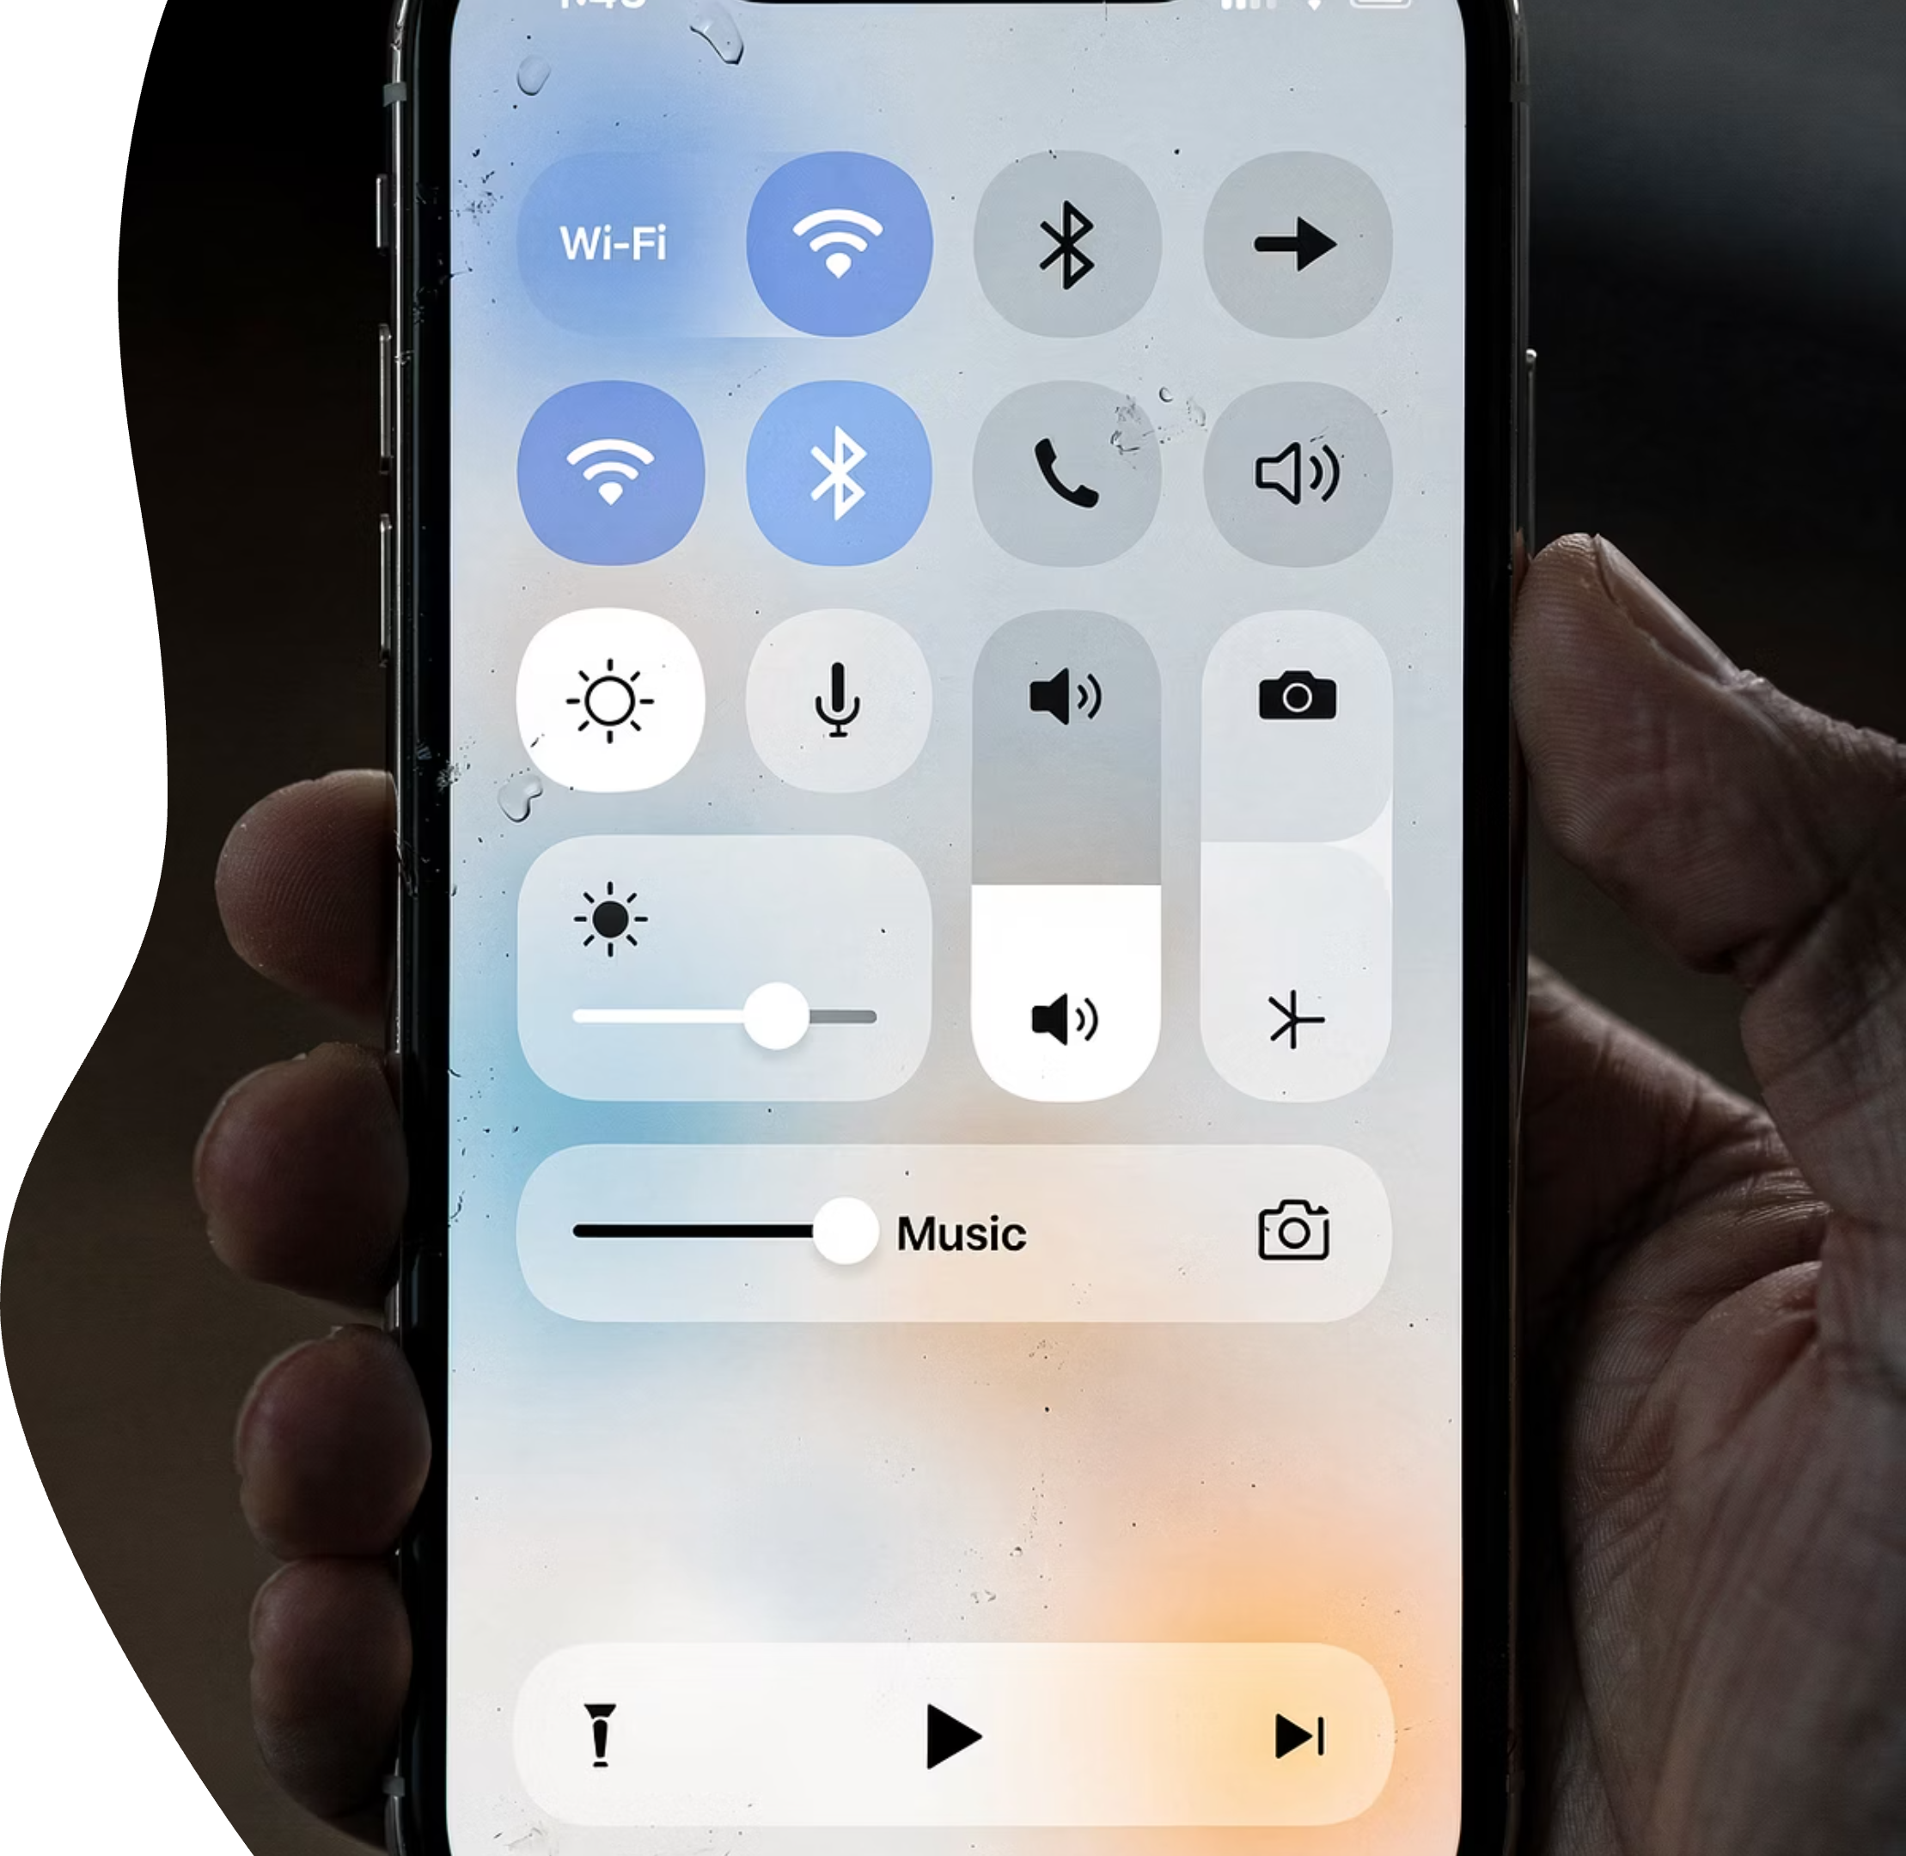
Control Center
Quick-access controls
Think of Control Center as your phone's tool tray.
Swipe down from top-right
Instead of digging through menus, you grab what you need quickly.
Notes:
Think of Control Center as your phone’s tool tray.
Instead of digging through menus, you swipe down from the top-right corner and grab what you need quickly.
Simple, efficient, and very handy.

Slide 15



Common Control Center Icons
Flashlight
Volume
Wi-Fi
Instant light when you need it
Quick sound adjustments
Connect to wireless networks
These are the greatest hits — the controls people use every day. Nothing fancy, just useful.
Notes:
These are the everyday favorites:
Flashlight
Volume
Wi-Fi
Nothing fancy. Just useful.

Slide 16



The Phone App
Keypad
Recents
Voicemail
Dial numbers directly
See your call history
Listen to messages
Yes, it's still a phone. And it still does phone things surprisingly well.
Notes:
Yes — it’s still a phone.
It makes calls, keeps a call history, and stores voicemail. Some things haven’t changed in decades — and honestly, that’s comforting

Slide 17

Making a Call
1
2
Dial
Tap Call
Enter the phone number using the keypad
Press the green call button
This part hasn't changed much in decades — and that's a good thing.
Answering a Call
Swipe or tap
Speakerphone basics
Depending on how the call comes in, you'll swipe or tap.
We'll also talk about speakerphone so you don't accidentally broadcast your life story.
Ending a Call
Red button
That big red button? It's there for a reason. You are absolutely allowed to use it.
Notes:
Making a Call
This part hasn’t changed much over the years.
Dial the number, tap the green button — done.
Answering a Call
Depending on how the call comes in, you’ll swipe or tap to answer.
We also talk about speakerphone so you don’t accidentally share your entire life story with the room.
Ending a Call
That big red button exists for a reason.
You are absolutely allowed to use it.

Slide 18
Voicemail Explained
Visual voicemail
Any order playback
You no longer have to listen to voicemails in order. It's one of the quiet victories of modern technology.
Choose which message to listen to first
Common Call Confusions
Missed calls
Accidental speaker use
If any of these have happened to you, congratulations — you're officially human.
Notes:
Voicemail Explained
Visual voicemail lets you choose which message to listen to first.
You no longer have to listen in order — one of the quiet victories of modern technology
Common Call Confusions
Missed calls and accidental speakerphone use happen to everyone.
If this has happened to you, congratulations — you’re officially human.

Slide 19
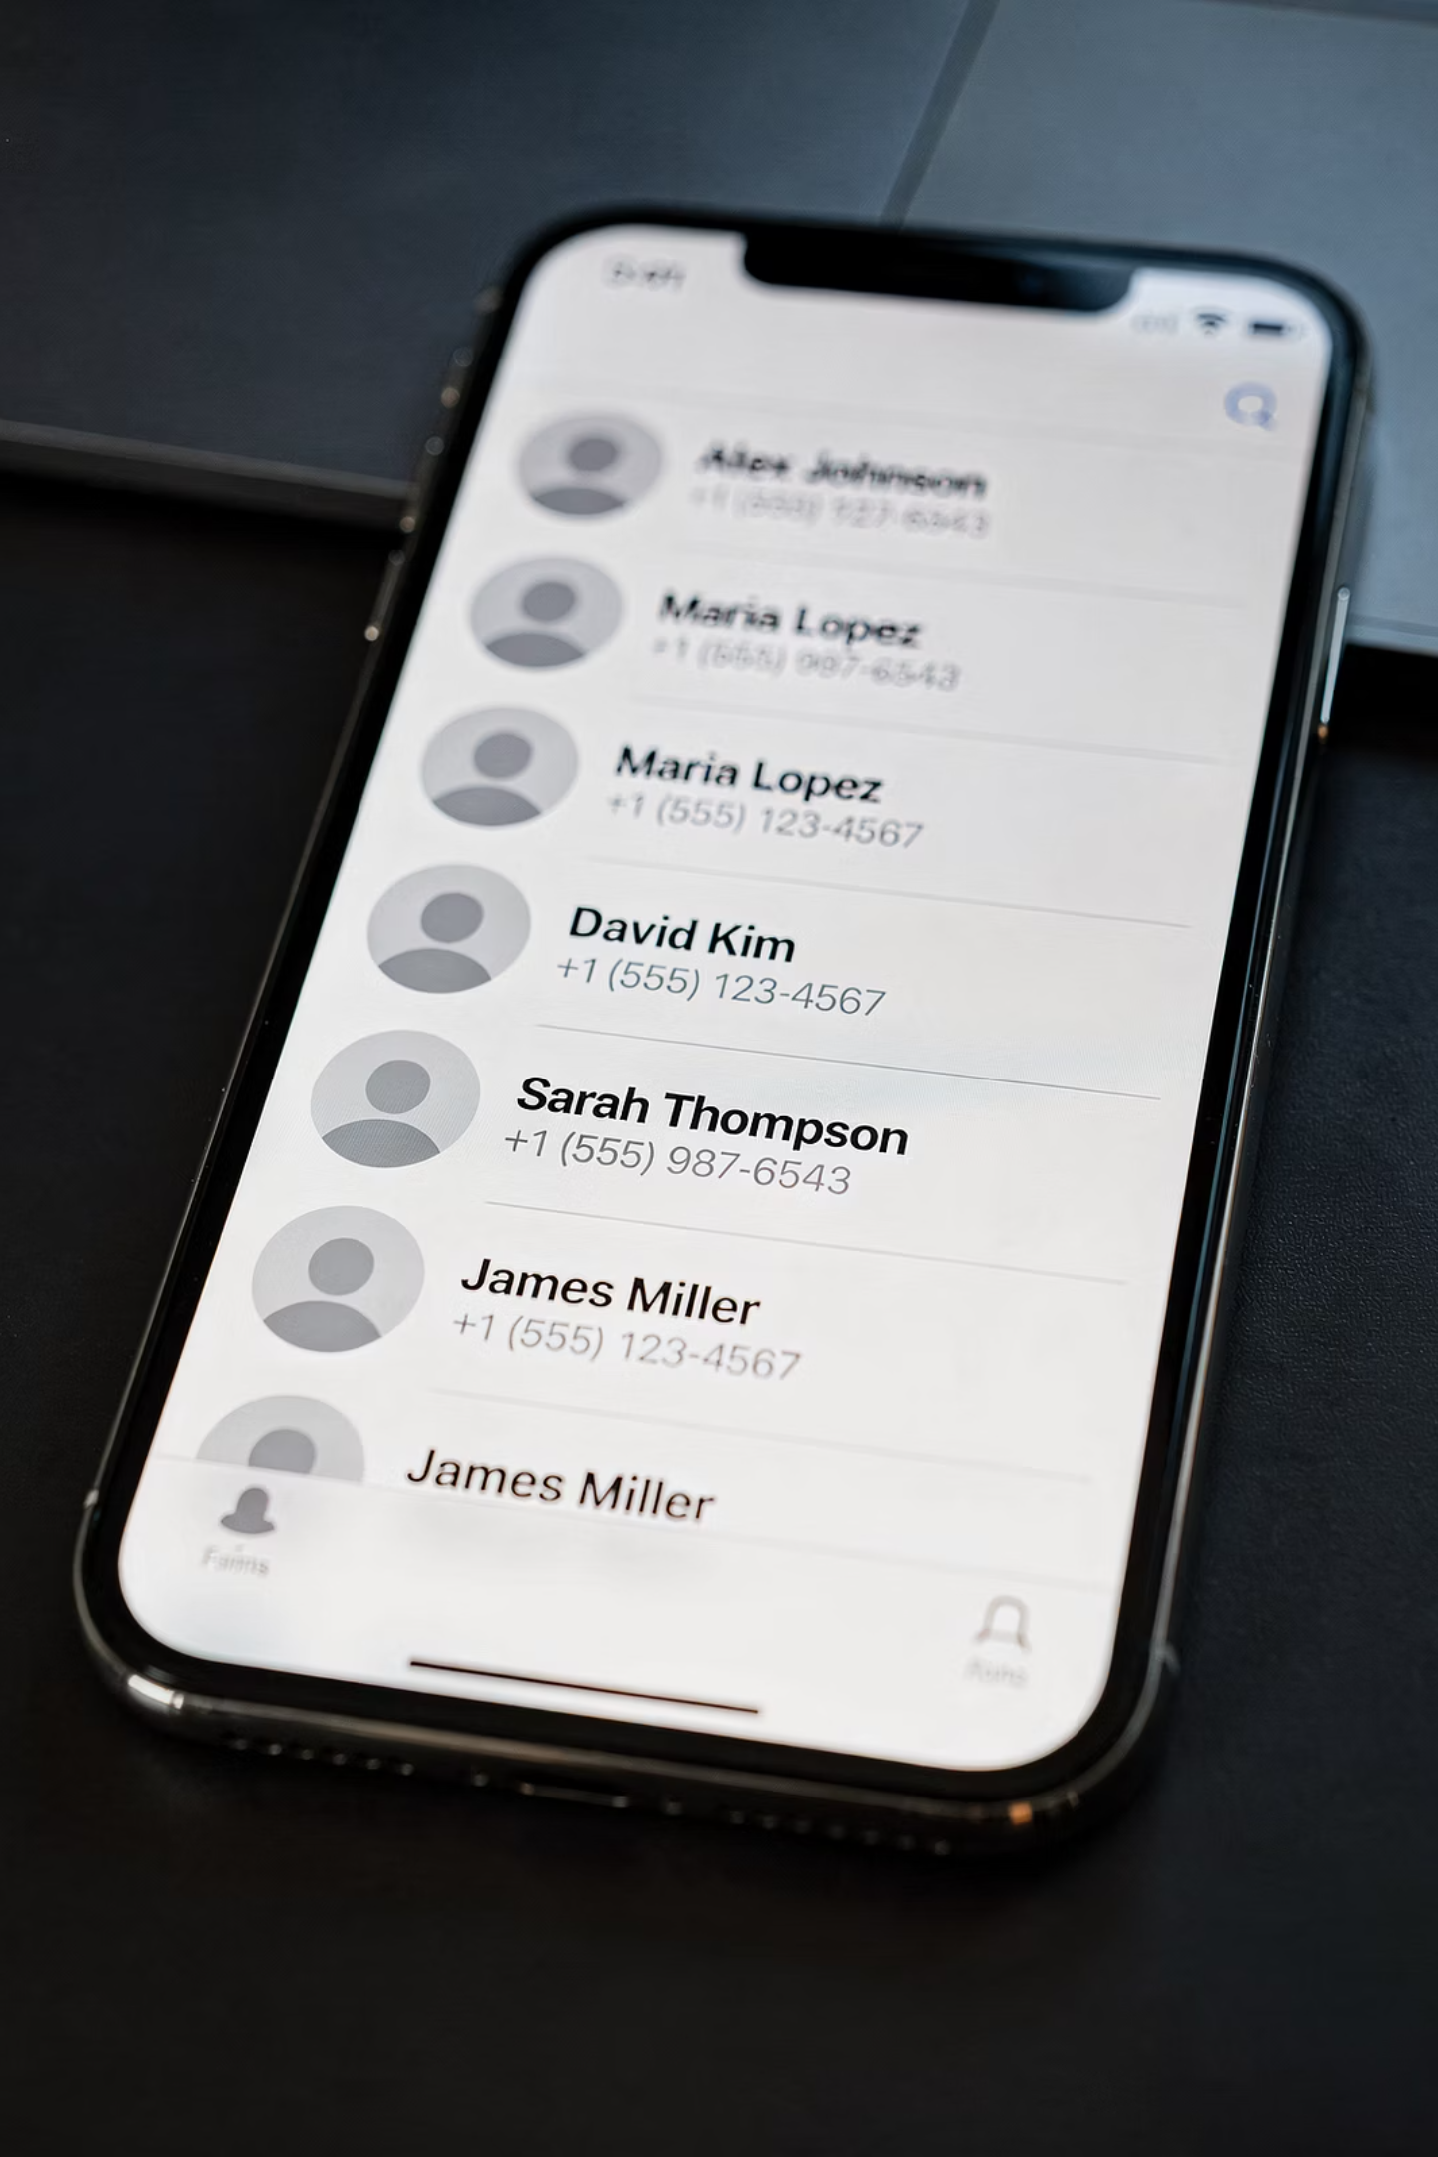
What Contacts Are
Digital address book
.
Notes:
What Contacts Are
Contacts replace the old paper address book — without crossed-out names and scribbles in the margins.
Cleaner. Easier. Less hunting around.

Slide 20
Viewing a Contact
Call
Text
Email
Notes:
Viewing a Contact
Everything you need for one person — call, text, email — lives in one place.
Simple and tidy.

Slide 21
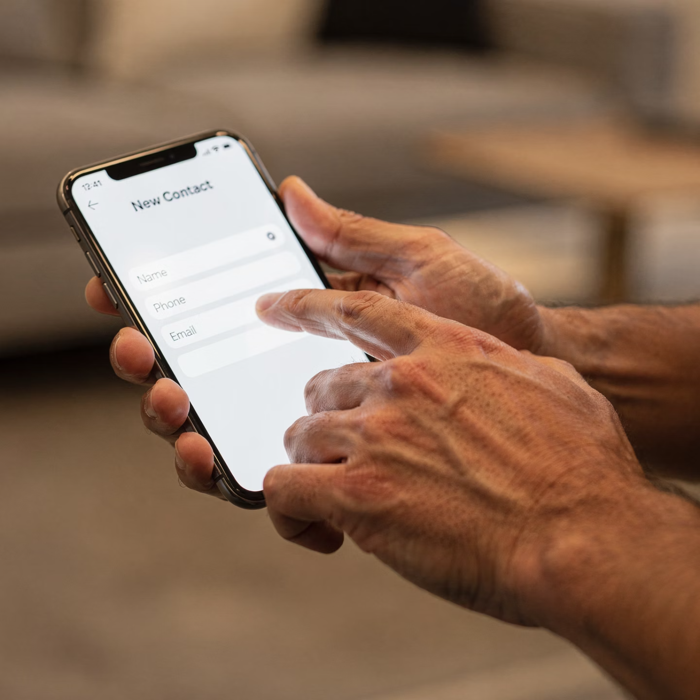
Adding a Contact
Name
Number
Optional email
Speaker Notes:You don't need to fill in every field. Less is more.
Notes:
Adding a Contact
You don’t need to fill in every field.
Name and number are enough. Less is more

Slide 22
Editing Contacts
Safe to fix mistakes
Notes:
Editing Contacts
Mistakes are safe to fix.
Nothing is permanent, and nothing breaks when you edit a contact.

Slide 23
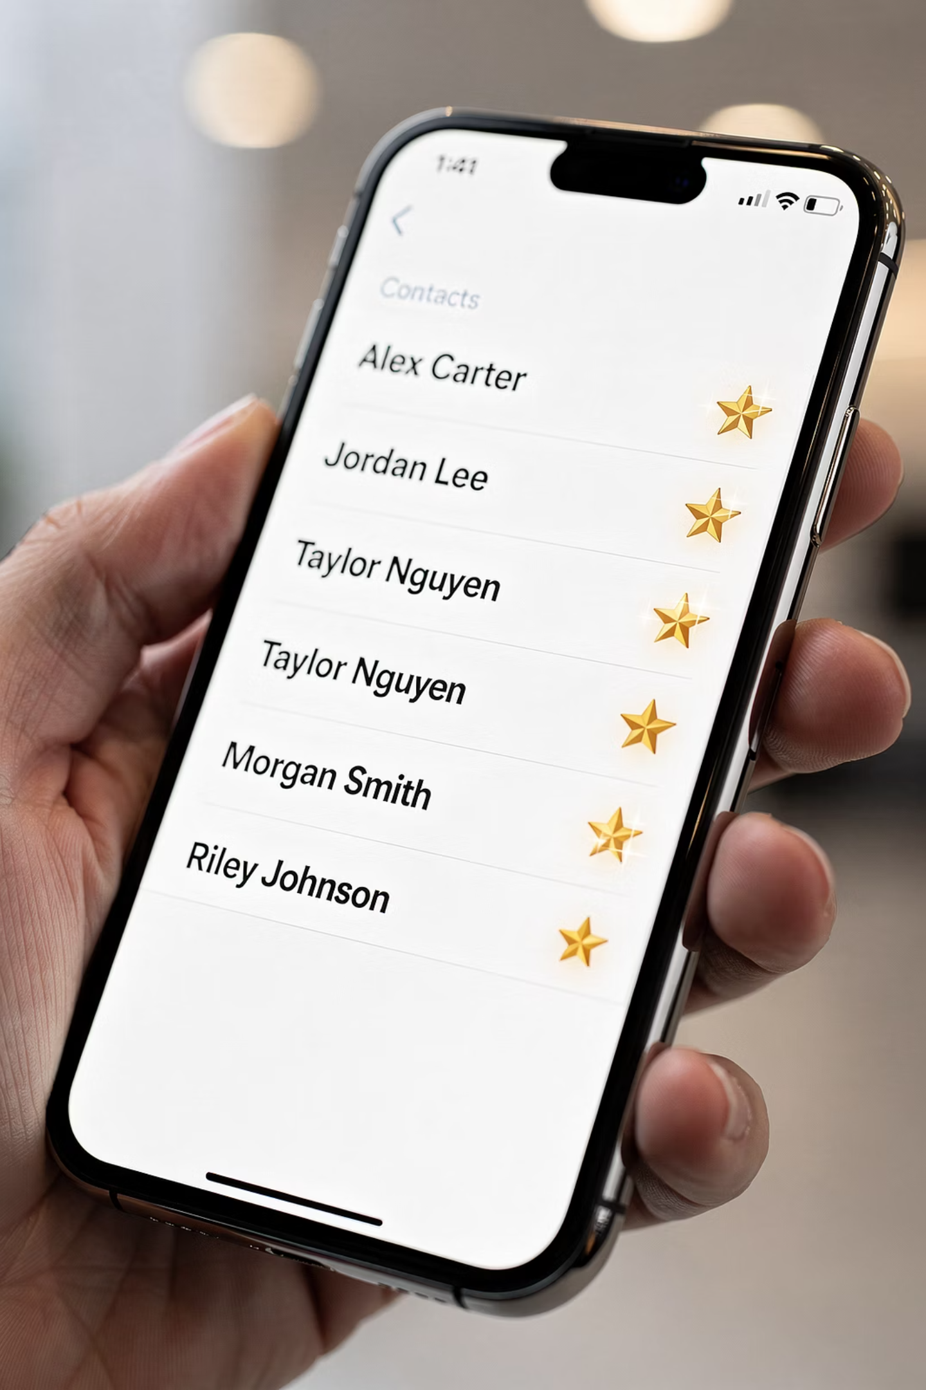
Favorites
One-tap calling
Emergency-friendly
Notes:
Favorites
Favorites allow one-tap calling.
They save time, reduce stress, and are especially helpful in urgent moments.

Slide 24

Contact Safety Tip
Don't delete unless sure
.
Notes:
Contact Safety Tip
If you’re unsure about deleting something, stop.
Pausing is always the right move. You can come back later with fresh eyes

Slide 25
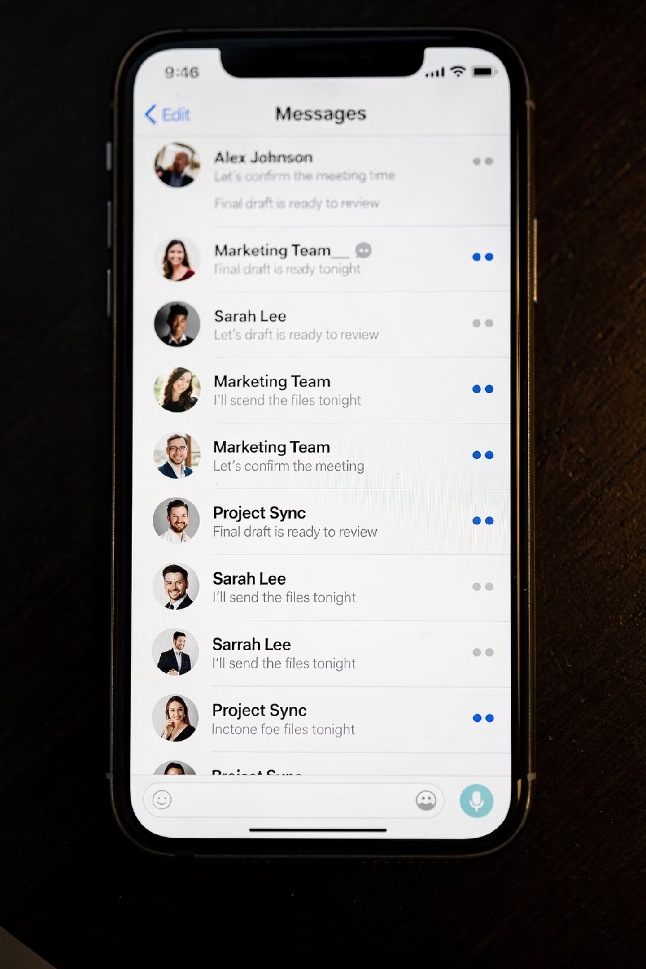
Messages App Overview
Conversation threads
Notes:
Texts stay grouped by person, which makes conversations much easier to follow than email.

Slide 26
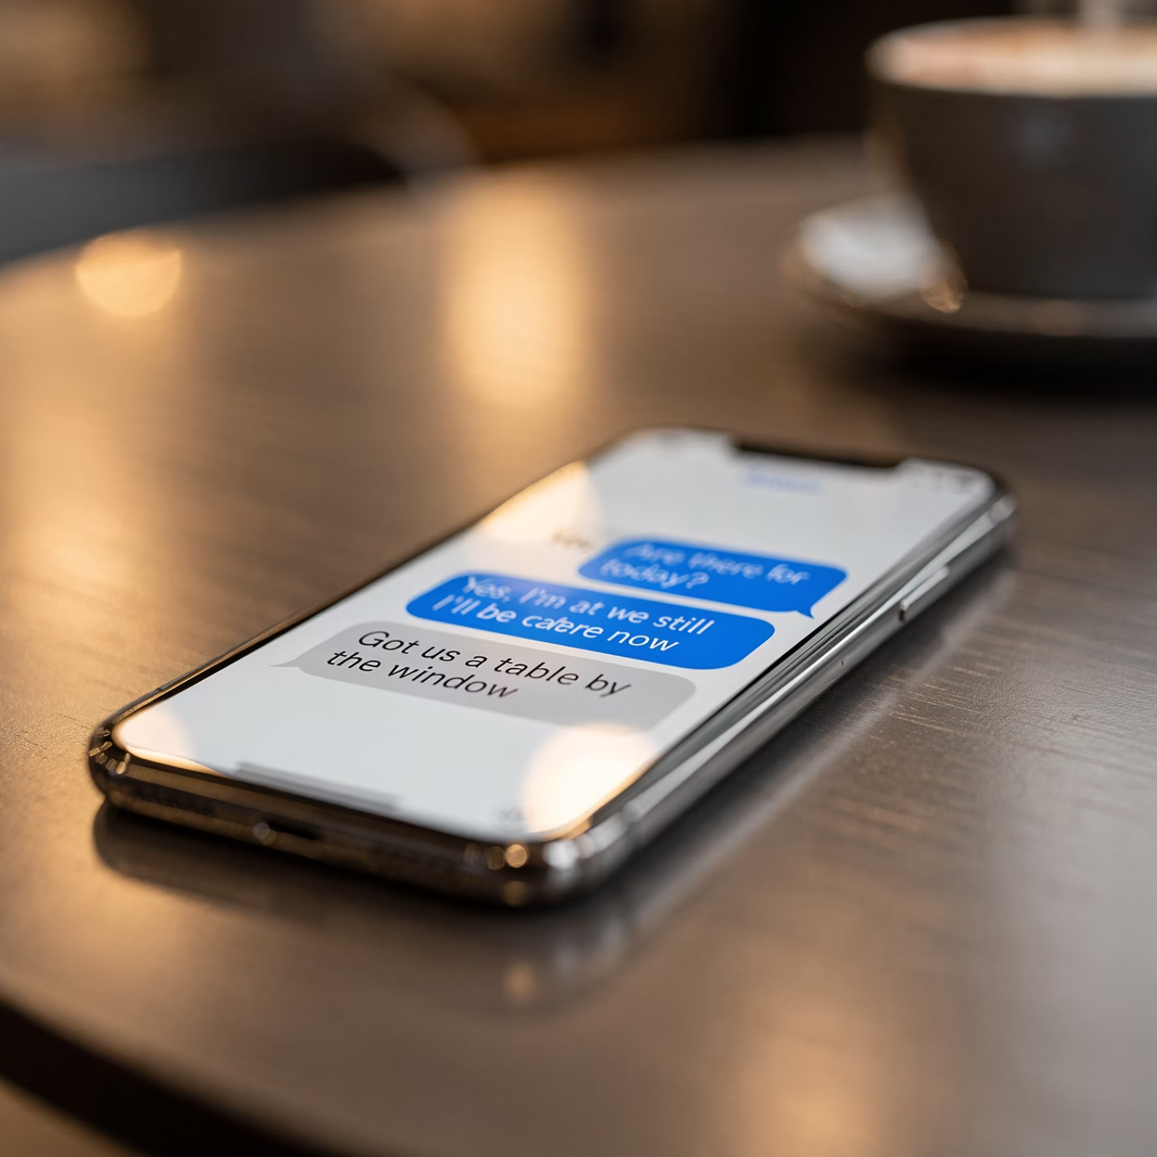
Reading a Text
Blue vs gray bubbles
Notes:
Blue and gray bubbles simply show how the message was sent.
They are not judging you.

Slide 27


Sending a Text
Type
Tap Send
Notes:
Type your message. Tap Send.
That’s it. You’re texting.

Slide 28
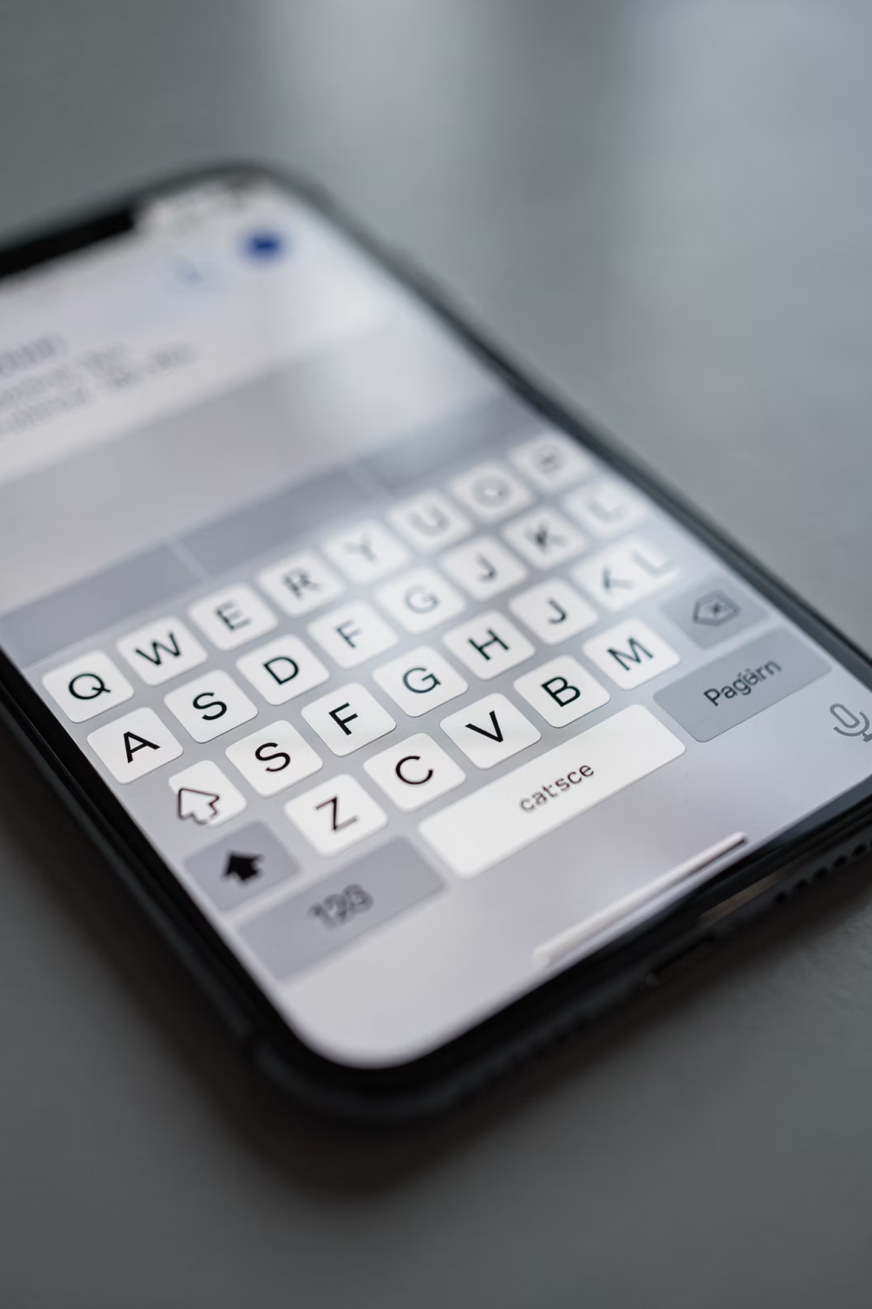
Keyboard Basics
Letters
Numbers
Backspace
.
Notes:
Backspace is your safety net.
Use it freely.

Slide 29
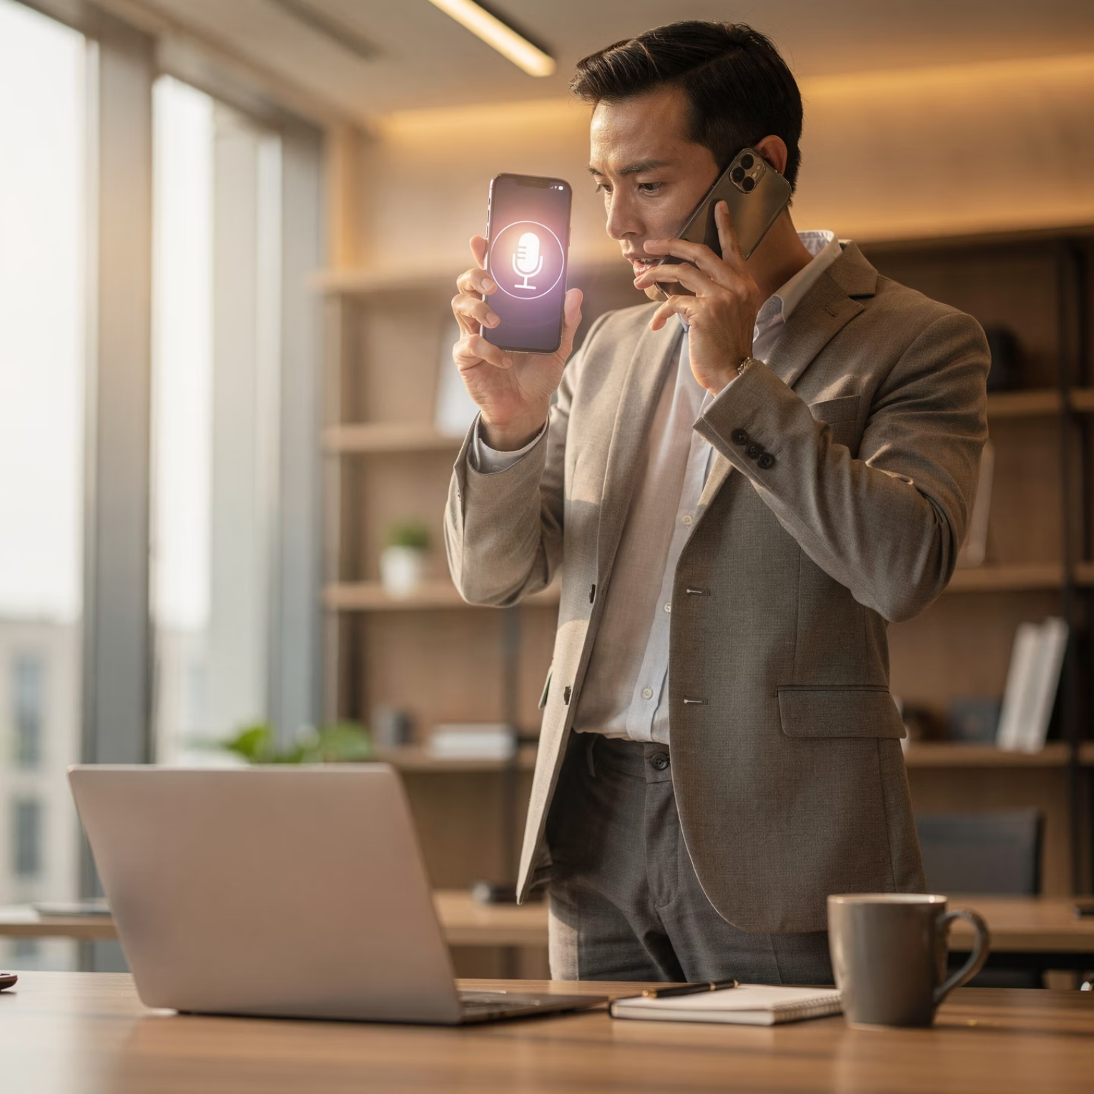
Dictation
Microphone
Speak naturally
Notes:
Dictation is great if typing feels awkward.
Just tap the microphone and speak naturally — like you’re talking to a person, not a machine.

Slide 30
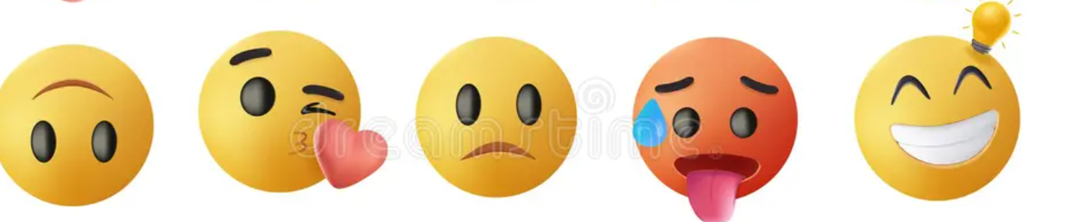
Emojis Explained
Optional
Ignore if desired
Notes:
Emojis are optional.
There will be no emoji quiz later, and you’re not missing out if you skip them entirely.

Slide 31
Common Texting Mistakes
New threads by accident
Notes:
Starting a new thread by accident happens all the time.
It’s easy to fix — and it’s not a sign you’ve done anything wrong.

Slide 32




What You Can Do After Today
Calls
Contacts
Texts
Play Part 1 Epilogue
Notes:
With calls, contacts, and texts, you’ve covered most daily phone use.
That’s a meaningful win — and a solid foundation.

Slide 33
What We Didn't Cover
Advanced settings
App overload
Notes:
We skipped advanced settings and app overload on purpose.
Comfort comes first. Complexity can wait.
That’s Why There’s a Part 2.

Slide 34
What’s Coming Next: iPhone 101 – Part 2
Builds on today's skills
Focus on photos, camera, and simple sharing
Same format and pace — no pressure
Part 2 continues the journey – no restart or speed up.
Notes:
Speaker Notes:Today was about comfort and confidence. Part 2 simply adds a few everyday skills that naturally follow what we covered today.
Part 2 builds on today’s skills — photos, camera, and simple sharing.
Same pace. Same format. No pressure.

Slide 35
Why There’s a Part 2
•We skipped advanced settings on purpose
•We focused on what people actually use every day
•Comfort comes before complexity
That’s why we take this one step at a time.
Notes:
Speaker Notes:Today was about comfort and confidence. Part 2 simply adds a few everyday skills that naturally follow what we covered
We focus on what people actually use.
Confidence comes before complexity — always. “If we didn’t cover it today, that wasn’t an oversight — it was a kindness. We designed this as a two-part seminar on purpose,
so today could stay comfortable and the information would actually stick. We’ll pick up the rest in Part 2.”

Slide 36



Next Steps
Handouts
Practice
Tech Tuesday support
Speaker Notes:You don't have to do this alone. Support is always available.
Your iPhone should work for you —not the other way around.
Notes:
You’ll have handouts, time to practice, and Tech Tuesday support.
You don’t have to do this alone
Final Slide – Closing Thought
The goal isn’t mastery.
It’s confidence.
Your iPhone should work for you — not the other way around.

