Slide 1
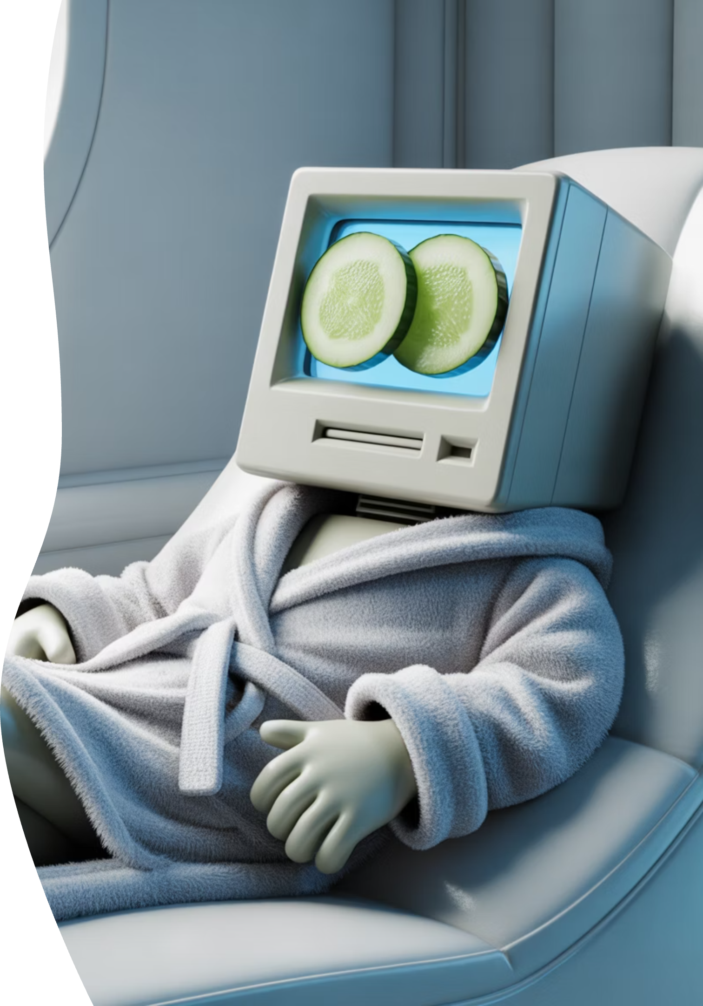

KEEPING YOUR PC / LAPTOP TUNED-UP
Give Your Computer a Spa Day — Not an ER Visit
Notes:
SLIDE 1 — KEEPING YOUR PC / LAPTOP TUNED-UP- Walk Thru Summary Notes
Computers don't “die” — they get overwhelmed
Digital clutter + dust
Big box myth: "You need a new one.”
Honest mechanic mindset
Spa day vs ER visit

Slide 2



Meet Jim Kallaugher: CSC Member & Volunteer
Red Glen Electronics
Weekly Tech Tuesdays
Monthly Tech Presentations
Founder and operator, with friendly “Home Tech Help for Hire” for Boomers.
Volunteer tech support and guidance to community members on Tuesday afternoons.
Conduct tech topic seminars for better understanding & to encourage confidence
With 25+ years of experience making technology clear, simple, and accessible.
Notes:
Hi, I'm Jim Kay-la-her, a Senior Center Member, Volunteer, and Home Tech Support Consultant representing Red Glen Electronics. Red Glen Electronics: I founded Red Glen Electronics as a friendly "Home Tech Help for Hire" for Boomers.
"Tech Tuesday" afternoons: I'm here every Tuesday afternoon for appointments. I offer hands-on tech support or one-on-one training as a regular volunteer.
Monthly Tech Seminars: Every month, I'll lead tech topic seminars for a better understanding and to encourage confidence

Slide 3
Welcome, Cromwell Senior Center (CSC) Members
Fast. Safe. Out of Trouble. (No IT Degree Required)
Play Seminar Video Overview Clip
Notes:
SLIDE 3 — What Today Is / Is Not-- Key Points of Seminar Summary Why We're Here Today This isn't about learning computer code or becoming an IT expert It is about building confidence Think of this as basic car maintenance for your computer — keeping it out of the emergency room Just Like Car Maintenance Things we can do ourselves: Windshield washer fluid Tire pressure Car wash Things for a mechanic: Oil changes New tires Battery replacement Engine repair Computers Work the Same Way Safe to do yourself: Restart your computer
Manage browser tabs
Run monthly virus scans
Install system updates
Clean keyboards, screens, and dust Best done with a technician:
Deleting unused programs
Changing start-up behavior
Security/anti-virus decisions
Browser internals (clearing cache)
Managing storage space

Slide 4
What Today Is (and Is Not)
✔ Simple habits anyone can do ✔ Safe, everyday tune-ups ✖ No repairs ✖ No sales ✖ Not “about blame”.
“If you can click a mouse and restart a computer, you’re already qualified for everything we’re talking about today.”
Notes:
“Before we go any further, I want to slow down for a second — because this slide is essential.
“Today is about simple, safe habits you can do yourself — the kind of things that keep your computer running well without taking risks.”
“We’re not fixing anything. We’re not opening the computer. And we’re definitely not doing anything that could break it.”
“This is also not a sales pitch. No one is leaving here being told they need to buy a new computer or new software.” “If your computer has ever acted up, that doesn’t mean you did anything wrong. Computers are like cars — they need routine care.” “Think of today as giving your computer a spa day, not an emergency room visit.”
“If at any point something sounds unfamiliar, that’s okay. You don’t have to remember everything — I’ll highlight the few things that really matter.” “And if a question pops into your head later, that’s normal. There are no bad questions here.”

Slide 5

The #1 Fix in Tech
Have You Tried Turning It Off and On Again?
This solves more problems than anything else we’ll talk about today.
Notes:
It’s the oldest joke in tech support — and it’s a joke because it works. If you remember only one thing today, let it be this: restarting fixes about half of all strange computer problems. It clears out the cobwebs and lets the computer start fresh.
Restart fixes a lot
Sounds silly
Works often
Clears memory
Resets stuck programs

Slide 6
Sleep vs Restart
Sleep = Nap
Restart = Deep Sleep
The computer is still half-awake, still holding onto problems; still running in the background s
A deep, dreamless sleep that clears everything
Notes:
Most of us just close the laptop lid. That’s Sleep mode. The computer is still half-awake, still holding onto problems. A Restart is a deep, dreamless sleep. The Red Glen Rule: restart your computer at least once a week.
Sleep = nap
Problems linger
Restart = deep sleep
Fresh start
Restart first, always

Slide 7
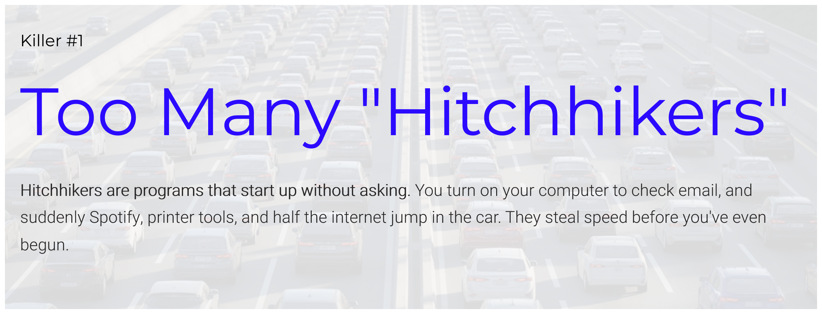
Some of the things we’ll cover today will need adjustment with guidance — Not a click-around experiment– Start Programs; Cache clear; Uninstalls. Set-up a “Tech Tuesday” Appointment Today!
Notes:
Hitchhikers are programs that start up without asking. You turn on your computer to check email, and suddenly Spotify, printer tools, and half the internet jump in the car. They steal speed before you’ve even begun.
Gentle Warning
Some fixes need guidance
Startup programs
Cache clears
Uninstalls
Tech Tuesday = smart move

Slide 8

Browser Tabs
1 Tab = 1 Grandkid
50 Tabs = Chaos
Notes:
We’re all guilty of this. Each open tab uses memory. Think of each one as a grandkid in the kitchen. One or two is lovely. Fifty? Flour on the ceiling and no one can find the spatulas. If you’re not using it right now — close it.
Tabs use memory
Few = fine
Many = chaos
Grocery analogy
Close what you’re not using

Slide 9
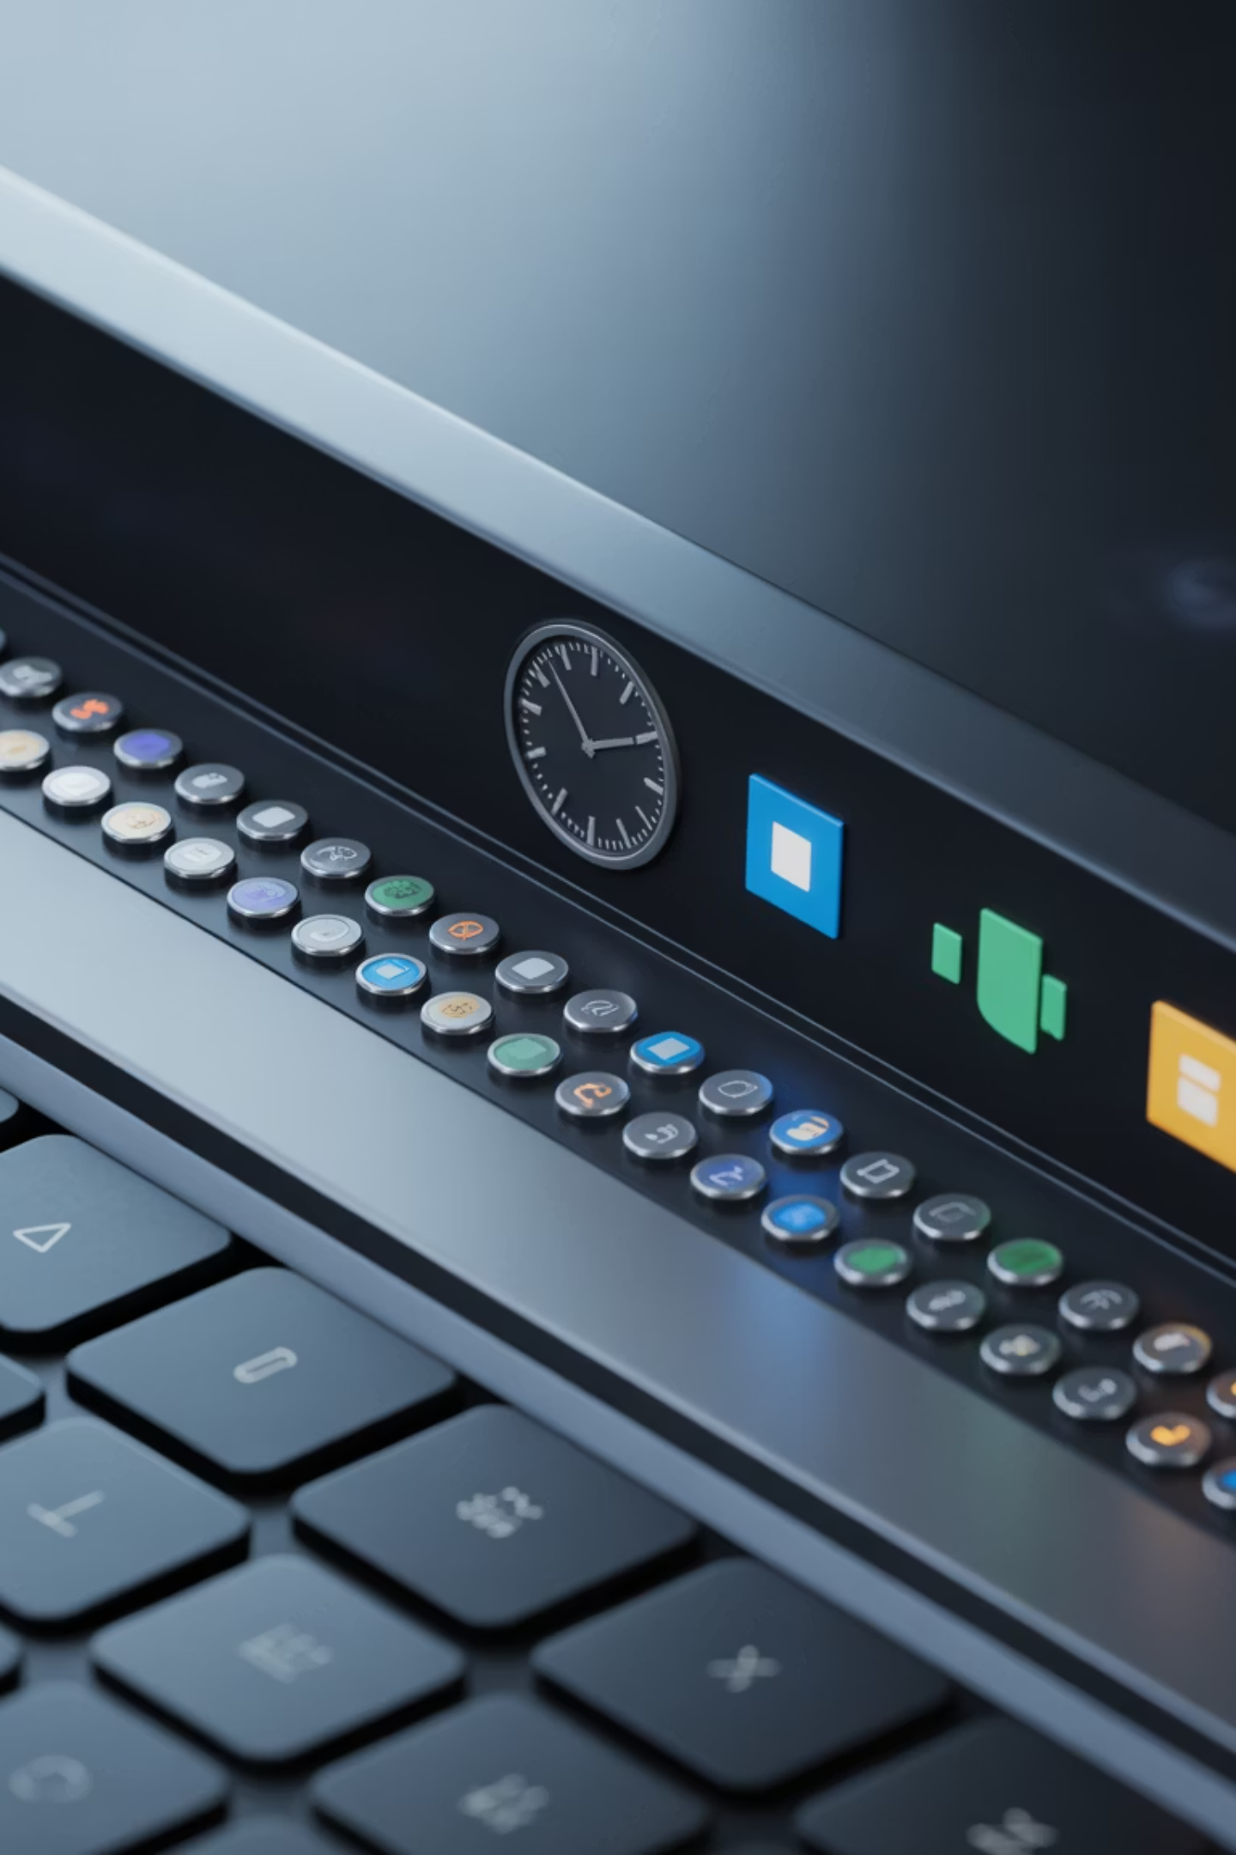
System Tray Icons
This is that little area down by the clock.
Tiny Icons = Speed Leaks
Notes:
Look near the clock on your screen. Every tiny icon is a program currently running and taking a paycheck from your computer’s power. If you don’t recognize it, it probably doesn’t need to be running. Jot down what doesn’t look right, and review with a technician
Area by the clock
Background programs
Too many = slow leaks
Not fixing today
Just notice

Slide 10
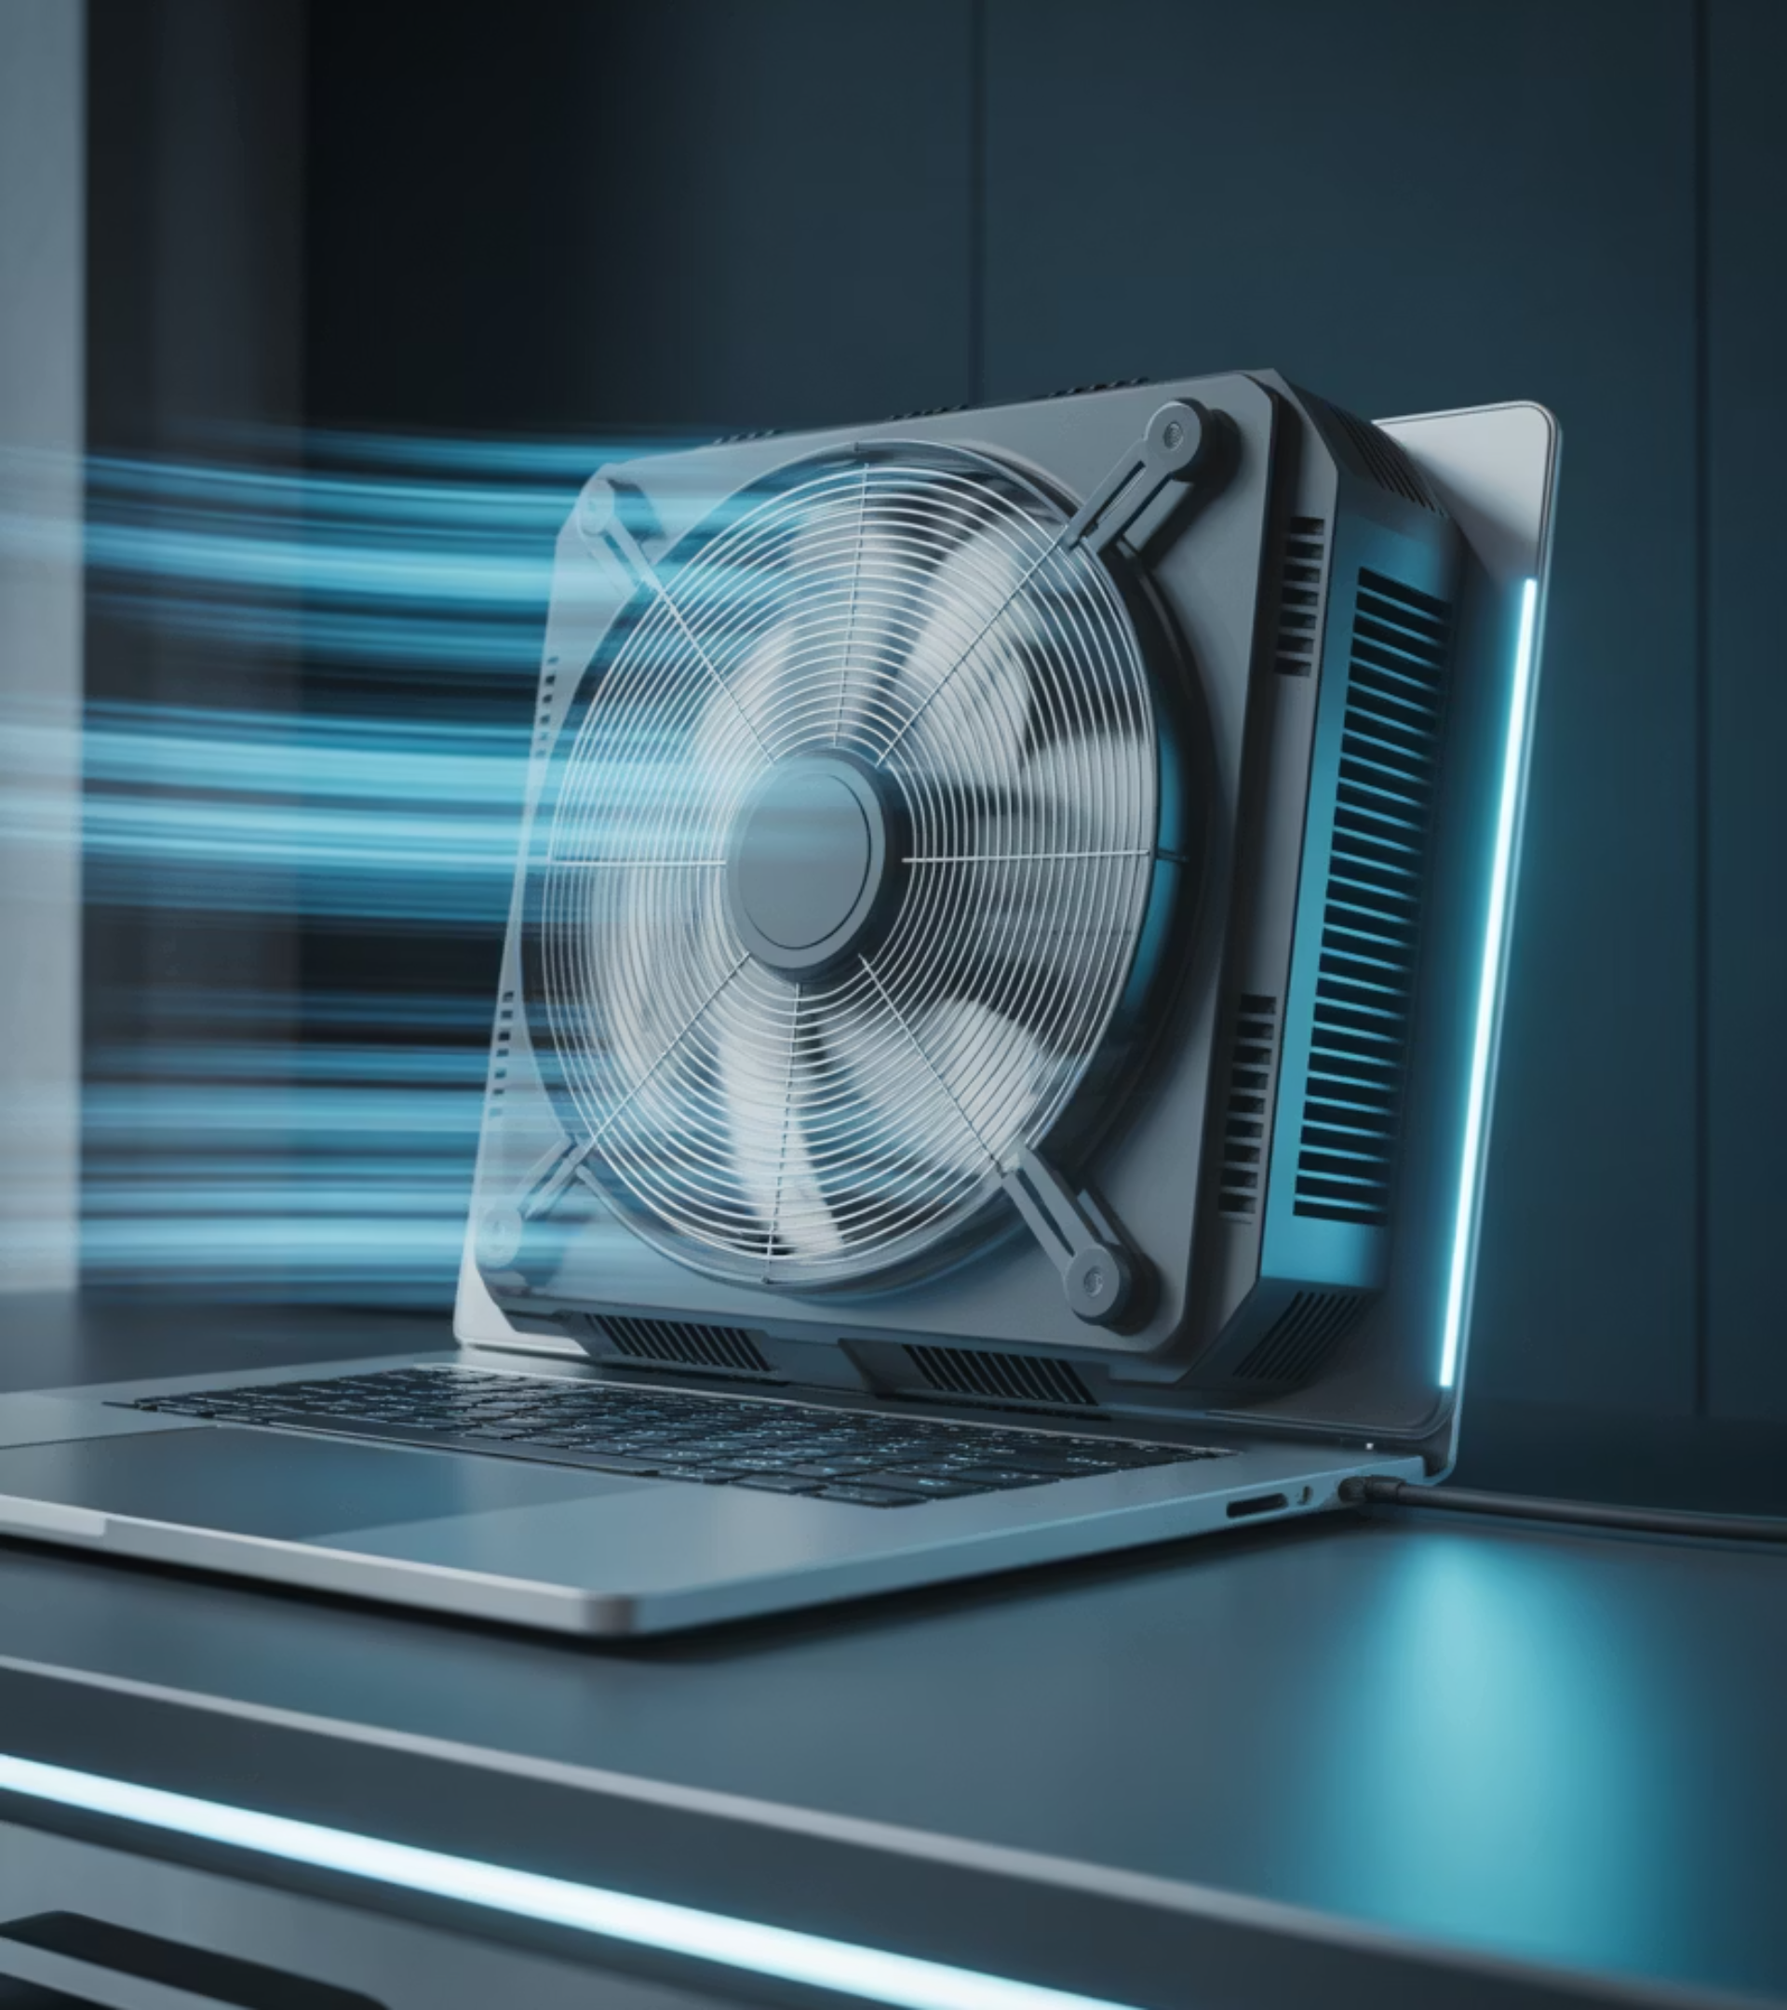
Listen to Your Computer
Jet Engine = Overworked
If it sounds like it’s working hard while you’re doing nothing, that’s a clue.
Notes:
Your computer talks to you. If it sounds like it’s trying to take off, it’s overheated and overwhelmed — not broken. That’s your cue to close things or check for dust.
Other times, if it’s continuous even after dusting, then it may be a hardware problem which require a tech review and repair
Jet engine sound = clue
Heat
Dust
Overwork
Noise = early warning

Slide 11
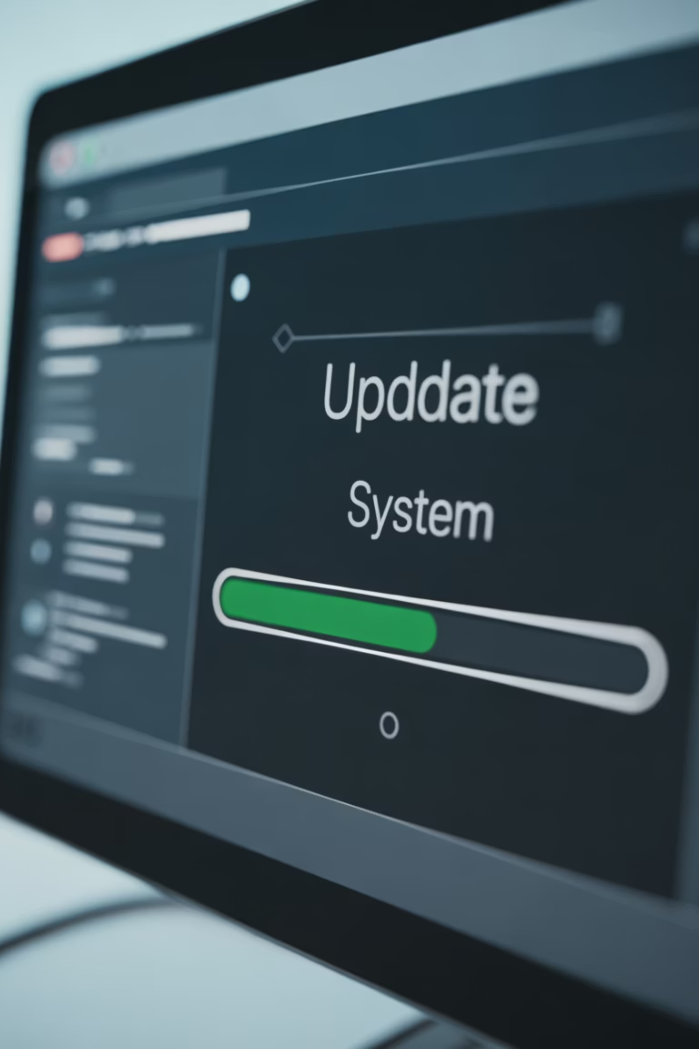
Updates
Updates = Flu Shots
Antivirus isn’t something you install and forget. It’s something you let update quietly in the background — like smoke detector batteries If your computer is updating itself regularly, you’re probably okay for everyday use
Notes:
Updates are annoying. They always pop up at the worst time. But they protect you from hackers and fix glitches. Skipping updates is like leaving your front door unlocked in a storm If you ever feel unsure about your security, that’s not a failure — that’s a hand-off moment. Get a second set of eyes before clicking anything scary .
Updates = flu shots
Boring but vital
Antivirus updates quietly
Smoke detector analogy
Updating = usually OK

Slide 12

Stop Postponing
You’re not in trouble — we’ve all done this
Let's Make a Pact
No more "Remind me tomorrow" for weeks on end. Next time it asks, click "Okay." Five minutes of updating beats five days of problems.
Notes:
No more “Remind me tomorrow” for weeks on end. Next time it asks, click “Okay.” Five minutes of updating beats five days of problems.
“Remind me tomorrow” trap
Make a pact
Click OK
5 minutes now
Beats 5 days later
No guilt — we all do it

Slide 13
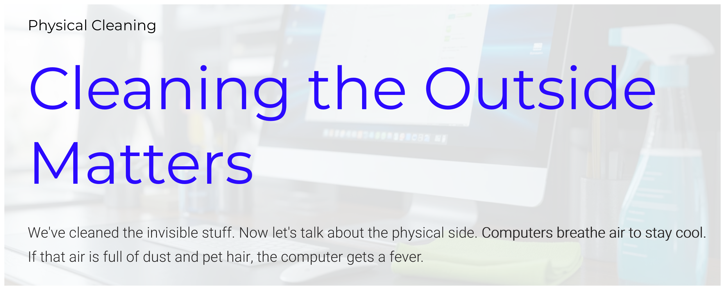
Note: You’re cleaning around the computer, not inside it
Notes:
We’ve cleaned the invisible stuff. Now let’s talk about the physical side. Computers breathe air to stay cool. If that air is full of dust and pet hair, the computer gets a fever.
Around the computer
Not inside
No screwdrivers
No bravery awards

Slide 14
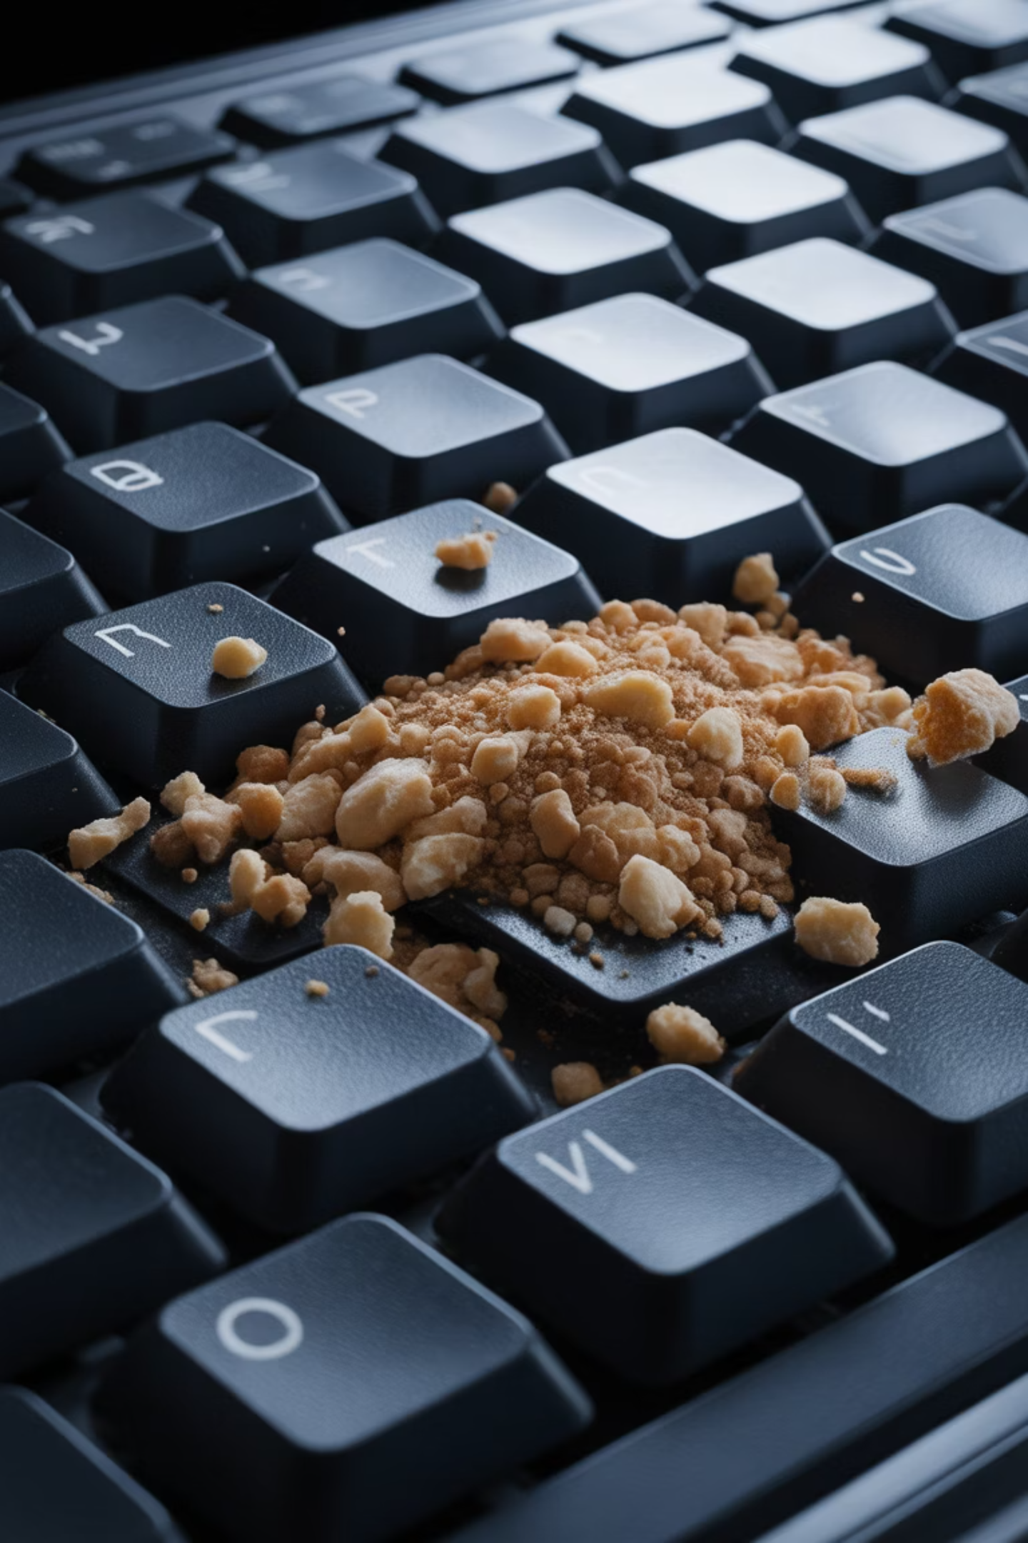
Keyboard Snack Bar
What's Living Under Your Keys?
Notes:
Be honest — who snacks while using their computer? Crumbs get under keys and cause sticky behavior. Turn the keyboard upside down and gently shake. You may discover last Tuesday’s muffin.
Crumbs happen
Dust happens
Canned air helps
Better airflow

Slide 15

Canned Air
Dust = Heat
Heat = Slow
Notes:
A $5 can of compressed air is one of the best investments you can make. Short bursts into the vents will blow out dust and help your computer cool down.
Dust = heat
Heat = slow
Short bursts
Gentle

Slide 16
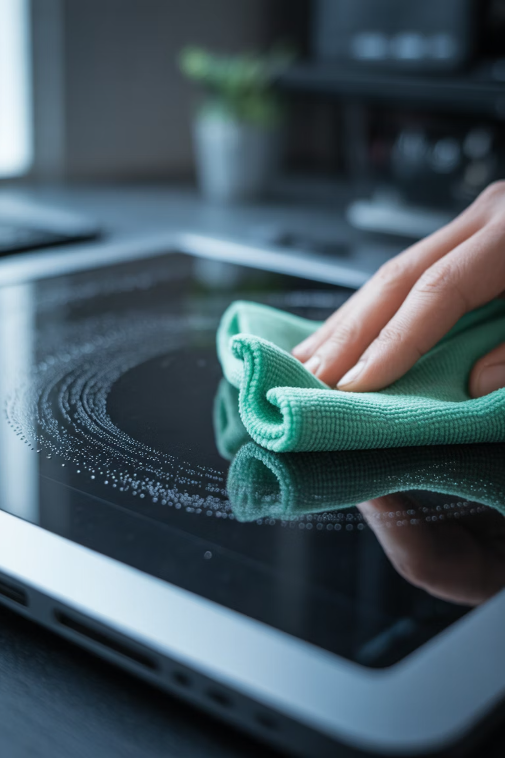
Screen Cleaning
Spray the Cloth — Not the Screen
Notes:
Never spray liquid directly on the screen. Spray a microfiber cloth lightly and wipe gently. Liquids that seep inside can damage electronics.
Spray cloth
Not screen
Liquid sneaks inside

Slide 17
Safety Tip
Don't Shake the Can
Keep canned air upright. Shaking it or turning it upside down can spray freezing liquid onto delicate parts. Calm, short bursts are the way to go.
Notes:
Keep canned air upright. Shaking it or turning it upside down can spray freezing liquid onto delicate parts. Calm, short bursts are the way to go.
Can upright
Don’t shake
No upside-down spray
Calm, steady bursts

Slide 18
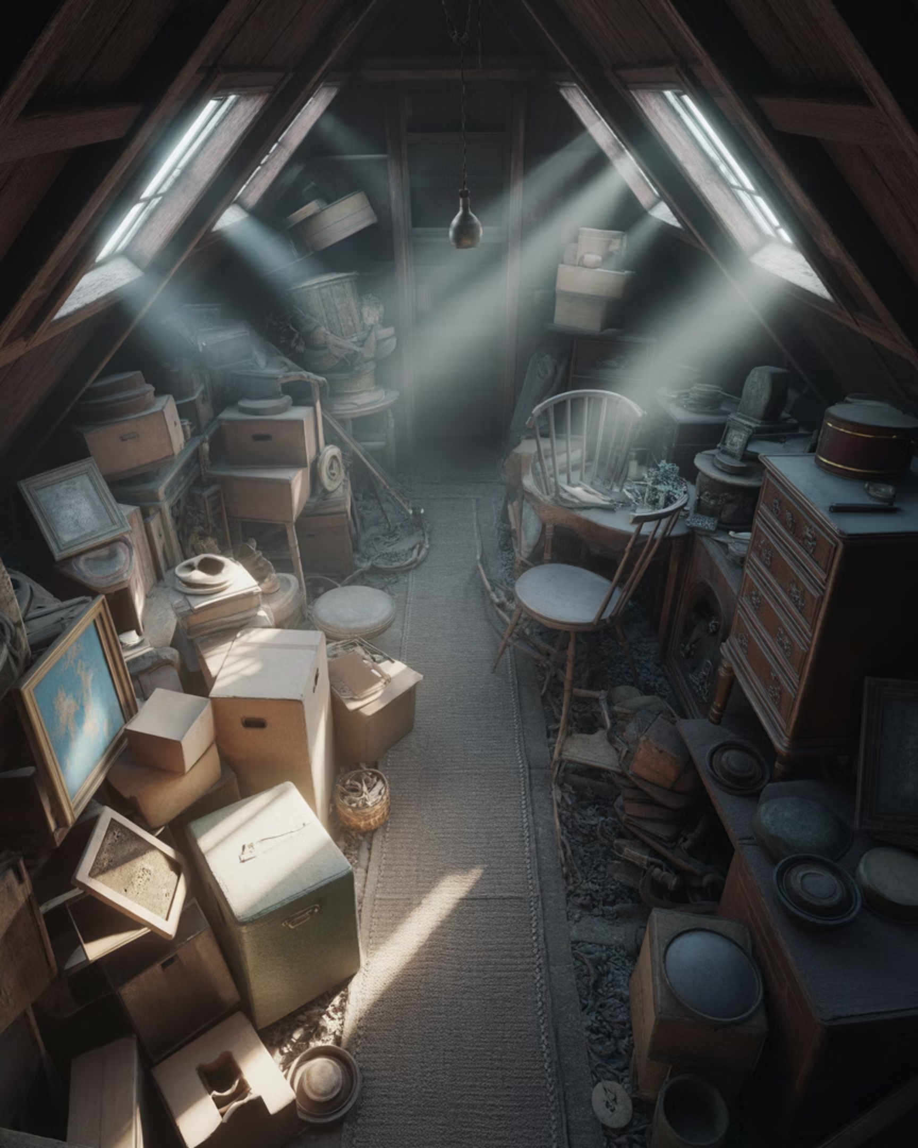
Storage Space
Your Digital Attic
Notes:
A hard drive that’s almost full is like an attic you can’t walk through. Your computer needs breathing room — ideally 15% free space — just to function properly.
If your space is less than 15%, review ways to trim data with a technician
Storage = attic
Fills slowly
One day: no room

Slide 19

Photos & Videos
The Biggest Space Hogs
Notes:
Best done with a technician:
One short video can take more space than thousands of emails. You don’t need to delete memories — just move older ones to an external drive or the cloud. If unsure how to use an external hard drive or the cloud, discuss with a technician
Precious files
Need backups
Not forgotten clutter

Slide 20
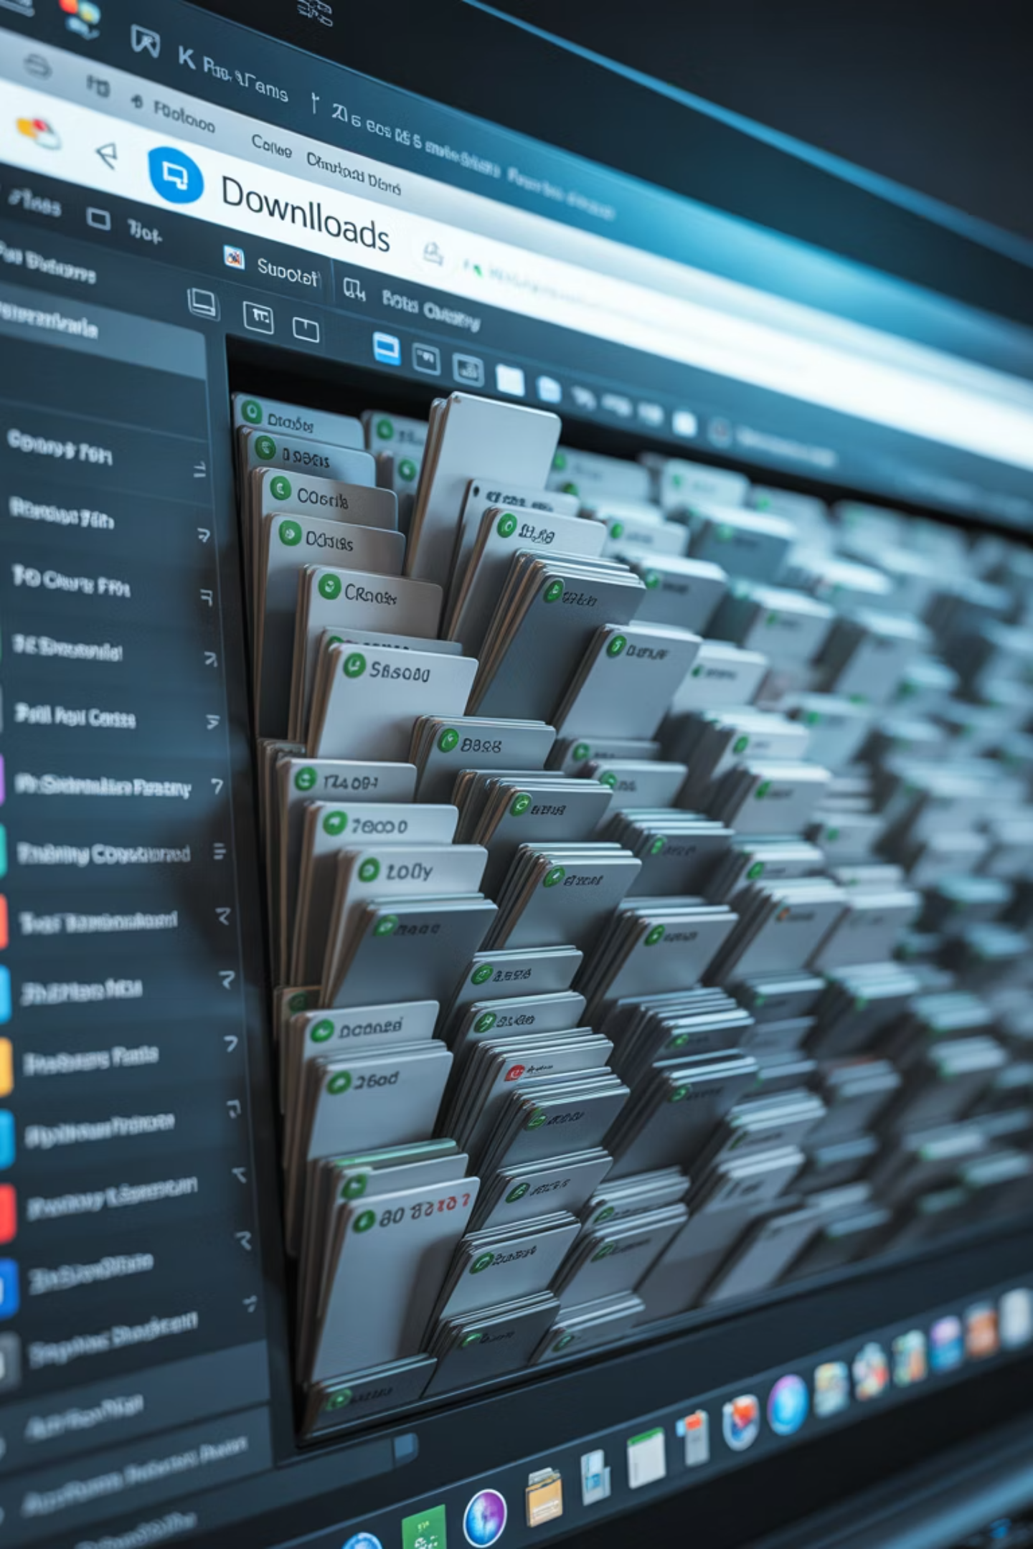
Downloads Folder
The Junk Drawer
Notes:
Most people forget this folder exists. Old menus, forms, and duplicates pile up. If you’ve already used it, move it or delete it.

Slide 21

Empty the Trash
Delete Isn't Final --
Until you empty the trash, the computer still thinks it owns those files
Notes:
Deleting moves files to the trash — they’re still in the house. Empty the Recycle Bin or Trash to actually get space back. Do this monthly, but always review before clearing in case there’s something you need to “UNDELETE”

Slide 22

Unused Programs
If You Don't Use It — Lose It
Notes:
If you haven’t used a program in years, uninstall it. It’s taking up space and sometimes running quietly in the background.
Again, get a technical review for programs that can be safely deleted
Best done with a technician:
Old software lingers
Takes space
Can slow things
If unsure — ask

Slide 23
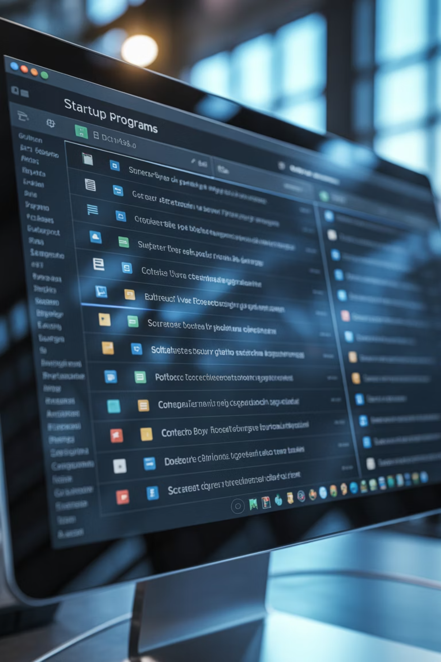

Startup Programs
"Not Yet!"
Notes:
We’re not deleting these programs — just telling them they can wait. This is one of the fastest ways to make an older computer feel younger A technical review is recommended to ensure only non-essential programs are taken off the “auto-start” list.
Best done with a technician:
Start automatically
Often unnecessary
Guided fix
Not DIY today

Slide 24

Antivirus
Security Is a Habit
You don’t need to buy anything today.
Notes:
More antivirus programs don’t mean more safety — they can actually fight each other. One good program, run monthly, is enough.
This should always be up to date – get a technical expert involved if you’re not sure what the state of your anti-virus is.
Best done with a technician:
Security = habit
No buying today
Built-in often enough
Keep it updated

Slide 25
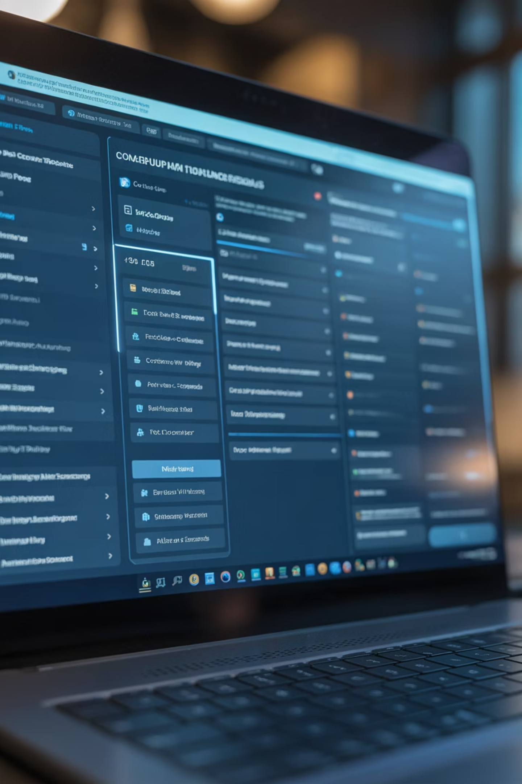
Built-In Tools
Let the Computer Clean Itself
These are tools that already came with your computer — you already paid for them.
Notes:
Windows and Macs include cleanup tools. Think of them as built-in housekeeping services. They safely remove junk for you.
Get a review before using. Cleanup tools are already there
You paid for them
Let the computer help itself
Best done with a technician:

Slide 26

Browser Cache
Wiping the Chalkboard
.
Notes:
If a website acts strangely, clearing the browser cache often fixes it. It’s like erasing old chalk so the new lesson shows clearly.
- Best done with a technician:
Cache speeds sites
Too much slows things down
Clearing = refresh
Chalkboard analogy

Slide 27
Web Data: Cache vs. Cookies: Key Differences Primary Purpose
Cache: A “memory bank” that speeds up websites by saving static files on your device.
Cookies: An “ID badge” that remembers who you are, including preferences and login status.
Content & Storage
Cache: Stores large items such as images, logos, videos, and fonts.
Cookies: Store small text data such as usernames, session IDs, and site settings.`
.
Notes:
The Cache is a "Memory Bank" for fast loading, while Cookies are an "ID Badge" for your logins.
The Cache saves the building for everyone, but Cookies remember the person inside.
— Cache vs Cookies
Cache = building
Cookies = person
Cache big
Cookies tiny

Slide 28
Web Data: Cache vs. Cookies: Key Differnces (Cont’d)
Personalization Cache: Stores general website data that’s the same for all visitors. Cookies: Store personalized information specific to you and your browsing session. Storage Impact
Cache: Can grow large over time (hundreds of MBs or more). Cookies: Very small files that take up almost no space.
Summary Tip
Think of it this way: The Cache saves the building, while Cookies remember the person inside the building.
.
Notes:
The Cache stores general data that can clutter storage, while Cookies are tiny files for personal settings.
A "Spa Day" clears the large Cache files, while clearing Cookies resets your identity on sites.

Slide 29

Repair or Replace?
When Is "Old" Too Old?
Notes:
Sometimes a computer really is ready for retirement. The question is whether it needs a tune-up or a replacement.
Practical decisions
Not cheap
Not wasteful

Slide 30
The 5-Year Rule
Tune-Up vs Replace
Under 5 Years Old?
Over 6 or 7 Years?
Almost always worth fixing.
The hardware may simply be outdated.
That’s not failure — that’s just time doing its thing.
This is about being practical — not wasteful.
Notes:
Under 5 years old? Almost always worth fixing. Over 5+ years and struggling? The hardware may be outdated.
Under 5 = fix
5+ = aging hardware
Not failure
Time doing its thing

Slide 31

The Grandchild Test
Museum-Ready?
If your grandkid sits down and says, "Wow… what is this?" — that's your sign. If they can make it run faster, you just need a Spa Day.
Notes:
f your grandkid sits down and says, “Wow… what is this?” — that’s your sign. If they can make it run faster, you just need a Spa Day.
Wow… what is this?”
Museum-ready joke
If faster = spa day

Slide 32
Quick Checklist
Your Monthly Spa Day
1
2
3
Restart Weekly
Clean Dust Seasonally
Empty the Trash
Give your computer a fresh start regularly.
Keep the physical components clean.
Remove unnecessary files and clutter.
Do these simple things and you'll avoid most major problems.
Notes:
— Quick Checklist -- Walk Thru Key Parts of HandOut Easy Maintenance
Restart weekly
Dust seasonally
Empty trash
Restart to prevent half of the problems Best done with a technician:
Deleting unused programs
Changing start-up behavior
Security/anti-virus decisions
Browser internals (clearing cache)
Managing storage space

Slide 33
Ask Me Anything -- No Question Is Too Small
Notes:
No small questions
Someone else is thinking it
You're in charge

Slide 34
You're the Boss
Thank you for coming and give your computer a Spa Day.
Notes:
Technology should serve you — not intimidate you. The computer may smell your fear sometimes… but it can’t survive you pulling the plug.
Thank you for coming, and give your laptop a Spa Day.

Slide 35
Suggested Questions for Consideration
How many people here leave their computer on for days — or even weeks — at a time?
Has anyone ever opened their computer and thought, “Why does this feel slower than it used to?”
Was there one thing today that surprised you, even a little?
Is there something you’ve been afraid to click in the past, but feel better about now?
What’s one small habit from today that feels doable — even if it’s just restarting once a week?
Notes:
Suggested Questions for Consideration

