Slide 1
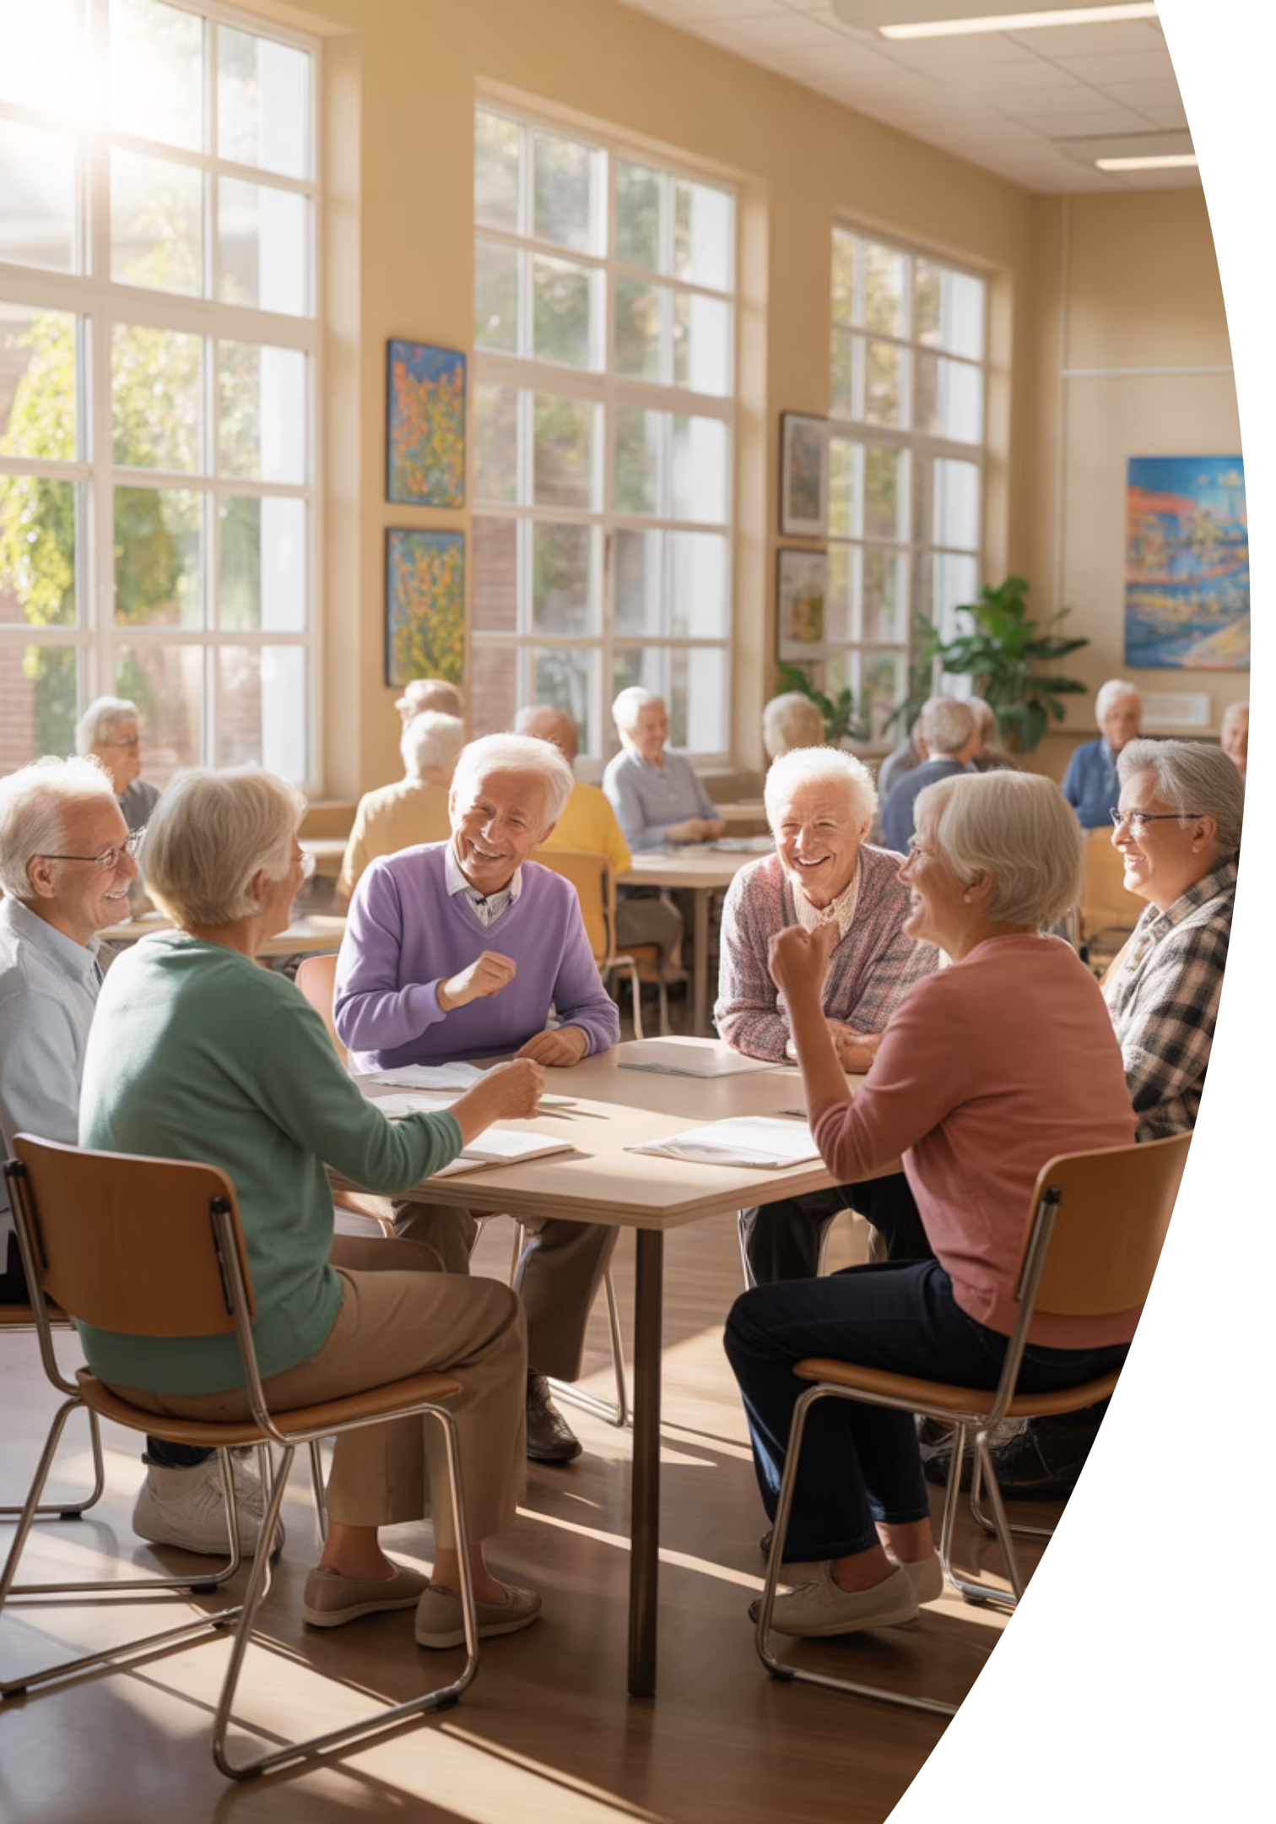
AI & ChatGPT Seminar
for Seniors
Notes:
Good Afternoon
Coming right after lunch is a tough act to follow!
I hope I can keep this entertaining enough so that you don’t fall asleep.
Let’s walk through our handouts for a moment, so you have an idea of what we’re going to cover:
Overviews of AI & ChatGPT
Prompts
Staying Safe & Smart
Benefits
Demo Ideas
Accessing ChatGPT
Final Take-Aways
Put your mind at ease that you don’t have to write anything down to review this stuff later, if desired.

Slide 2
Welcome, Cromwell Senior Center (CSC) Members
A friendly, practical introduction to AI & ChatGPT
— no jargon, no pressure, and no tests!
Notes:
Welcome, everyone. Today, we're going to take a simple, friendly tour of Artificial Intelligence and ChatGPT.
-What they are,
- Why they matter, and
- How they genuinely make life easier
No Jargon, No Pressure, No tests!
This session is designed for everyday users — especially us seniors.
If you can ask a question,
email a letter,
or text a message,
you can use ChatGPT.
This seminar will use three methods of explanation:
- PowerPoint Slides to cover concepts:
- Video Clips, to reinforce these concepts; and
- Demos to show these concepts in action!

Slide 3



Meet Jim Kallaugher: CSC Member & Volunteer
Red Glen Electronics
Weekly Tech Tuesdays
Monthly Tech Presentations
Founder and operator, with
friendly “Home Tech Help for Hire” for Boomers.
Volunteer tech support and guidance to community members on Tuesday afternoons.
Conduct tech topic seminars for better understanding & to encourage confidence
With 25+ years of experience making technology clear, simple, and accessible.
Notes:
Hi, I’m Jim Kallaugher, a Senior Center Member, Volunteer, and Home Tech Support Consultant
Red Glen Electronics:
I founded Red Glen Electronics as a friendly “Home Tech for Hire” for Boomers
Tech Tuesdays:
I‘m here every Tuesday afternoon for appointments.
I offer hands-on tech support or one-on-one training as a regular volunteer.
Monthly Tech Seminars:
Every month, I’ll lead tech topic seminars for a better understanding and to encourage confidence

Slide 4
Play ChatGPT for Seniors Video Clip #1
Notes:
Play ChatGPT For Seniors Video Clip #1

Slide 5
Today's Roadmap
01
02
What Are AI & ChatGPT? (5m)
Why they matter (5m)
03
04
How to stay safe? (5m)
Every day, senior-friendly uses (5m)
05
06
Live demos (5m) & Videos (10m)
Q&A (10m)
Notes:
Here’s our roadmap:
What AI is, in plain English
How ChatGPT works
Why It Matters
Safety guidelines
Everyday Uses
Live demos
And Q&A
The goal is clarity, confidence, and comfort.
We’ll go nice and slow — nothing to memorize.

Slide 6
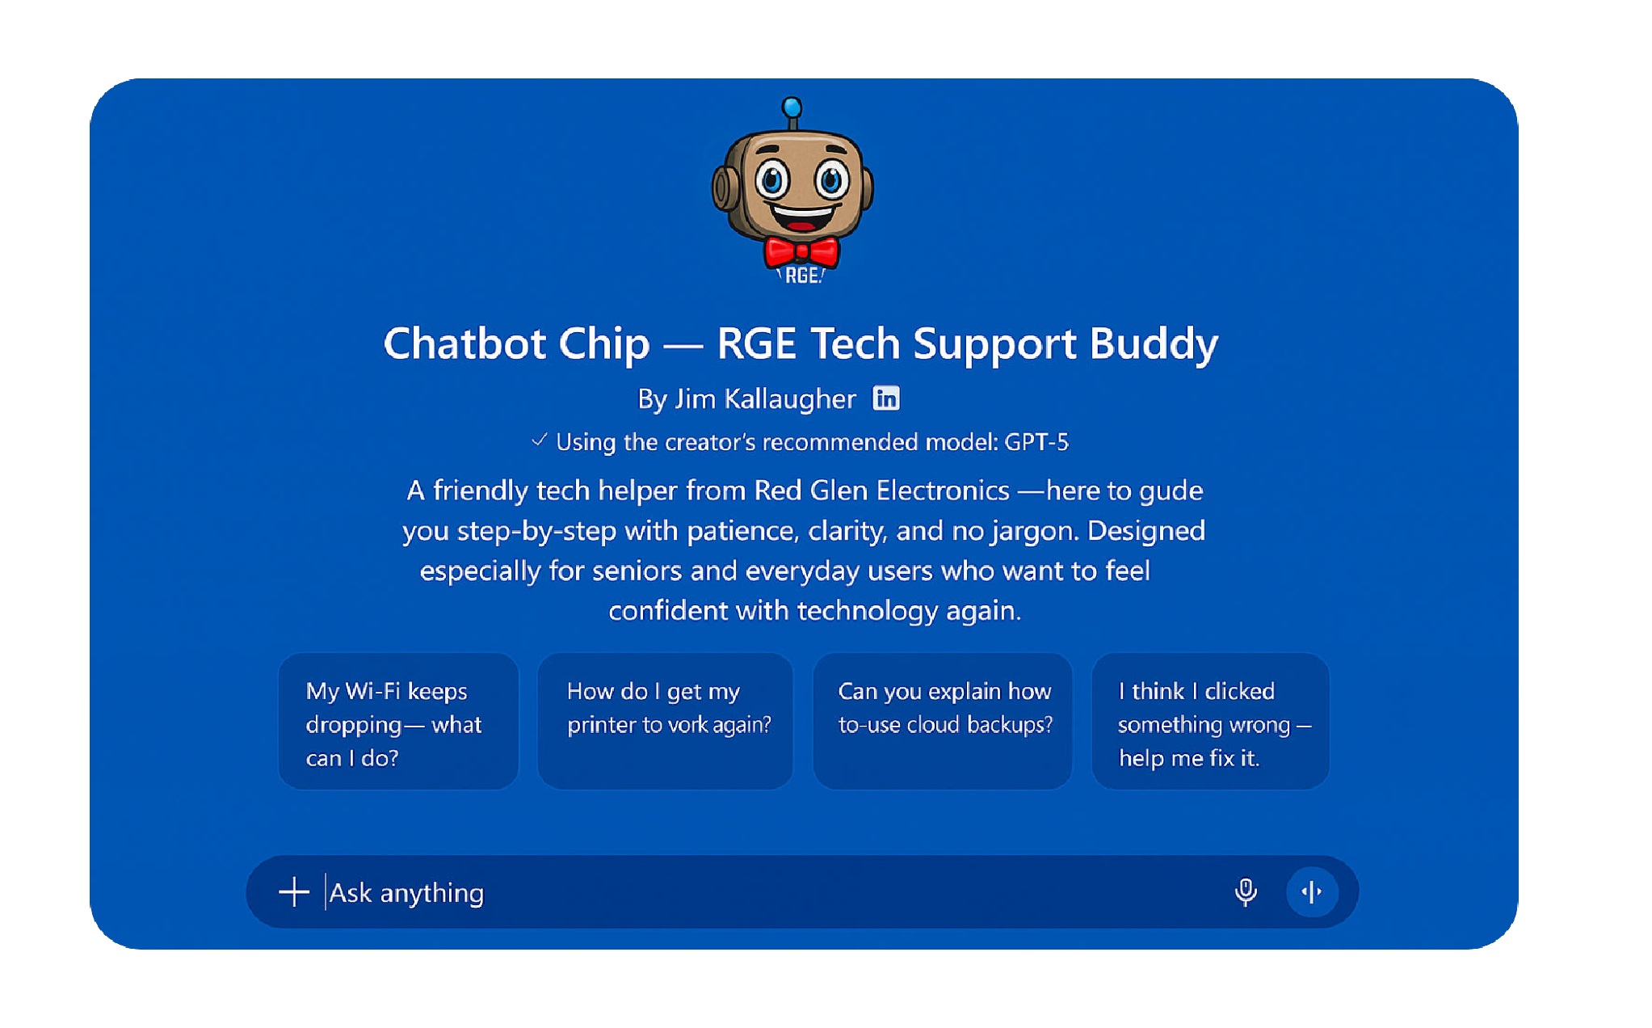
Notes:
“This is simply a picture of Chip, my virtual helper, on the screen.
— It works just like the regular ChatGPT page, but with a friendlier Red Glen wrapper.
The only thing I want you to notice right now is the prompt box at the bottom — that’s where we type a question, just like sending a text message.”
“If you ever want to try Chip at home, he’s right on the Red Glen website under ‘Chat with Chip.’ But for today, watch along — no tech skills needed.”

Slide 7
DEMO #1: See? It's Easy
LIVE DEMO
"Explain Wi-Fi, AI, and ChatGPT in one plain-English sentence. Then, try it in 3 separate tones
Show ChatGPT works like texting or drafting email sentences.
Notes:
Alright — now that you’ve seen what Chip looks like, let’s try a simple example together.
For this first demo, I’m going to ask ChatGPT to explain three things —
Wi-Fi, AI, and ChatGPT — each in one plain-English sentence. Nothing technical, nothing fancy. Think of this like asking a friend to ‘just tell it to me straight.
Then I’ll ask Chip to do the same thing in three different tones — so you can see how flexible it is.
The goal here is simple: show you that ChatGPT works just like texting or writing a short email.
You type something in the box, press Enter, and ChatGPT does the heavy lifting.
Okay, let’s give Chip his first question…
Explain Wi-Fi, AI, and ChatGPT — each in one plain-English sentence.
Now, try in 3 different tones…

Slide 8
Introduction to Artificial Intelligence - AI
Notes:
Title Card

Slide 9
Two Words to Remember
Vast
Fast
Trained on trillions of examples
Usually answers in seconds
Notes:
AI in two words: Vast and Fast.
Vast: It has been trained on a massive amount of information.
Fast: It answers in seconds.
That's the core idea. That’s the heart of it.
Artificial Intelligence is pattern recognition.
It has seen so many examples of language that it can
explain things,
write things,
and help troubleshoot
— all in plain English.

Slide 10
What AI Is
Recognizes patterns
Trained on huge amounts of text
Explains, writes, plans, troubleshoots
Speaks plain English
Notes:
So, What Is AI?
Innovative software trained on patterns.
It reads & processes vast amounts of info, and
helps solve everyday problems
It Speaks in everyday English
AI Does Not Replace People!
It assists, doesn’t replace
You stay in control
Your judgment matters
Why It Sounds Human
Learns how people write
Mimics natural tone
Not consciousness — patterns

Slide 11
Big Claim vs Reality
Claim:
Reality:
"AI knows everything."
Impressive, not all-knowing.
A neighbor with a giant tool shed—very handy, but not with every tool ever made.
Notes:
AI is impressive but not all-knowing.
Think of it as a neighbor with a giant tool shed: lots of tools,
very handy, but not every tool ever made.
Helpful? Absolutely.
Omniscient? Not a chance.
What It Can Do
Explain topics clearly
Write messages/notes
Plan trips & activities
Help with tech instructions
What It Cannot Do
Know everything
Access private info
“Think” like a human
Always be right

Slide 12
Internet vs AI
Internet
AI
live, always changing
snapshot from last update
Ocean vs photograph analogy
You access the Internet with an app like Chrome, (or MS Edge, or Safari)
You access AI with an app like ChatGPT (or MS Co-Pilot, or Google's Gemini)
Notes:
Important difference:
The Internet is live.
AI is a snapshot of what it learned the last time it was updated.
Think of the Internet as the ocean, and AI as a photograph of it— close, but not current.
You access the Internet with an app like Chrome, (or MS Edge, or Safari)
You access AI with an app like ChatGPT (or MS Co-Pilot, or Google's Gemini)
So,
Internet vs AI
Internet = live & changing.
AI = trained snapshot in time
Its training stopped in June 2024, but it does look up current web facts
If asked or inferred by your question, e.g.,
“What’s the cheapest iPad price right now?”
Bottom line: Think of Chat GPT as …
“A 2024 college grad with a 2025 smartphone and very fast thumbs.”

Slide 13
Honest Summary
AI knows a lot — but not everything.
Always double-check breaking news, dates, and prices.
Notes:
AI knows a lot, but not everything.
Always double-check breaking news, prices, dates, or time-sensitive info.
It Can Get Things Wrong
Sometimes makes mistakes
Sounds confident even when wrong
Check important info
Remember – Predicts – like a meteorologist –
Weather forecasters look at a bunch of data
quickly analyze and sometimes get things wrong!
Same for ChatGPT

Slide 14
Think of AI as a “Super Parrot.”
Mimics fluent English, but does not understand the meaning
Has no life experience — doesn’t know what “sunshine” or “heartache” feels like
Not sentient – but “Super” -- more than just language repetition: plans, writes, organizes, summarizes, helps
troubleshoot, etc.
Notes:
Read The Slide
Super Parrot b/c not only language mimics but…..
IT communicates in plain English:
It can write,
explain,
simplify,
plan,
help with learning, and troubleshoot tech problems—

Slide 15
A Giant Guessing Game
AI isn’t thinking — it’s predicting the next word based on patterns
Example: Type “The cat sat on the…”
  AI predicts “mat” as the most likely (99%) next word
  (As a Dr. Seuss fan, I would’ve said “hat” 😄)
Notes:
Read The Slide

Slide 16
🦜 The Parrot Analogy
For AI, it’s like saying “Polly wants a cracker” — even though it doesn’t know what a cracker is or what it tastes like.
What AI Can Do
Copy patterns from millions of examples
Super parrot
Predict which words usually come next
Sound confident and fluent
Notes:
Read The Slide

Slide 17
What AI Cannot Do
Taste a cracker
Want a cracker
Know why a cracker exists
🎯 Takeaway: AI uses language without lived experience.
We humans supply the meaning, judgment, and common sense.
Notes:
Read The Slide

Slide 18
Your New Tireless Assistant
The Holmes & Watson Team
  You are Sherlock Holmes: You provide the genius, intuition, and direction.
  The AI is Dr. Watson: It handles the legwork and facts.
Notes:
Read The Slide

Slide 19
Why You’ll Love It
  It quickly summarizes long documents.
  It can rewrite a paragraph 50 times without losing interest or energy.
  Note: Like Watson, it needs your supervision to solve the mystery
Notes:
Read The Slide

Slide 20
Watch Out for "Confident Blunders" The 'Pattern' Trap
◦ Sometimes, AI sounds professional but invents details. This is sometimes called a “hallucination.”
◦ For example, asking for a biography of a fake person, 'Guadalupe O'Shea’ --1st Woman Astronaut landing on Mars via the Ares Space Mission -- can lead AI to invent a life, including fake awards and dates.
◦ Golden Rule: AI isn't lying on purpose but always verify facts!
Notes:
Read the Slide

Slide 21





Everyday AI You Already Use
Netflix/Spotify suggestions
Smart speakers
Email spam filters
Photo enhancement
Voice Typing On Phones
Notes:
Read the slide ---
“AI has been here quietly, all around us, for a while now.”

Slide 22
Play VIDEO #2 How AI Works
Notes:
Play Video #2 How AI Works…
Again, this is to reinforce the ideas we just went over…

Slide 23
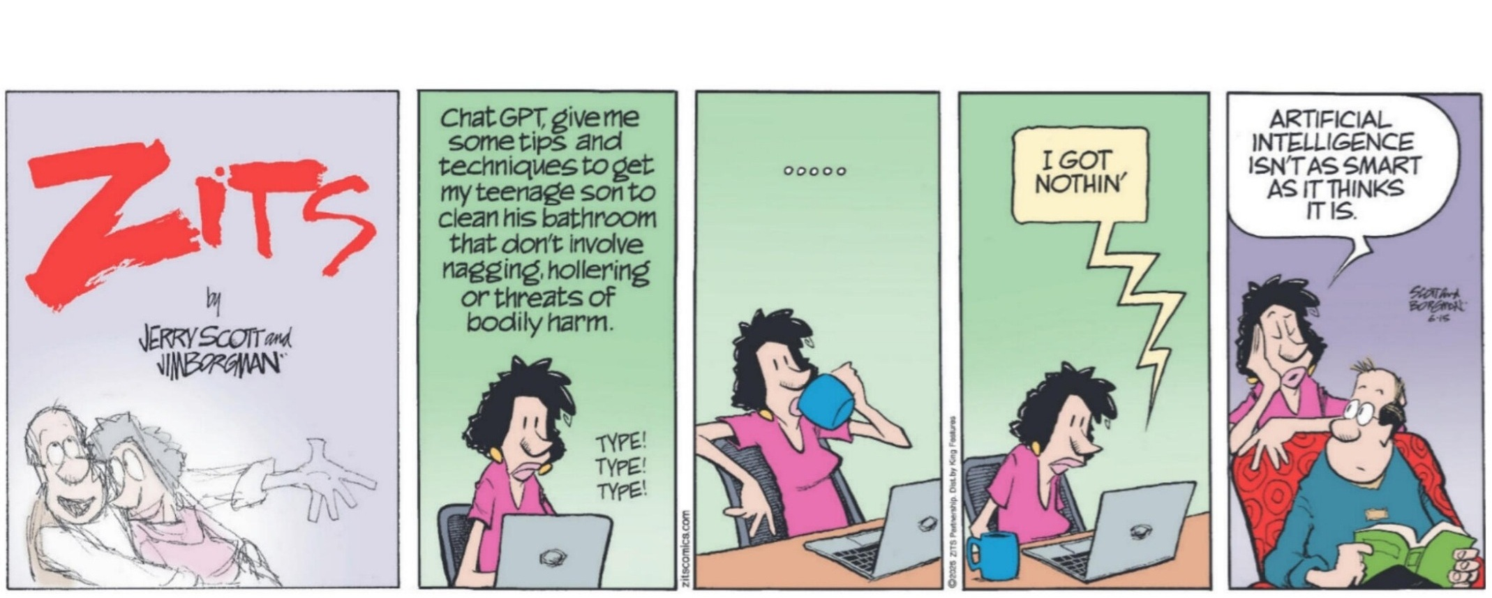
Notes:
Read Cartoon
Wait for Laugh & Pause for any Q’s

Slide 24
Stretch Break! Any Questions So Far?
Notes:
Stretch Break + Q&A Check-In

Slide 25
Introduction to ChatGPT
Notes:
Title Card

Slide 26
What Is ChatGPT?
Answer: AI that you talk to in plain English.
Explains things
Writes things
Helps plan & troubleshoot
Patient and friendly
Notes:
ChatGPT is an AI that communicates in plain English.
It can write,
explain,
simplify,
plan,
help with learning, and troubleshoot tech problems—
patiently and clearly. It's like having a helpful assistant you can ask anything.
Why This Matters
Saves time
Helps you learn new things
Simplifies technology
Makes everyday tasks easier
Think of it as a helper who never gets tired.

Slide 27



How ChatGPT Works (Simple)
Learns patterns
Predicts the following
best sentence
Does not browse the live internet
by default — unless your question
clearly asks for current information.
“What’s the best price for
gas, today?”
Notes:
It learns patterns in language.
It predicts the following best sentence.
It’s not browsing the live web.
Unless you ask it to
Or your question implies current data, like
What’s the best price for Gas, today?
Today, we’re focusing on simple question-and-answer use.
Ask → Answer.
Just like our Meteorologists from our earlier example of predictions ---
without a 100% accuracy rate!

Slide 28




Prompts = Your Instructions
A prompt is your question.
Examples:
"Explain this simply."
"Write a friendly note."
"Show steps one at a time."
There are no perfect questions — you can’t “break” it.
Notes:
A prompt is your question, or request to AI
No special wording needed.
Examples:
“Explain this simply.”
“Write a friendly letter.”
“Show steps one at a time.”
Talk/write normally
Be Clear – no need for fancy words.
“Prompts = instructions”
Why Prompts Matter
Better question = better answer
Be clear and specific
Tone and detail shape results

Slide 29
Tone Control
Friendlier
Shorter
More fun
More formal
Notes:
Tone Control
“Make it friendly.”
“Make it brief.”
“Explain like I’m new to tech.”
You can tell ChatGPT how to speak.
(…like our earlier demo.)
More formal, more friendly, shorter, funnier — whatever tone you prefer.
This gives you complete control.
You’re always in the driver’s seat.

Slide 30




Correcting AI
"Try again, simpler."
"Make it shorter."
"No wrong questions."
Notes:
If ChatGPT gives an answer you don’t like, correct it:
“Try again, simpler.”
“Make it shorter.”
“Give me options.”
It’s patient and flexible.
Tips for Clear Prompts
Say who it’s for
Say the tone you want
Ask for steps or a summary
It doesn’t get offended — it adjusts.

Slide 31
Real Everyday Uses
Travel plans
Notes & messages
Recipes
Tech troubleshooting
Senior phone help
Gift ideas
Memory joggers
Budget reminders
Event planning
Notes:
Popular real-world uses:
• Travel planning
• Recipes
• Writing messages
• Organizing notes
• Gift ideas
• Lists & reminders
• Troubleshooting tech
• Job searches, resumes, & interviews
Simple tasks you deal with every day.

Slide 32
Let’s Talk Safety Basics
Don't share private info
Double-check important answers
Ask for sources
Use common sense
Notes:
Let’s Talk Safety
Safety is simple:
• Don’t share private info
• Double-check important answers
• Ask for sources
• Use the same common sense you already use online
Golden rule: Never type anything you wouldn’t share with a stranger.

Slide 33
Safe vs Not Safe
Safe:
Not Safe:
recipes
SSN
notes
bank info
stories
Final medical or legal decisions
(always verify with a Doctor or Lawyer)
planning
Notes:
Safe to type:
Recipes, notes, stories, planning, creative ideas.
Not safe to type:
Social Security numbers, bank info, medical or legal decisions, and account numbers.
Rule of thumb: If you’re unsure, don’t type it.

Slide 34
Let’s Talk Accuracy
Accuracy Clues
Has sources → good
Vague → check
Confident but unsourced → verify
Notes:
Now, let’s consider Accuracy:
Reliable answers often:
• Give sources
• Provide details
• Explain steps
• Admit uncertainty
If something sounds too sure, ask to see sources.

Slide 35









Family Uses -- A Primary ChatGPT Benefit
Poems for grandkids
Birthday notes
Memory stories
Translate tech jargon
Plan events
Notes:
It makes communication easier with
Fun, personal uses for yourself or family members:
• Birthday messages
• Poems for grandkids
• Memory stories
• Translating tech jargon
• Planning events
• Travel ideas
• Cooking help
• Drawing creative ideas

Slide 36
Play “How ChatGPT Works” #3 Video Clip
Notes:
Play How ChatGPT Works Video Clip #3

Slide 37








AI & ChatGPT Boost Tech Independence
Learn privately
No embarrassment
Ask anything
Solve frustrations
Notes:
AI helps you stay independent.
You can learn privately at your own pace.
Ask anything, anytime.
No waiting, no embarrassment.
It’s help on your terms.
AI becomes a confidence booster.
Remember
Your Experience Matters
Life skills beat tech skills
Ask questions your way
You bring wisdom — AI brings the tools

Slide 38
LIVE DEMOs
ChatGPT Concepts In Action
Notes:
Title Card

Slide 39
DEMO #2: Creative Travel Planning
LIVE DEMO
“Plan a slow-paced Boston day trip from Cromwell,
by chartered bus, with rest stops and lunch, plus
an estimated cost per member.”
Notes:
“Plan a slow-paced Boston day trip by bus from Cromwell, CT, with rest stops
and lunch recommendations.”
Great for lifestyle planning and leisure.

Slide 40
DEMO #3: Getting Tech Self-Help
LIVE DEMO
"Show me how to connect my HP Inkjet printer step-by-step,
on Windows 11 with wi-fi, slow and simple, as if I’m new to tech."
Notes:
Demo: Here’s a real example:
Show me how to connect my HP Inkjet printer step-by-step, on Windows 11 with wi-fi, slow and simple
Watch how clear the steps are.
This is perfect for home tech frustrations.
Notice how clear and patient it is.

Slide 41
DEMO #4: Define Medicare
LIVE DEMO
"Explain Medicare in simple terms for a friend turning 65."
Notes:
Let’s continue our demos
Example prompt:
“Explain Medicare in simple terms for a friend turning 65”
This is where many people realize how helpful ChatGPT can be with complicated topics.

Slide 42
Key Takeaways for Chat…G-P-T
AI = math, not magic
Creates — not copies
The “G”(Generative)
Snapshot — not live
The “P”(Pre-Trained)
Patterns = how it "thinks“
The “T”(Transformer)
Your words shape results
Notes:
Key Takeaways
• AI is math, not magic
• It creates, not copies (Generative)
• It’s a snapshot, not live (Pre-Trained)
• It uses patterns (Transformer)
• Your words shape the results
Now you know what the GPT Part of ChatGPT means:
if it comes up in Jeopardy!
You don’t need to master AI — feel comfortable asking questions.

Slide 43
Play Video #4 – Seminar Finale
Notes:
Play Video #4 – Seminar Finale

Slide 44
You’re More Ready Than You Think, Right Now.
You bring wisdom, patience, and curiosity.
AI simply adds speed and clarity.
Notes:
You already have wisdom, patience, and curiosity.
AI simply adds speed and clarity.
You are more ready for this than you think.

Slide 45
You’re Still in Charge
You don’t need to trust AI — you need to know how to use it wisely.
Notes:
Read Slide
You’ll see Red Glen Electronics mentioned on your handout and in the finale as a “fee-based” service
because that’s where this project came from —
But for today, Tech Tuesdays, and for this seminar series, this is strictly educational.
No sales, no pressure, no obligations.
Thank you all — truly — for the great questions and energy today. You made this a joy.
If today sparked curiosity or follow-up questions, that’s wonderful —
and the best place to dig in together is Tech Tuesdays, where we can take our time one-on-one.
That’s All Folks – Happy Computing!

Slide 46
Optional – Time Permitting:
Audience “Jump Start” Suggestions for Q&A
Notes:
If Time Permits… More Q&A or Demo Requests!

Slide 47
Ask It Live — Jump-Start Questions
“What sounded confusing at first — but is a little clearer now?”
“If you asked AI one fun question, what would it be?”
“What everyday problem would you love some extra help with?”
“What still feels a little uncertain or questionable about AI?”
“What feels less scary now than it did before we started?”
Notes:
Side pocket Qs if nothing forthcoming from shy crowd

