Slide 1

GrandPad vs iPad
Choosing the Right Fit for Seniors
RED GLEN ELECTRONICS

Slide 2
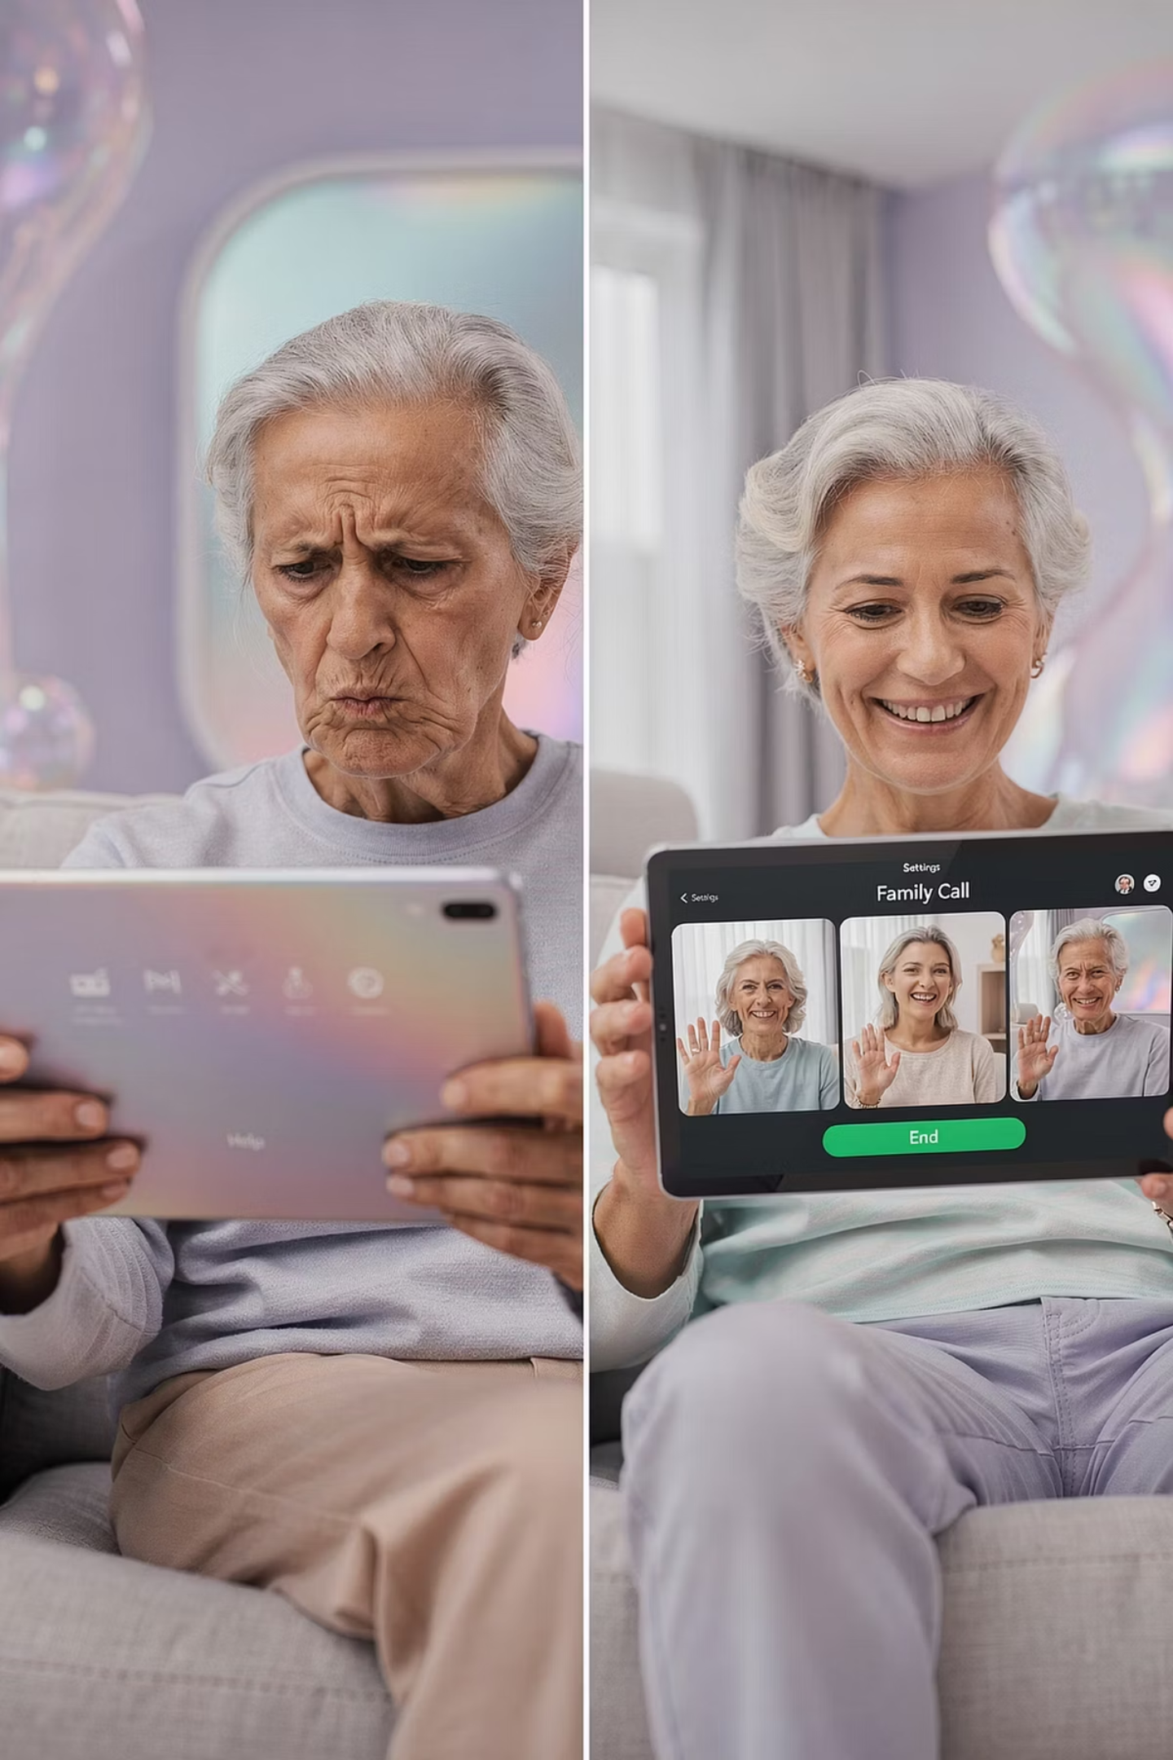
Why This Matters
Families Want Ease
Seniors Want Reliability
Everyone is searching for the simplest option available.
The device just needs to work — every single time.
Mismatch = Frustration
Most problems aren't tech problems — they're fit problems.

Slide 3

The Common Mistake
"Let's just get the simplest thing."
Simple sounds good… until it becomes too limiting. Choosing a device based on simplicity alone can leave seniors without the tools they actually need — and families back at square one.

Slide 4

No "best device." Only the right fit.
The goal isn't to find the most popular tablet or the cheapest option — it's to match the device to the person using it. That's the whole ballgame.

Slide 5
The Core Question
Every decision in this comparison comes down to one single trade-off:
Simplicity
Freedom
A guided, controlled experience with fewer choices and less to manage.
A flexible, open experience with full access to apps, internet, and exploration.

Slide 6
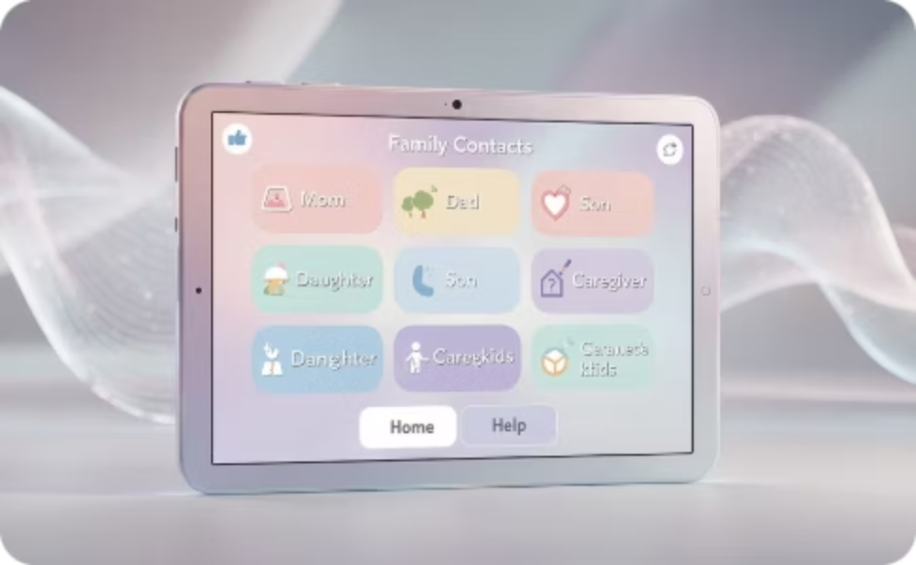
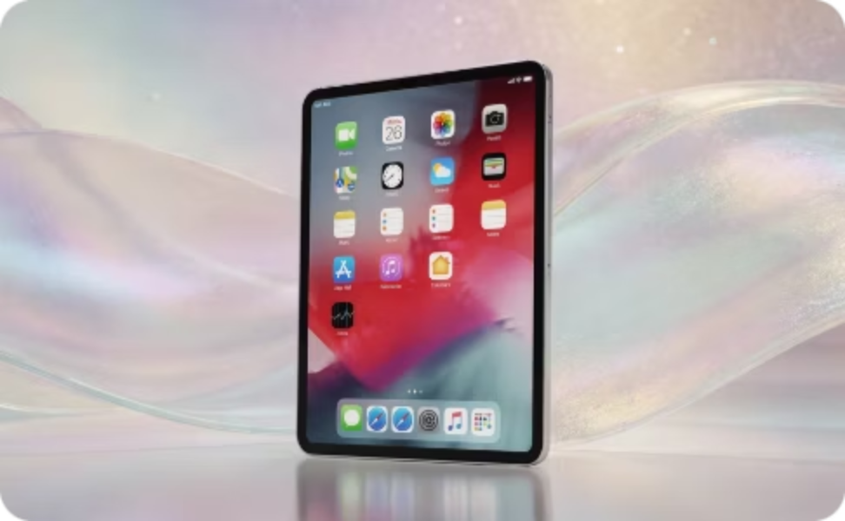
Two Very Different Philosophies
GrandPad → Guided
iPad → Flexible
A curated, family-managed environment designed to remove confusion entirely.
A full-featured device that opens the entire digital world to the user.

Slide 7
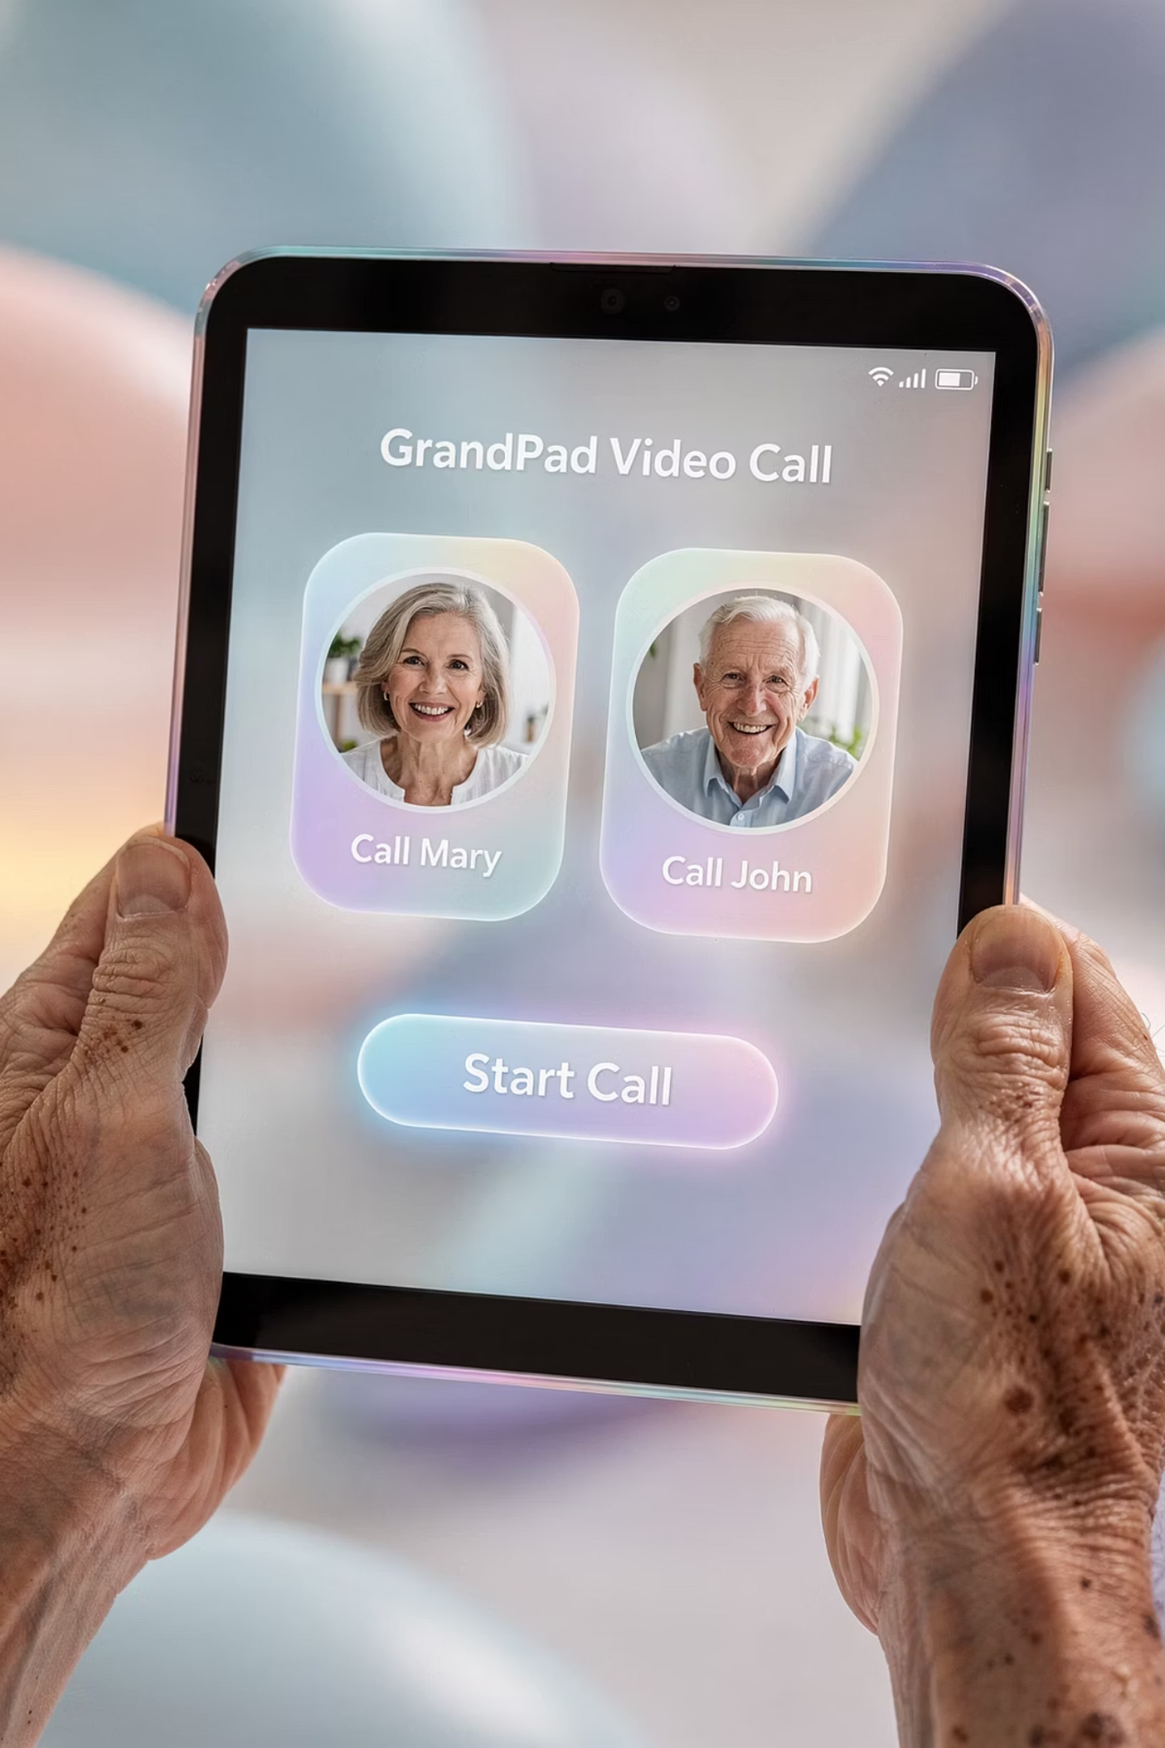
What Is GrandPad?
GrandPad is a guided, family-managed device — not really a traditional tablet. Think of it more as a controlled communication hub built specifically for seniors who want connection without complexity.

Slide 8
GrandPad Strengths
Easy Calls
Messaging
Tap a face, you're talking. That's the magic.
Simple, clear communication with family members.
Photos
No Confusion
Family can send photos directly to the device.
A clean, distraction-free interface every time.

Slide 9

GrandPad Limits
No Internet Browsing
No App Store
No Exploration
Users cannot search the web or visit websites independently.
There is no ability to download or explore new applications.
The experience is curated — what the family sets up is what exists.
GrandPad keeps things simple by limiting options. That's the deliberate design choice.

Slide 10

Removes complexity by removing control.
That's the GrandPad trade-off in one sentence. For some seniors, that's exactly right. For others, it's too restrictive. Understanding this distinction is everything.

Slide 11
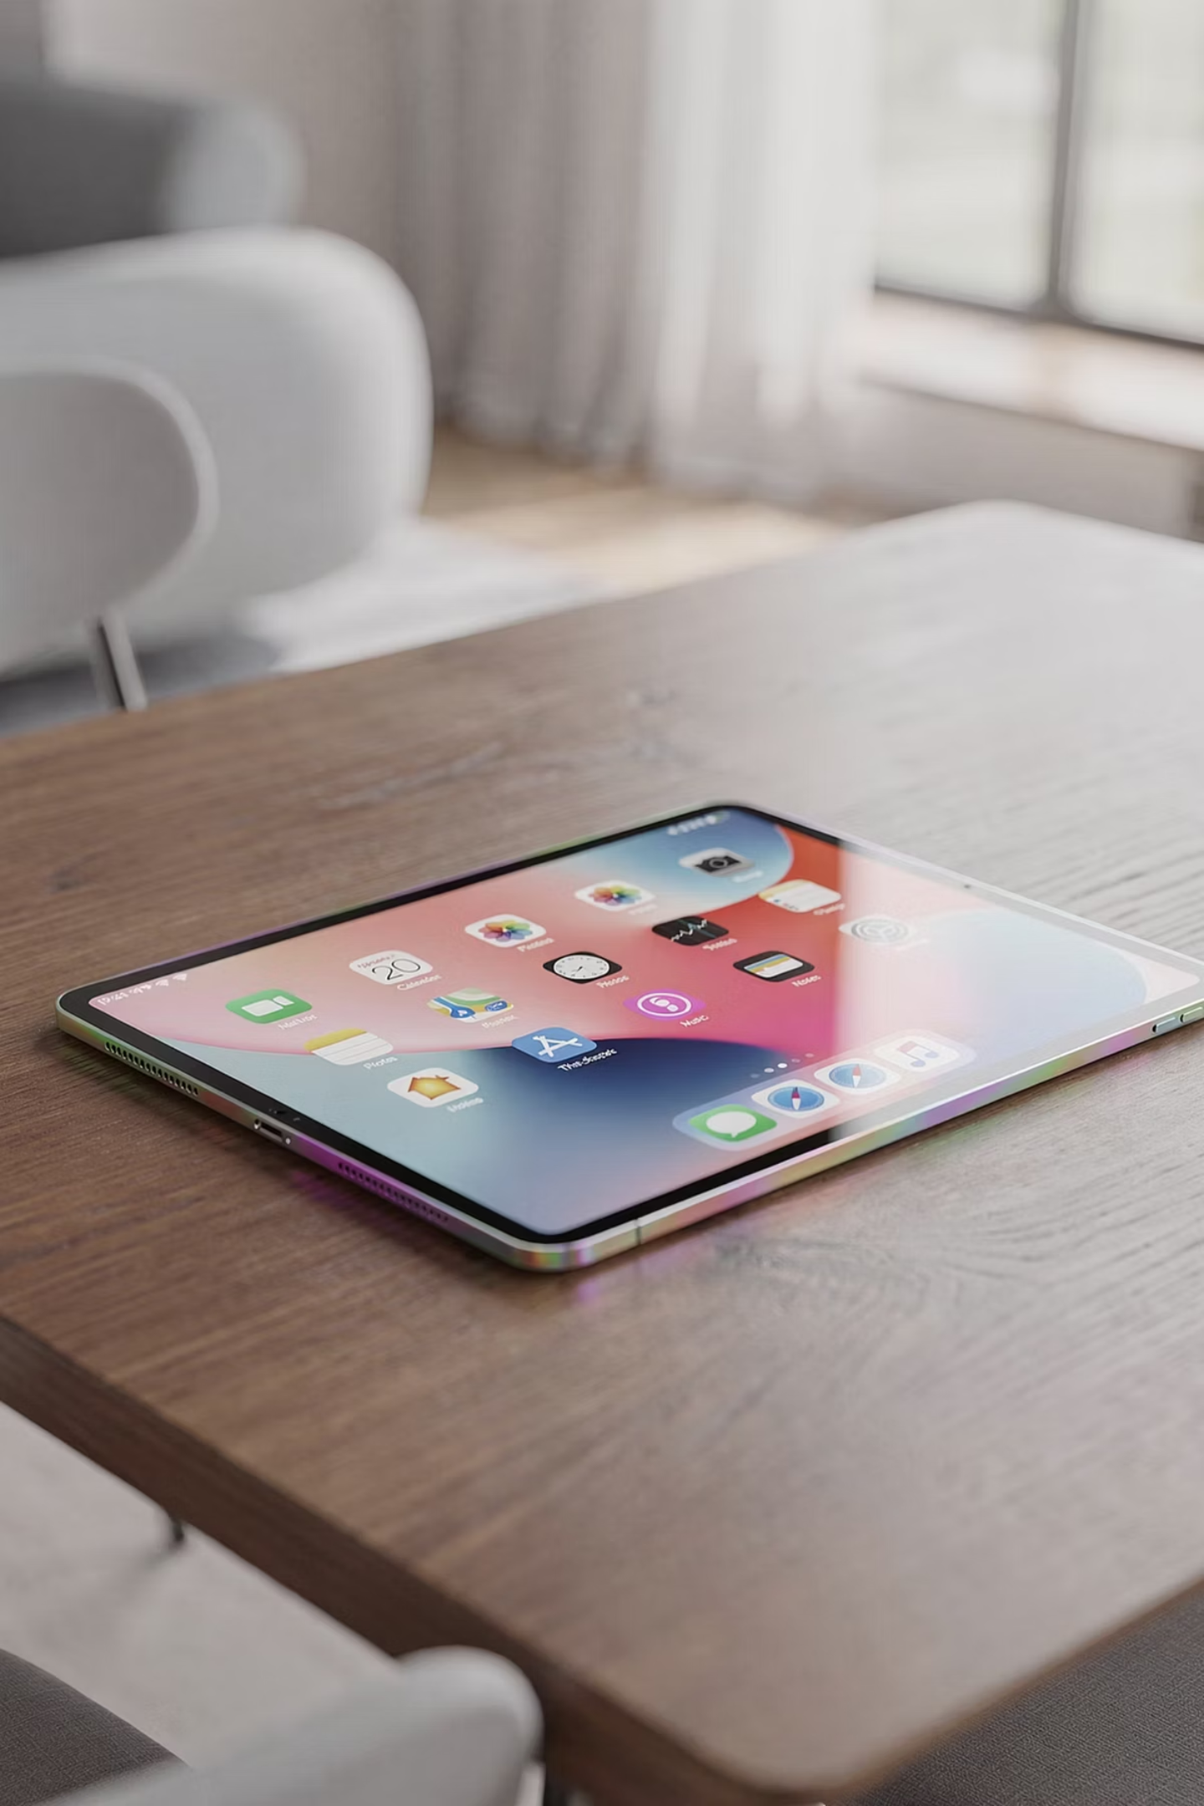
What Is an iPad?
The iPad is a flexible, full-featured device — the complete digital toolbox. It gives seniors access to the entire internet, thousands of apps, entertainment, learning, and communication all in one place.

Slide 12
iPad Strengths
Internet Access
Apps
Browse, search, and explore the full web freely.
Thousands of apps for every interest and need.
Learning
Communication
Courses, news, books, and endless discovery.
FaceTime, email, messaging — all built in.
The iPad opens the whole world. It's the full digital experience.

Slide 13
iPad Challenges
What to Expect
The Reality
A learning curve at the start
More choices to navigate
Requires digital awareness
More power means more responsibility. The iPad rewards those willing to invest a little time upfront. For the right person, that investment pays off enormously.

Slide 14
Safety Comparison
GrandPad
iPad
Maximum protection. The closed system means scams, phishing, and harmful content simply can't reach the user.
Strong + awareness. Apple provides robust protections, but some user judgment is still required to stay safe online.
Neither is unsafe — but they protect in different ways.

Slide 15
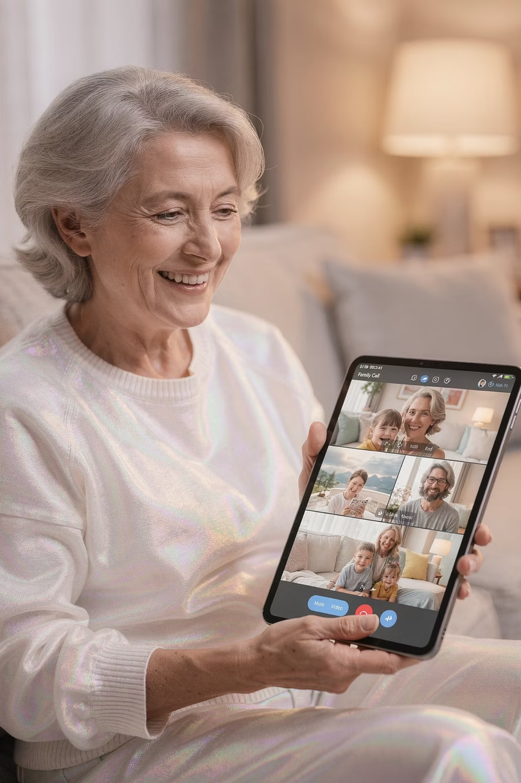
Communication: No Wrong Choice
📞 Calls
💬 Messaging
Both devices support voice and video calls.
Text and photo messages work on both platforms.
📷 Photos
Family can share photos on either device easily.

Slide 16
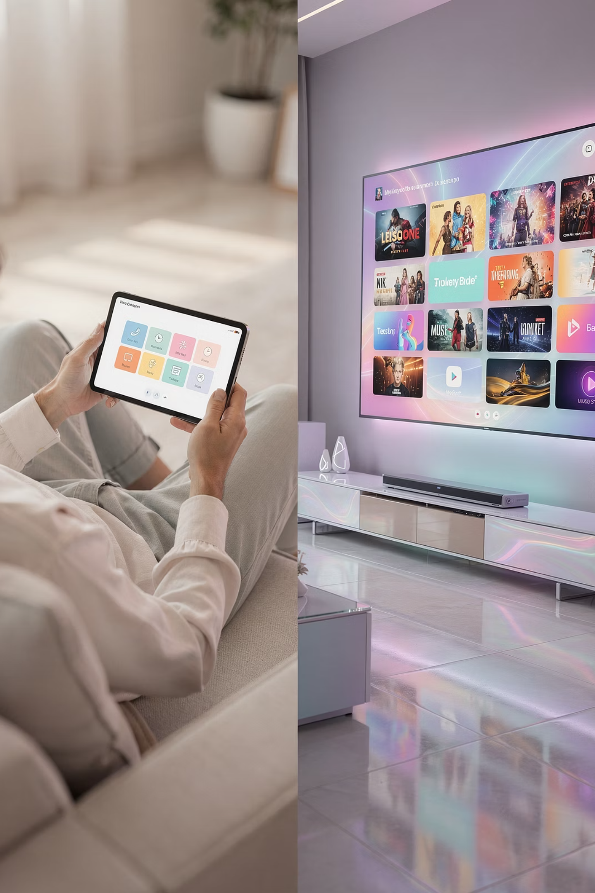
The Entertainment Gap
This is where the differences show up fast. For seniors who want to watch, explore, or play — the gap between these two devices is significant.

Slide 17
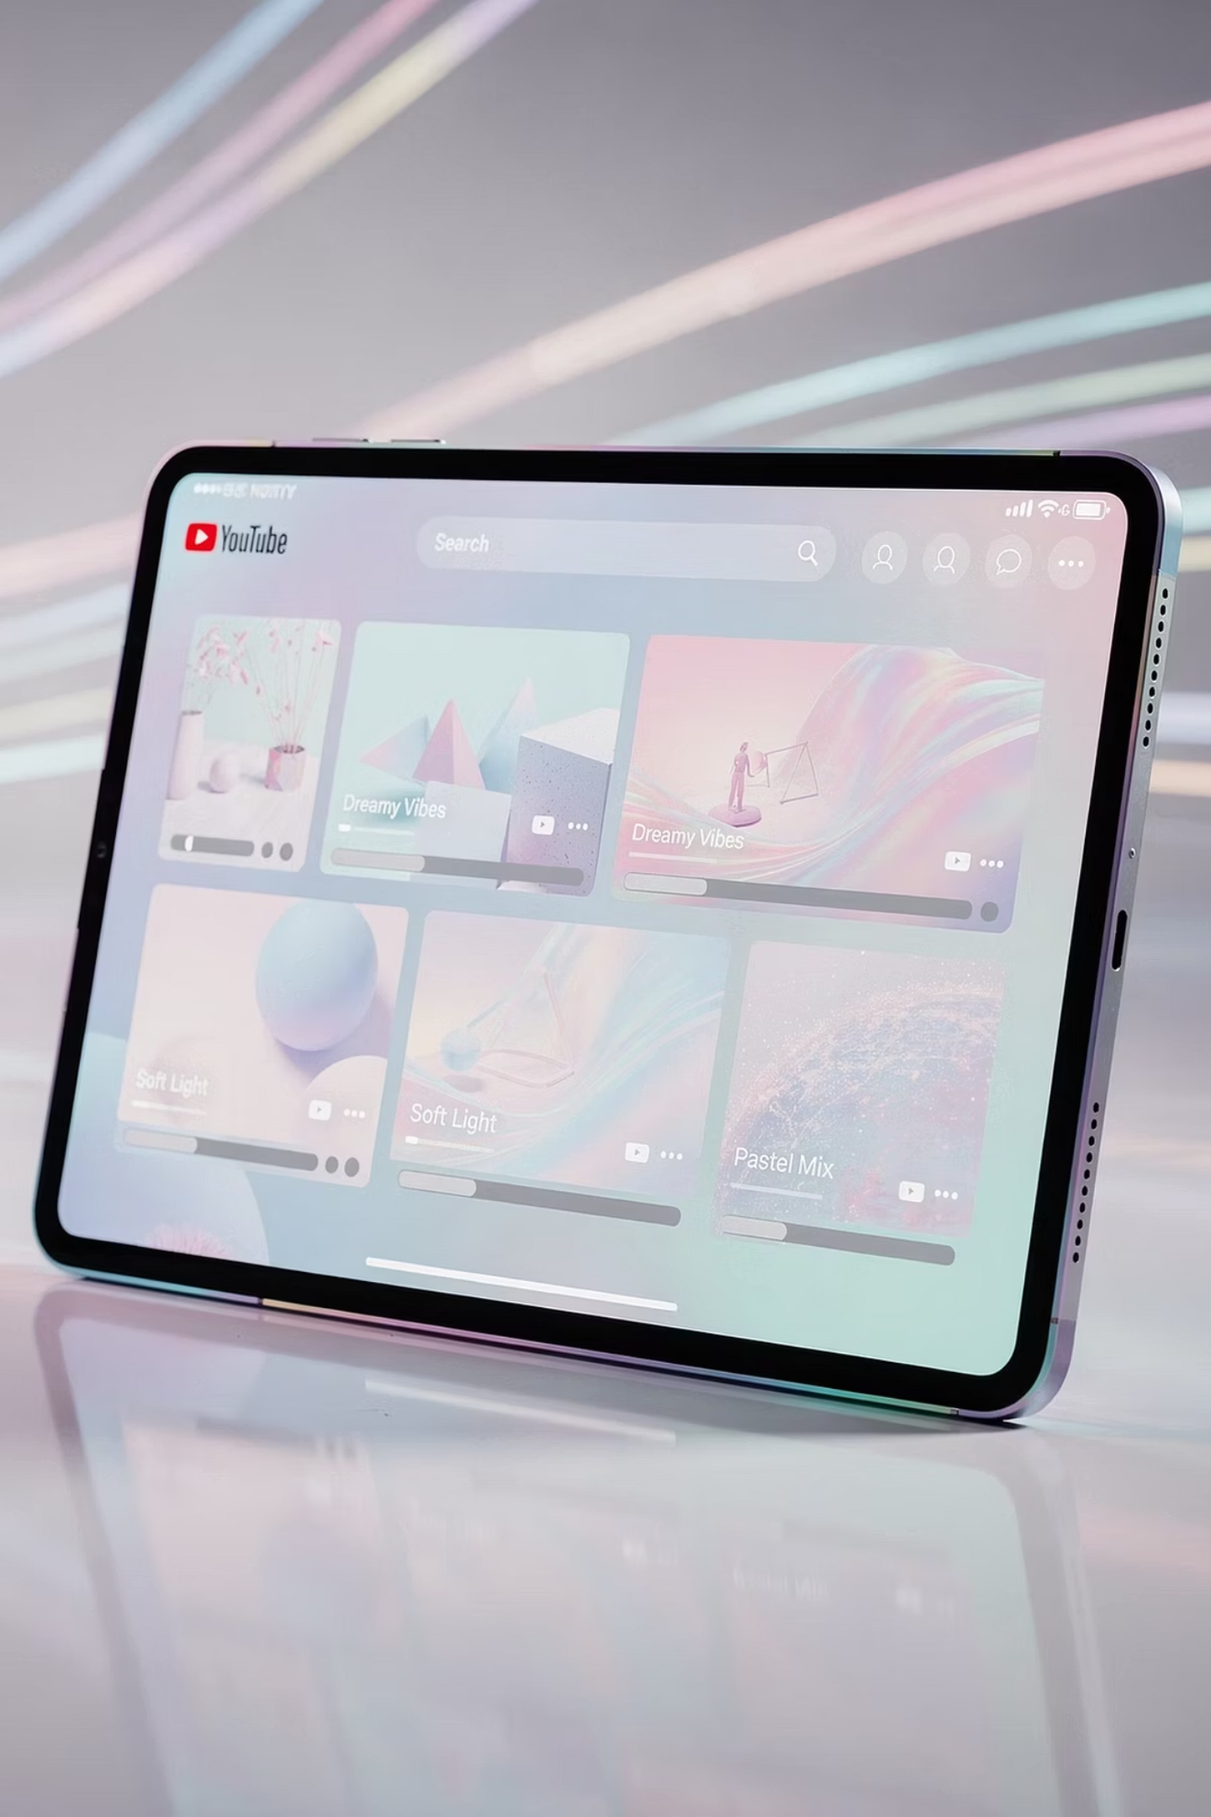
YouTube Example
GrandPad
iPad
Family can send a specific video to the device — but the senior cannot browse or search YouTube independently.
Full YouTube access. Search, subscribe, explore, and watch anything at any time — complete independence.

Slide 18
Shopping Example
GrandPad
iPad
Not available. No internet browsing means no online shopping — period.
Fully available. Amazon, grocery delivery, clothing — the entire e-commerce world is accessible.
For seniors who value independence in daily tasks, this distinction matters enormously.

Slide 19


Two User Types
Keep It Simple
Still Curious
Wants ease, avoids complexity, prefers guidance. Values peace of mind over options.
Wants to explore, willing to learn, values independence. Sees technology as an opportunity.
Now we match the tool to the person.

Slide 20

Profile: Keep It Simple
Wants Ease Above All
Every interaction should feel effortless and familiar.
Avoids Complexity
Too many choices cause stress, not excitement.
Prefers Guidance
Feels most comfortable when the path is clear and set.
THIS IS GRANDPAD TERRITORY.

Slide 21

Profile: Still Curious
Wants to Explore
Enjoys discovering new content, apps, and ideas independently.
Willing to Learn
Embraces a learning curve as part of the experience.
Values Independence
Wants to do things on their own terms, at their own pace.
THIS IS IPAD TERRITORY.

Slide 22

It's about preference — not ability.
Framing the conversation this way keeps it positive and respectful. Neither choice implies a limitation — it simply reflects what kind of experience the person values most. That distinction matters.

Slide 23
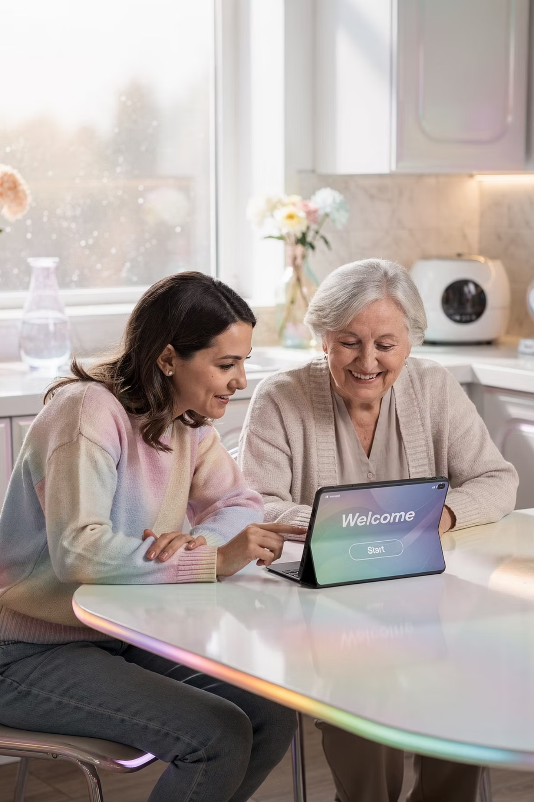
The Family Role
Both devices require ongoing family support. There is no such thing as "set it and forget it" — regardless of which device you choose. The nature of that support just looks different depending on the platform.

Slide 24
Supporting a GrandPad User
01
02
03
Manage the Admin
Add Contacts
Send Content
The family administrator controls the entire system remotely.
Only approved contacts can communicate with the senior.
Photos, videos, and messages are pushed directly to the device.
You help run it — they enjoy it.

Slide 25
Supporting an iPad User
01
02
03
Initial Setup
Teach the Basics
Build Confidence
Configure accessibility settings, Apple ID, and key apps from the start.
Walk through core functions until they feel comfortable and confident.
Encourage independence gradually — the front-loaded effort pays off later.

Slide 26

What NOT To Do
"Plop, drop, and walk away."
That's how devices end up in drawers — unused, uncharged, and forgotten. Whether it's a GrandPad or an iPad, handing over a device without support is a recipe for frustration and wasted money.

Slide 27
The Hybrid Idea
GrandPad + TV
Why It Works
Pair the GrandPad with a smart TV setup to solve its entertainment limitations — giving seniors the best of both worlds.
The GrandPad handles communication beautifully. A separate TV device handles entertainment. Each tool does one job — and does it well. No compromise required.

Slide 28
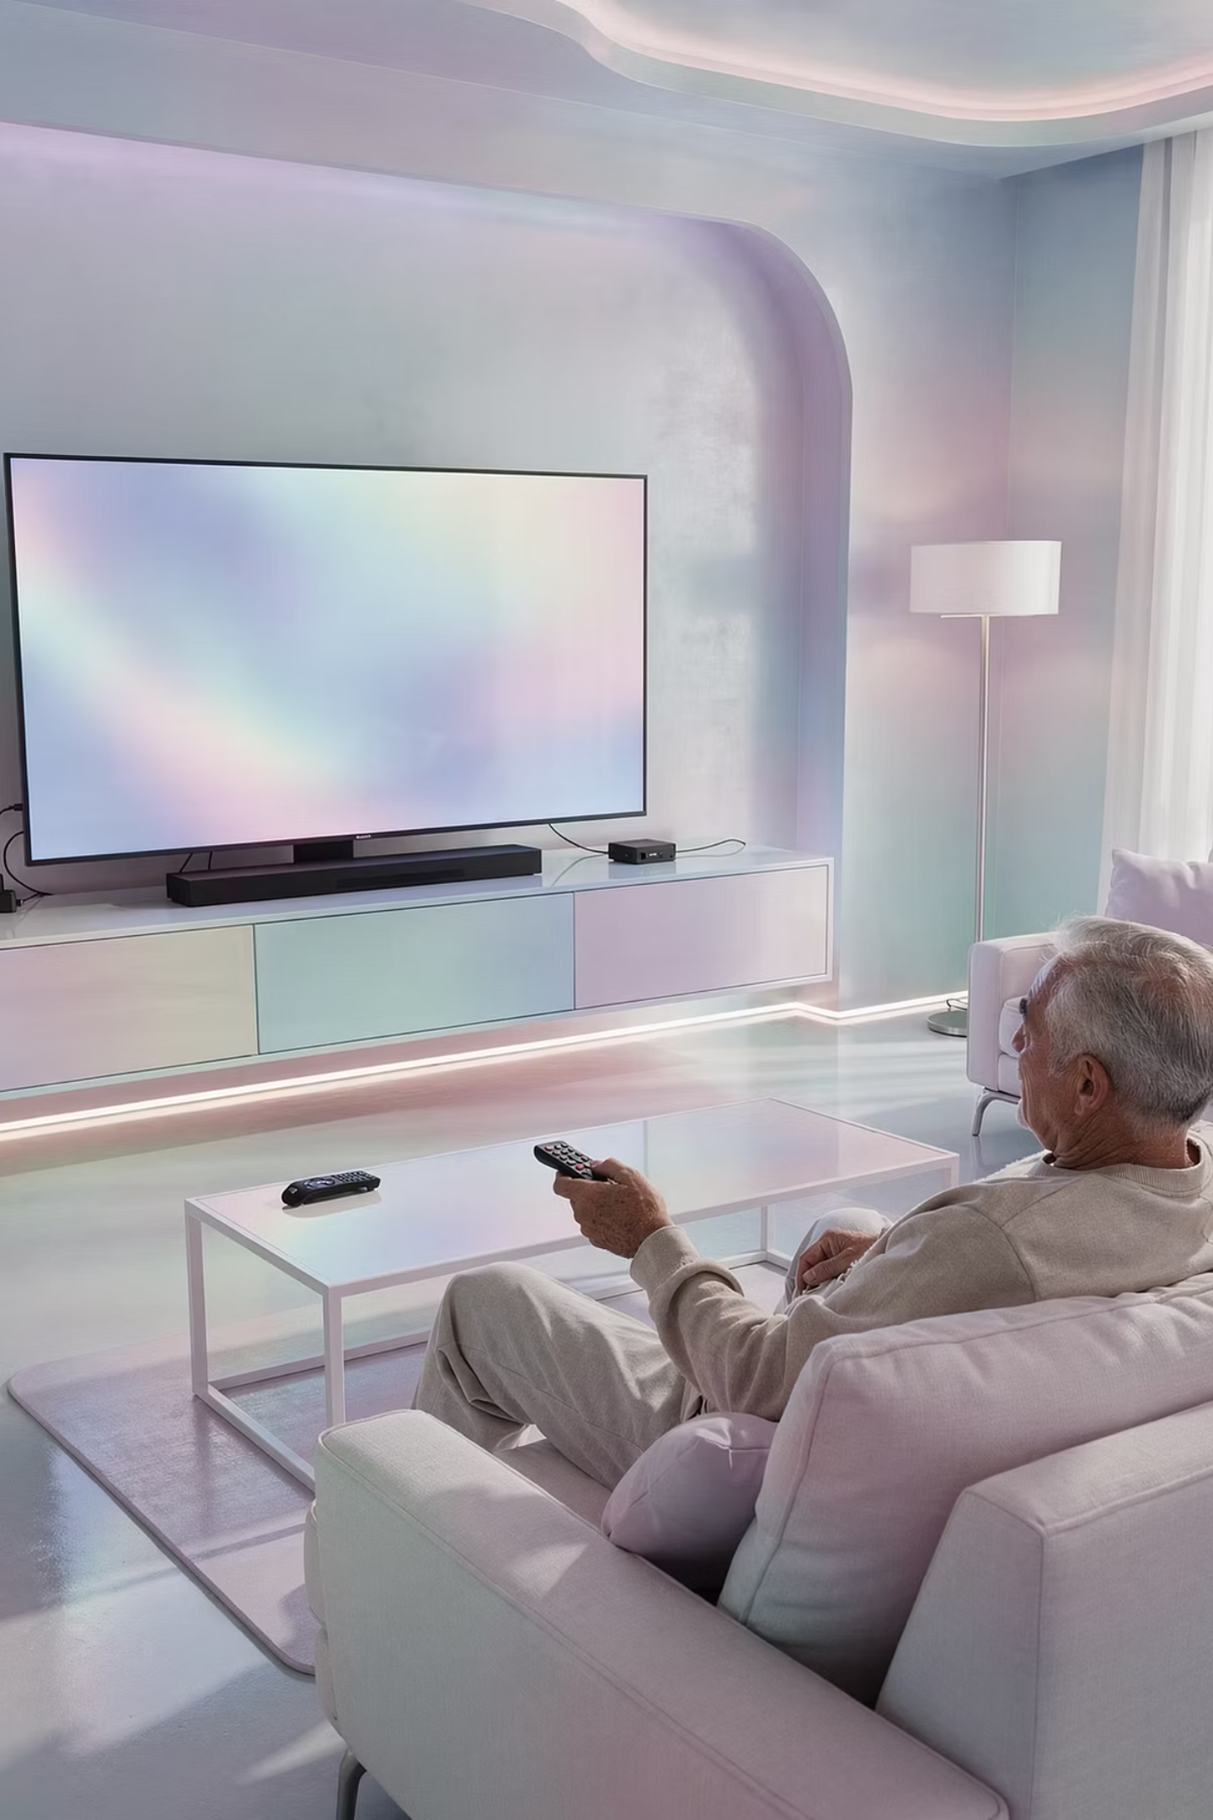
The Roku Example
Simple Remote
Big Screen
Easy to hold, easy to use — minimal buttons.
Comfortable viewing without squinting at a tablet.
Easy Videos
YouTube, Netflix, and more — all on the TV.
THE PERFECT COMPANION DEVICE FOR A GRANDPAD USER.

Slide 29

A Day in the Life
1
Morning
Photos on GrandPad
2
Afternoon
Video calls on GrandPad
3
Evening
TV streaming with Roku
Each device does one job well. The result is a complete, satisfying daily digital experience — without any single device being overwhelmed.

Slide 30
The Decision Shortcut
Want Simplicity?
Want Freedom?
→ GrandPad — Guided, managed, and worry-free for the whole family.
→ iPad — Flexible, full-featured, and open to the whole world.
Keep it easy for families. When in doubt, come back to this shortcut.

Slide 31
The Cost of the Wrong Choice
3
Real Costs
Frustration, disuse, and wasted money — the three outcomes of a poor fit.
😤 Frustration
📦 Disuse
💸 Wasted Money
The senior struggles and gives up.
The device sits in a drawer, untouched.
The investment delivers zero return.
WE'RE HERE TO PREVENT EXACTLY THIS.

Slide 32

Confidence, not complexity.
That's the mission. Every recommendation, every setup, every training session — it all comes back to this. Technology should make seniors feel capable, not confused.

Slide 33
How RGE Helps
Selection
Setup
We help identify the right device for the right person.
We configure everything so it's ready to use from day one.
Training
Support
We teach seniors and families how to use their device confidently.
We're here when questions come up — because they always do.

Slide 34
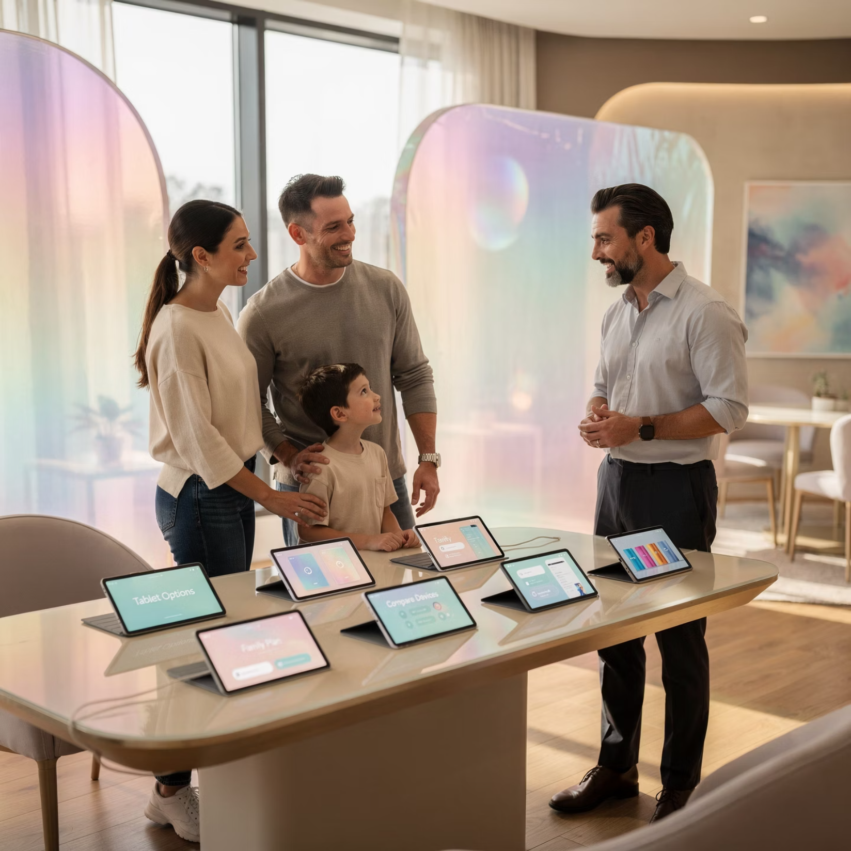
Let's Choose the Right Fit First
"Better to decide right than fix later."
A consultation before purchase saves time, money, and frustration. RGE walks families through the decision so the first choice is the right choice — no returns, no regrets, no devices collecting dust.

Slide 35

Fit matters more than features.
Always match the person first. The most powerful device in the world is worthless if it doesn't fit the person using it. This is the principle that guides every recommendation we make at Red Glen Electronics.

Slide 36

The best device is the one they'll use.
That's the only metric that counts. Not specs. Not price. Not what's popular. The right device is the one that gets picked up every day — and brings real connection and joy.

Slide 37
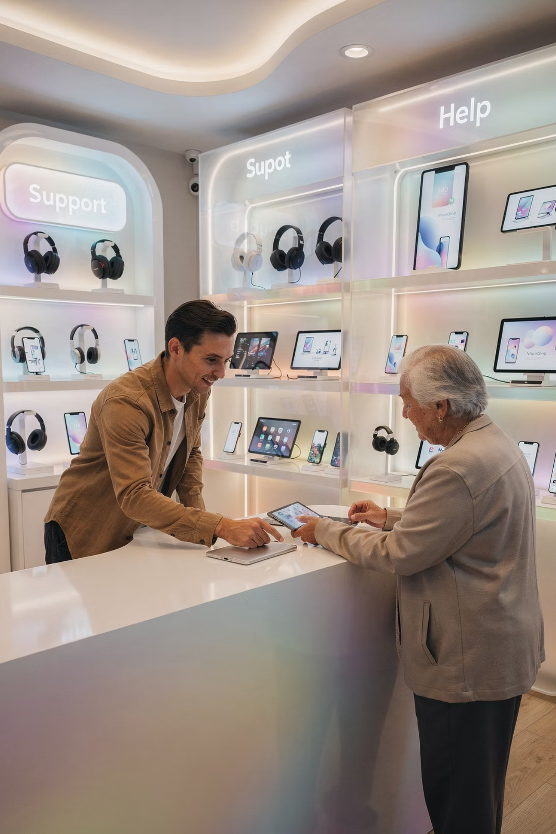
Red Glen Electronics
Helping You Own Your Tech
Making technology simple, approachable, and actually useful — for seniors and the families who love them. That's what we're here for.
Selection
Right device, right person.
Setup
Ready from day one.
Training
Confidence, not confusion.
Support
We're always here.

